Slide 1
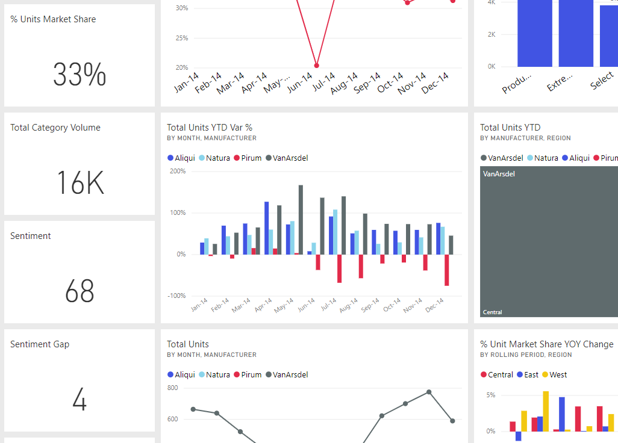
Notes:
“Adjust the color by typing EF1B36 in the Hex field. (You can also type manually as decimal R 239, G 27, B 54.)”

Slide 2
