Slide 1
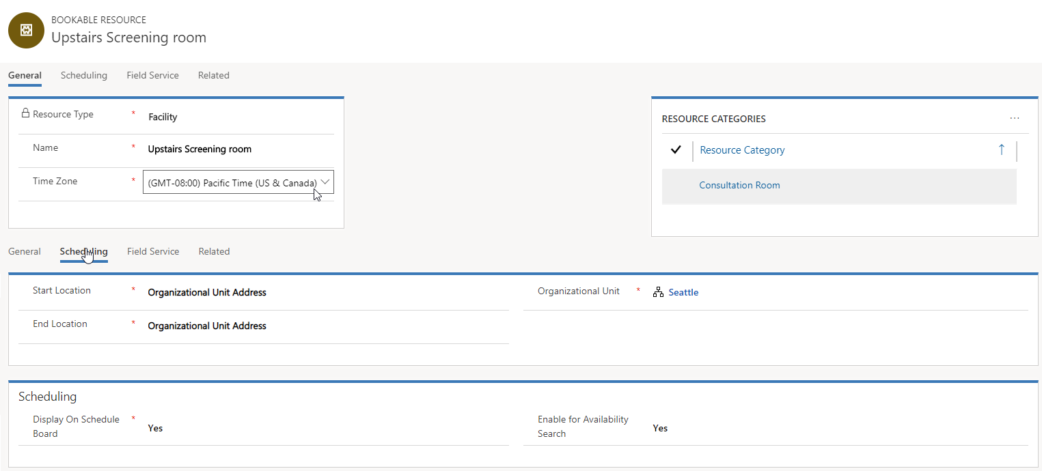
Starting and ending locations must be set to use Organizational Unit address.
Must be associated with an Organization Unit with valid latitude and longitude values.

Slide 2
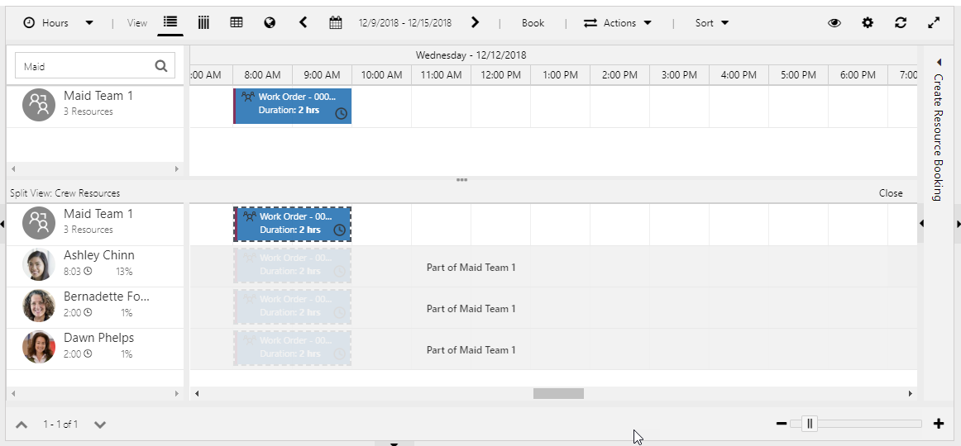
Crew members can be viewed in split screen. When booking is created for the team, a corresponding booking record is created for each member.

Slide 3
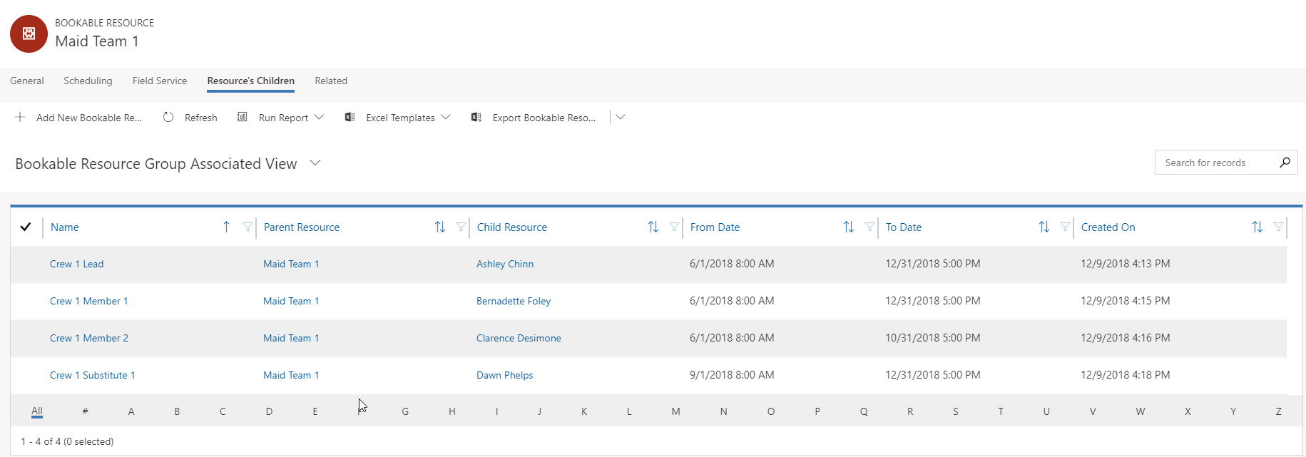
Resources will not be displayed as crew members when scheduling outside of their date windows.

Slide 4
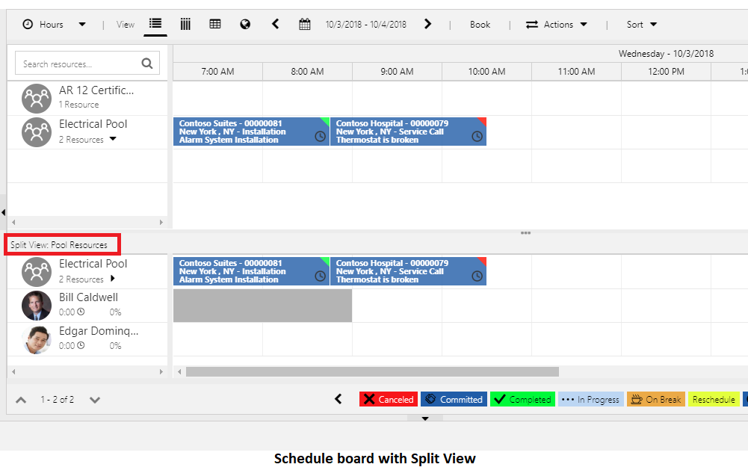
Items are scheduled to the resource pool as a whole, not the induvial members.
Individual members can selected and scheduled once they have been identified as the resource.

Slide 5
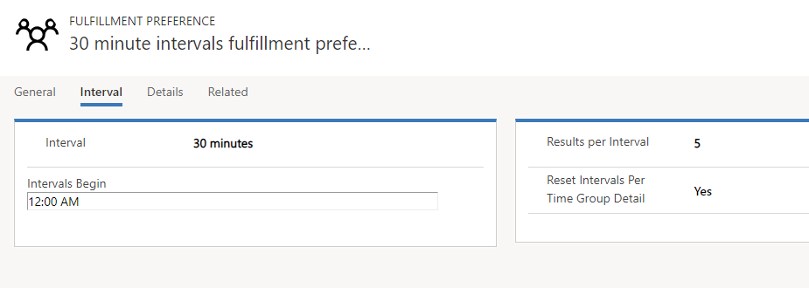

Slide 6
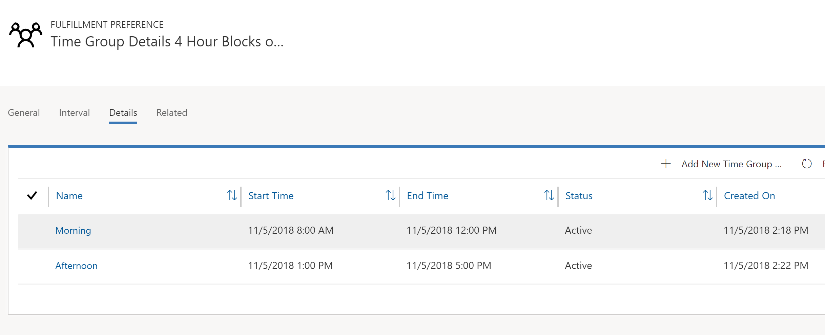
Separate time windows defined for both morning and afternoon time blocks.

Slide 7
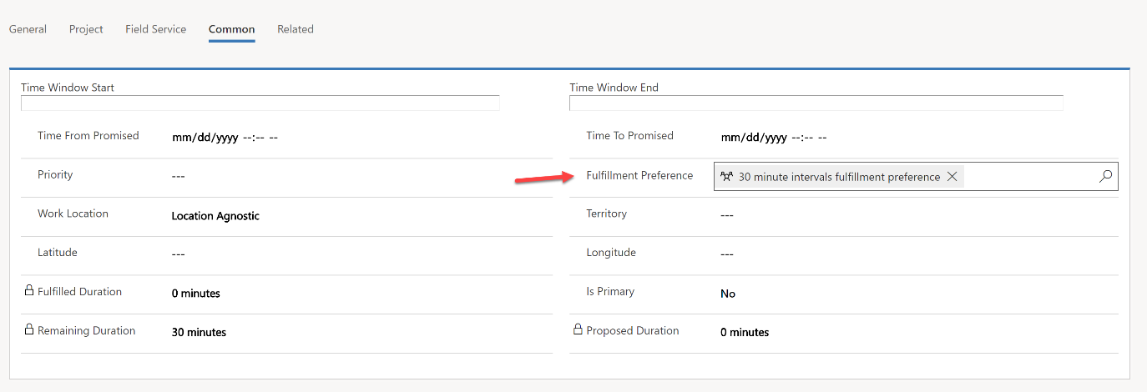
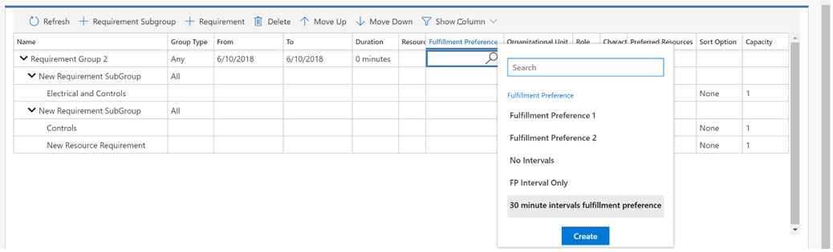
Fulfillment Preference defined on individual requirement record.
Fulfillment preferences can be defined with resource requirement groups

Slide 8
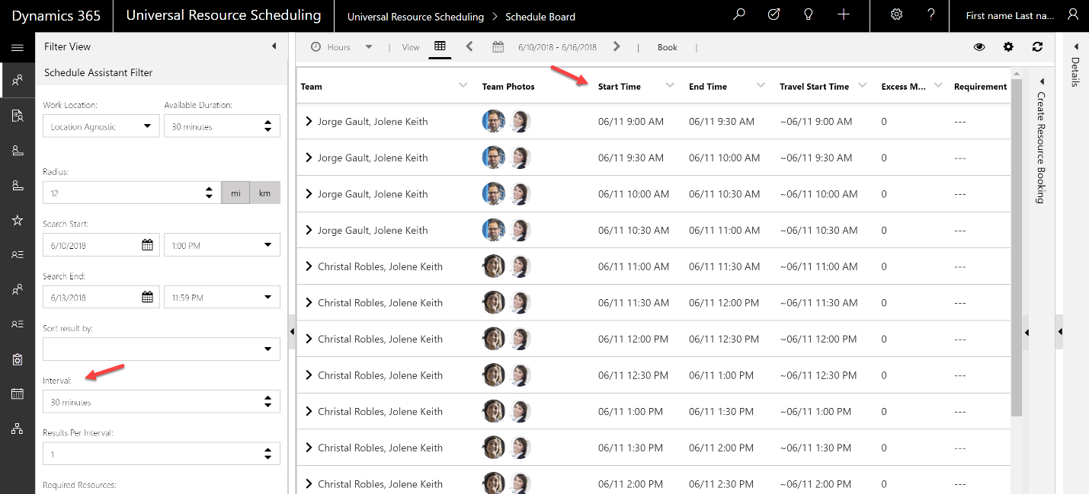
Intervals are suggested every 30 minutes.
30 minute intervals

Slide 9
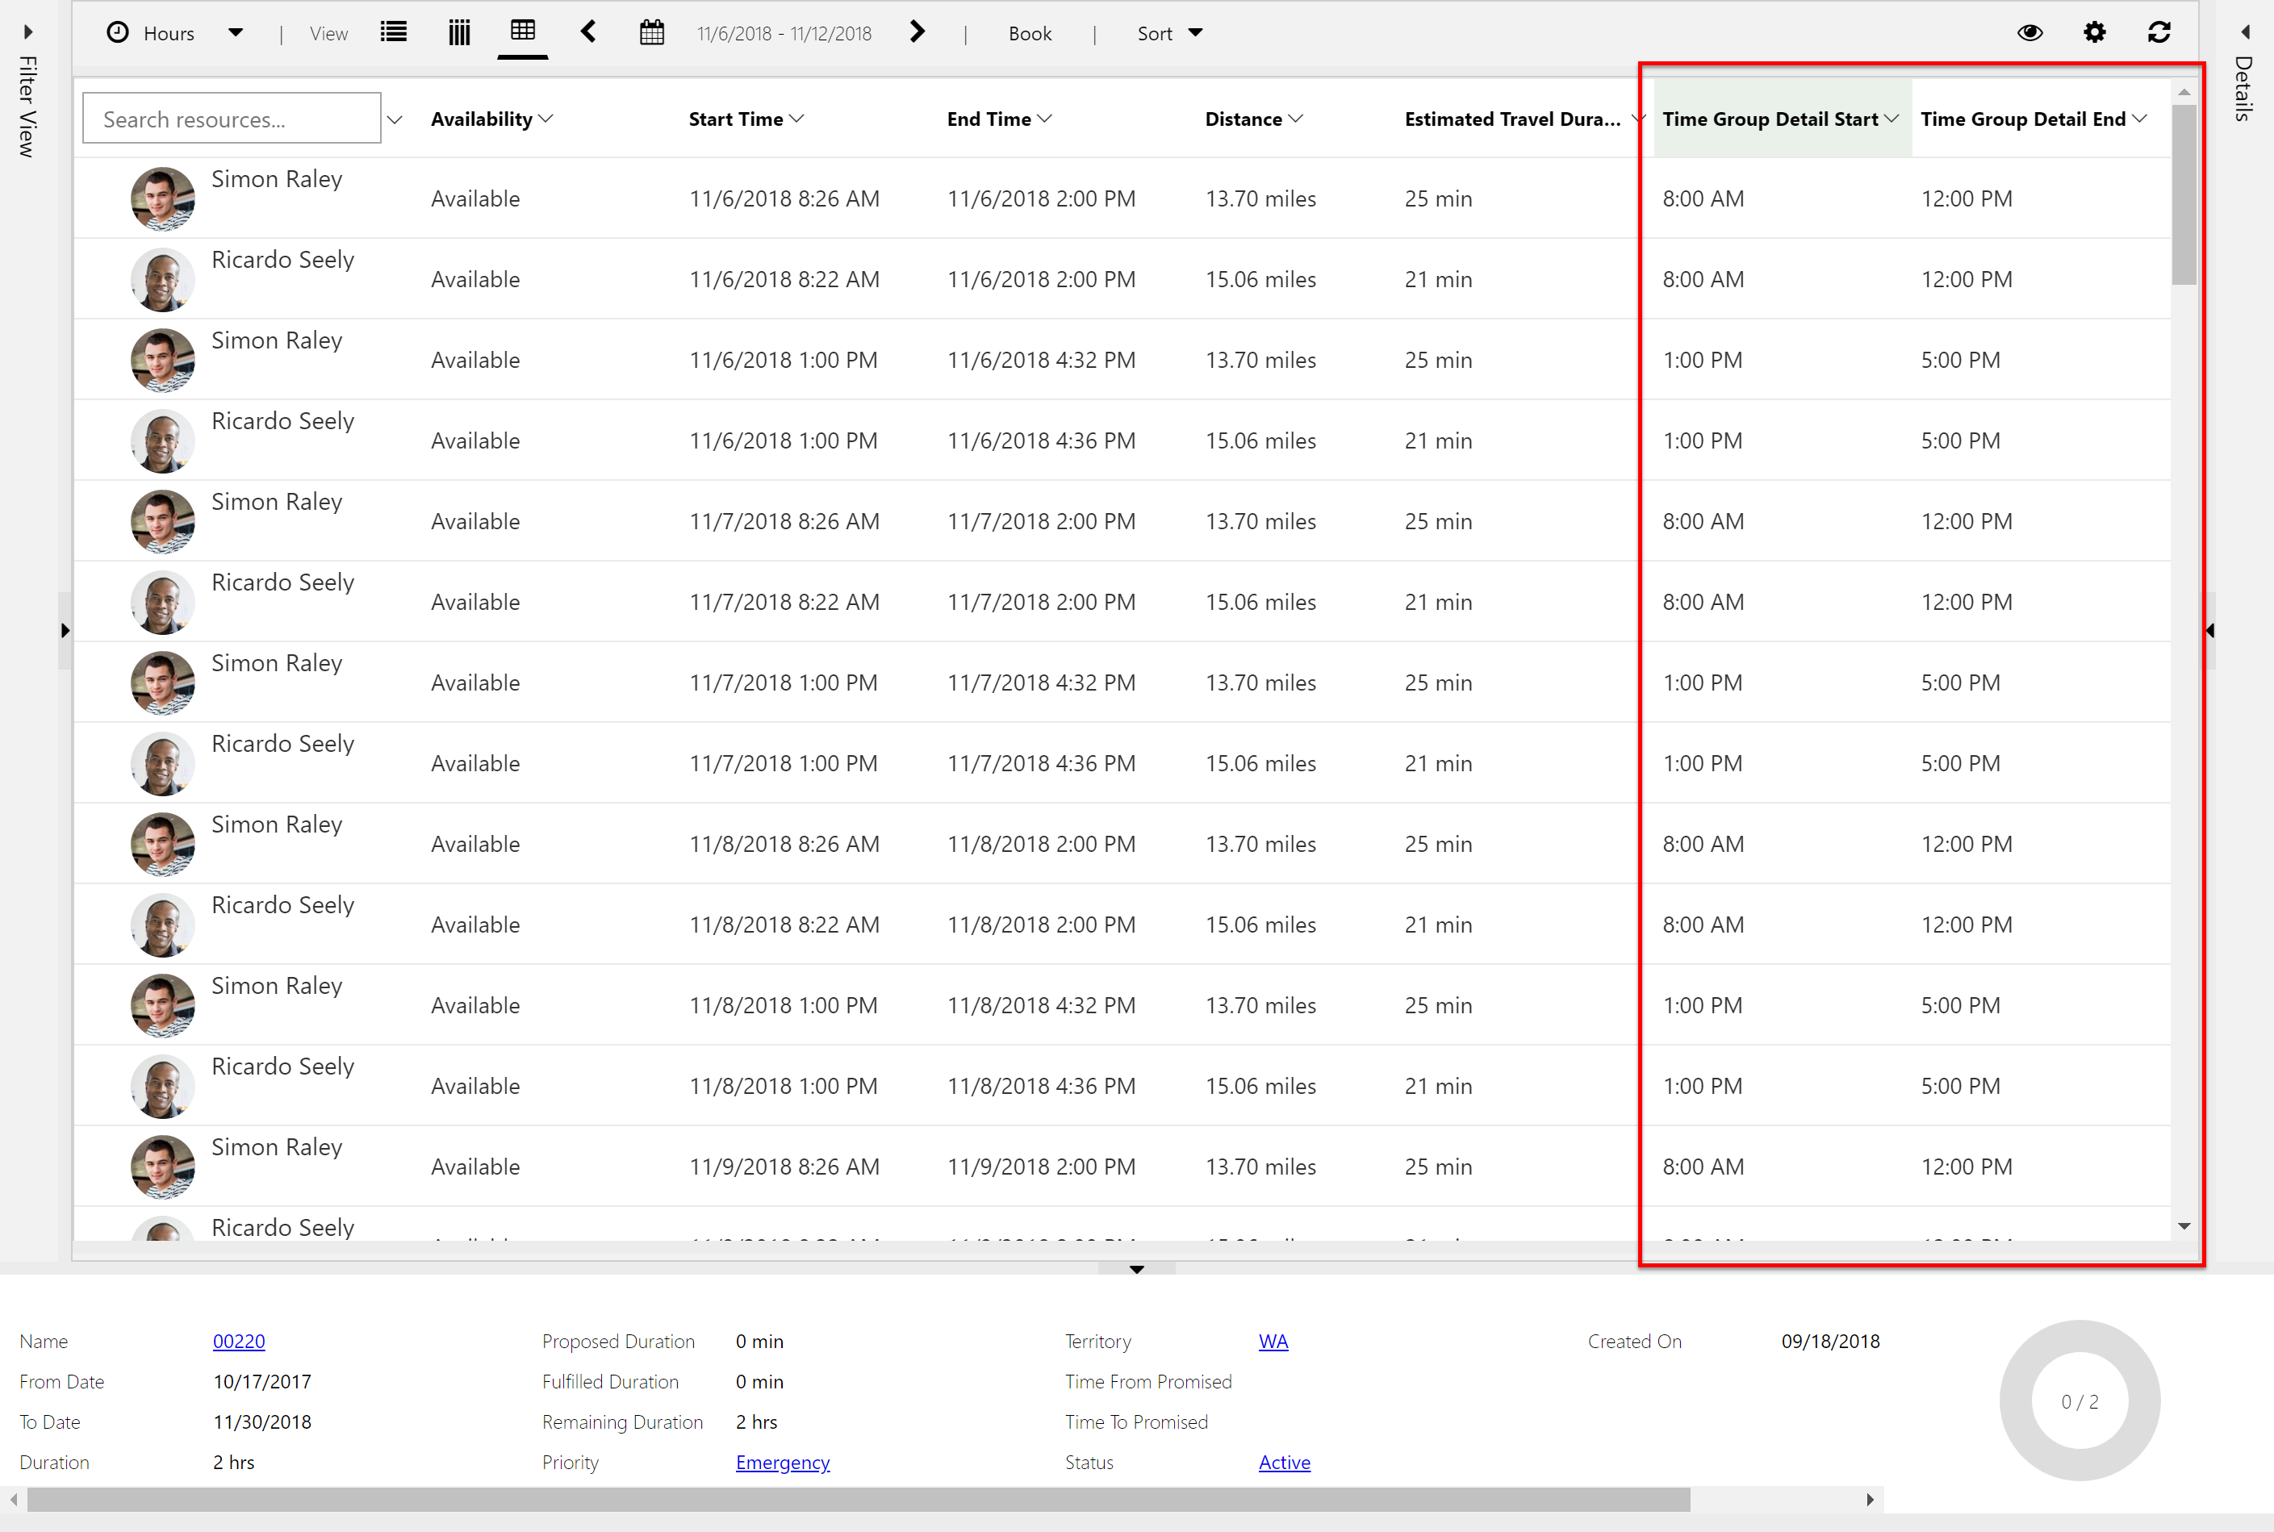
The time group that the suggested resource falls into is provided.

Slide 10
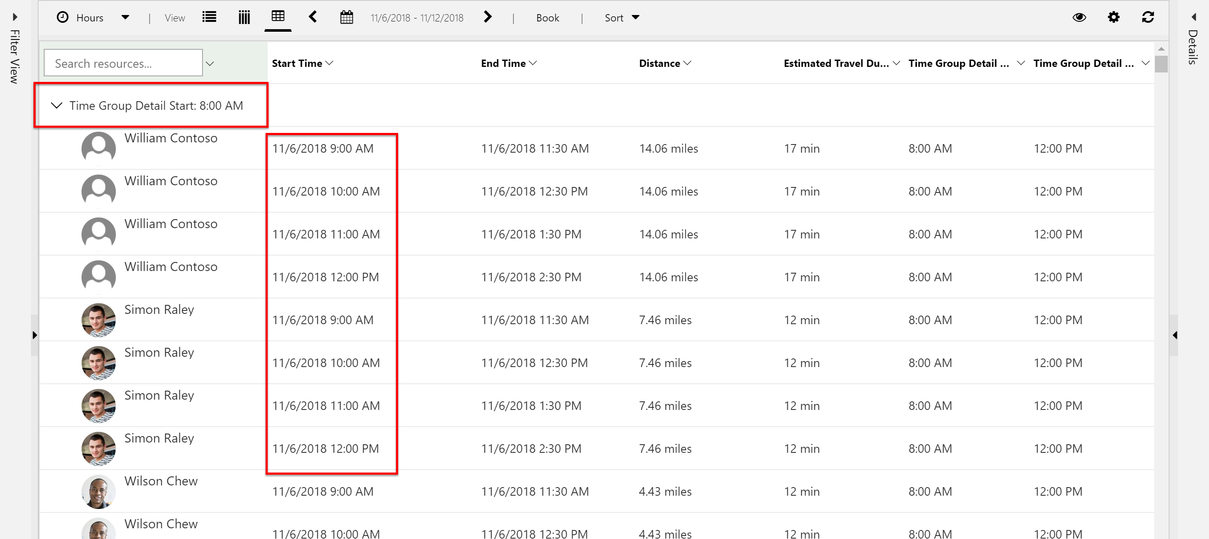
Interval suggested based on earliest time group.
Time Suggested based on the intervals defined on the fulfillment preference record.

Slide 11
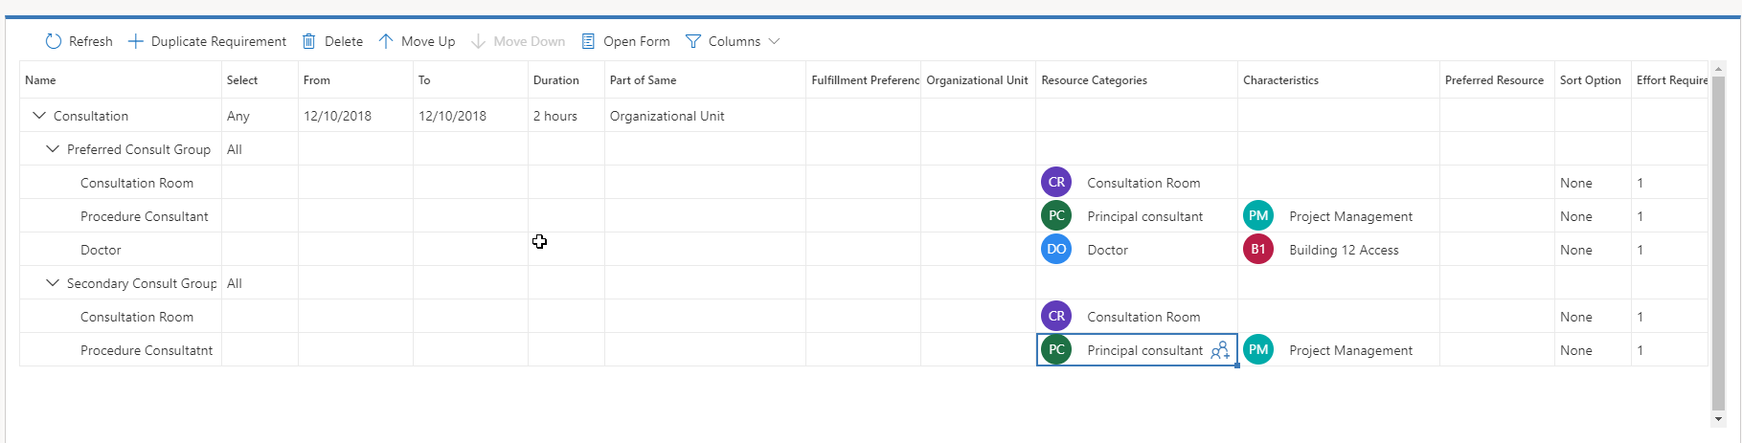

Slide 12
Any requirements are evaluated in the order presented on the screen. The order can be changed.
Will attempt to fill all of the requirements defined in this group first.
Will attempt to fill all of the requirements defined in this group second.

Slide 13
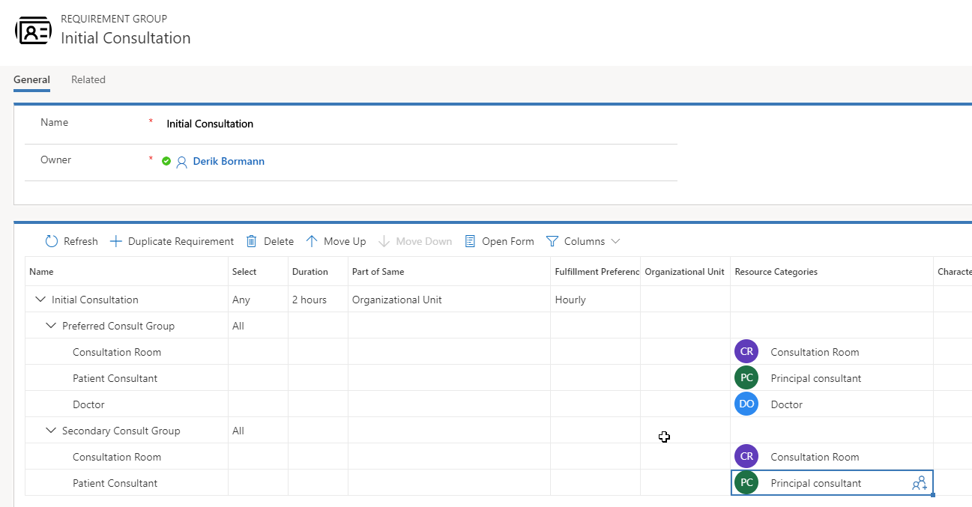
Templates do not have specific from and to dates defined.

Slide 14
Settings defined at an overall group level.
Settings defined at an individual requirement level.

Slide 15
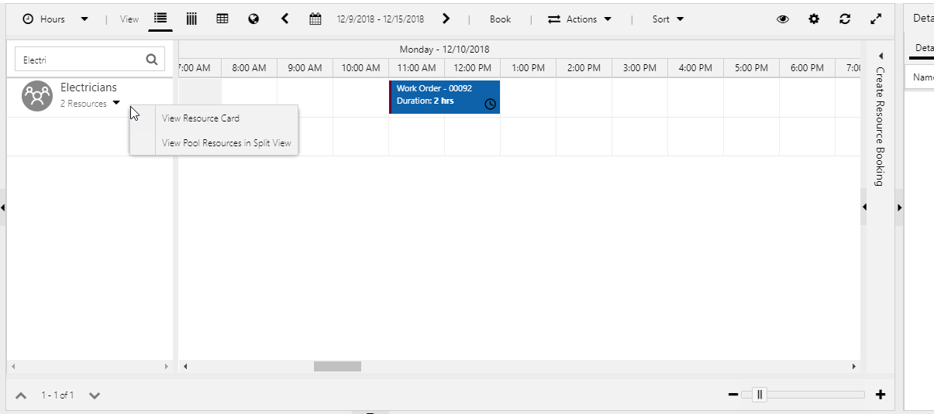
Provides the option to view either the pool or crew resources in split view based on the type of resource selected.

Slide 16
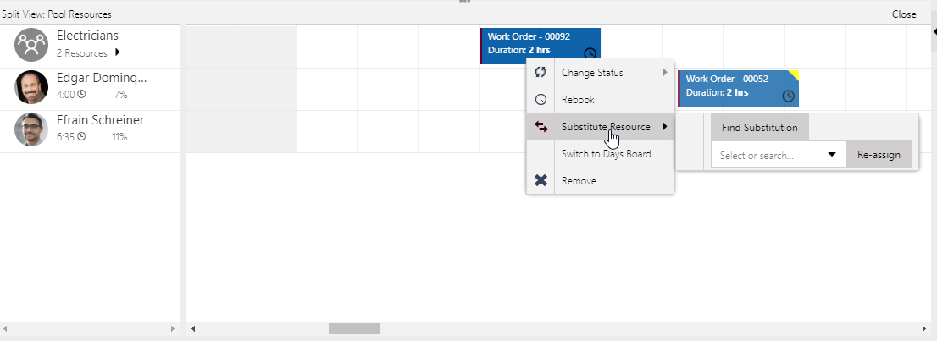
Bookings can be reassigned to pool resources by selecting the pool resource, or clicking find substitution. Only qualified resources from the pool will be suggested.

Slide 17
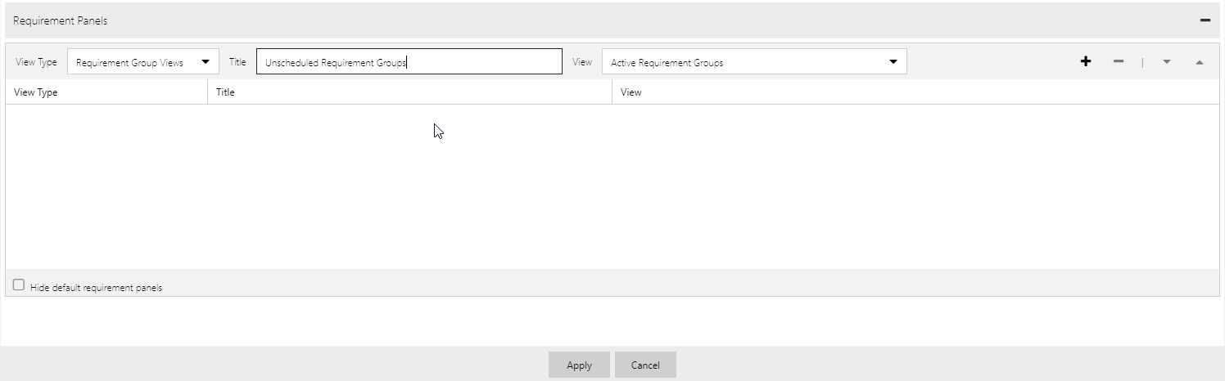
View type must be set to requirement groups.
Only published public views will be displayed.
Name can be any descriptive name you choose.
Adds the view to the list.
After clicking apply, the schedule board will reload and your new requirement view will be displayed.

