Slide 1



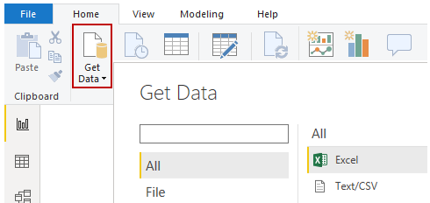
create
share
publish
Power BI Desktop
Power BI service

Slide 2





Capture at ☑80%
☑
☑
Mod 1, Unit 1:
4. Connect to data
1. Install
3. Launch and explore UI
5. Import data from Excel
2. Sign in
publish
Data
Browser & mobile apps (virtually all platforms)
6. Transform data
Create
Share
Power BI Desktop
Power BI service
PC application for gathering, transforming, and publishing your data
Online SaaS (Software as a Service) for business analytics and visualization

Slide 3
Capture at ☑80%
☑
☑
Mod 1, Unit 1:
☑ Install
☑ Sign in
publish
Data
Browser & mobile apps (virtually all platforms)
Create
Share
Power BI Desktop
Power BI service
PC application for gathering, transforming, and publishing your data
Online SaaS (Software as a Service) for business analytics and visualization

Slide 4
Capture at ☑80%
☑
☑
Mod 1, Unit 2:
☑ Launch and explore UI
publish
Data
Browser & mobile apps (virtually all platforms)
Create
Share
Power BI Desktop
Power BI service
PC application for gathering, transforming, and publishing your data
Online SaaS (Software as a Service) for business analytics and visualization

Slide 5
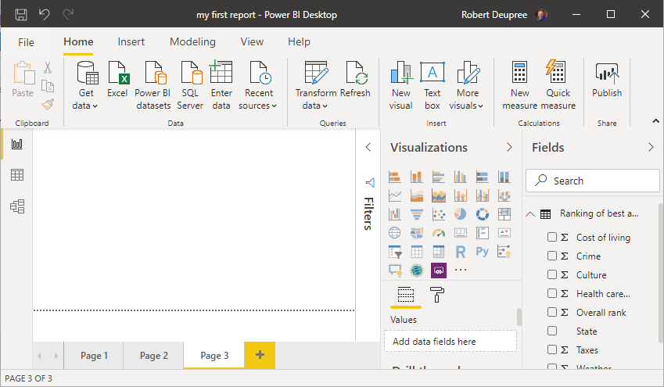
Mod 1, Unit 2:
1
← Report view
4
5
← Data view
2
← Model view
3

Slide 6
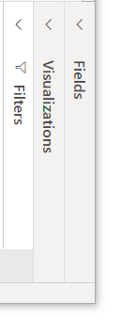
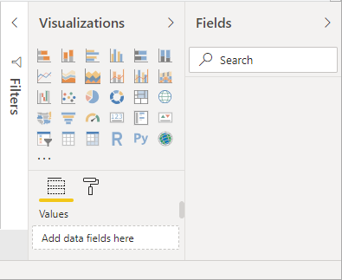
Mod 1, Unit 2:

Slide 7
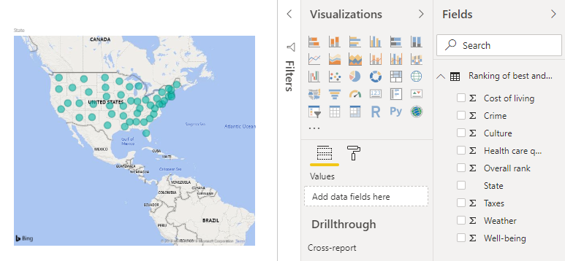
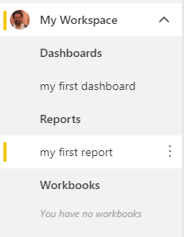
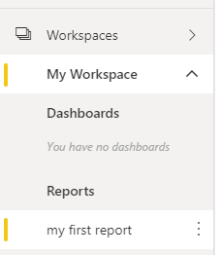
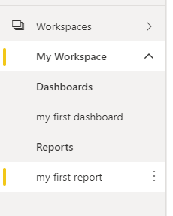
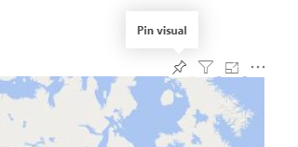
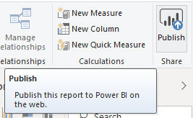
Mod 1, Unit 2:

Slide 8

Capture at ☑80%
☑
☑
Mod 1, Unit 3:
☑ Connect to data sources
publish
Data
Browser & mobile apps
Create reports
Publish reports
Power BI Desktop
Power BI service

Slide 9
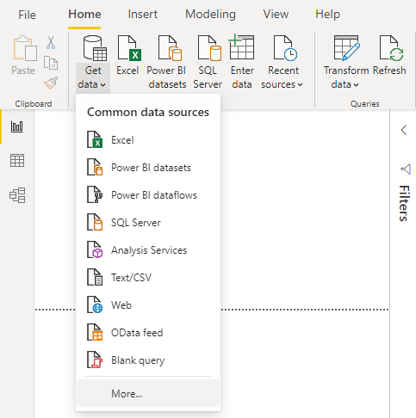
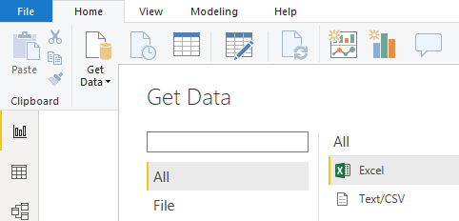
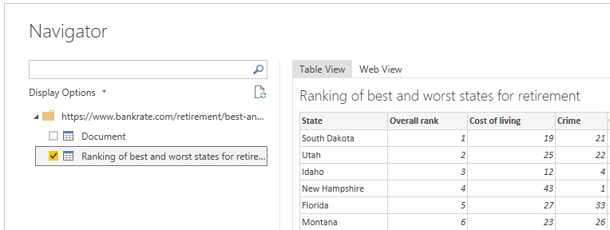
Mod 1, Unit 3:

Slide 10
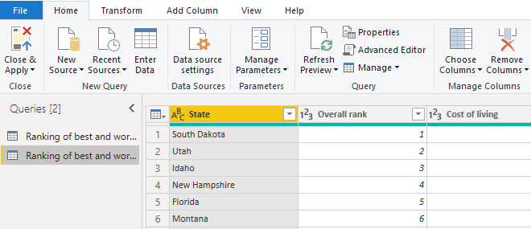
Mod 1, Unit 3:

Slide 11
Capture at ☑80%
☑
☑
Mod 1, Unit 4:
☑ Transform data with Query Editor
publish
Data
Browser & mobile apps
Create reports
Publish reports
Power BI Desktop
Power BI service

Slide 12
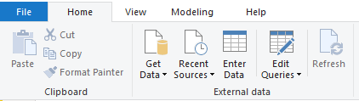
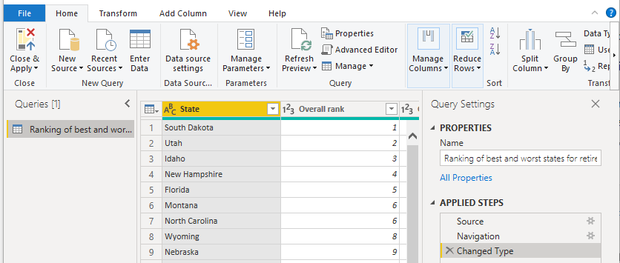
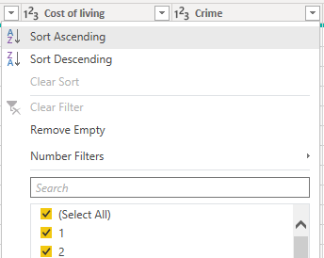
Mod 1, Unit 4:
1
4
2
3

Slide 13
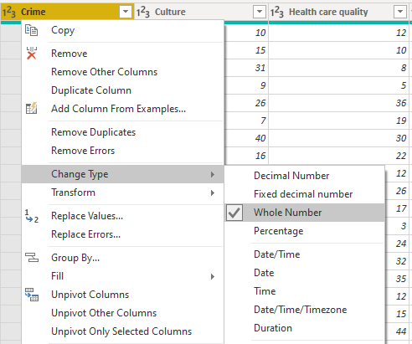
Mod 1, Unit 4:

Slide 14
Capture at ☑80%
☑
☑
Mod 1, Unit 5:
☑ Combine data from different sources with Query Editor
publish
Data
Browser & mobile apps
Create reports
Publish reports
Power BI Desktop
Power BI service

Slide 15
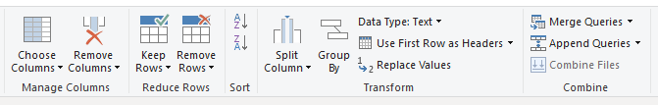
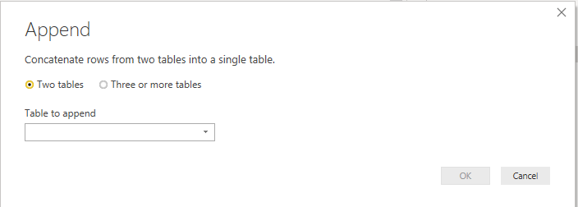
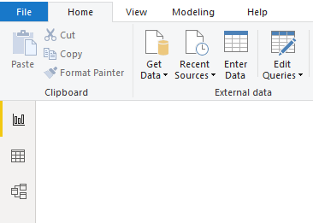
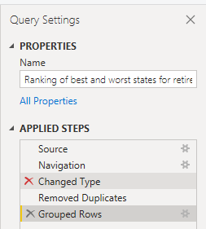
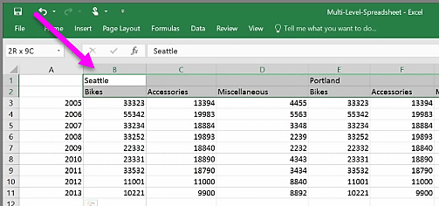
Mod 1, Unit 5:
← Report view
← Data view
← Model view

Slide 16
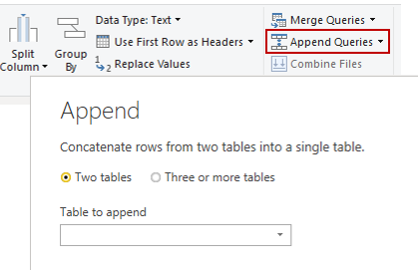
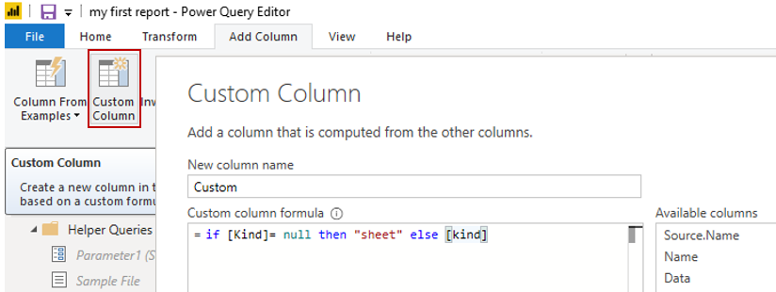
Mod 1, Unit 5:

Slide 17
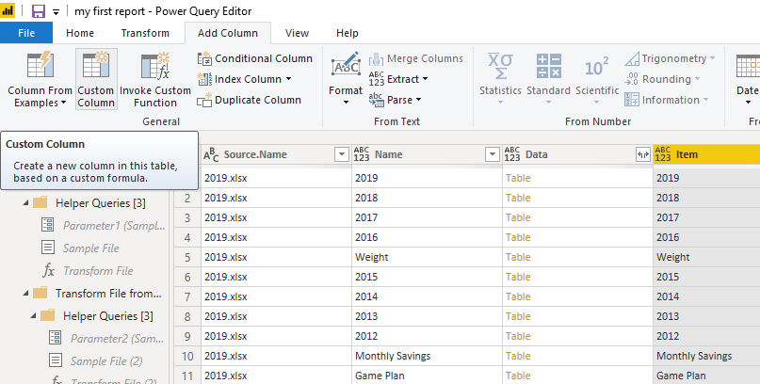
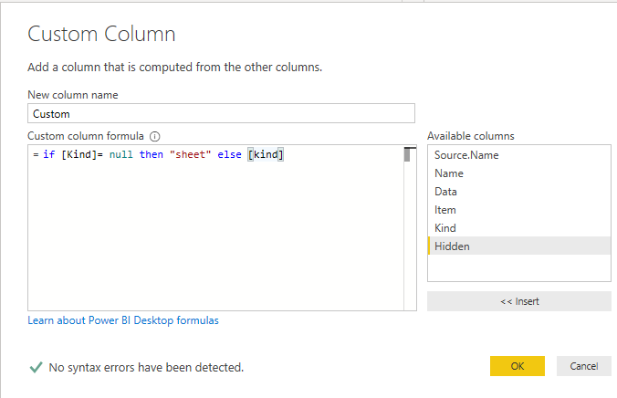
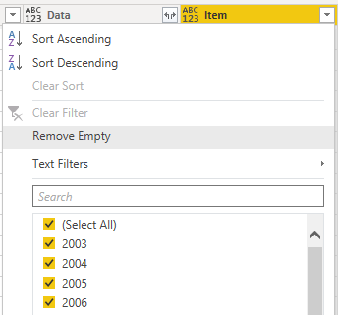
Mod 1, Unit 5:

Slide 18


Capture at ☑80%
☑
☑
Mod 1, Unit 6:
☑ Clean columnar data
Clean
Data
Publish
Browser & mobile apps
Create reports
Publish reports
Power BI Desktop
Power BI service

Slide 19
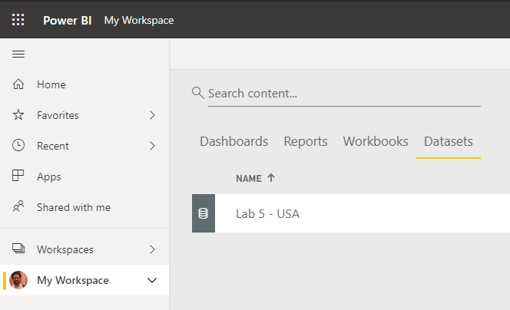
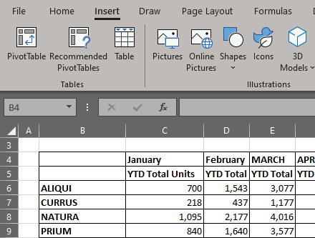
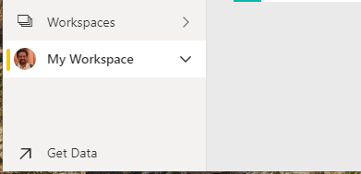
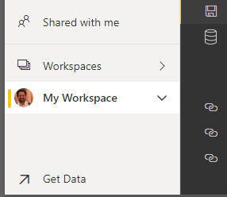
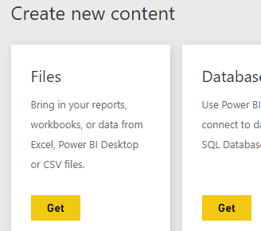
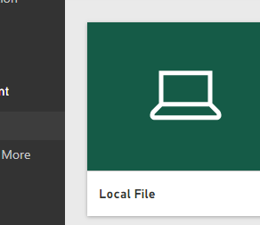
Capture at ☑80%
☑
☑
Mod 1, Unit 6b:
Imported Excel sheet

Slide 20
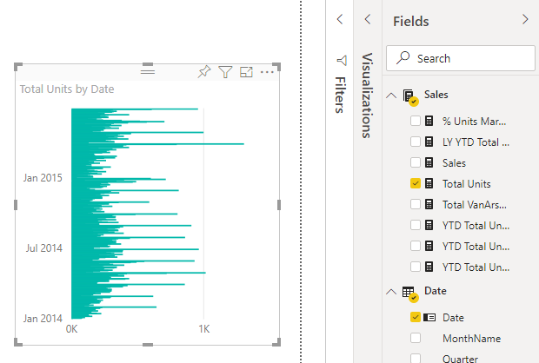

Slide 21
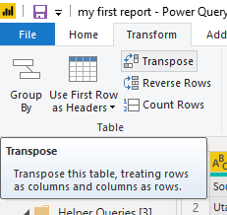
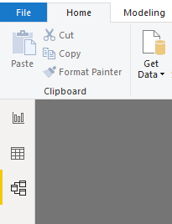
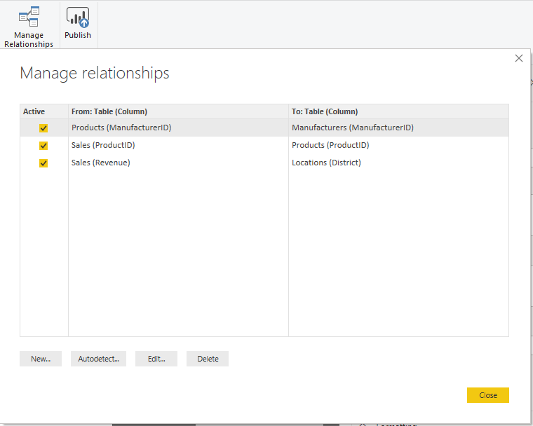
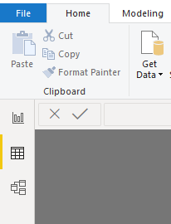
← Model view
← Data view

Slide 22
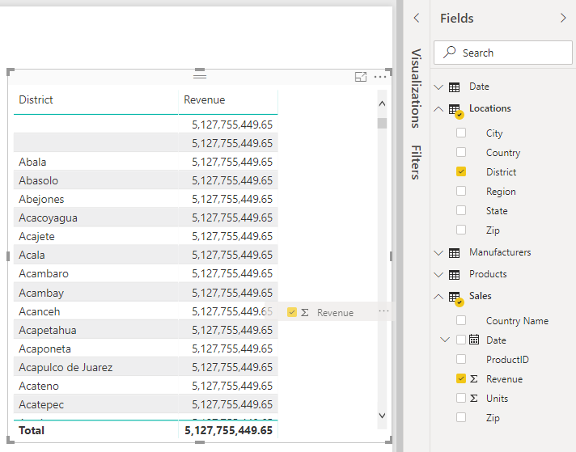

Slide 23
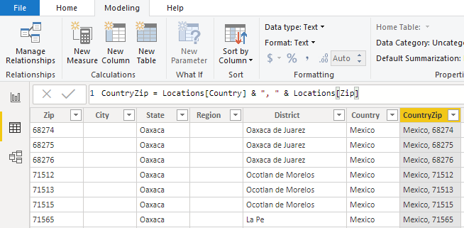
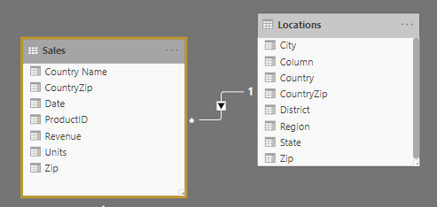

Slide 24
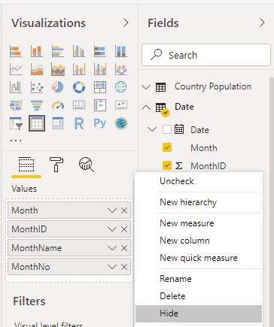
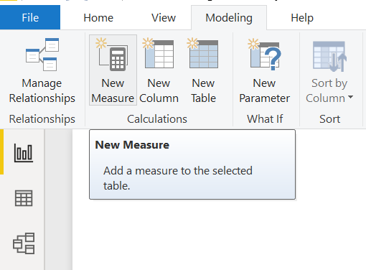

Slide 25
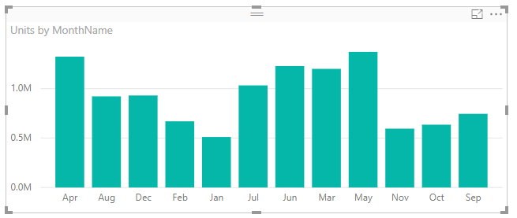
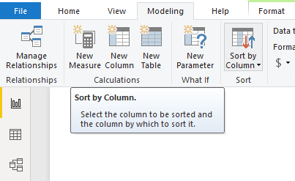
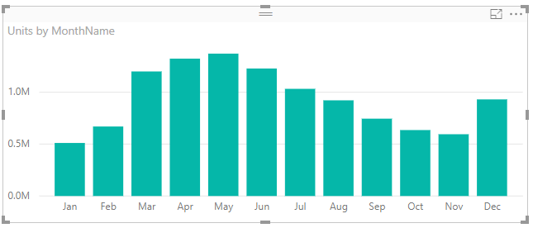

Slide 26
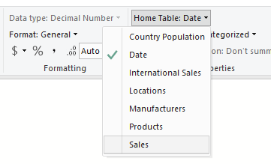
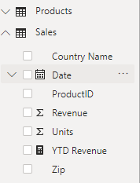
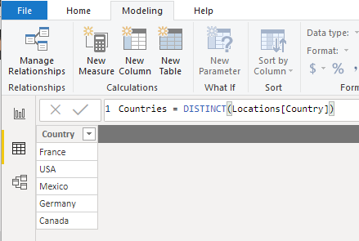

Years
Quarters
Months
Days
2019
February
Q3

Slide 27

Year
Quarter
Month
Day
2020
Q4
2019
Q3
May
2018
Q2
2017
Q1

Slide 29
Capture at ☑80%
☑
☑
Mod 1, Unit 1:
4. Connect to data
1. Install
3. Launch and explore UI
5. Import data from Excel
2. Sign in
publish
Data
Browser & mobile apps (virtually all platforms)
6. Transform data
Create
Share
Power BI Desktop
Power BI service
PC application for gathering, transforming, and publishing your data
Online SaaS (Software as a Service) for business analytics and visualization

Slide 30


Capture at ☑80%
☑
☑
☑ Use a calculated table to create a relationship between two tables
Mod 2 overview
☑ Format time-based data so that you can drill down for more details
☑ Use a calculated table to create a relationship between two tables
☑ Create a new field with calculated columns
☑ Create relationships between your data sources
☑ Optimize data by hiding fields and sorting visualization data
☑ Optimize data by hiding fields and sorting visualization data
input field
1. Create relationships
Publish
Browser & mobile apps
Create reports
Publish reports
Power BI Desktop
Power BI service

Slide 31

Capture at ☑80%
☑
☑
Mod 2, Unit 2
☑ Create relationships between your data sources
Model View
Publish
Browser & mobile apps
Create reports
Publish reports
Power BI Desktop
Power BI service

Slide 32

Capture at ☑80%
☑
☑
Mod 2, Unit 3
☑ Create a new field with calculated columns
Publish
Browser & mobile apps
Create reports
Publish reports
Model View
Power BI Desktop
Power BI service

Slide 33


Capture at ☑80%
☑
☑
Mod 2, Unit 4
☑ Optimize data by hiding fields and sorting visualization data
Publish
Browser & mobile apps
Create reports
Publish reports
Model View
Power BI Desktop
Power BI service

Slide 34

Capture at ☑80%
☑
☑
Mod 2, Unit 4b
☑ Create a measure to perform calculations on your data
input field
transformed data
Publish
Browser & mobile apps
Create reports
Publish reports
Model View
Power BI Desktop
Power BI service

Slide 35






Mod 2, Unit 4b

Slide 36
Capture at ☑80%
☑
☑
Mod 2, Unit 5
☑ Use a calculated table to create a relationship between two tables
input field
Publish
Browser & mobile apps
Create reports
Publish reports
Model View
Power BI Desktop
Power BI service

Slide 37

Capture at ☑80%
☑
☑
Mod 2, Unit 6
☑ Format time-based data so that you can drill down for more details
Publish
Browser & mobile apps
Create reports
Publish reports
Model View
Power BI Desktop
Power BI service

Slide 38


Capture at ☑80%
☑
☑
Mod 3, Unit 1
☑ Explore and create Power BI visuals
Publish
Browser & mobile apps
Create reports
Publish reports
Power BI Desktop
Power BI service

Slide 39





Mod 3, Unit 2

Slide 40



Mod 3, Unit 4
Mod 3, Unit 5
Mod 3, Unit 6

Slide 41


Mod 3, Unit 7
Mod 3, Unit 6

Slide 42






Mod 3, Unit 7
Mod 3, Unit 10

Slide 43




Mod 3, Unit 12

Slide 44
Capture at ☑80%
☑
☑
Mod 4, Unit 1:
Upload reports
Create dashboards
Ask questions of your data
publish
Data
Browser & mobile apps (virtually all platforms)
Create
Share
Power BI Desktop
Power BI service
PC application for gathering, transforming, and publishing your data
Online SaaS (Software as a Service) for business analytics and visualization

Slide 45



Mod 4, Unit 2:

Slide 46



Mod 4, Unit 2:
Mod 4, Unit 3:

Slide 47

Mod 4, Unit 3:

Slide 48


Mod 4, Unit 6:

Slide 49



Mod 4, Unit 5:

Slide 50



Mod 4, Unit 7:

Slide 51



Mod 4, Unit 8:

Slide 52

Mod 4, Unit 8:

Slide 53




Mod 4, Unit 9:

