Slide 2
Child Assets
Account
IoT Commands
Customer Asset
Parent Asset
IoT Alerts
Product
Work Orders

Slide 3
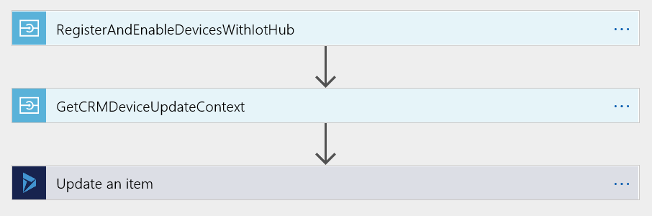
Message Queue
CRM-to-IoT Logic App

Slide 4
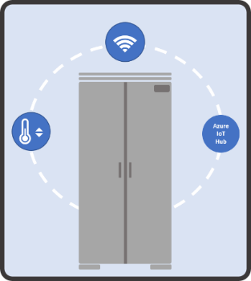
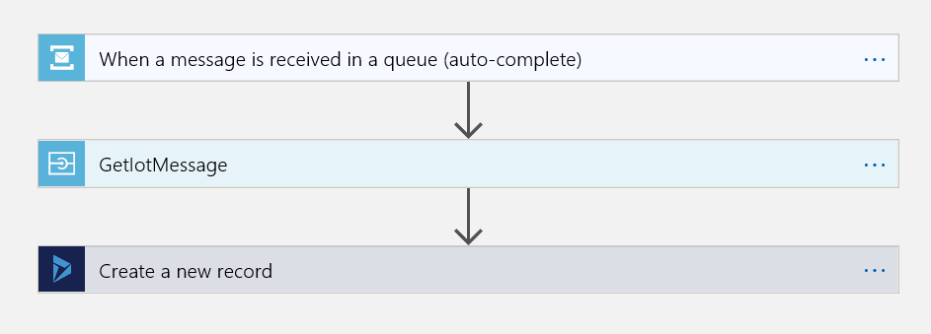
Stream Analytics Job
Alert Queue
IoT-to-CRM Logic App

Slide 5
Stream Analytics Job
Alert Queue
Azure IoT Hub
Real-time analysis (alerts, actions)
Devices
IoT Hub Routes
Azure Storage
Azure ML
IoT-to-CRM Logic App
Scheduled batch processing (training, machine learning)

