Slide 1








Case Resolution using the Knowledge Base
Article linked back to the case
Case auto created
Agent selects case from Queue
Resolution found
Article emailed to customer
Customer
Request for support emailed
Case routed to gold Queue
Agent searches KB for resolution

Slide 2
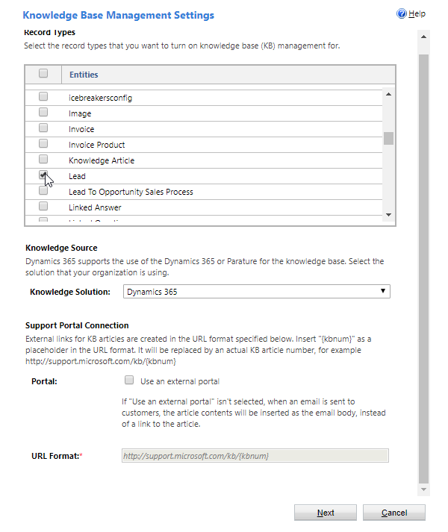
Select each entity that you want to enable the Knowledge Base for.
This will always be set to Dynamics 365 since Parature is no longer an active product.

Slide 3
Example Category Hierarchy
Support
Defects
Cosmetic Defects
Hardware Defects
Returns & Exchanges
Delivery Issues
Return Policies

Slide 4
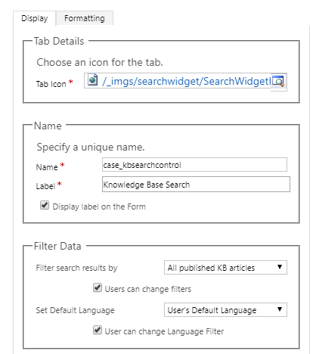

Slide 7
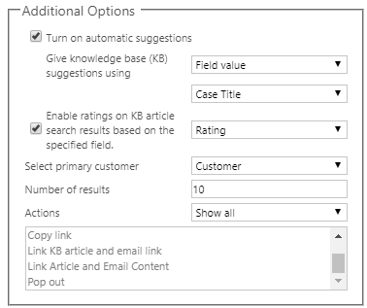

Slide 8
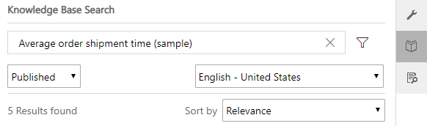
Toggles the display of available filter options.
Only articles with published translations in the chosen language display.
Can switch between Published, Approved, and Draft articles.
Articles can be sorted by relevance, number of views, or last modified date. (Newest or Oldest first)

Slide 9
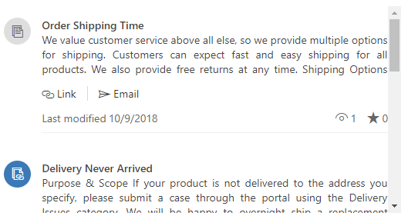
Currently not linked to case.
Article views and rating value
Displays available article actions
Currently linked to case.

Slide 10
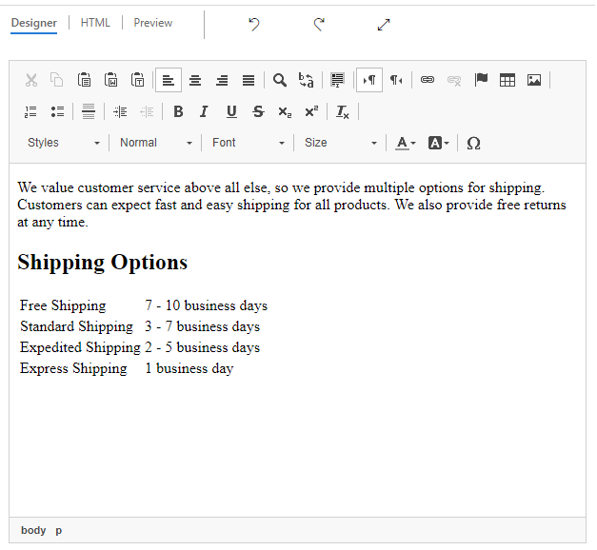

Slide 11
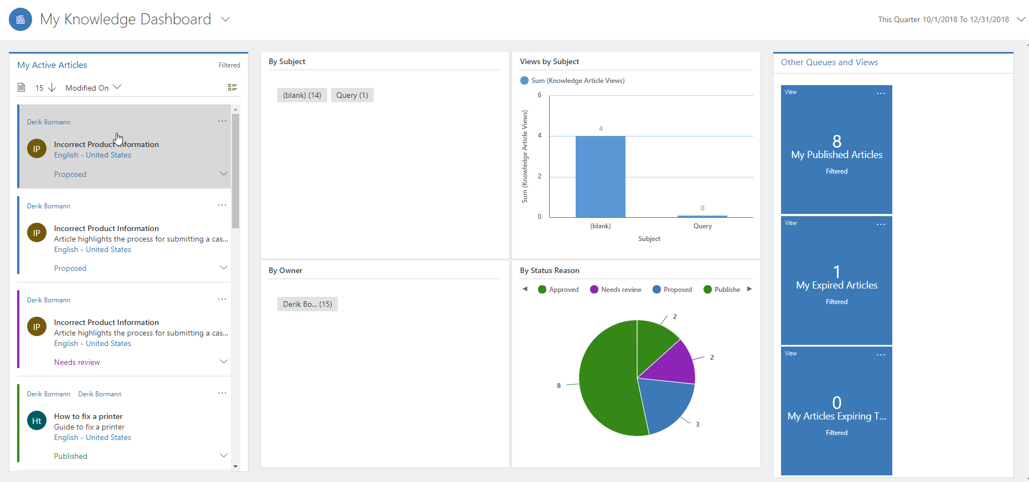
Stream
Charts & Visual Filters
Tiles

Slide 12
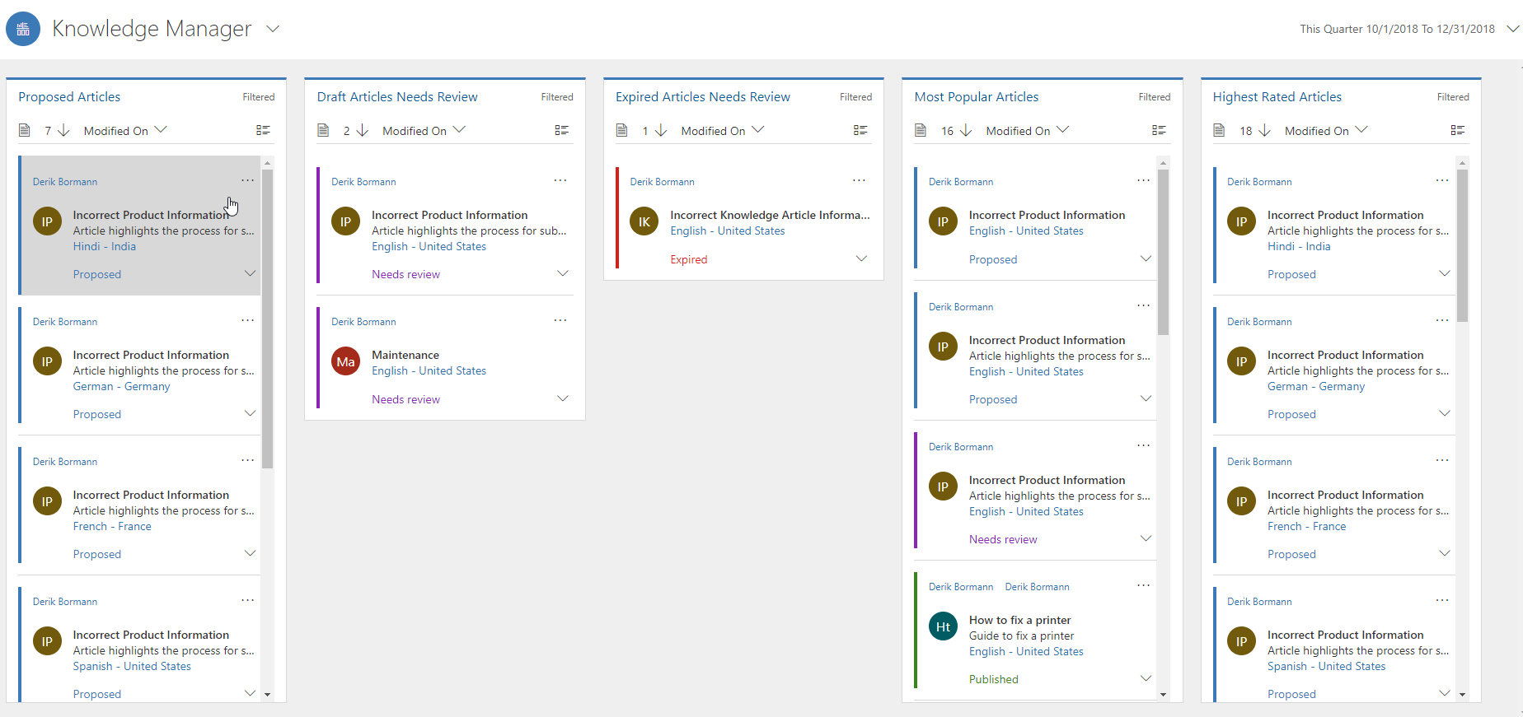
Proposed & Articles in need of review
Expired Articles
Most Popular & Highest Rated Articles

Slide 13
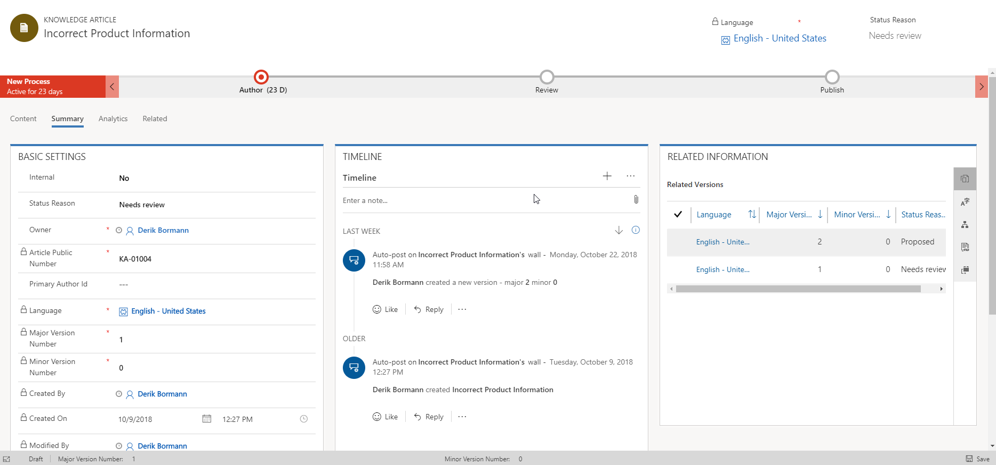
Icons make it easy to navigate to records related to the article such as versions, translations, and associated products.
Timeline displays activities related to the article

Slide 14
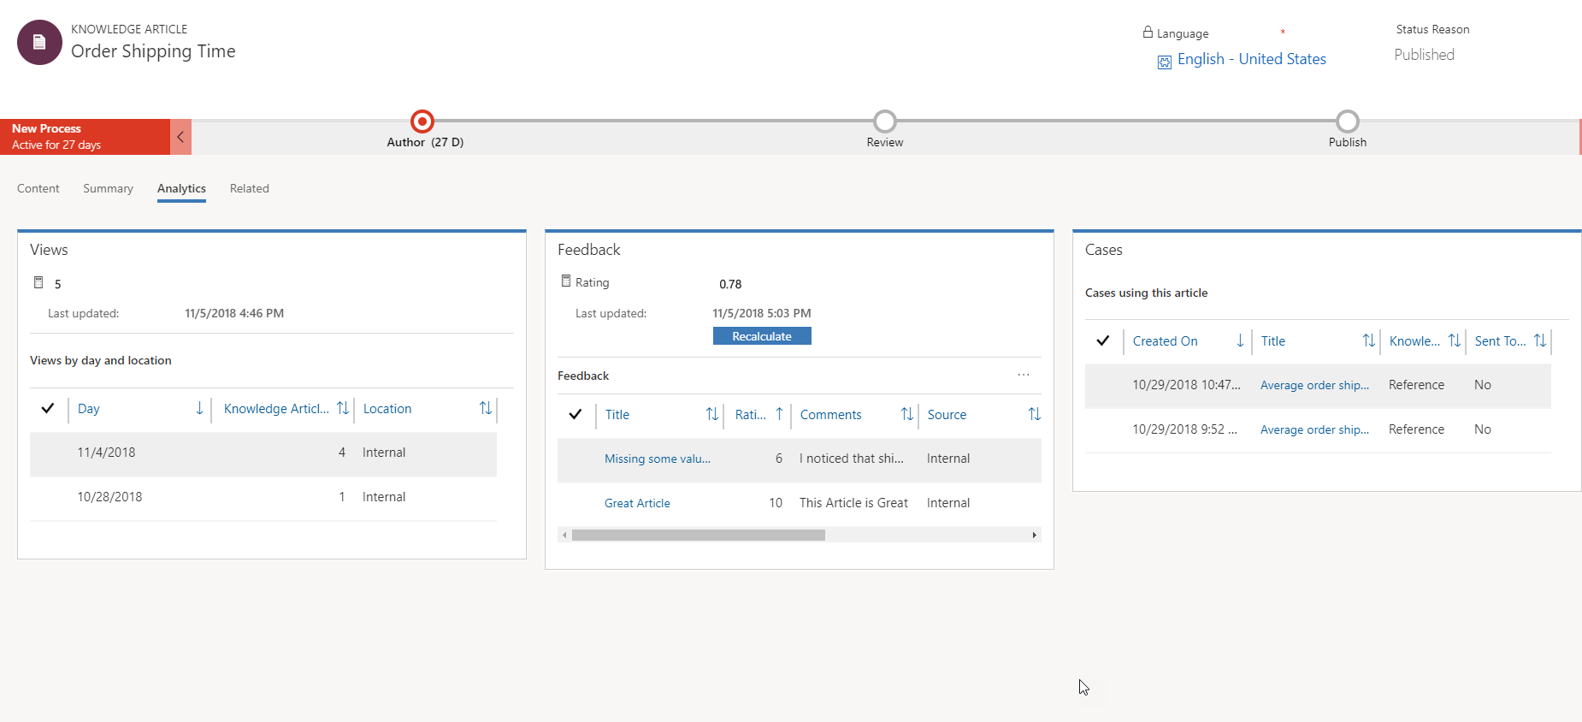
Total article views
Feedback list & rating
Cases using this article
The total number of views and overall feedback rating fields are calculated every 12 hours. They can be manually triggered by selecting the calculator icon, and clicking the Recalculate button.

