Slide 1


Improved customer interaction
No waiting time
Reduced customer service costs
Quick ROI
Power Virtual Agent Benefits
Easy escalation to live agents
Task Automation
Instant responses to customer inquires
Direct dialog with customer
Personalized customer interaction through integration to other applications

Slide 2
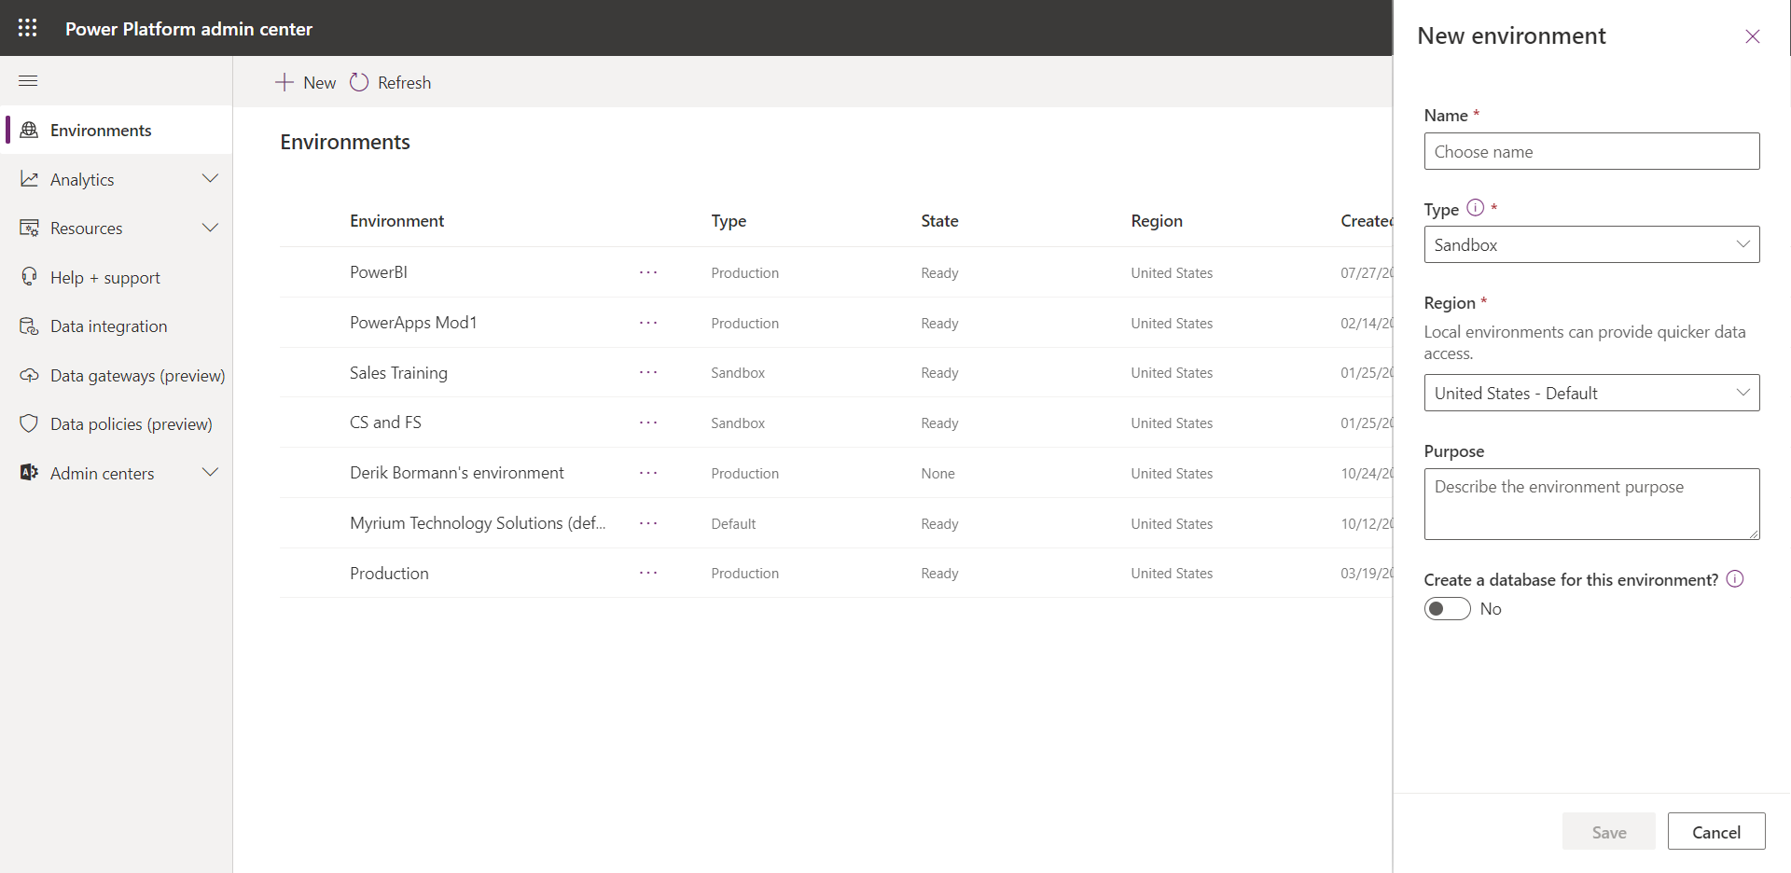
3
2
1
Select the best region that based on your location.

Slide 3
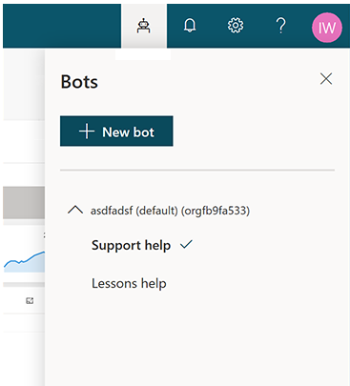
Displays a list of your environments and the bots associated with each one.
Creates a new bot in the currently selected environment.

Slide 4
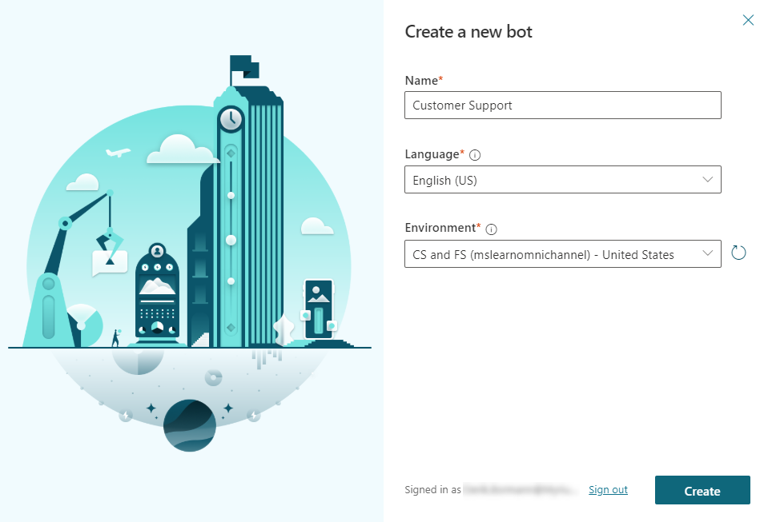
The environment can be changed if you selected the wrong one initially.

Slide 5
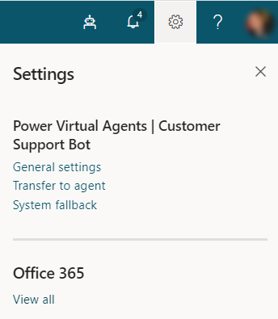

Slide 6
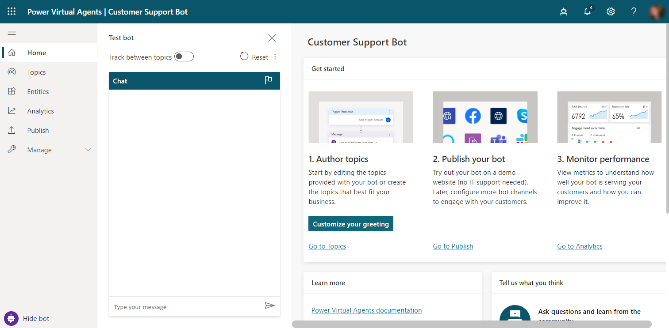
1
2
10
3
4
5
6
7
8
9

Slide 7
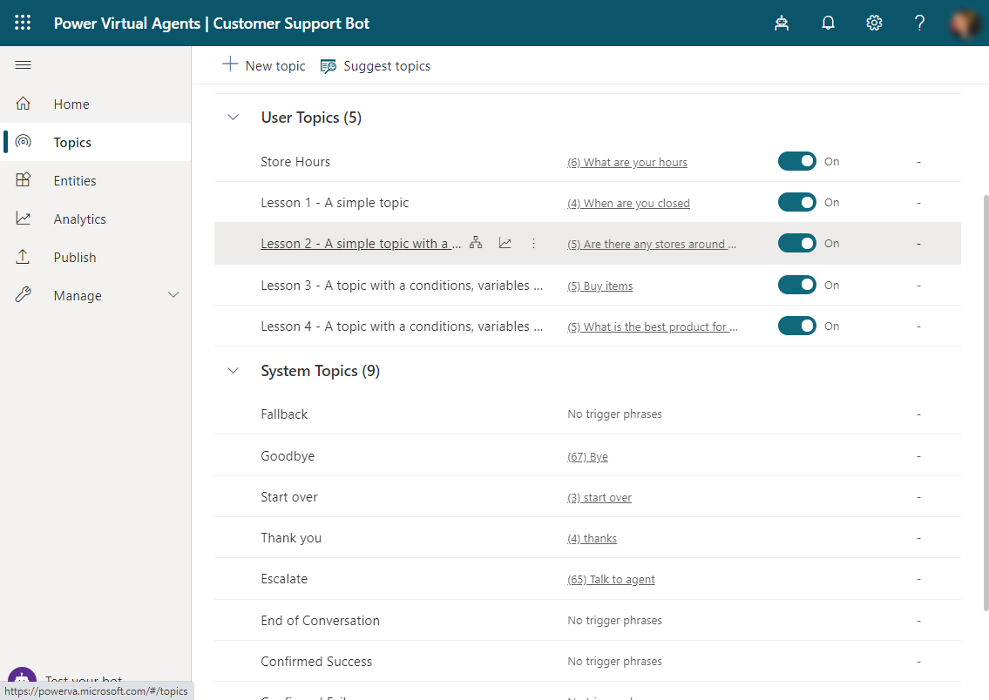

Slide 8
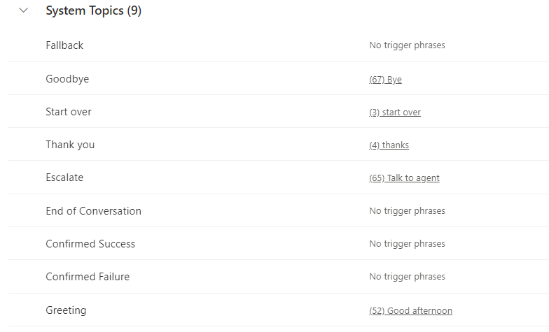

Slide 9
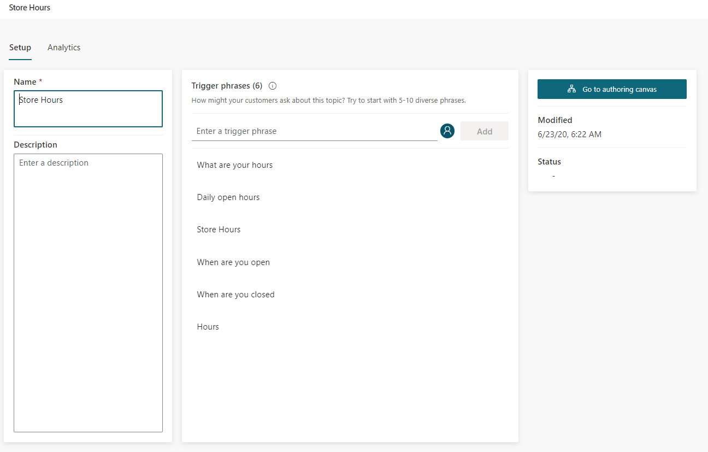
Launches the authoring canvas where you will design the conversation flow for the topic.
Trigger phrases should be unique to the topic. Using the same trigger phrase in multiple topics can result in items not displaying correctly.

Slide 10
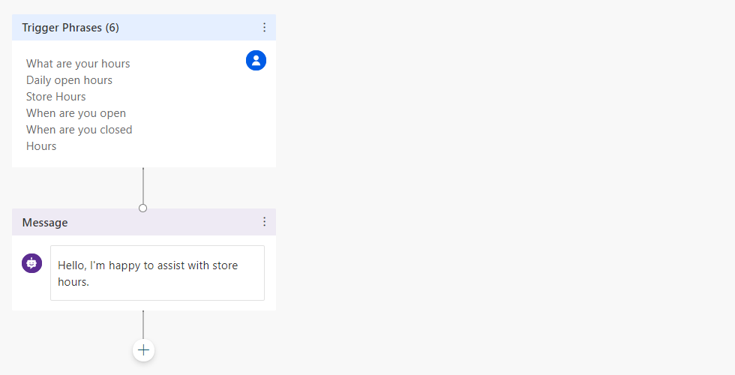
Trigger phrases will be pre-populated based on what you defined on the previous screen.
Message will be blank by default, you will need to supply necessary text.

Slide 11
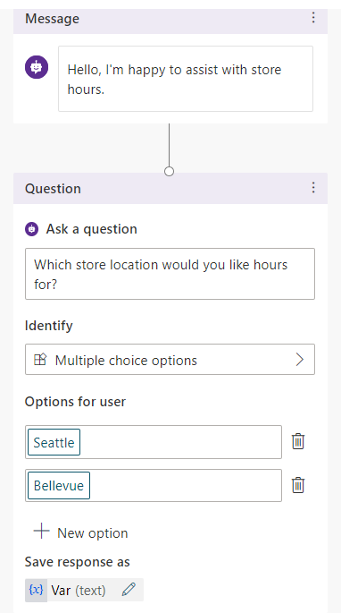
Different node types can be inserted based on what you want to display or capture.
Options are presented as buttons in the chat conversation window.

Slide 12
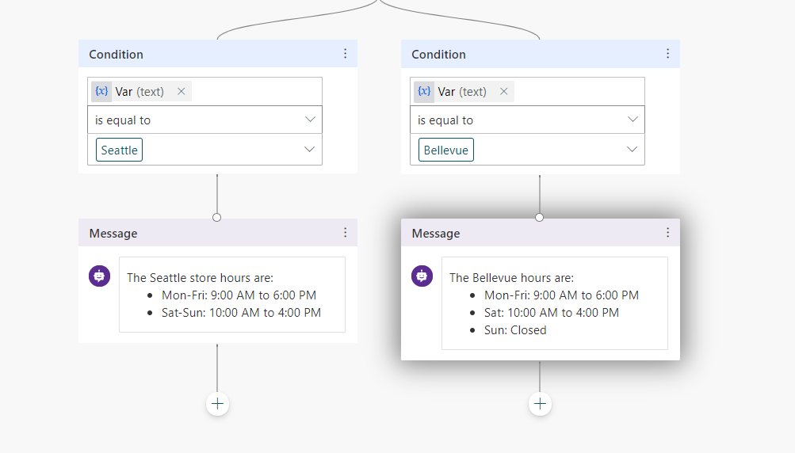

Slide 13
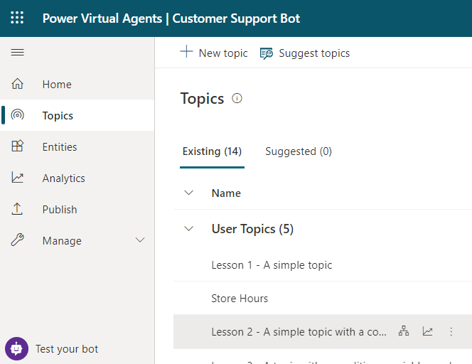
Toggles between test and hide depending on if the test bot window is displayed.

Slide 14
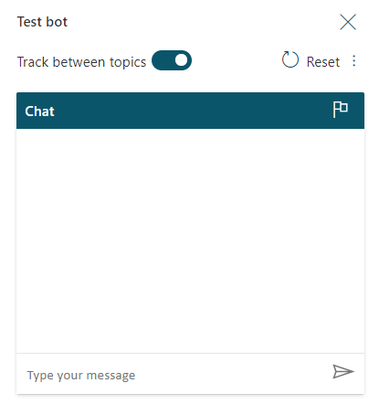

Slide 15
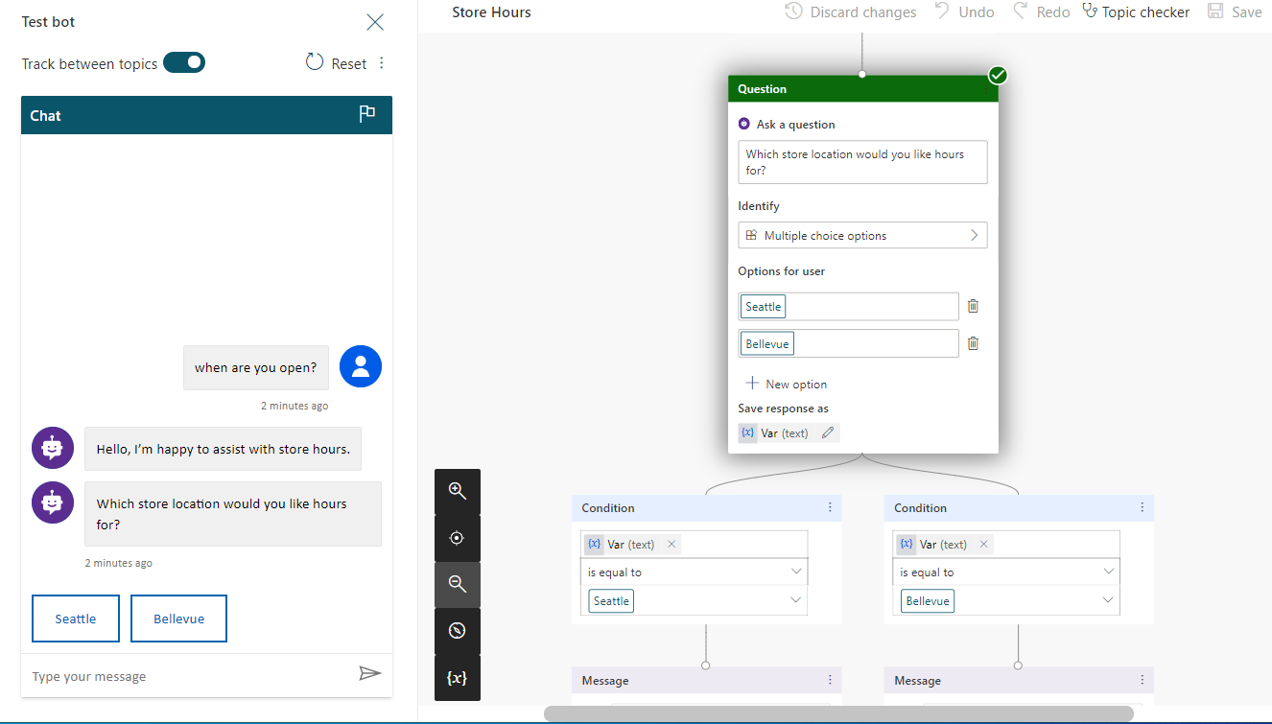
Identifies the name of the topic being tested.
Icon indicates if item was successful or not.

Slide 16
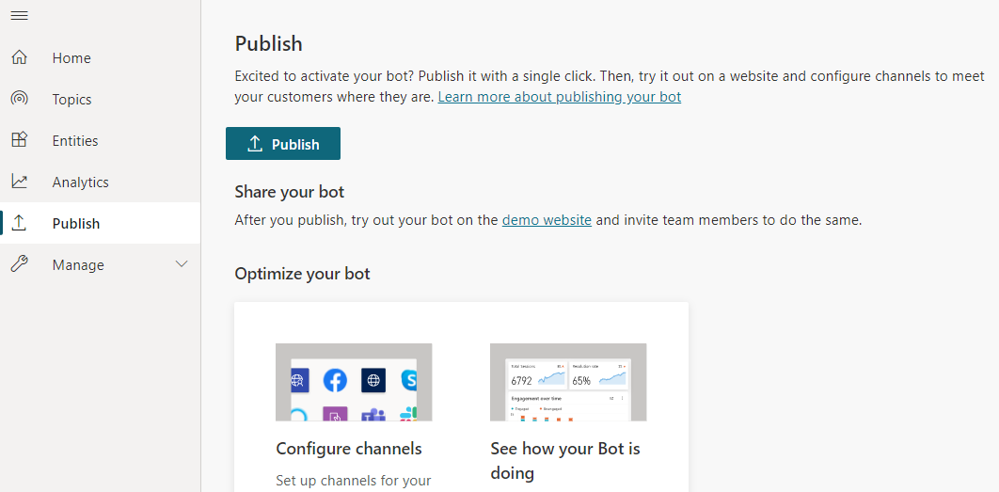

Slide 18
