Slide 1


Bot conversation with customer
Hello.
Available Topics
Hi, I am your virtual agent. How can I help you today?.
Greeting
Account Inquiry
What is the weather today?
Weather Inquiry
Current weather at your location is warm and sunny. Can I help you with anything else?
Find an Answer
Escalate Conversation
I have an account question.
End Conversation
I can help u with that, I just need more information

Slide 2
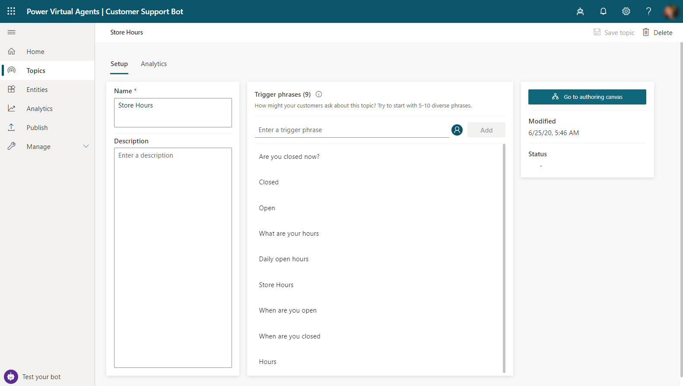

Slide 4
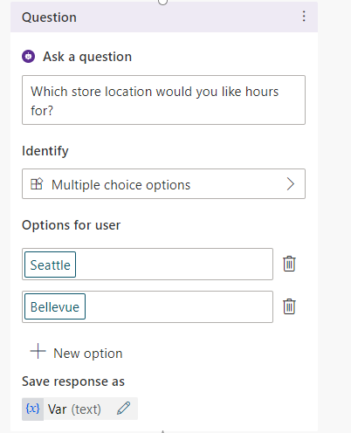
Different types of data such as cities, states, dates, or custom data are available as options.

Slide 5
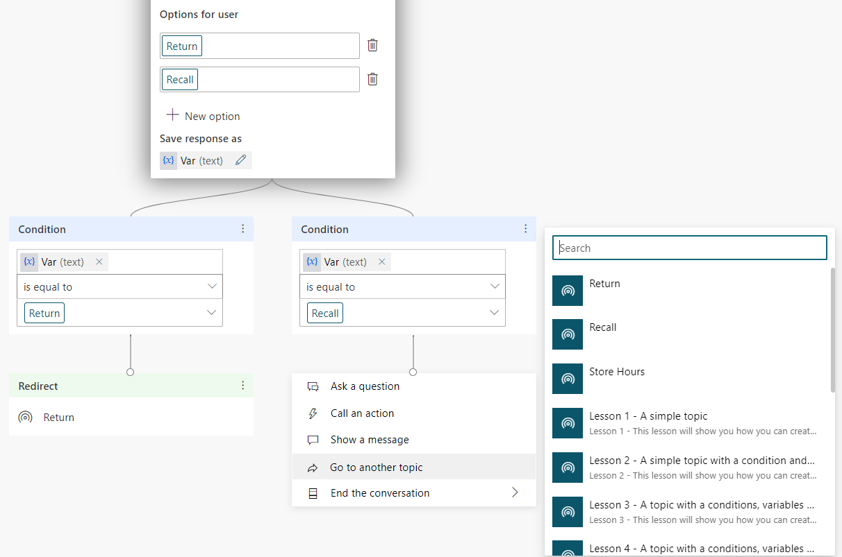
Any topic in the bot can be selected.

Slide 6
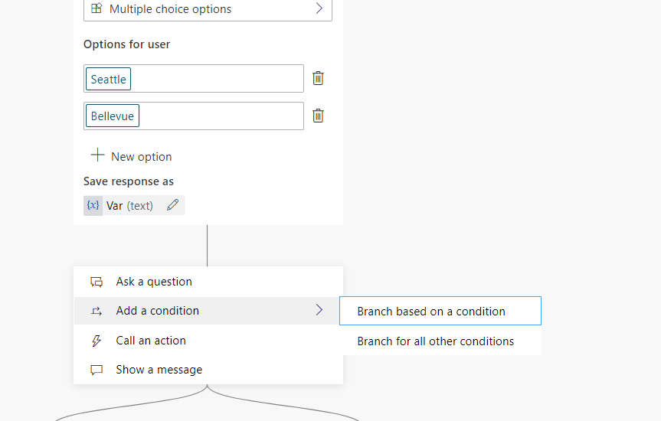

Slide 7
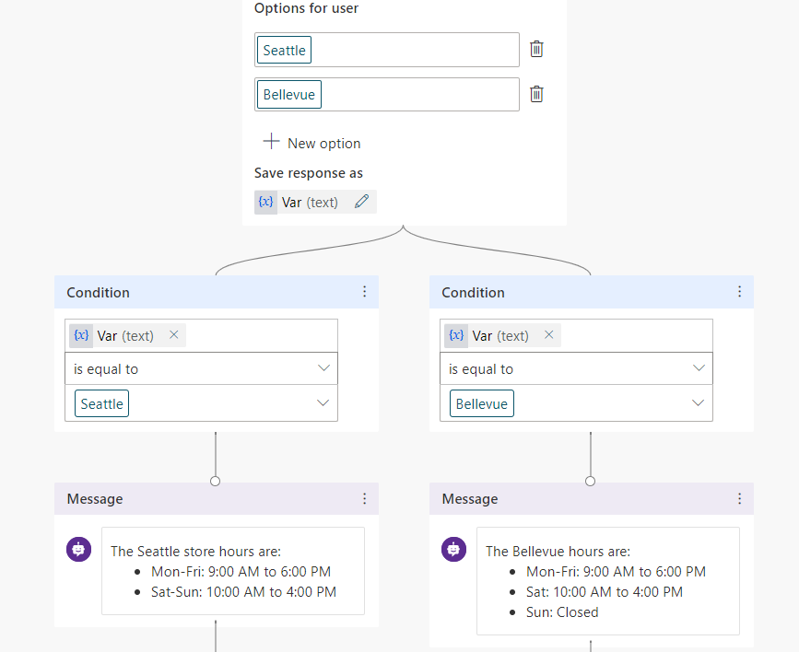
Branching conditions are automatically created based on the options defined.

Slide 8
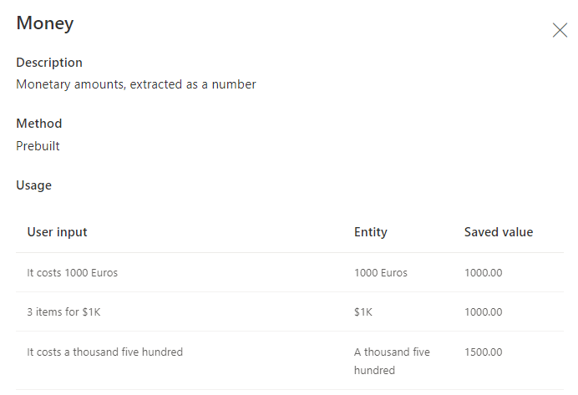
Defines the extracted text for entity.
Shows the saved value stored in variable.
Show examples of user input.

Slide 9
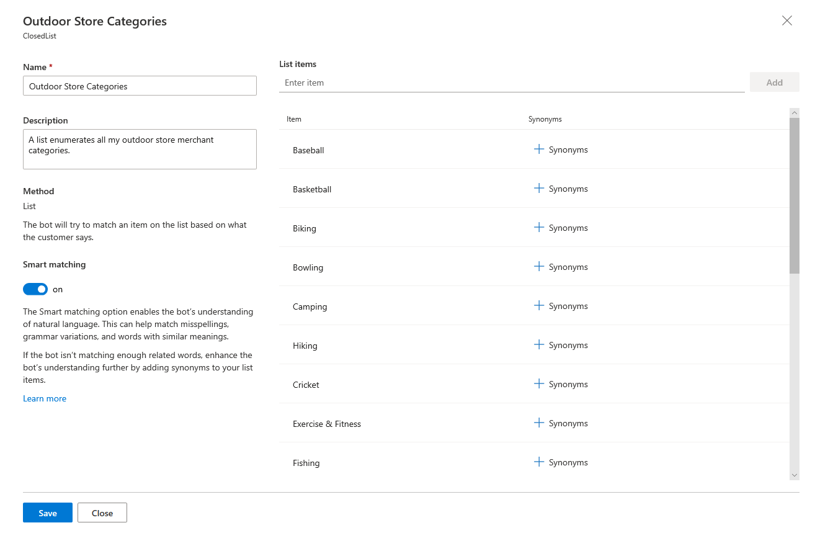
These items will be used as values stored in variables.

Slide 10
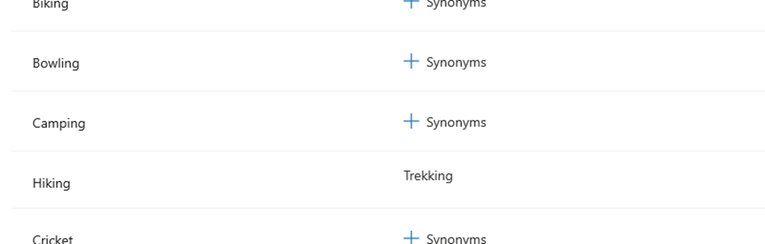
Alternative text that represents the same thing as the list item.

Slide 11
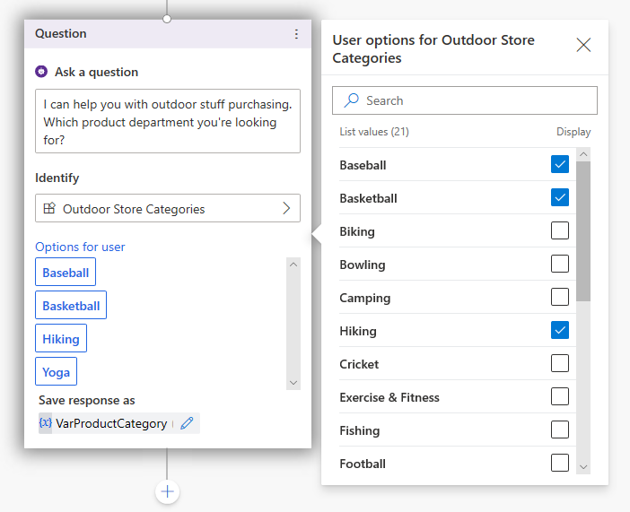
I can help you with purchasing outdoor items. Which product department are you looking for?
Selected options displayed as buttons in the chat window.

Slide 12
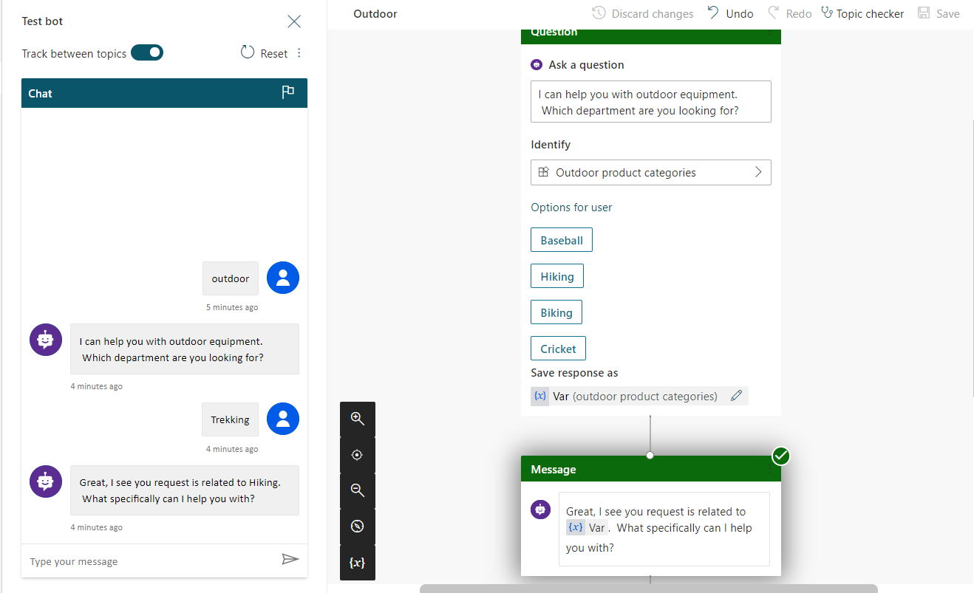
Because trekking was defined as a synonym, slot filling replaced it with Hiking in the variable.

Slide 13
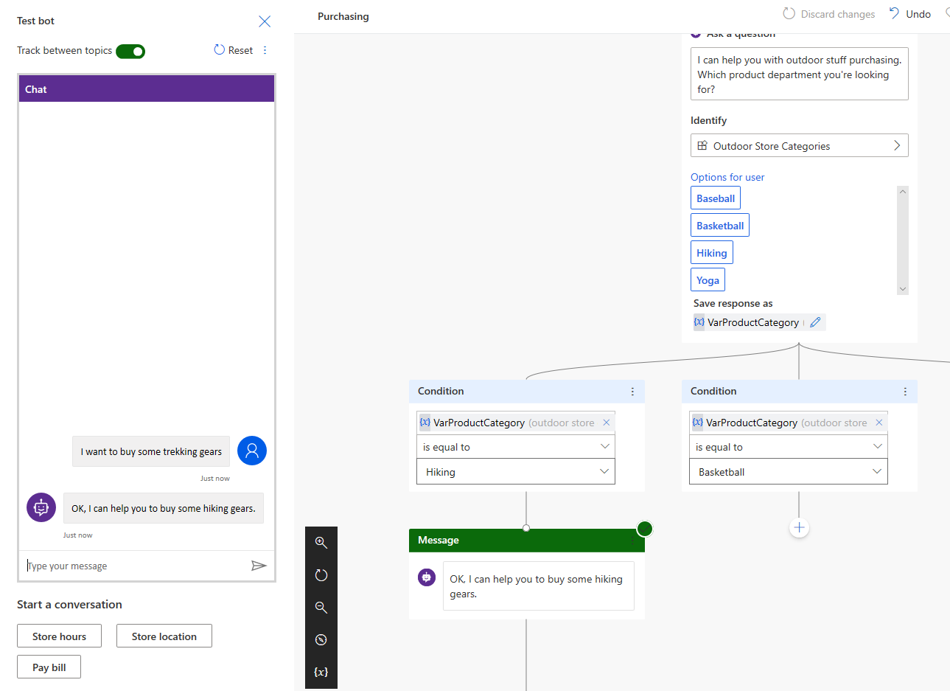
I can help you with purchasing outdoor items. Which product department are you looking for?
The question asks for product type is skipped and the variable is automatically populated with the category.
You will need to define a bookable resource record for the agent before you can assign skills to them.

Slide 14
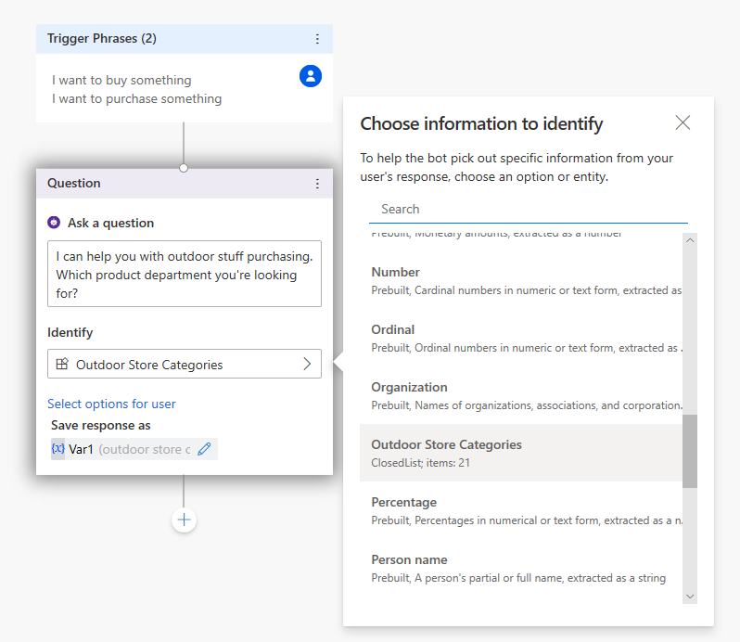
I can help you with purchasing outdoor items. Which product department are you looking for?
The variable is created based on the entity selected in the Identify field.

Slide 15
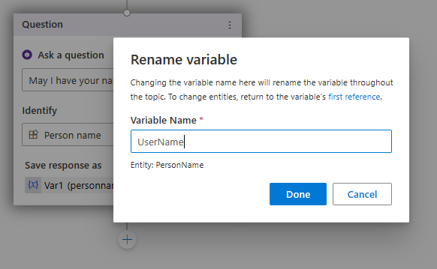

Slide 16
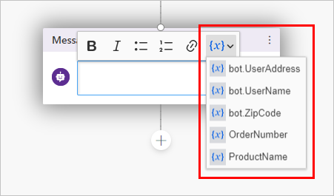

Slide 17
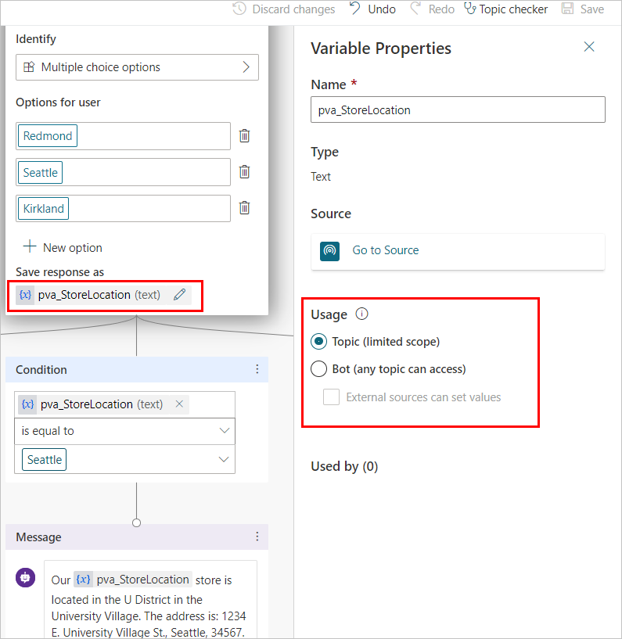

Slide 18
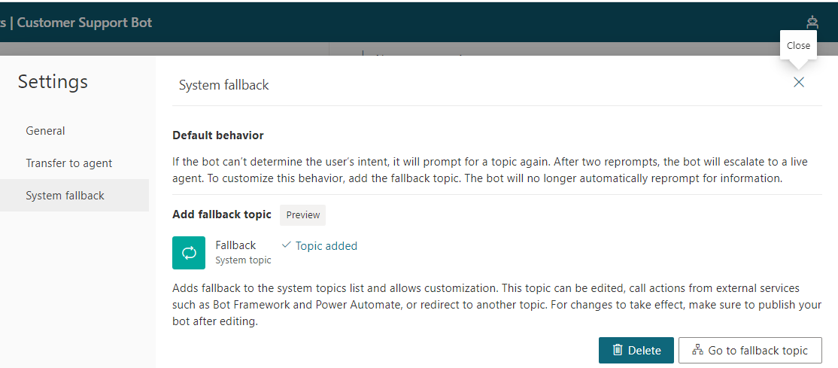
Notes the Fallback topic has been added.
Directly opens the topics to be edited as needed.

Slide 19
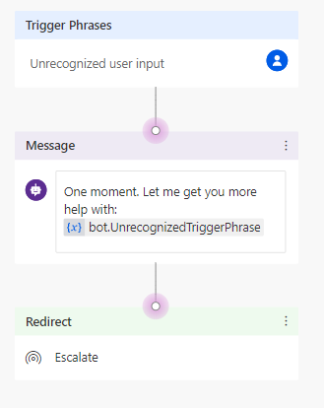

Slide 20
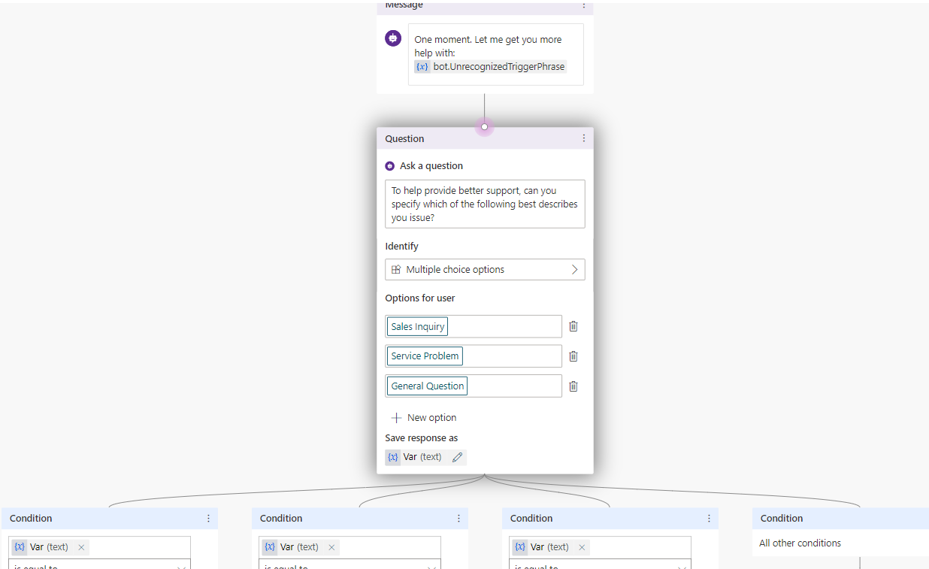
To help provide better support, can you specify which of the following best describers your issue?
Question node added with multiple choice options to direct the user accordingly.

Slide 22
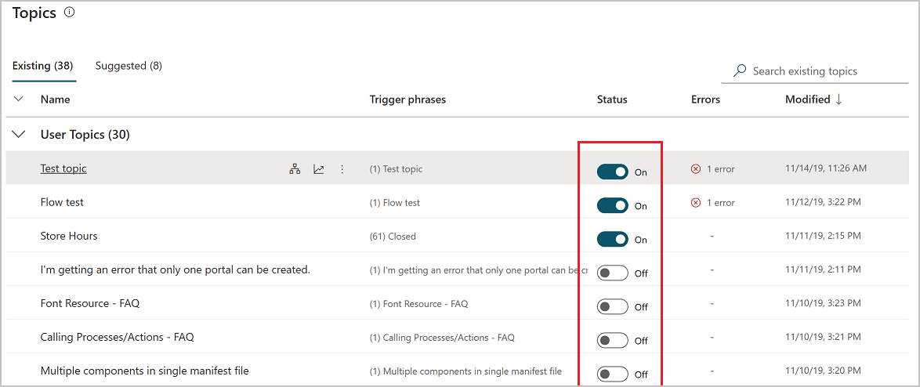
All topics are on by default when they are created.

Slide 23
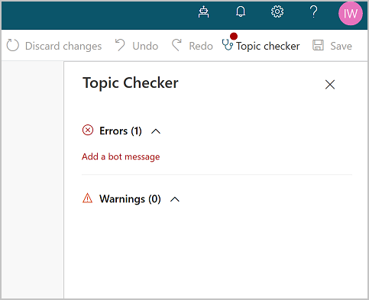

Slide 24
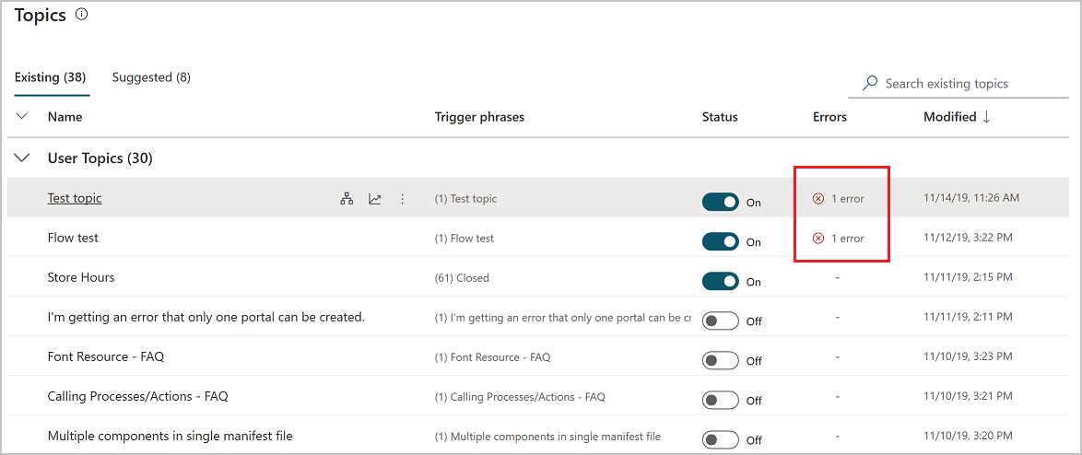
Errors can impact your bots ability to perform. They should be resolved as soon as possible.

Slide 25
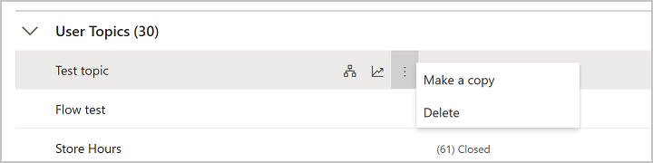

Slide 26
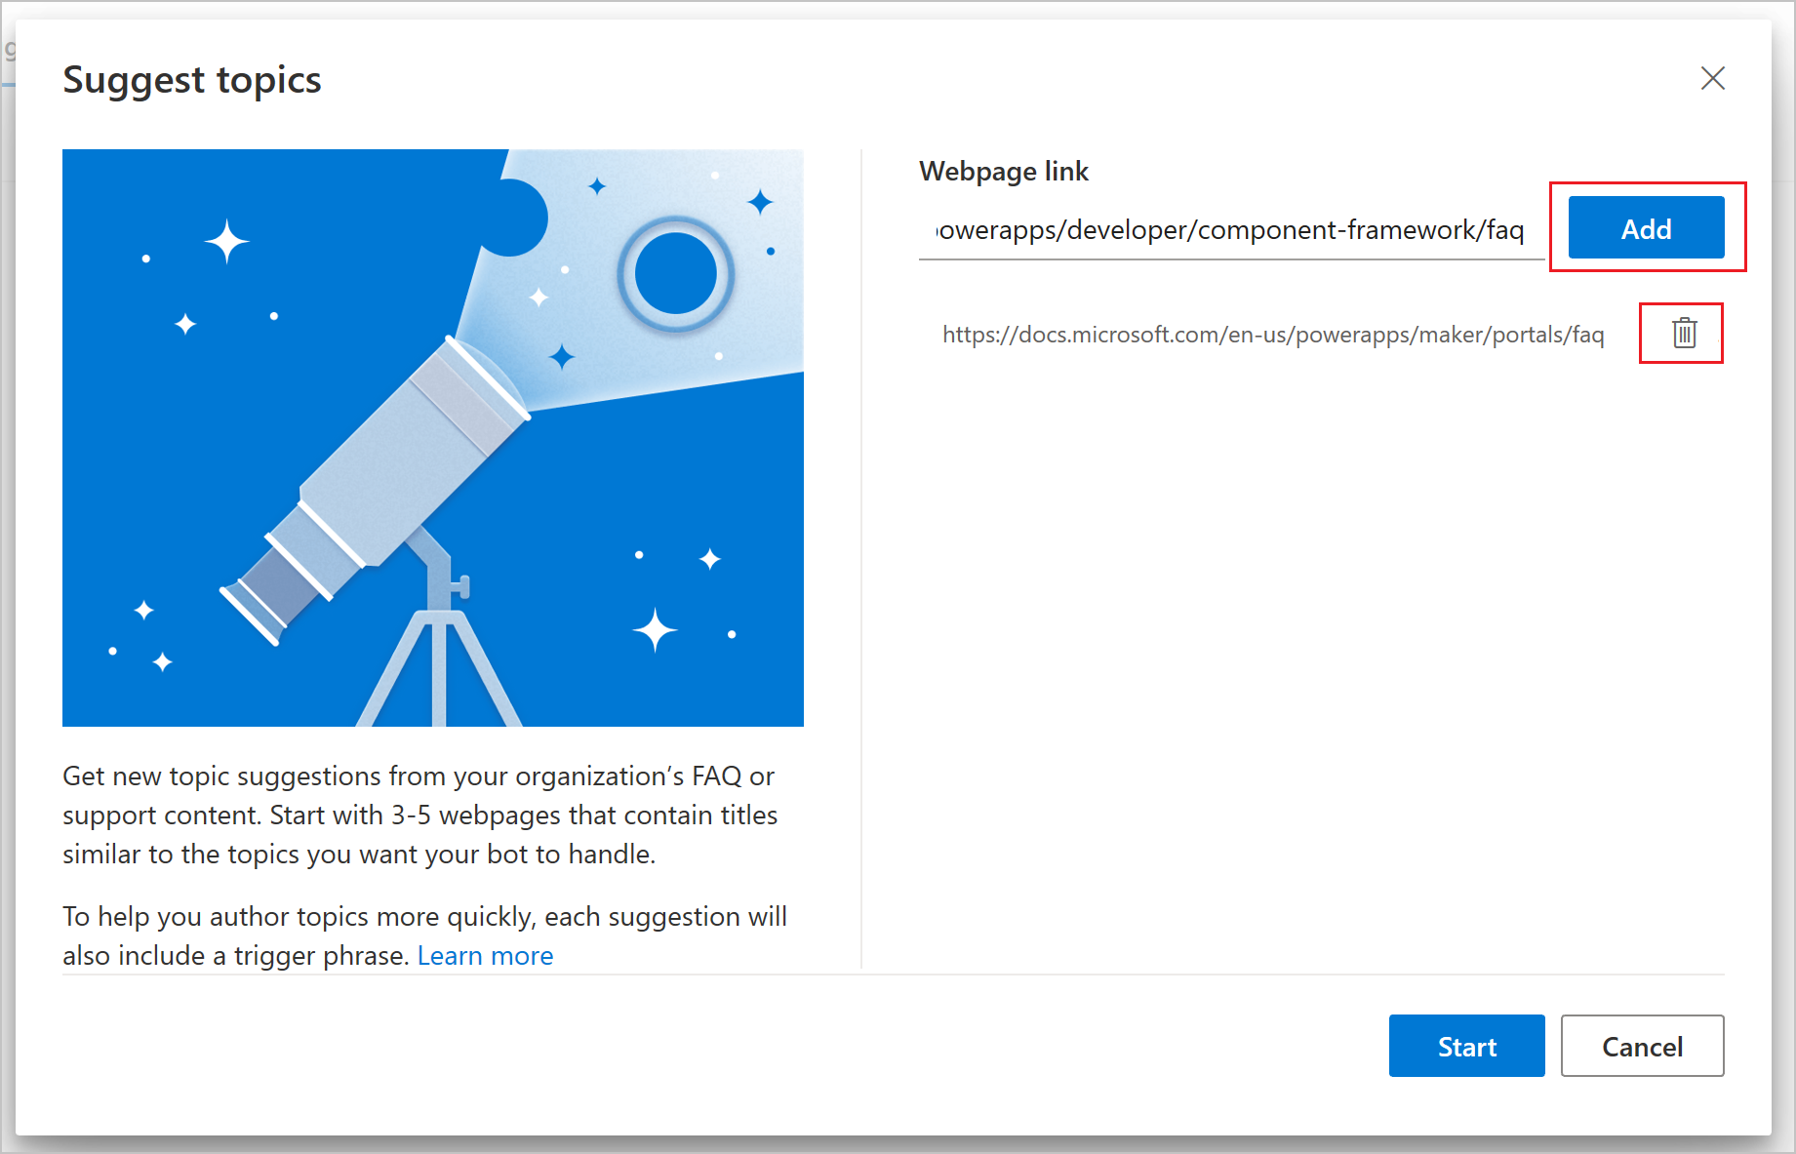
Suggest topics is built to run on webpages formatted to FAQ pages or support sites. Pages not following that structure might not work as expected.

Slide 27
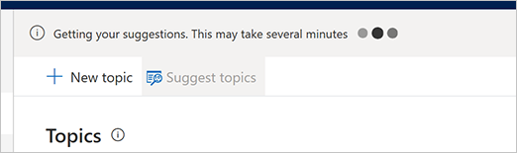

Slide 28
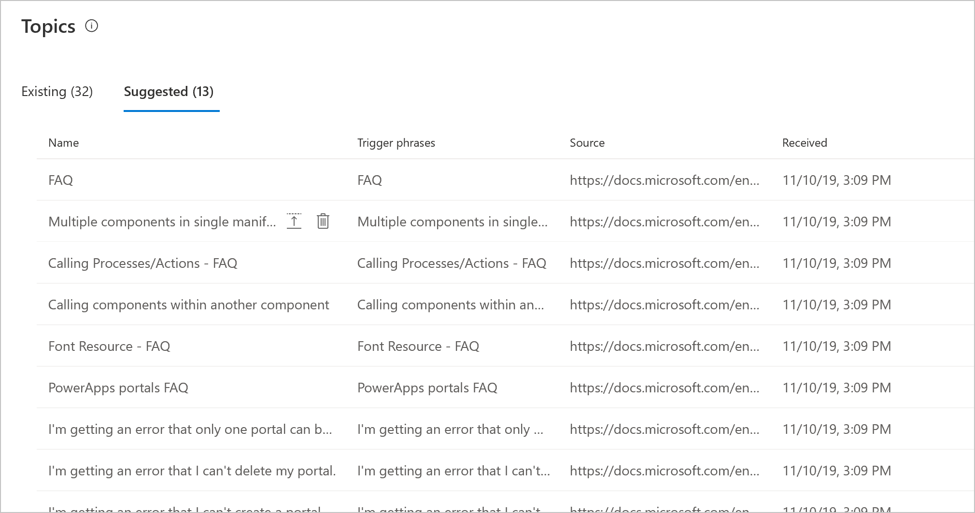
Suggested topics are not actual topics that can be consumed by the bot. They will need to be added to the bot before they can be used.

Slide 29
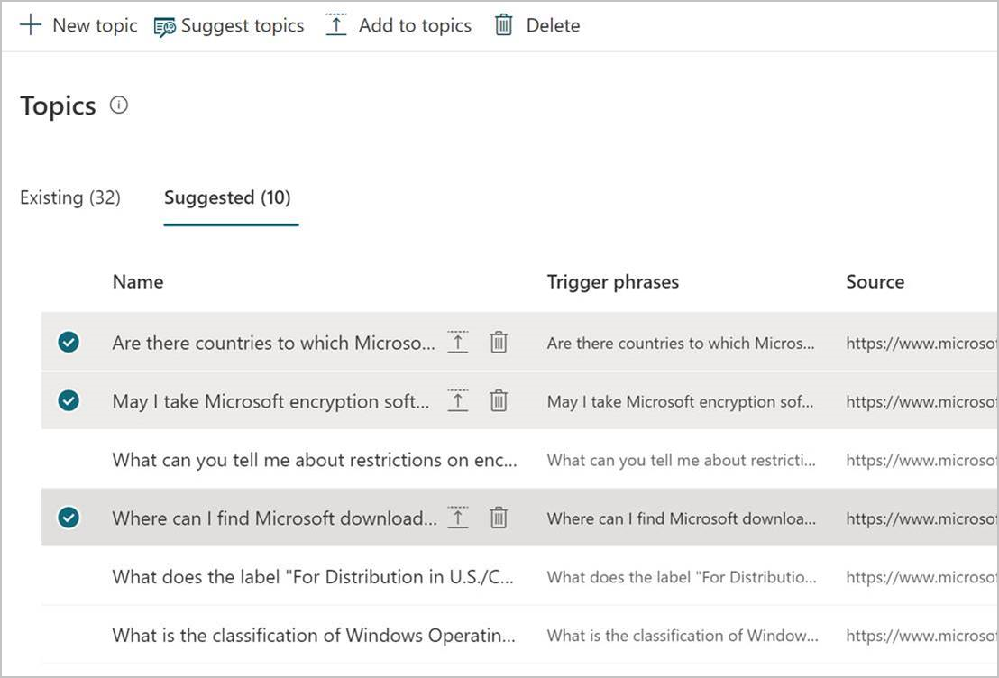

Slide 30
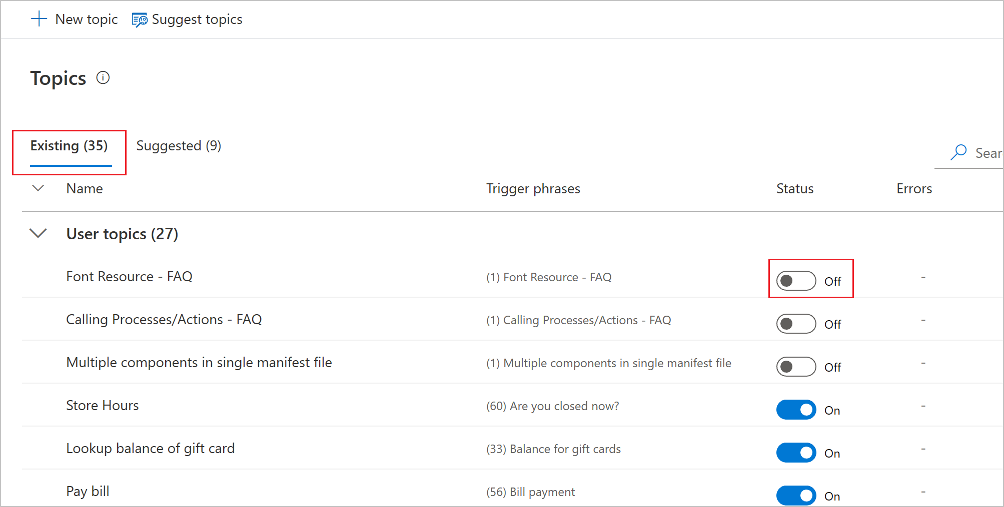
Once added, the topic will be moved to the existing list.
The topic needs to be turned on before the bot can consume it.

