Slide 2
Child Assets
Account
IoT Commands
Customer Asset
Parent Asset
IoT Alerts
Product
Work Orders

Slide 3
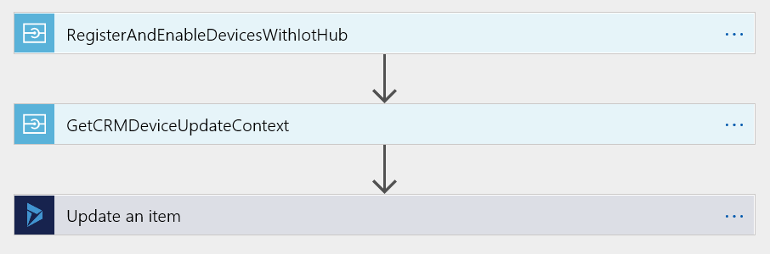
Message Queue
CRM-to-IoT Logic App

Slide 4
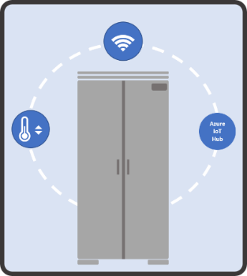
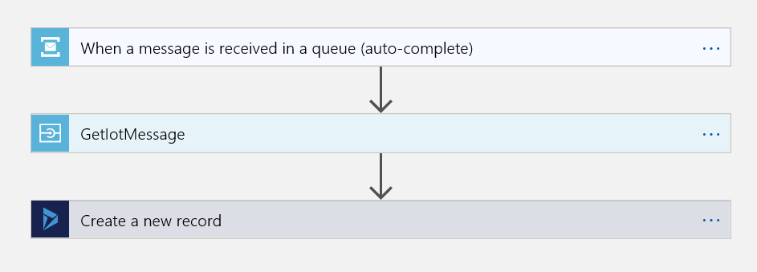
Stream Analytics Job
Alert Queue
IoT-to-CRM Logic App

Slide 5
Stream Analytics Job
Alert Queue
Azure IoT Hub
Real-time analysis (alerts, actions)
Devices
IoT Hub Routes
Azure Storage
Azure ML
IoT-to-CRM Logic App
Scheduled batch processing (training, machine learning)

Slide 6
Connected Field Service Architecture
Dynamics 365 (Online)
Customer Azure Account
Connected Field Service
Register Device, Device Commands
Azure Service Bus
Logic Apps
IoT Hub
AzureStorage: Blob, Table, Etc.
IoT
FS Adapter
. . .
Service Alert Workflow
Thermostat Simulator
Queue Connector
Stream Analytics
Database: Azure SQL,
Document DB, etc.
Field Service
Registration Status, IoT Alerts
CRM Connector
Register Asset
Power BI
Direct Query
Mobile Client
Azure Service Bus
Azure Service Bus
Notes:
Component or service
Description/Purpose
Dynamics 365
Includes the CRM Service and Field Service. The Connected Field Service feature is only available in the online version of Microsoft Dynamics 365. Dynamics 365 provides support for popular mobile clients, which can be used to register and monitor assets in the field.
Azure Service Bus
Provides a channel for both inbound and outbound messages flowing between Dynamics 365 (CRM) and Azure: IoT Hub alerts sent to CRM, and CRM commands sent to the IoT Hub.
Azure Logic Apps
Custom Azure applications that provide orchestration logic that uses the CRM Connector and the Queue Connector. The CRM Connector is used construct CRM-specific entities, whereas the Queue Connectors for polling the Azure Service Bus queue.
Azure IoT Hub
Enables applications and administrators to connect, monitor, and manage IoT devices at scale. All the inbound messages received from and outbound messages sent to devices are routed through this service.
Azure Storage
Provides persistence using a set of standard structures that include Blob storage (object storage), Table storage, and File storage. Stream Analytics queries use Blob storage.
Databases
For longer-term storage and querying of raw data, events, and analytical data: commonly Azure SQL for relational data and DocumentDB for semi-structured data. Connected Field Service uses SQL Azure to store device heartbeat messages for later use by PowerBI to display the status of devices in Dynamics 365.
Azure Stream Analytics
Provides self-managed, real-time event processing and analysis on streaming data, such as IoT data feeds. Supports comparing different streams or with historical values and models. It can detect anomalies, shape incoming data, trigger alerts and provide real-time metrics. Ad-hoc queries are supported through an SQL-based language. Stream Analytics is configured to pump filtered alerts into an Azure Service Bus queue, which then delivers these to Dynamics 365.
Thermostat Simulator
A test web app that provides sample temperature and humidity device data and responds to a small set of device-specific commands.
Power BI service
[Optional] Provides advanced analysis and 360-degree visualization of data sets, with rich interaction models and natural search features.
Note that this list is not exhaustive when considering your customized solution, as there are other Azure services or custom components that could be used. For example, Azure Machine Learning could be employed to discern patterns in the incoming device data in order to predict likely device malfunctions.
The red components in the diagram represent likely areas for developer customization when creating solutions for your organization. For example, your solution will probably have its own simulator for your device type(s) and a custom workflow to handle device alerts. Source code for the standard CRM and Queue Connectors will be publicly released; the source for the Thermostat Simulator will not be released.

Slide 7
Getting Started Module
Unit 1 (the one with arrows and the core subsystems)
This one is from the Azure Reference Architecture document, I just added the emphasis on business applications - https://aka.ms/iotrefarchitecture
Identify Exceptions
Unit 5 – a 10 second tumbling window
This one is a cropped version of the Tumbling window diagram here without the query showing https://docs.microsoft.com/en-us/azure/stream-analytics/stream-analytics-window-functions
Using IoT Central
Unit 1 flow chart and the second block diagram
Flow chart is from the release notes – here https://docs.microsoft.com/en-us/business-applications-release-notes/october18/service/field-service/connected-field-service/enhanced-iot-central-integration
Second is from Iot Central – Metadata management section here - https://docs.microsoft.com/en-us/azure/iot-central/concepts-architecture

