Slide 1

Next level in the hierarchy
Switch to vertical layout
Drill Up
Pin
Turn on
Drill Down
Expand Down
Filters (affecting this visual)
More options

Slide 2








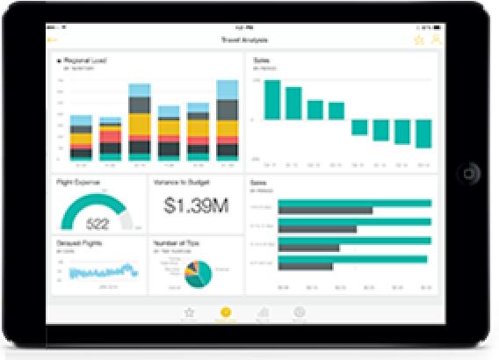
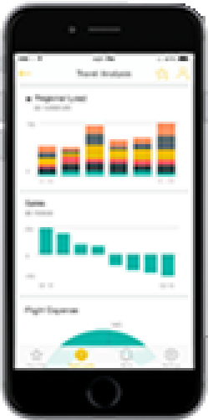
Email
Charts
Spreadsheets
Reports
Reports
Charts
Power BI
Email
Spreadsheets

Slide 3
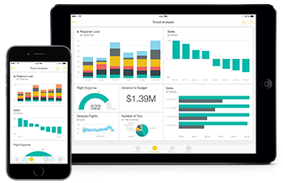
Uses Power BI service in a browser
Explores reports
Can filter, save, and share bookmarks
Uses the Power BI Desktop tool
Creates reports
Creates new filters
Consumer
Designer

Slide 4






V1.0
V1.1
V1.1.2
V1.2
V1.21
V1.7

Slide 5




Report
Dashboard
App
Multiple views into a single data source
Single story drawn from one or more reports
Collection of dashboards and/or reports that can be packaged and shared
visualizations
tiles
many ways to filter
no filtering
single or multiple pages
tabs
single page

Slide 6

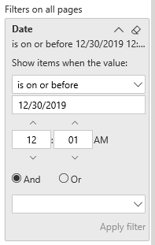
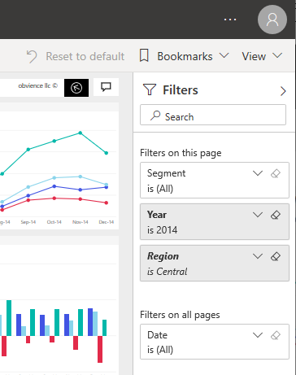
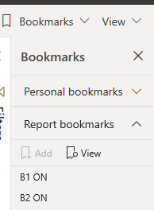
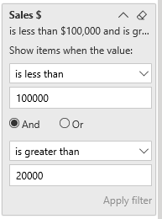
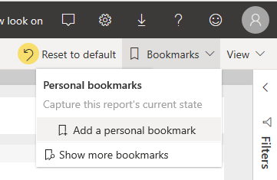
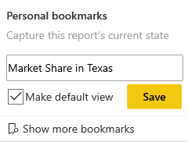


2-1

Slide 7
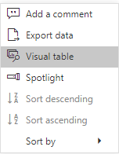
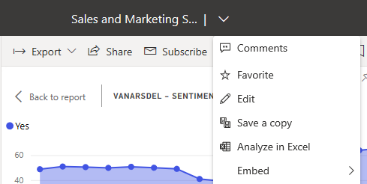
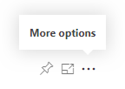
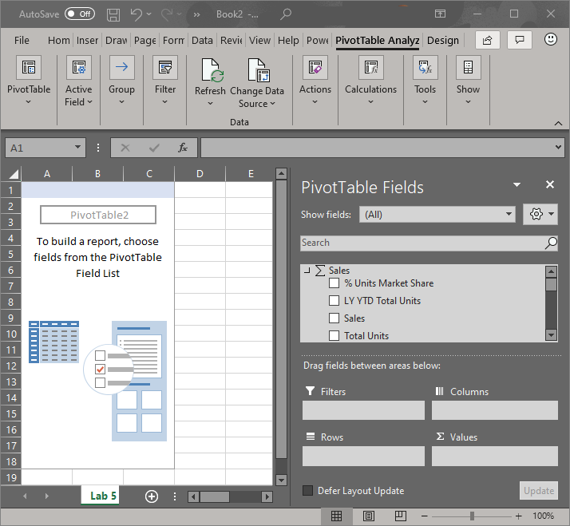
2-2

Slide 8
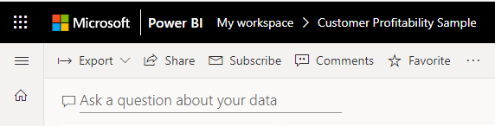
2-3

Slide 9
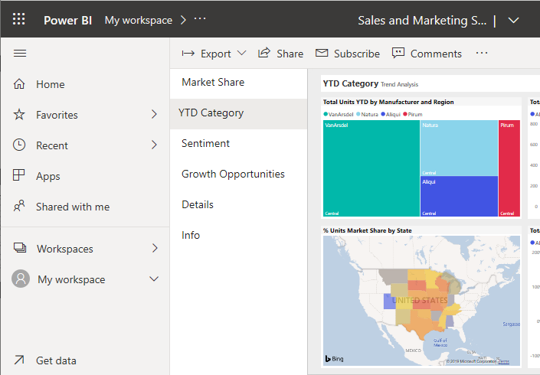
2-4 (lab)

