Slide 1
Monte Carlo Algorithm for Leakage Optimization Based on Input Vector Control
Yuan Cao

Slide 2
Contents
Problem definition --- Input Vector Control
Algorithm and implementation
Results and Discussion
Conclusion

Slide 3
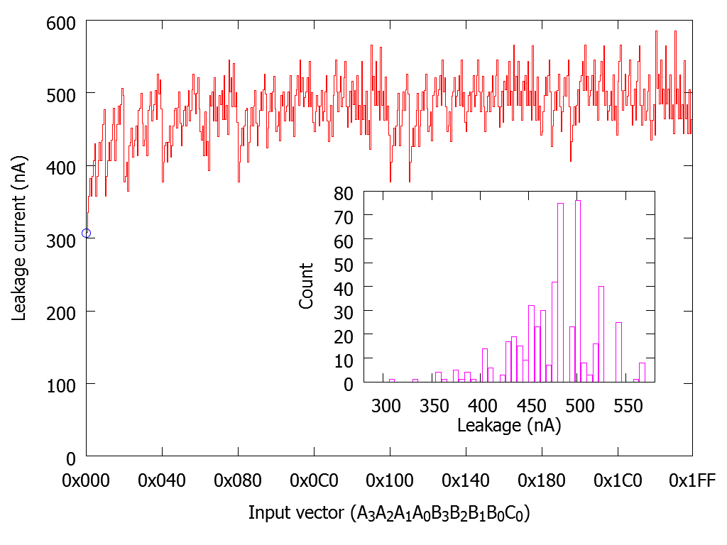
Input Vector Control
A method for reducing leakage power consumption
A₀
B₀
A₁
B₁
A₂
B₂
A₃
B₃
A
FA
S
B
C₀
FA
FA
FA
FA
C₄
C_{i}
C_{o}
S₀
S₁
S₂
S₃
Input vector(A,B,Ci) | Output(S,Co) | Leakage/nA
000 | 00 | 76.97
001 | 01 | 104.60
010 | 01 | 126.48
011 | 10 | 124.12
100 | 01 | 146.35
101 | 10 | 126.51
110 | 10 | 146.13
111 | 11 | 105.73
Extracted from Cadence GSCLIB090 ADDFXL

Slide 4
Finding the best input vector
NP-Complete problem
Heuristic algorithm
Random search
Existing Algorithms
Linear programming
Dynamic programming
2-SAT
Random searching
Problems
Slow
Sub-optimal result

Slide 5
Random search
A large class of algorithms based on random numbers
Crude and simple, but can be sometimes effective
Simplest random search:
n=64 inputs
Number of state N=1.845×10¹⁹
Random search ~10⁸ states

Slide 6
Improvement: Simulated Annealing
Analogue of thermodynamics problem
Temperature T: characterizes the randomness

Slide 7
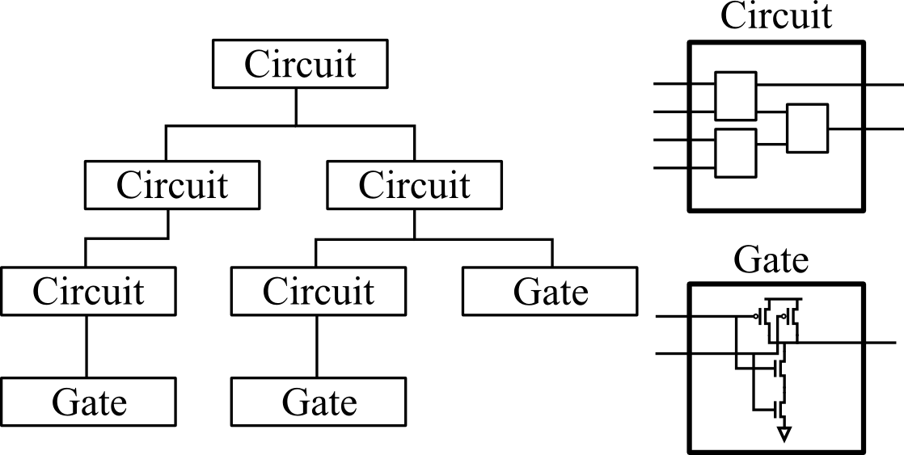
Simulation model
Hierarchical model for simulating combinational logic
Input | Output | Leakage/nA
00 | 1 | 1.37
01 | 1 | 28.92
10 | 1 | 52.53
11 | 0 | 1.259
NAND

Slide 8
Implementation
Minimize_Leakage(C, n)
input[] = random(n);
leak = evaluate(input);
T = T₀;
while(T<T_{final}){
index = random(n);
input[index].flip();
new_leak = evaluate(input);
if(new_leak < leak){
leak = new_leak;
// save input vector
}
else{
prob = e^{-(new_leak-leak)/T};
if(random() < prob){
leak = new_leak;
}
else{
// restore
input[index].flip();
continue;
}
}
T = (1 - a) * T;
}
Top-level
Circuit
Input Vector

Slide 9
Extra heuristics
Since only one bit is flipped, possibility of getting stuck
Example: T=0.5
0000000011000000 10
0000000010000000 15
0000000001000000 15
0000000000000000 8
Solution: Do relaxation after several iterations
Enumerate and try all possible two-bit flips

Slide 10
Results and Discussion
Everything implemented in Java
2535 lines of code
NOT, AND, OR, NAND, NOR, XOR, FA, etc. tens of gates extracted from GSCLIB090 technology library.
Tested on a number of benchmark circuits

Slide 11
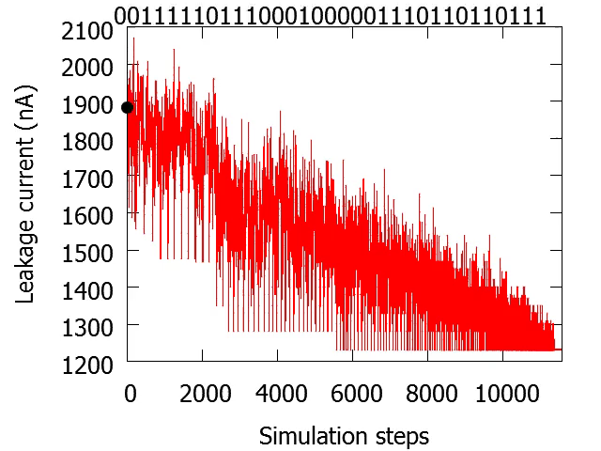
Simulated Annealing
16-bit Adder

Slide 12
Benchmark
Circuit | Inputs | Gate count | Min. Leakage(nA) | Time(s) (By bruteforcing) | Avg. annealing Leakage(nA) | Time(s) (By annealing) | Ratio
Adder-4 | 9 | 4 | 307.9 | 0.1 | 307.9 | 0.1 | 1.00
C17 | 5 | 6 | 35.4 | 0.1 | 35.4 | 0.1 | 1.00
C432 | 36 | 160 | 3360.6 | - | 3389.1 | 1.0 | 1.008
C880 | 60 | 383 | 9716.7 | - | 9815.9 | 6.0 | 1.010
C1355 | 41 | 546 | 11081.9 | - | 11081.9 | 5.0 | 1.00
C3540 | 50 | 1669 | 52588.5 | - | 52588.5 | 25.0 | 1.00
C6288 | 32 | 2416 | 75939.3 | - | 75939.3 | 22.0 | 1.00
C7552 | 207 | 3512 | 1.05×10⁵ | - | 1.07×10⁵ | 439.0 | 1.019
ISCAS85 Benchmark circuits

Slide 13
Conclusion
An improved version of random search for input vector control is developed based on widely-used simulated annealing algorithm
The effectiveness and validity of the algorithm is verified.
Possible further improvements
Use more efficient programming language such as C++

Slide 14
References
Gao, Feng, and John P. Hayes. "Exact and heuristic approaches to input vector control for leakage power reduction." Computer-Aided Design of Integrated Circuits and Systems, IEEE Transactions on 25.11 (2006): 2564-2571.
Chang, Xiaotao, et al. "Fast algorithm for leakage power reduction by input vector control." ASIC, 2005. ASICON 2005. 6th International Conference On. Vol. 1. IEEE, 2005.
Cheng, Lei, et al. "A fast simultaneous input vector generation and gate replacement algorithm for leakage power reduction." Proceedings of the 43rd annual Design Automation Conference. ACM, 2006.
Aloul, Fadi A., et al. "Robust SAT-based search algorithm for leakage power reduction." Integrated Circuit Design. Power and Timing Modeling, Optimization and Simulation. Springer Berlin Heidelberg, 2002. 167-177.
Halter, Jonathan P., and Farid N. Najm. "A gate-level leakage power reduction method for ultra-low-power CMOS circuits." Custom Integrated Circuits Conference, 1997., Proceedings of the IEEE 1997. IEEE, 1997.

Slide 15
Thanks!

