Slide 1
Monte Carlo Algorithm for Leakage Optimization Based on Input Vector Control
Yuan Cao

Slide 2
Contents
Problem definition --- Input Vector Control
Random algorithm
Results and Discussion
Conclusion

Slide 3
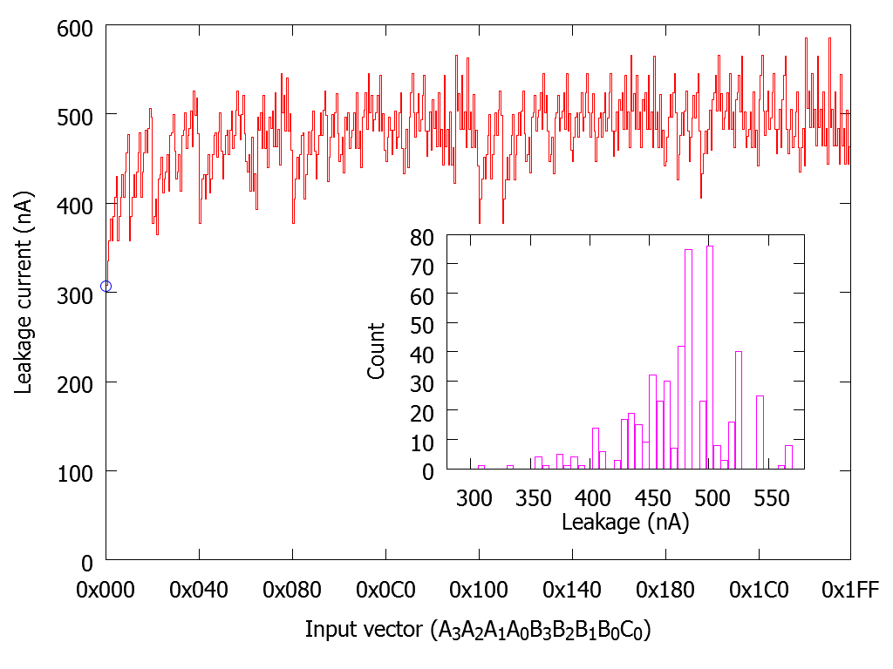
Input Vector Control
A method for reducing leakage power consumption
A₀
B₀
A₁
B₁
A₂
B₂
A₃
B₃
A
FA
S
B
C₀
FA
FA
FA
FA
C₄
C_{i}
C_{o}
S₀
S₁
S₂
S₃
Input vector(A,B,Ci) | Output(S,Co) | Leakage/nA
000 | 00 | 76.97
001 | 01 | 104.60
010 | 01 | 126.48
011 | 10 | 124.12
100 | 01 | 146.35
101 | 10 | 126.51
110 | 10 | 146.13
111 | 11 | 105.73
Result from Cadence GSCLIB090 ADDFXL

Slide 4

Pseudo-Boolean function
$F\left(A,B\right)=F_{00} \overline{AB}+F_{01}\overline{A}B+F_{10}A\overline{B}+F_{11}AB$
n inputs = 2^{n} terms to be summed
Impossible to bruteforce for large circuit

Slide 5
Finding the best input vector
NP-Complete problem
Heuristic algorithm
Random search
Existing Algorithms
Linear programming
Dynamic programming
2-SAT
Random searching
Problems
Slow
Sub-optimal result

Slide 6
Random search
A large class of algorithms based on random numbers
Crude and simple, but can be sometimes effective
Simplest random search:
n=64 inputs
Number of state N=1.845×10¹⁹
Random search ~10⁸ states

Slide 7
Improvement: Simulated Annealing
Analogue of thermodynamics problem
Temperature T: characterizes the randomness

Slide 8
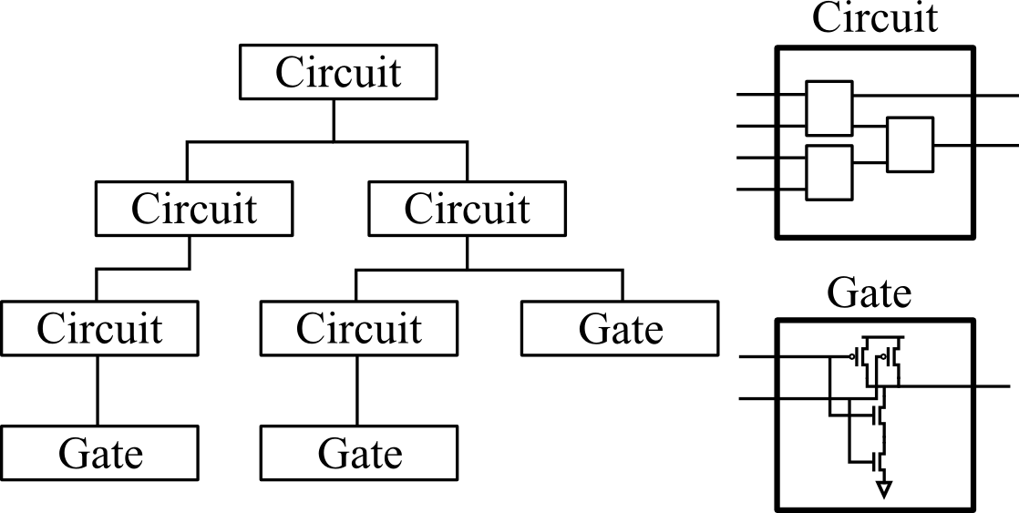
Simulation model
Hierarchical model for simulating combinational logic
Input | Output | Leakage/nA
00 | 1 | 1.37
01 | 1 | 28.92
10 | 1 | 52.53
11 | 0 | 1.259
NAND

Slide 9
Implementation
Minimize_Leakage(C, n)
input[] = random(n);
leak = evaluate(input);
T = T₀;
while(true){
index = random(n);
input[index].flip();
new_leak = evaluate(input);
if(new_leak < leak){
min_leak = new_leak;
// save input vector
}
else{
prob = e^{-(new_leak-leak)/T};
if(random() < prob){
leak = new_leak;
}
else{
// restore
input[index].flip();
}
}
T = (1 - a) * T;
}
Top-level
Circuit
Input Vector

Slide 10
Extra heuristics
Since only one bit is flipped, possibility of getting stuck
T=0.5
0000000011000000 10
0000000010000000 15
0000000001000000 15
0000000000000000 8
Solution: Do relaxation after several iterations
Enumerate and try all possible two-bit flips

Slide 11
Results and Discussion
Everything implemented in Java
2535 lines of code
NOT, AND, OR, NAND, NOR, XOR, FA, etc. tens of gates extracted from GSCLIB090 technology library.
Tested on a number of benchmark circuits

Slide 12
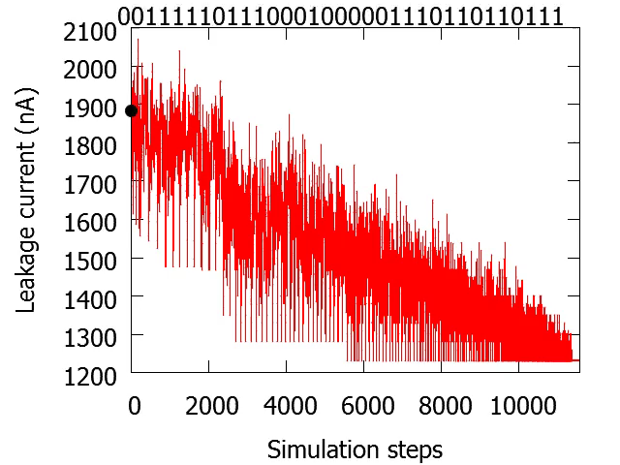
Simulated Annealing
16-bit Adder

Slide 13
Benchmark
Circuit | Inputs | Gate count | Min. Leakage(nA) | Time(s) (By bruteforcing) | Avg. annealing Leakage(nA) | Time(s) (By annealing) | Ratio
Adder-4 | 9 | 4 | 307.9 | 0.1 | 307.9 | 0.1 | 1.00
C17 | 5 | 6 | 35.4 | 0.1 | 35.4 | 0.1 | 1.00
C432 | 36 | 160 | 3360.6 | - | 3389.1 | 1.0 | 1.008
C880 | 60 | 383 | 9716.7 | - | 9815.9 | 6.0 | 1.010
C1355 | 41 | 546 | 11081.9 | - | 11081.9 | 5.0 | 1.00
C3540 | 50 | 1669 | 52588.5 | - | 52588.5 | 25.0 | 1.00
C6288 | 32 | 2416 | 75939.3 | - | 75939.3 | 22.0 | 1.00
C7552 | 207 | 3512 | 1.05×10⁵ | - | 1.07×10⁵ | 439.0 | 1.019

Slide 14
Conclusion
An improved version of random search for input vector control is developed based on widely-used simulated annealing algorithm
The effectiveness and validity of the algorithm is verified.
Possible further improvements
Use more efficient programming language such as C++

Slide 15
Thanks!

