Slide 1
sas
Yue Cao-Swap rate PCA analysis

Slide 2
ICE swap rate
The ICE Swap Rate® (formerly known as ISDAFIX) is recognised as the principal global benchmark for swap rates and spreads for interest rate swaps.
The ICE Swap Rate represents the mid-price for interest rate swaps (the fixed leg) and swap spreads (the applicable mid-price minus a corresponding specified government bond yield), in various specified currencies and tenors and at particular specified times of the day.
https://www.theice.com/iba/ice-swap-rate

Slide 3
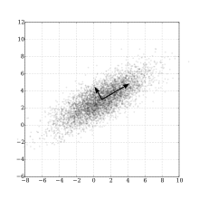
PCA
Principal component analysis (PCA) is the process of computing the principal components and using them to perform a change of basis on the data, sometimes using only the first few principal components and ignoring the rest.
https://en.wikipedia.org/wiki/Principal_component_analysis

Slide 4
Workflow
Download the data from Fred
Clean the data
Basic analysis
PCA analysis

Slide 5
Trend plot

