Slide 1

2026
Order
Weaver
Hackathon
results presentation
Team：Team X

Slide 2
PPT下载 http://www.1ppt.com/xiazai/
01
Backgrounds
02
Overall process
Table of
CONTENTS
03
Operation demo
04
Design conception

Slide 3
01
Background
Notes:
模板来自于：第一PPT https://www.1ppt.com/

Slide 4
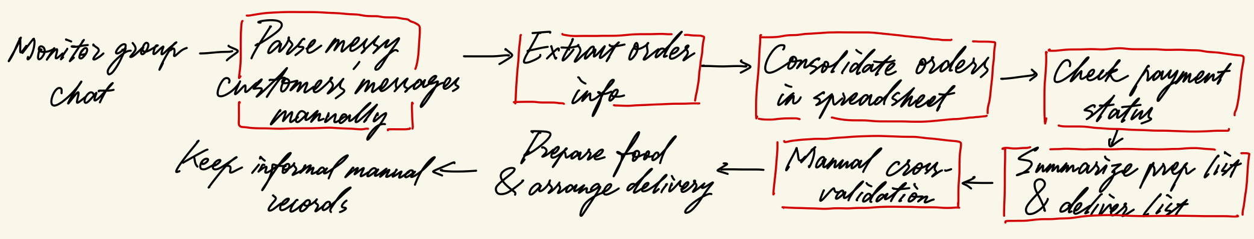
BACKGROUNDS
Main Users
Current situation
Core issues
Manual process
1.time-consuming
2.making mistakes easily
3.lack of approval records
4.no budgets for ERP
Managers of small
restaurants in Malaysia
Rely on Excel,WhatsApp,
manual processing on paper
as below

Slide 5
02
Overall process

Slide 6
Overall process
SDG 8
Campus micro food vendors are micro-enterprises with limited manpower. Manual order tallying is repetitive, draining work that takes time away from business improvement. Our AI-assisted ordering workflow automates this repetitive administrative burden without replacing the merchant. Merchants can redirect saved time to food quality, customer service and business expansion, supporting the growth and formalisation of local micro-enterprises.

Slide 7
03
Operation demo

Slide 8
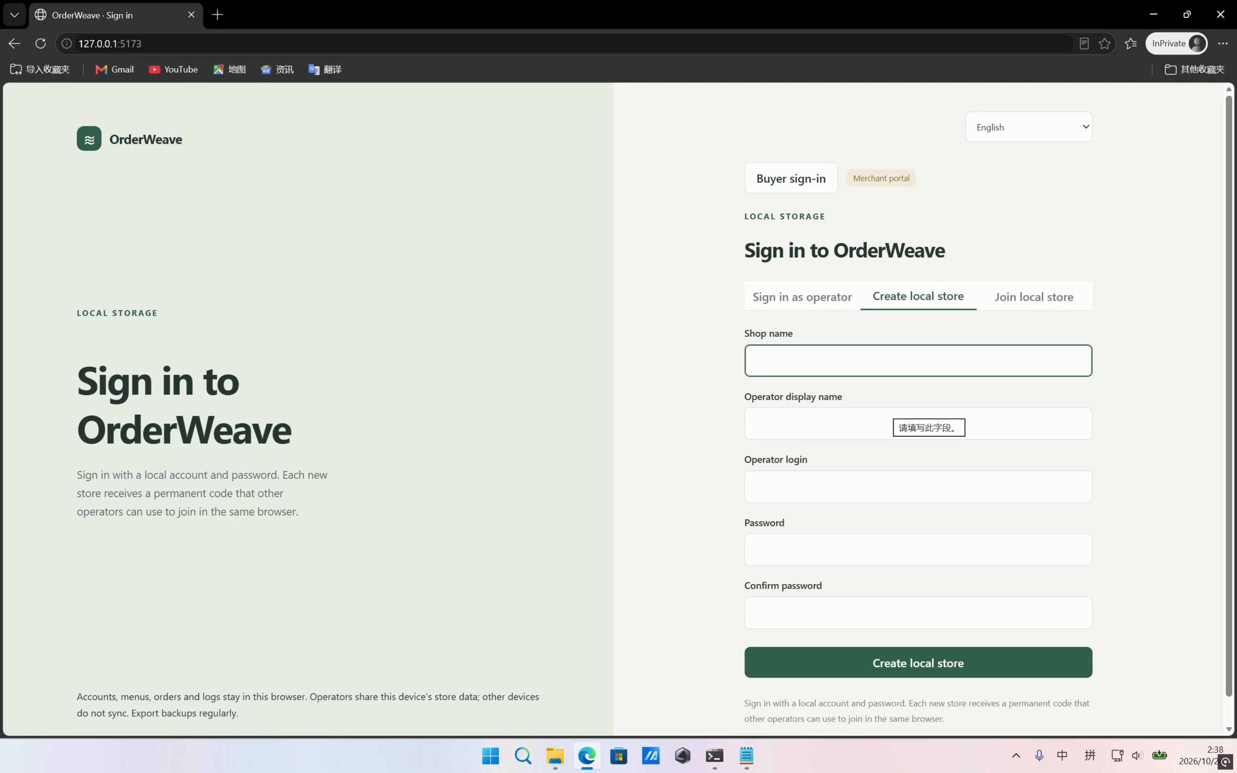

Slide 9
04
Design conception

Slide 10
Design conception
A clear enterprise problem
Core automation workflow
Target users: campus micro food merchants in Malaysia. They collect orders manually from group chat, spending heavy labour on parsing messy conversational messages, tallying orders and checking payments, which is slow and error-prone.
Unstructured chat input → AI extraction & structuring → order merging → merchant review → generate consolidated food prep list + delivery manifest.
Accurate and easy to learn, measurable
Human keeps full control
AI only suggests structured orders. Ambiguous/incomplete messages get flagged. Merchants can edit, approve or reject orders. Only
approved orders proceed. All actions are
logged in an audit trail.
We test with 7 synthetic chat samples, record side-by-side comparison of time consumption and error count between manual workflow and our system. The UI is
simplified for non-technical merchants.
Orbyte compatible & reusable
SDG impact with justification
Merchants configure their own menu, pricing, cut-off time and approver. We demonstrate
switching between multiple simulated merchants to prove the same tool can serve different small businesses.
Aligned with SDG 8.3 . We explain how it helps micro-enterprises reduce wasted
labour and cut food over-ordering, not merely attach SDG icons.

Slide 11
2026
THANK
YOU FOR WATCHING
Order
Weaver
Team：Team X

