Slide 1



Movie recommendation system

Slide 2

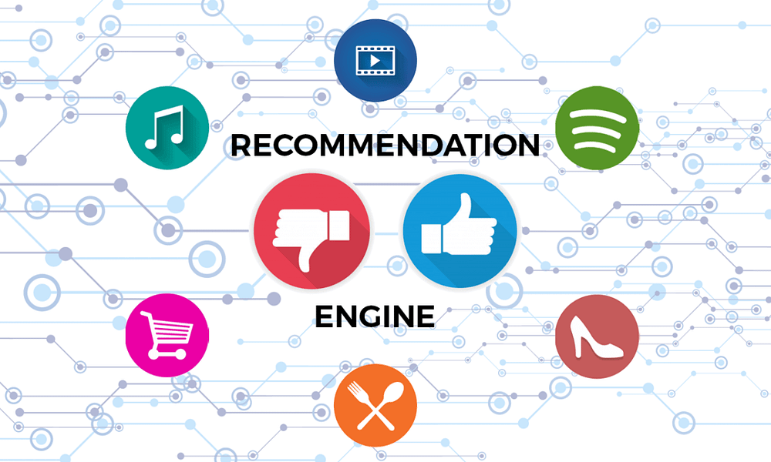
INTRODUCTION
A recommendation system is a type of information filtering system which attempts to predict the preferences of a user, and make suggestions based on these preferences.

Slide 3

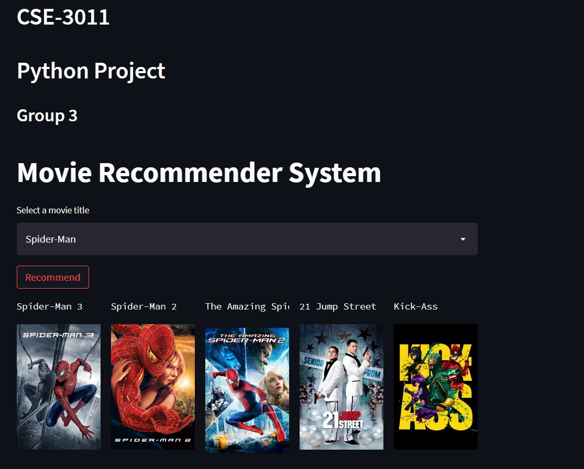
PROPOSED WORK
Aim
The goal of this project is to build a movie recommendation system using machine learning model with the Content-based Filtering algorithm and build a User Interface that can make movie recommendations based on user input.

Slide 4
HARDWARE & SOFTWARE REQUIREMENTS
Hardware Requirements
Processor: Intel core i5
RAM: 8 GB
Hard Disk Space: 2 GB
Software Requirements
Operating System: Windows 10
Coding Language: Python
Coding Software: Jupyter Notebook

Slide 5
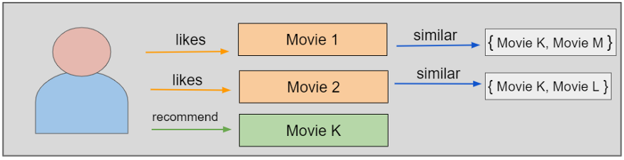
Content - based filtering
This filtration strategy is based on the data provided about the items. The algorithm recommends products that are similar to the ones that a user has liked in the past. This similarity is computed from the data we have about the items as well as the user’s past preferences.

Slide 6
Cont.
It performs item recommendation by predicting the utility of items for a particular user based on how "similar" the items are to those that he/she liked in the past.
E.g.,
In a movie recommendation application, a movie may be represented by such features as specific actors, director, genre, subject matter, etc.
The user's interest or preference is also represented by the same set of features, called the user profile.
Recommendations are made by comparing the user profile with candidate items expressed in the same set of features.
The top-k best matched or most similar items are recommended to the user.
The simplest approach to content-based recommendation is to compute the similarity of the user profile with each item.

Slide 7


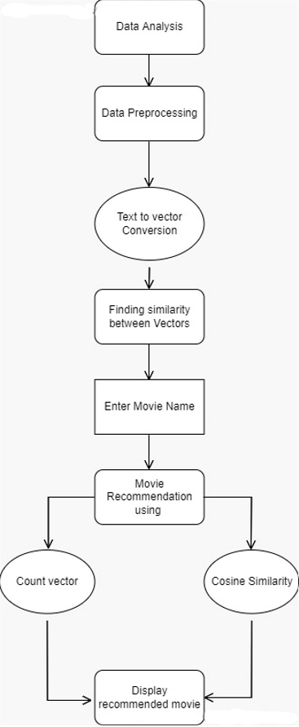
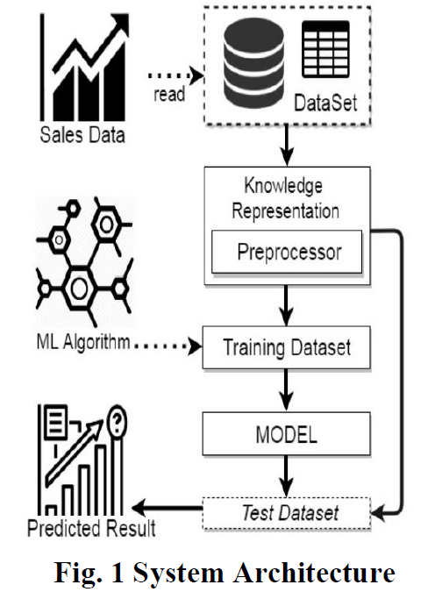
System architecture diagram

Slide 8
Applications
There are a wide variety of applications for recommendation systems.
These have become increasingly popular over the last few years and are now utilized in most online platforms that we use.
The content of such platforms varies from movies, music, books and video, to friends and stories on social media platforms, to products on e-commerce websites, to people on professional and dating websites, to search results returned on Google.
Often, these systems are able to collect information about a user's choices, and can use this information to improve their suggestions in the future.

Slide 9


Thank You

