Slide 1
Tools
Source Control: git
Interactive Development Environment (IDE): Visual Studio Code

Slide 2
Relevant URLs
GitHub Repository: https://github.com/cap273/Wedding-Website
Website: katie-carlos.com

Slide 3
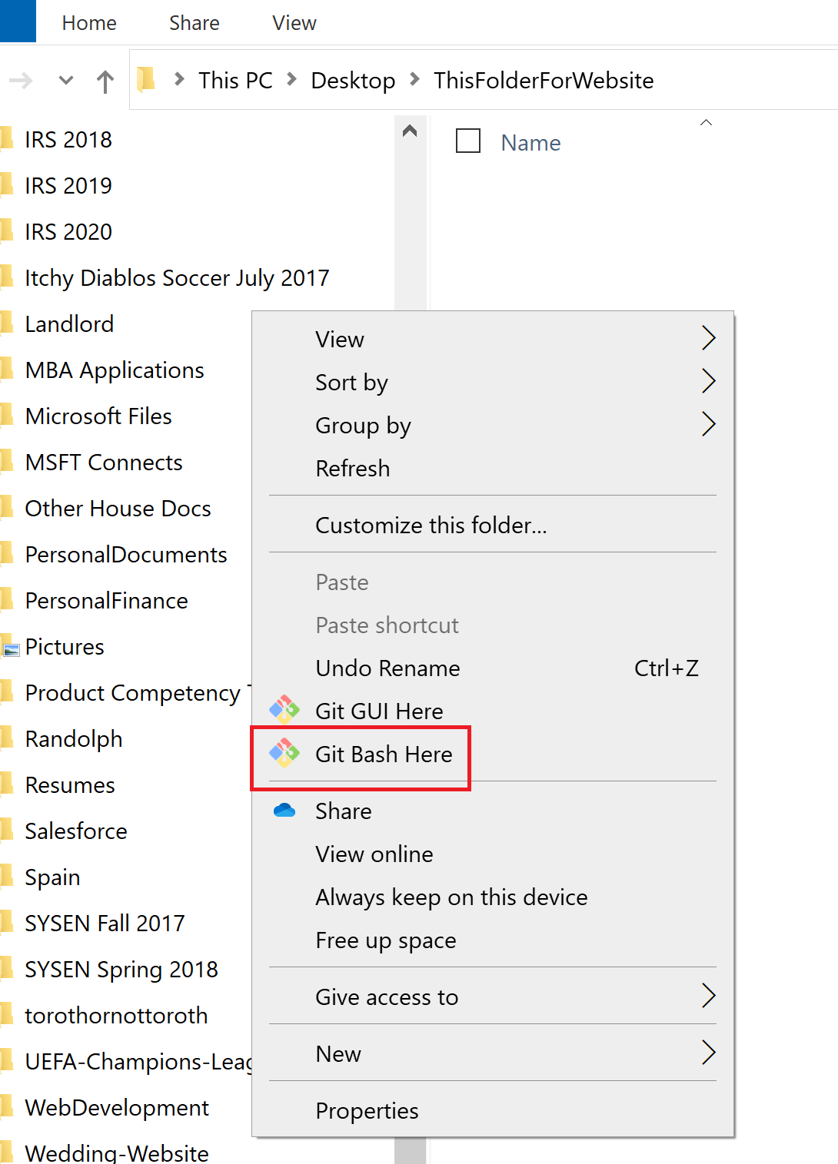
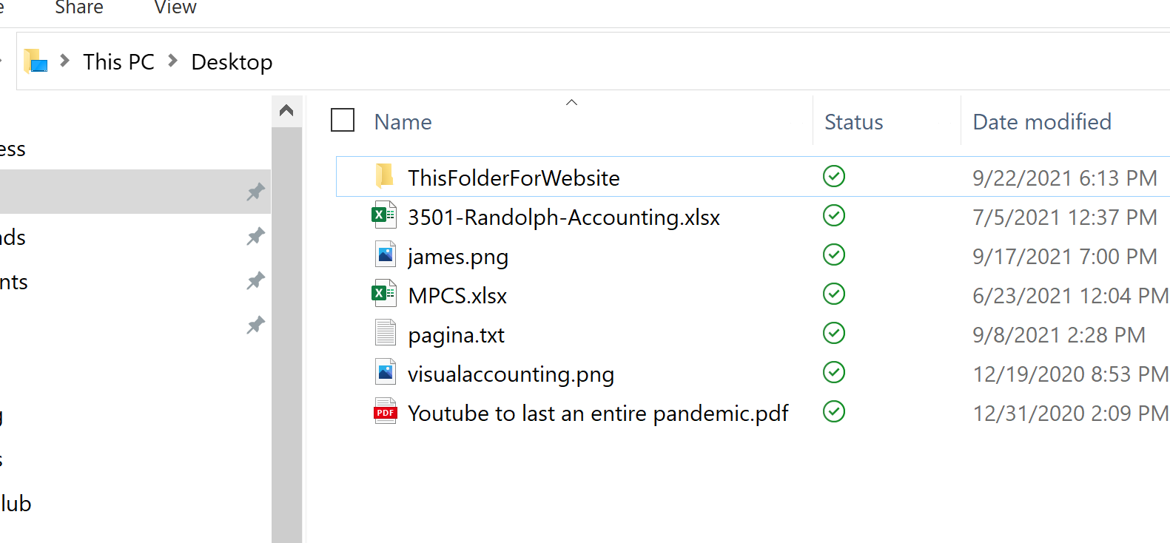
Step 1: Copy GitHub Repository Locally
1a: Download and install Git
1b: Create folder for wedding website files

Slide 4
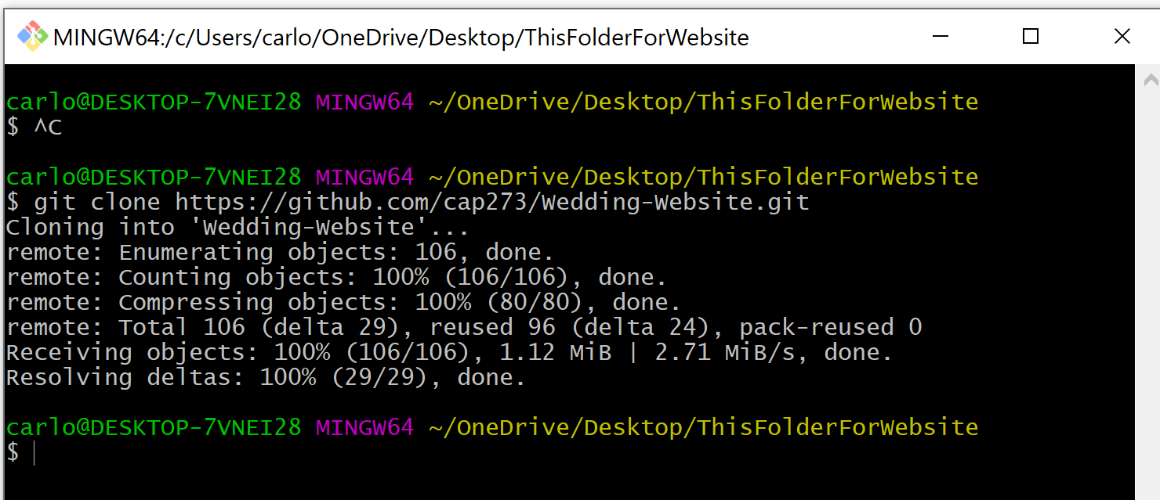
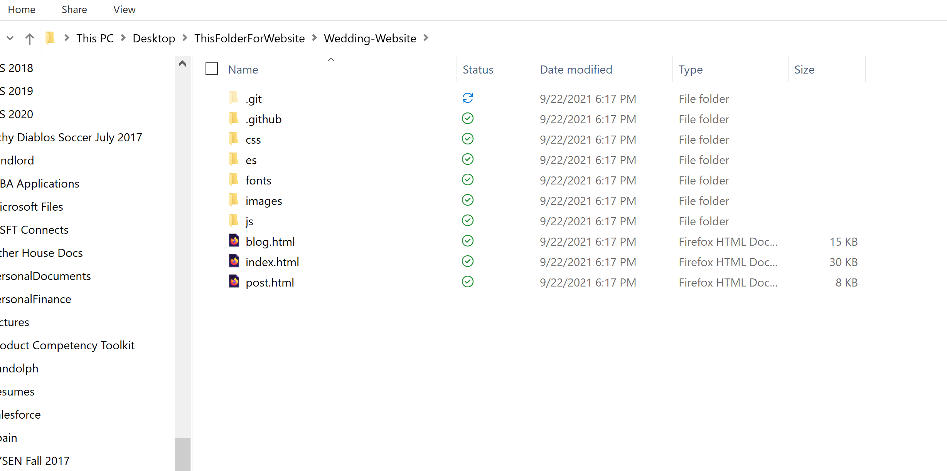
Step 1 (cont)
1c: Using Git Bash, copy GitHub Repository to computer
The command is:
git clone https://github.com/cap273/Wedding-Website.git

Slide 5
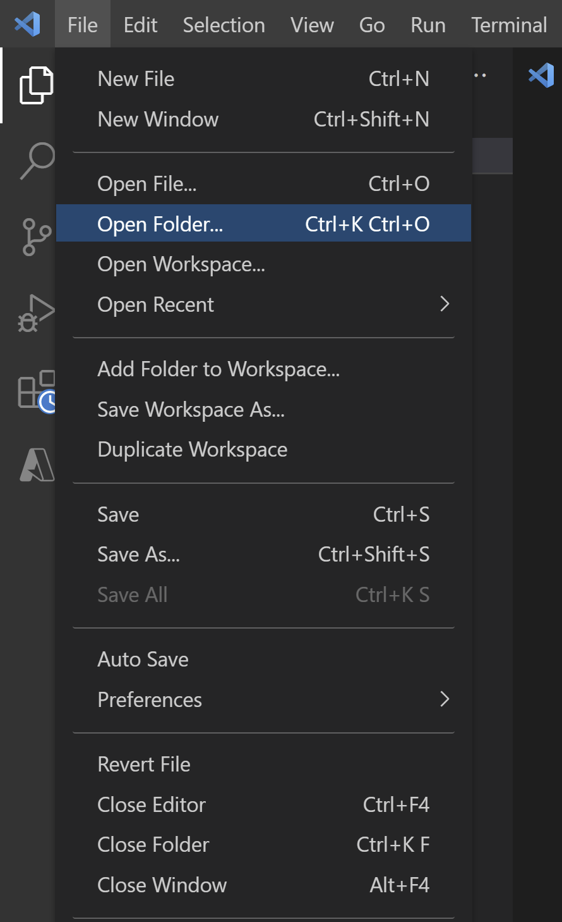
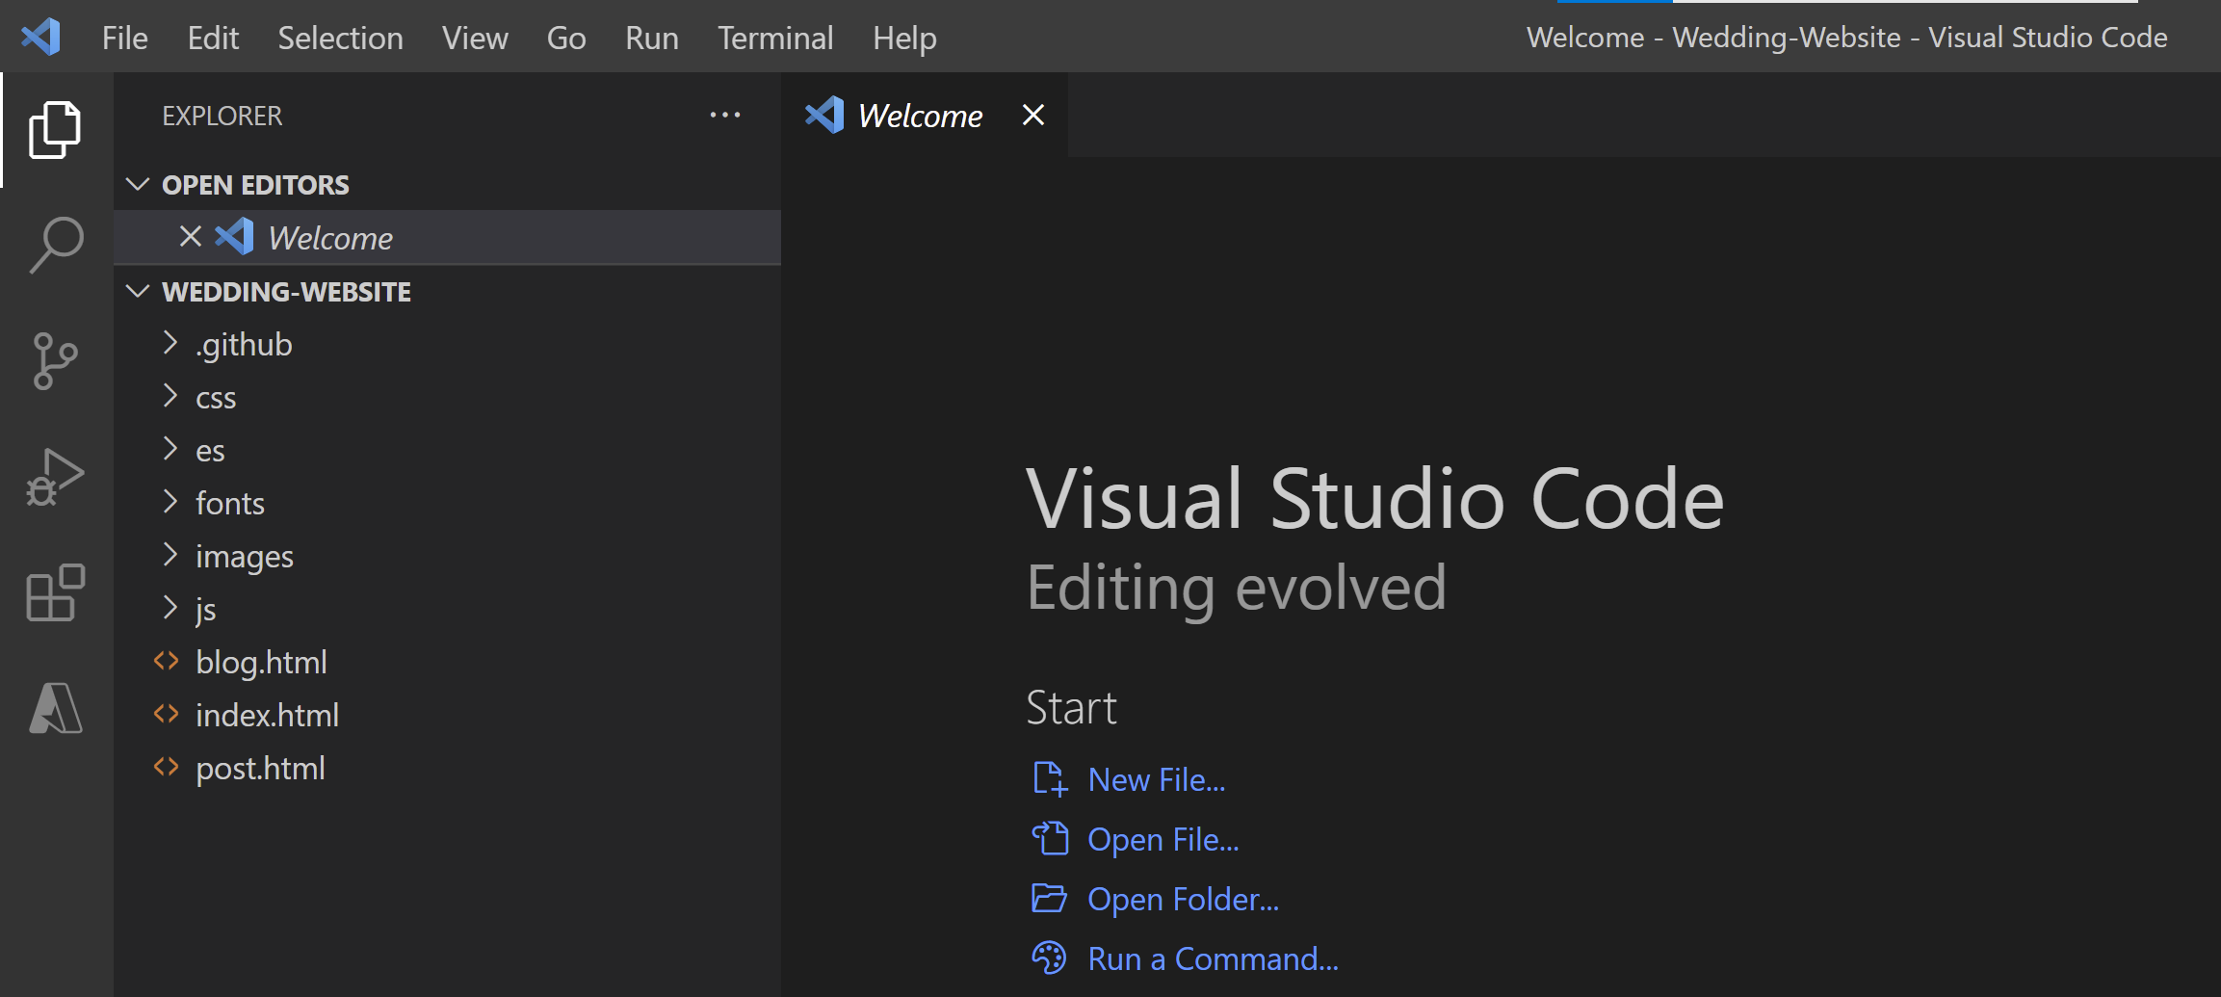
Step 2: Make Changes to Website
2a: Open wedding website folder with Visual Studio Code

Slide 6
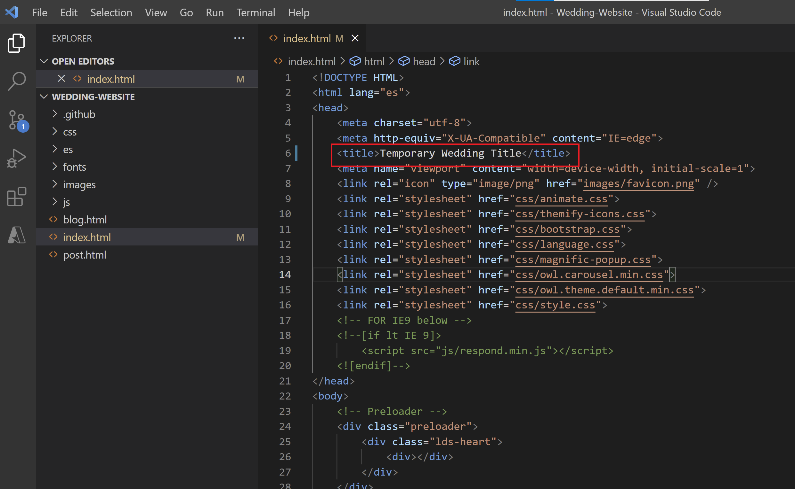
Step 2 (cont.): Make Changes to Website
2b: Make changes to index.html

Slide 7
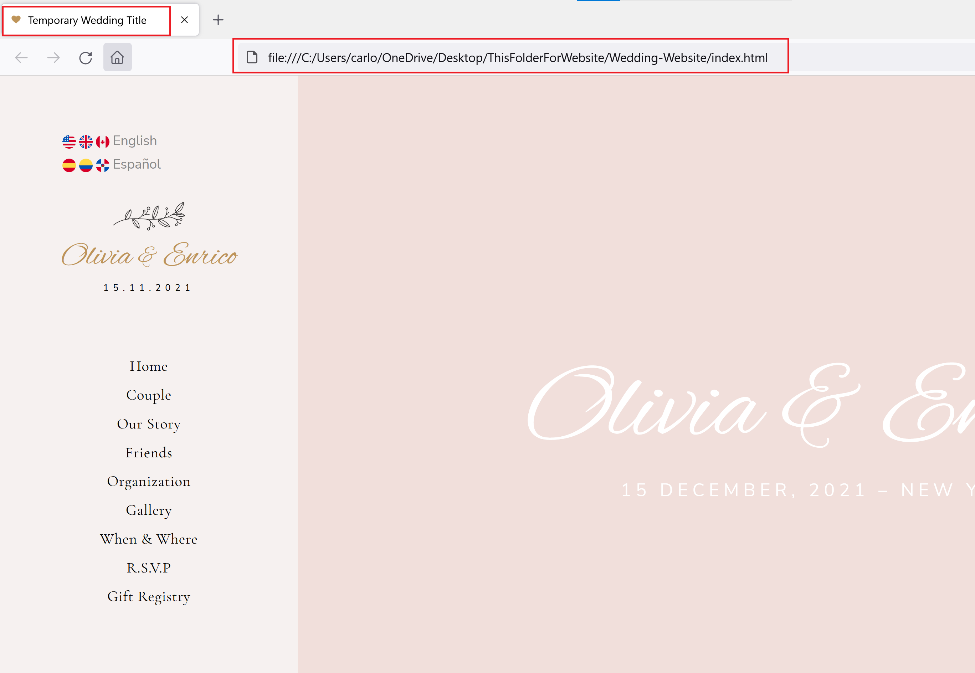
Step 2 (cont.): Make Changes to Website
2c: View Changes Locally by opening index.html

Slide 8
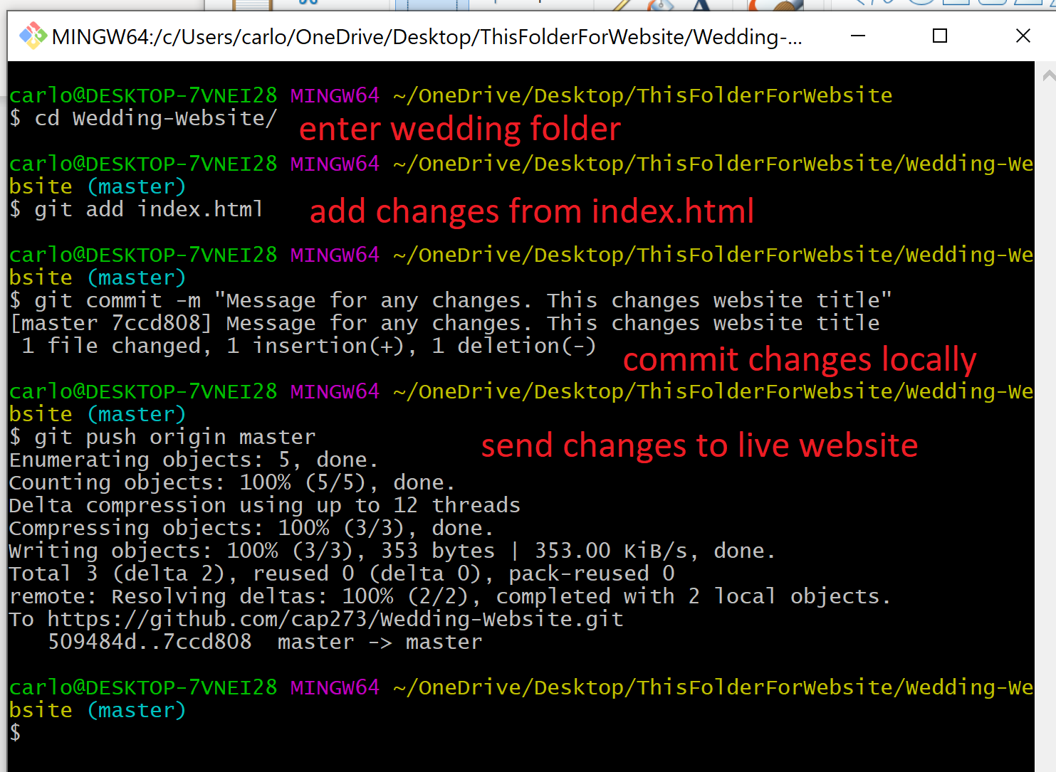
Step 3: Publish Changes to Live Website
3a: Using Git Bash, enter the folder with the wedding files, and then execute the following commands

Slide 9
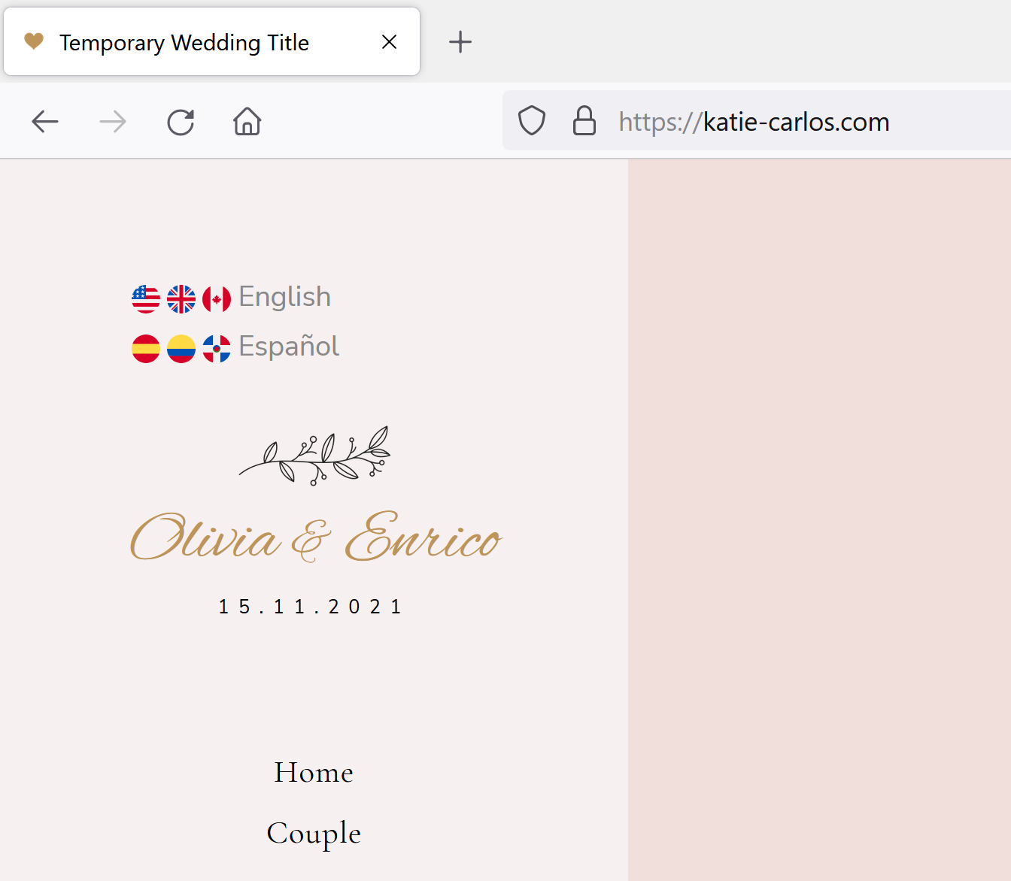
Step 3 (cont.): Publish Changes to Live Website
3b: Wait a minute or two, and then check live website

