Slide 1
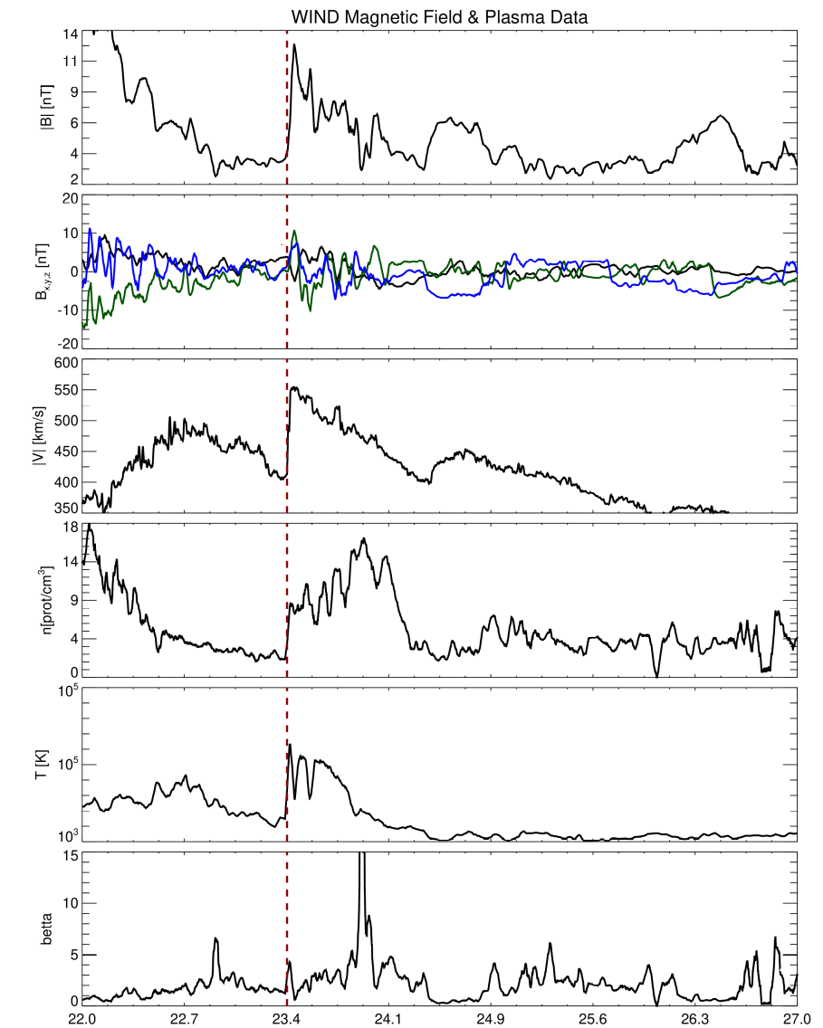
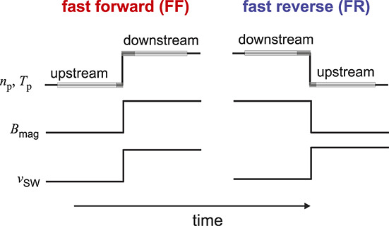
Interplanetary shocks
Characterized by an abrupt change in pressure, temperature, density and magnetic field intensity.
-Bx
-By
-Bz
DOY time
Jan 23, 2001
Kilpua, E., et al., 2015

Slide 2
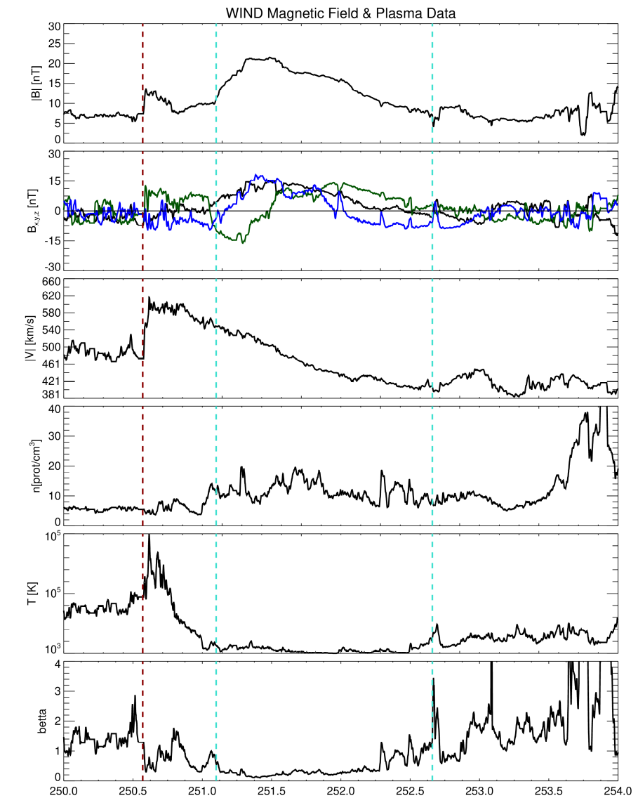
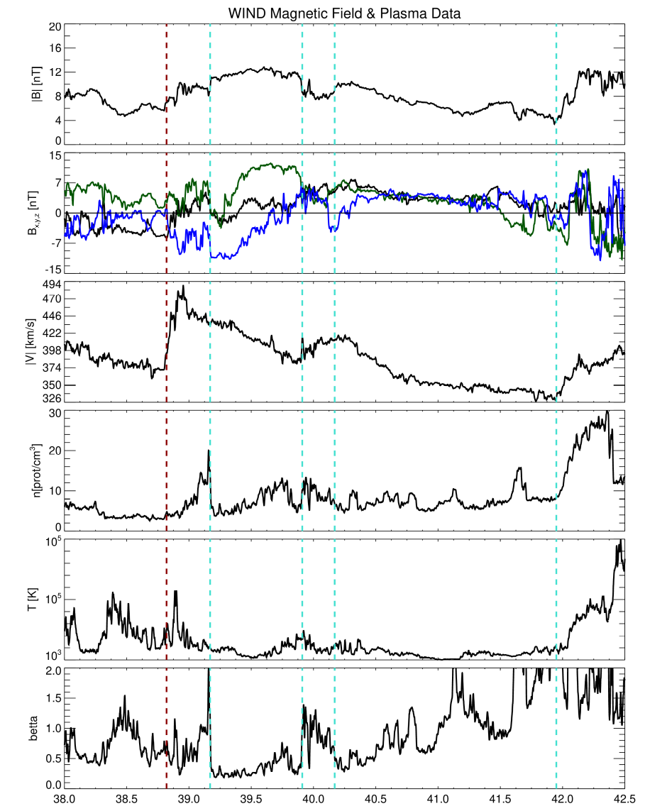
Coronal mass ejections
a)
a)
ICME
FR1
Shock
Shock
FR2
a) Increase of magnetic field strength B, characterized by a stronger than ambient magnetic field.
b) Smooth rotations in the magnetic-field components (presence of a flux-rope).
c) Declining velocity.
e) Low proton temperature.
f) Low βp <1 (presence of a flux-rope).
Sheath
Sheath
b)
b)
-Bx
-By
-Bz
-Bx
-By
-Bz
c)
c)
d)
d)
e)
e)
f)
f)
DOY time
Sep 09, 2015
DOY time
Feb 07, 1995
L. Jian et al. 2006

Slide 3
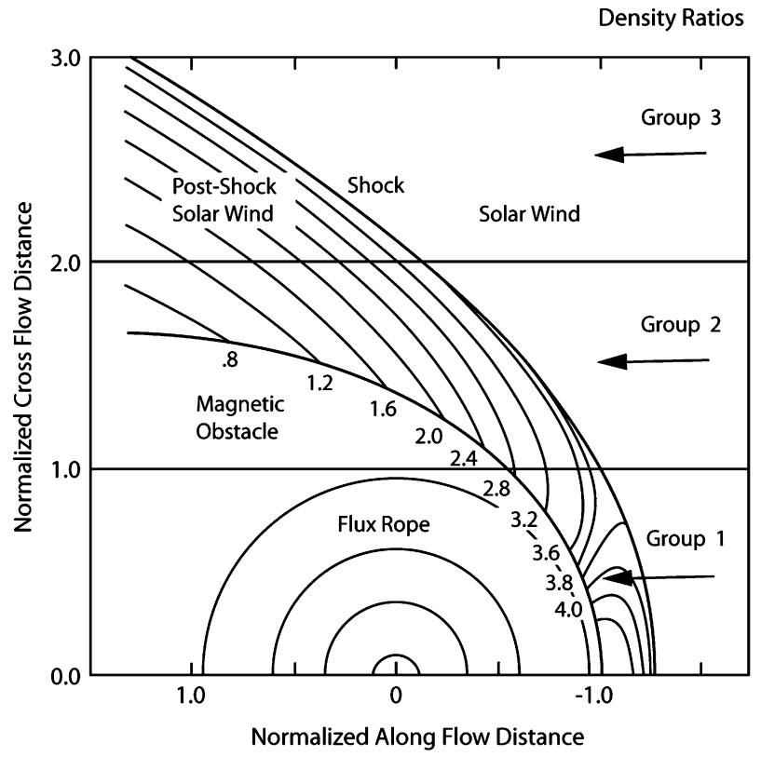
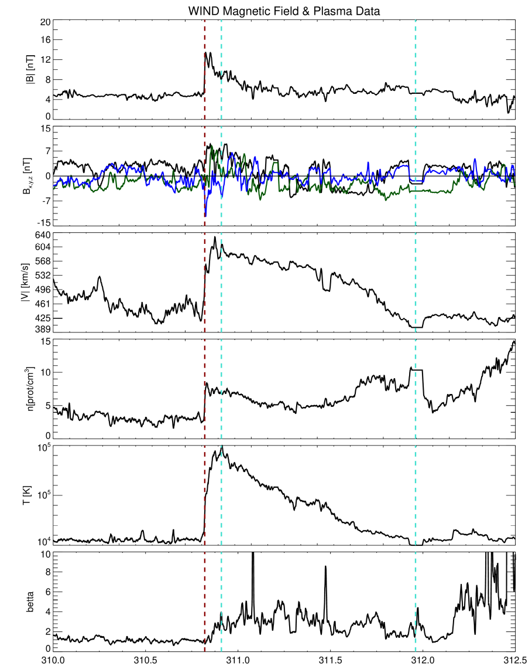
a)
Shock
ICME
b)
-Bx
-By
-Bz
c)
d)
e)
f)
Group 1 events encounter the magnetic obstacle.
Group 2 events encounter the ICME near the obstacle.
Group 3 events the shock detected away the obstacle.
[L. Jian, 2006]
DOY time
Nov 06, 2003

Slide 4
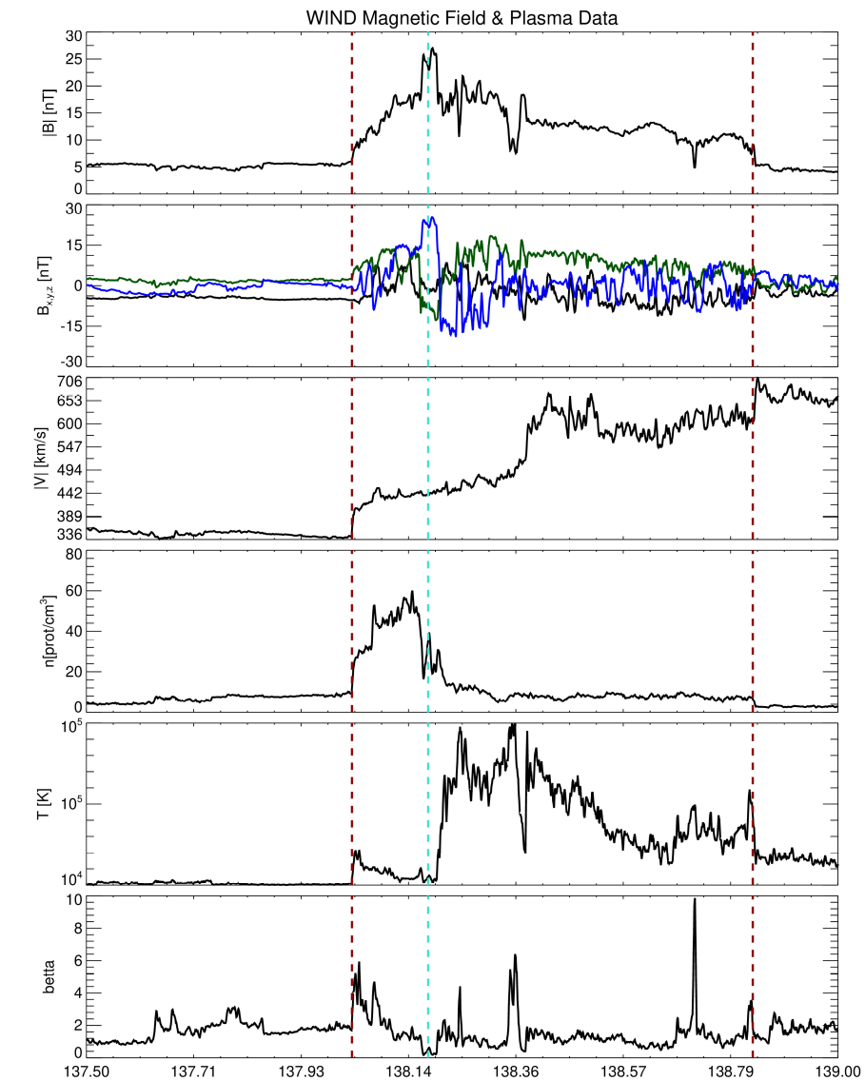
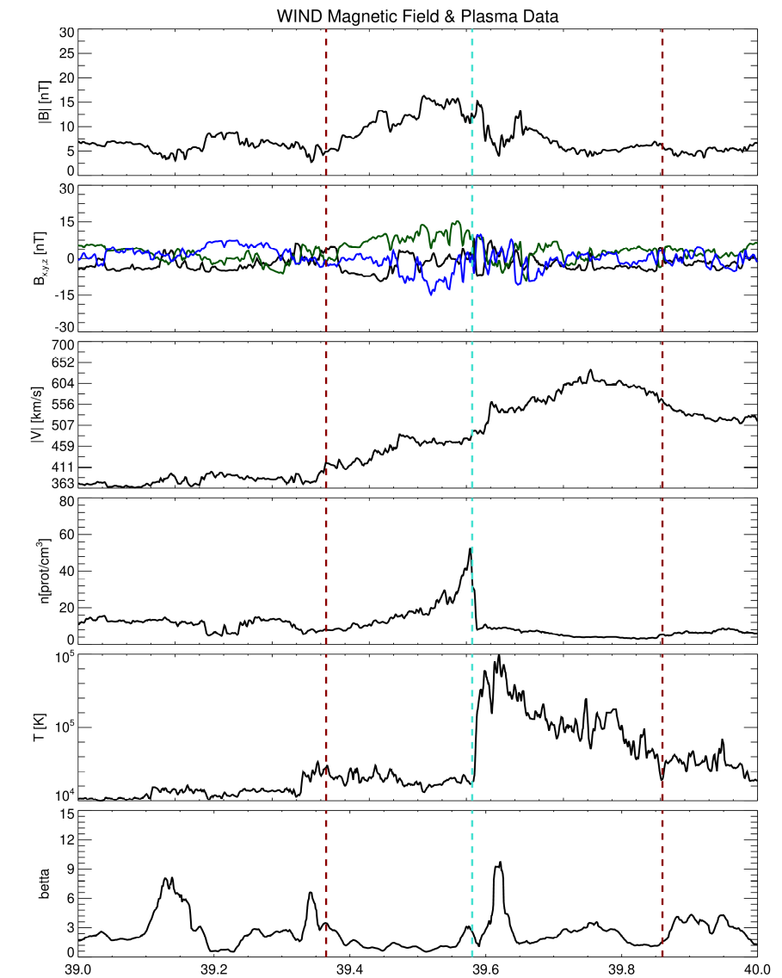
Stream interaction regions
SIR event with a pair of forward-reverse shocks
SIR event without shocks
a)
reverse-shock
a)
forward-shock
SI
a) Compression of magnetic field strength B.
c) Continuosly increased solar wind speed Vp.
d) Increase of proton number density Np.
e) An enhancement of proton temperature Tp.
f) Slight increases in entropy.
SI
b)
-Bx
-By
-Bz
b)
-Bx
-By
-Bz
c)
c)
d)
d)
e)
e)
f)
f)
DOY time
May 18, 1999
DOY time
February 8, 1997

