Slide 1
Picking a CHERI:
Security and Performance Considerations
Jacob Bramley
Dejice Jacob
Andrei Lascu
Jeremy Singer
Laurence Tratt
16/06/23
ISMM’23

Slide 2
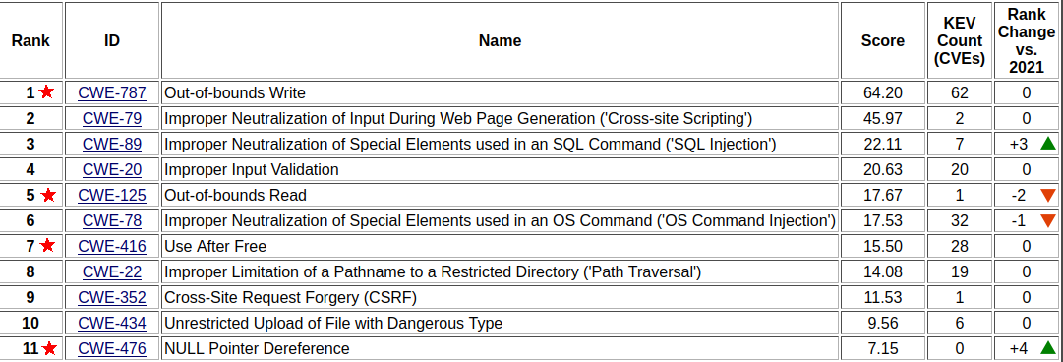
Motivation
Source: https://cwe.mitre.org/top25/archive/2022/2022_cwe_top25.html

Slide 3
CHERI
Notes:
Better linkage with the allocator story

Slide 4
CHERI
Capability Hardware Enhanced RISC Instructions
Notes:
Better linkage with the allocator story

Slide 5
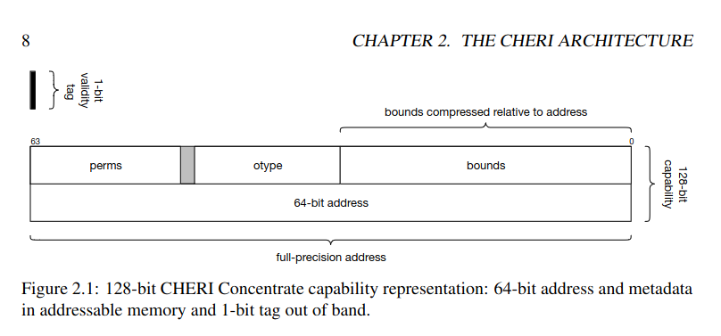
CHERI
Capability Hardware Enhanced RISC Instructions
Source: An Introduction to CHERI - https://www.cl.cam.ac.uk/techreports/UCAM-CL-TR-941.pdf

Slide 6
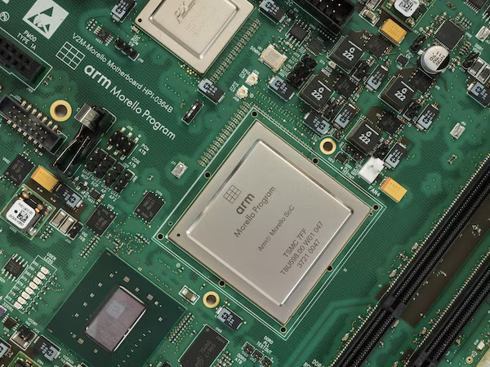
CHERI
Capability Hardware Enhanced RISC Instructions

Slide 7
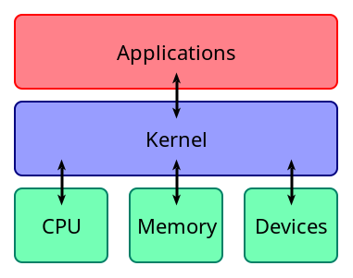

CHERI
Diagram source: https://en.wikipedia.org/wiki/Kernel_(operating_system)

Slide 8
CHERI allocators
jemalloc | dlmalloc | snmalloc
xalloc | dmalloc | ElectricFence
ptmalloc | libmalloc_simple

Slide 9
CHERI allocators
jemalloc | dlmalloc | snmalloc
xalloc | dmalloc | ElectricFence
ptmalloc | libmalloc_simple

Slide 10
Security

Slide 11
Security
uint8_t *arr = malloc(256);
for (uint8_t i = 0; i < 256; i++)
arr[i] = i;
arr = realloc(arr, 1);
arr = realloc(arr, 256);
for (uint8_t i = 0; i < 256; i++)
assert(arr[i] == i);
✓ snmalloc
⛌ libmalloc_simple
⛌ jemalloc

Slide 12
Security
uint8_t *arr = malloc(16);
assert(cheri_perms_get(arr) & CHERI_PERM_STORE));
arr = cheri_perms_clear(arr);
assert((cheri_perms_get(arr) & CHERI_PERM_STORE) == 0);
arr = realloc(arr, 16);
assert(cheri_perms_get(arr) & CHERI_PERM_STORE);
✓ snmalloc
✓ libmalloc_simple
⛌ jemalloc

Slide 13
Security
uint8_t *arr = malloc(16);
assert(cheri_tag_get(arr));
arr = cheri_tag_clear(arr);
assert(!cheri_tag_get(arr));
arr = realloc(arr, 16);
assert(cheri_tag_get(arr));
✓ snmalloc
✓ libmalloc_simple
✓ jemalloc

Slide 14
Performance

Slide 15
Performance
Purecap
void *
Hybrid
void __capability__ *

Slide 16
Performance - machine
quad-core Armv8-A 2.5GHz CPU
64KiB L1 data cache
64KiB L1 instruction cache
1MiB L2 unified cache per core
two 1MiB L3 unified caches (shared between a pair of cores)
16GiB DDR4 RAM
CheriBSD 22.12

Slide 17
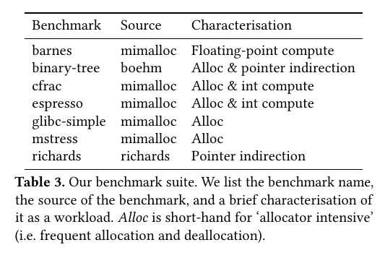
Performance - benchmarks

Slide 18
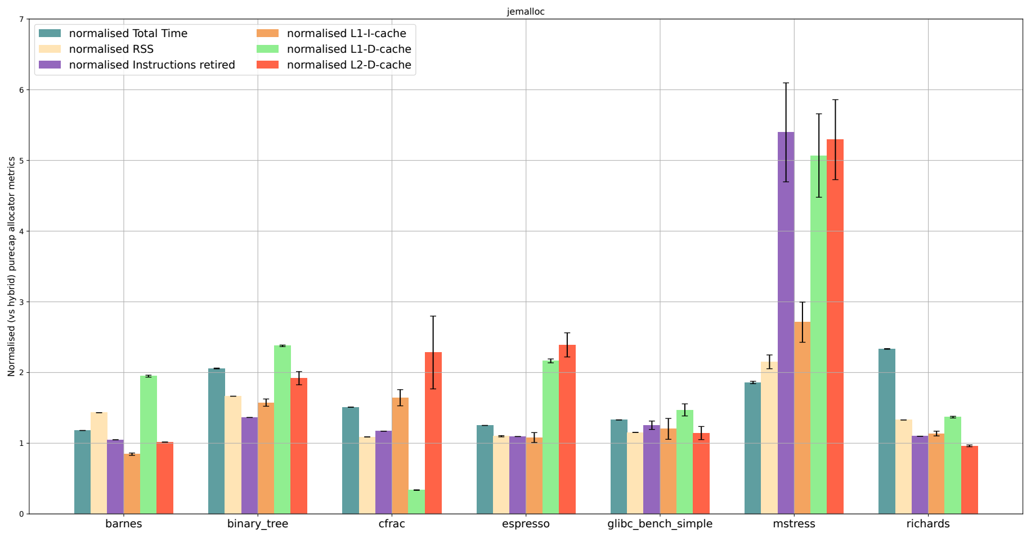
Performance - jemalloc

Slide 19
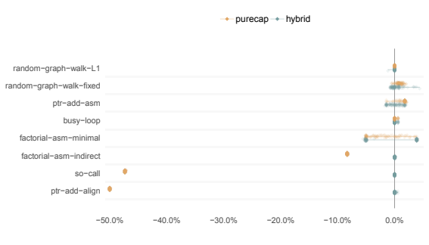
Performance

Slide 20
Conclusions
Security implementation versus expectations
Performance tooling and space
snmalloc as default?

Slide 21
Questions?
https://github.com/capablevms/cheri_misidioms

