Slide 1
jQuery $(Begins)
Notes:
1

Slide 2
Admin Items
Notes:
1

Slide 3
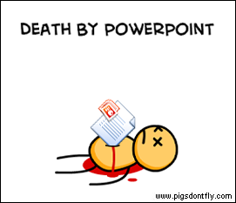
Not the Way to Learn Coding
Notes:
1

Slide 4

True Way to Learn Coding
Notes:
1

Slide 5
A New Era of Class
Be prepared to have classes that are increasingly “just code”
You will appreciate it in the long-run
Notes:
1

Slide 6
Today’s Class
Notes:
1

Slide 7
Objectives
In today’s class we’ll be covering:
DOM Manipulation using Plain Javascript
DOM Manipulation using jQuery
Responding to click events
Notes:
1

Slide 8
DOM Manipulation
Notes:
1

Slide 9
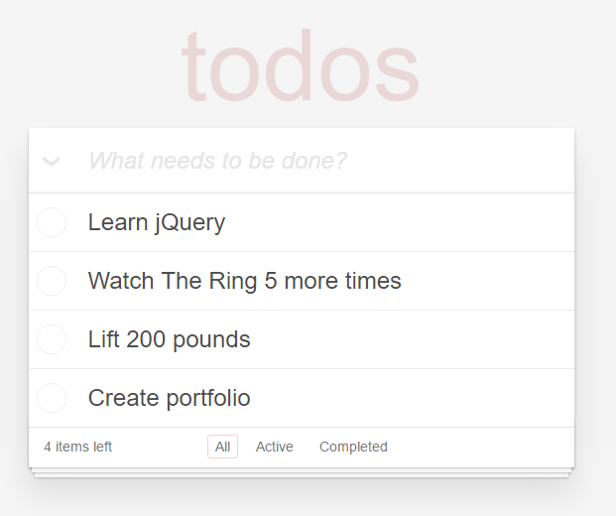
Understanding the “DOM”
Every HTML page begins as static content..
However, with Javascript / jQuery we can “modify the DOM” and change this static content in real-time.
This allows us to build dynamic sites.
Basic Example: http://todomvc.com/examples/jquery/#/all
Notes:
1

Slide 10
Where’s my HTML page’s DOM?

Slide 11
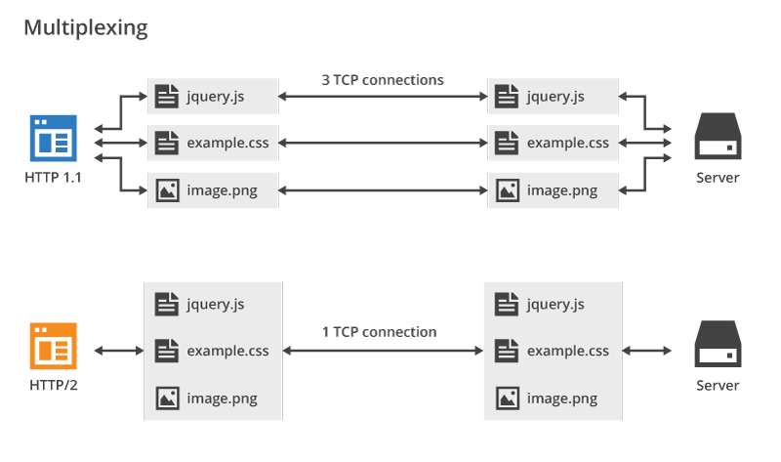

Slide 12
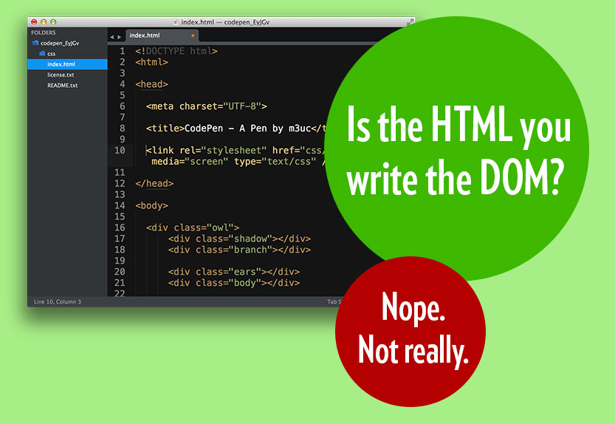

Slide 13
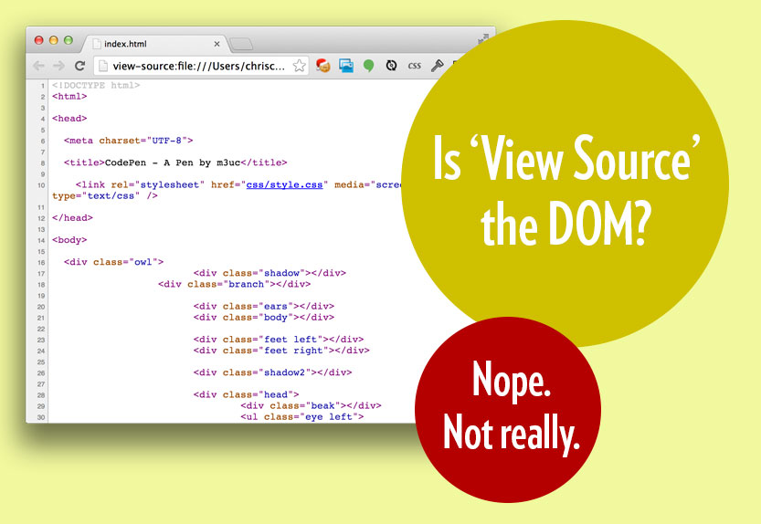

Slide 14
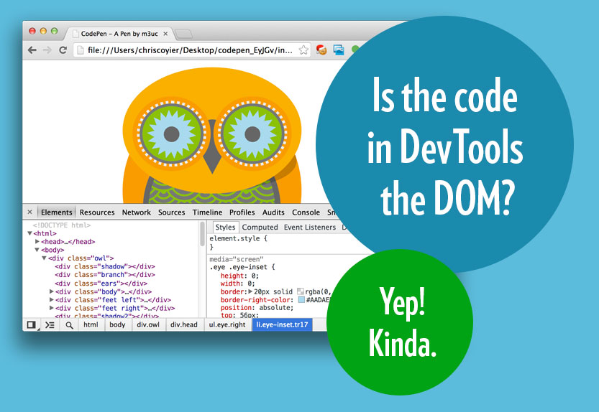

Slide 15
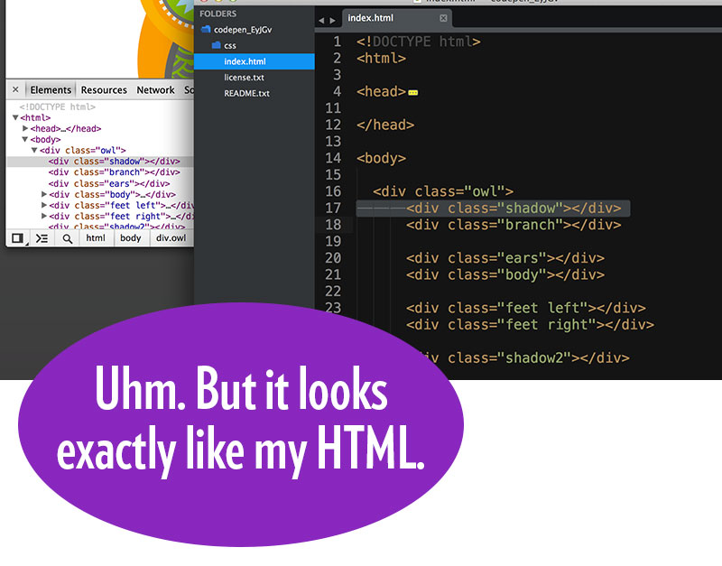

Slide 16
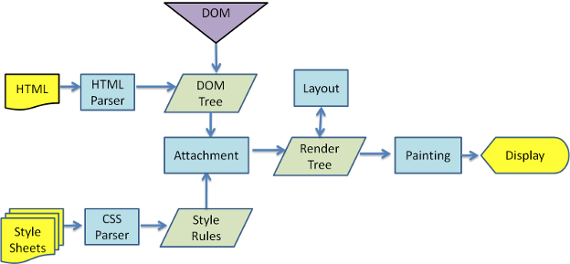
What the browser does with your HTML and CSS

Slide 17
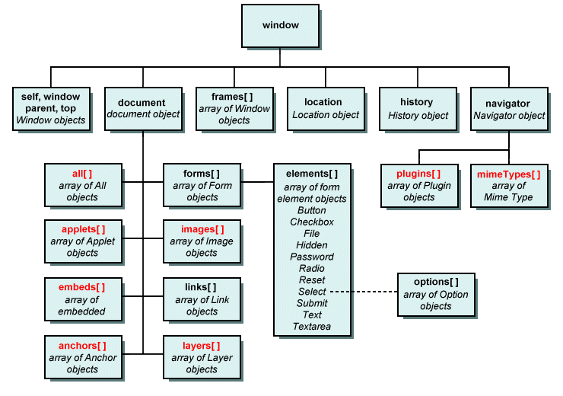
What the DOM actually looks like

Slide 18
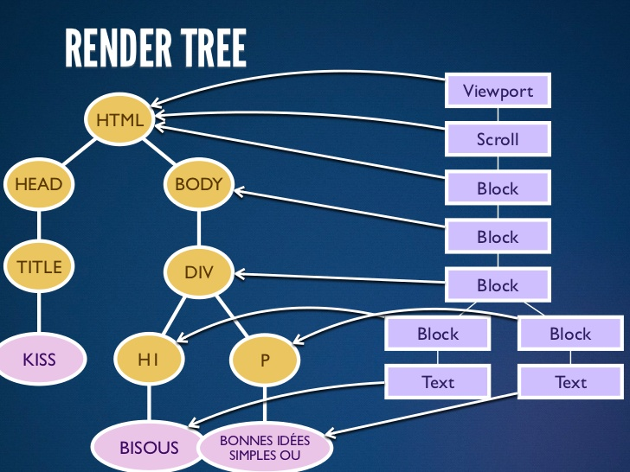

Slide 19
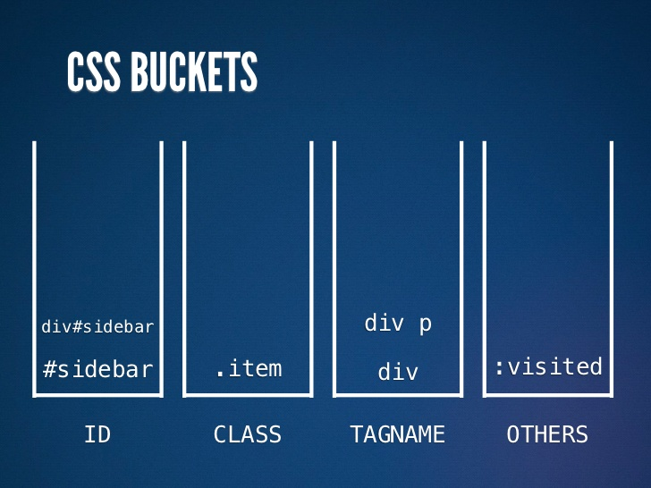

Slide 20
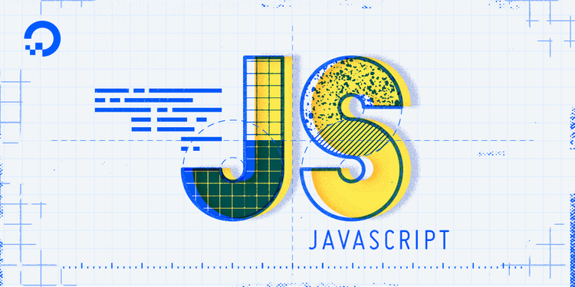

Slide 21
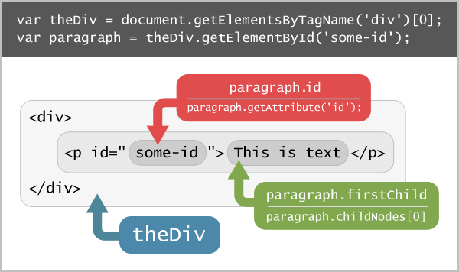

Slide 22
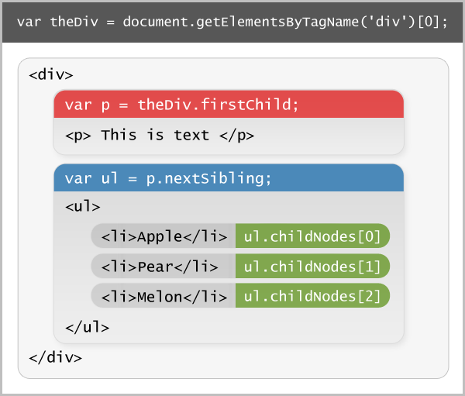

Slide 23
Demo Time
Instructor: Demo
(1-5.html | 1-JSGenerators)
Notes:
1

Slide 24
> YOUR TURN!!
Activity: 2-JSDrinkList | Suggested Time: 15 min
Code Creation: Generating HTML with Javascript
Using the file sent to you as a starting point, add the missing code such that your Javascript generates HTML content that displays all of the drink options.
HINT: You will need a for-loop. Inside your for loop you will need to use each of the following methods: createElement, innerHTML, and appendChild.
Notes:
1

Slide 25
Intro to jQuery
Notes:
1

Slide 26
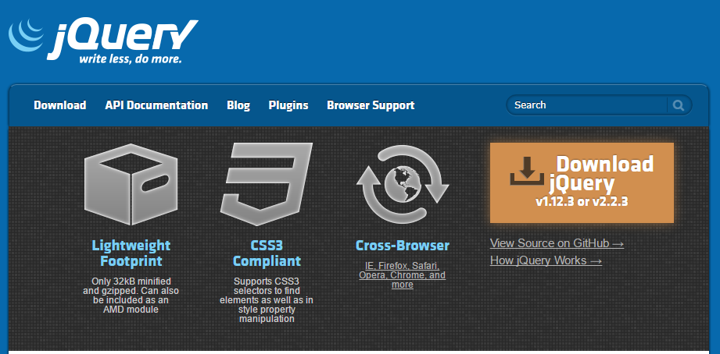
Intro to jQuery
https://jquery.com/
jQuery is a cross-platform Javascript library for easier of client-side HTML scripting.
Notes:
1

Slide 27

jQuery Helper Library
jQuery can be useful for tasks like:
Dynamically Inserting, Updating, or Removing HTML
Registering click or other change events
Animating HTML elements
Download data from databases
And much more!
Notes:
1

Slide 28


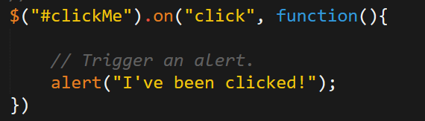
Working with jQuery generally involves…
1. Including a CDN Link to the jQuery script…
2. Utilizing the jQuery specific ($) selector…
3. Then applying jQuery methods on the selected elements.
Notes:
1

Slide 29
Demo Time
Instructor: Demo
(1-3.html | 3-jQueryGenerators)
Notes:
1

Slide 30
> YOUR TURN!!
Activity: 4-jQueryDrinkList | Suggested Time: 12 min
Code Creation: Generating HTML with jQuery
Re-factor (re-write) your previous drinkList code from earlier, but this time use jQuery to complete all of the same tasks.
Your final code should NOT have any of the following methods: createElement, innerHTML, or appendChild.
HINT: Don’t forget to “incorporate” jQuery before you begin.
BONUS: Instead of using a `for` loop try searching about the use of the jQuery `.each` method.
Notes:
1

Slide 31
Demo Time
Instructor: Demo
(OnClick.html | 5-OnClickBasic)
Notes:
1

Slide 32
> YOUR TURN!!
Activity: 6-SandwichClick | Suggested Time: 20 min
Code Creation: Click Events with jQuery
Add in the missing code such that clicking any of the sandwiches causes…
An alert message to popup saying something snarky about the sandwich type.
A second alert message that displays to the user the number of that specific sandwich they’ve eaten.
HINT: You will need counter variables.
BONUS: Add an image to the `image-div` on the click event.
Notes:
1

Slide 33
> YOUR TURN!!
Activity: 7-TriggerRandom | Suggested Time: 12 min
Code Creation: Generating Numbers with jQuery
Add in the missing code such that clicking the big blue button triggers a random number (between 1 and 1000) to be selected and prominently displayed in the randomNumber div.
Hint: None. You got this.
Notes:
1

Slide 34
> YOUR TURN!!
Activity: 8-LotteryGenerator | Suggested Time: 20 min
Code Creation: Lottery Numbers with jQuery
Using the code from the previous random number generator as a starting point, create a lottery generator.
In our case, the lottery number should pick 9 random numbers (and always 9 numbers). As an example 886563264.
Display this number in the randomNumber div.
Then when a user clicks again, have the code create a new row with the latest number at the top.
Notes:
1

Slide 35
Questions?
Notes:
1

Slide 36
Extra!
Notes:
1

Slide 37
> YOUR TURN!!
Activity: 9-NumberChecker | Suggested Time: 20 min
Code Creation: Checking Numbers with jQuery
Using the displayed application as an example, create code in which:
A computer picks a random number between 1 and 4
Users then “click” buttons numbered 1 – 4.
If the user’s number matches the computer’s number display text informing them of this in the Result panel. Otherwise, display text informing them they lost.
If you finish early, try to improve the aesthetics.
Notes:
1

Slide 38
Questions
Notes:
1

