Slide 1

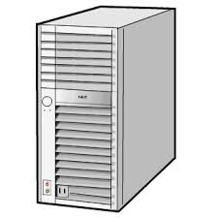
<form action="http://www.tut.ac.jp/Service" method="GET">
GET,POST,PUT,DELETE
HTML
HttpServletRequest
Client
Filter
Servlet
HttpServletResponse

