Slide 2
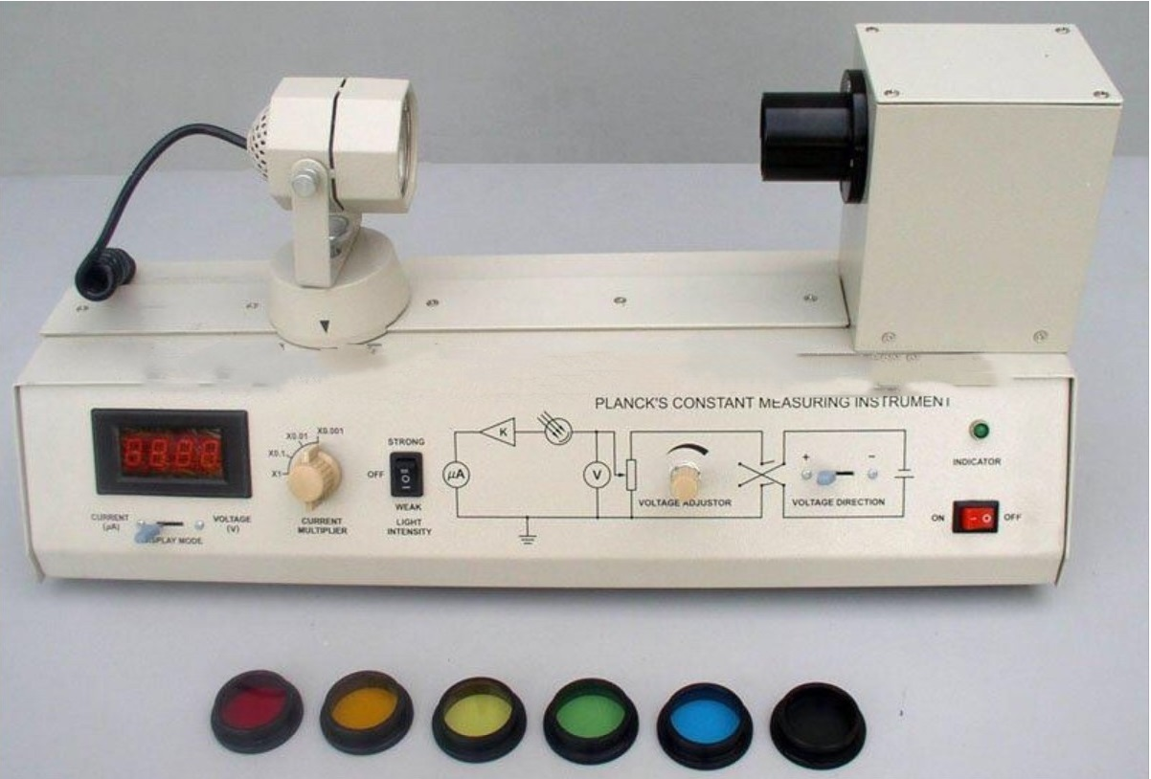
Apparatus
This set-up is a compact portable kit and a tabletop model.
It has various components packed into it.

Slide 3
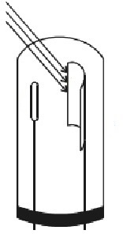
Light source 12V/35W Halogen Tungsten Lamp
Draw Tubes
Guide
Cover(for photo-emissive cell)
Anode
Cathode
Current
Multiplier
Voltage Direction Switch
Light Intensity Switch
Voltage Accelerator
Digital Meter
Color Filters
Lens Cover

Slide 4
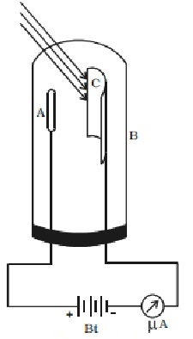
The photo-emissive cell used in our experiment is a vacuum type cell.
The photo-emissive cell consists of a glass or quartz bulb depending upon its use with visible or ultraviolet light. This bulb encloses a cathode C in the form of a semi-cylindrical plate having large surface area and an anode A in the form of a straight wire
When the cell is to be used with visible light, a sensitive material like sodium, potassium or cesium is deposited on the cathode surface while for use with ultraviolet light cadmium is deposited

Slide 5
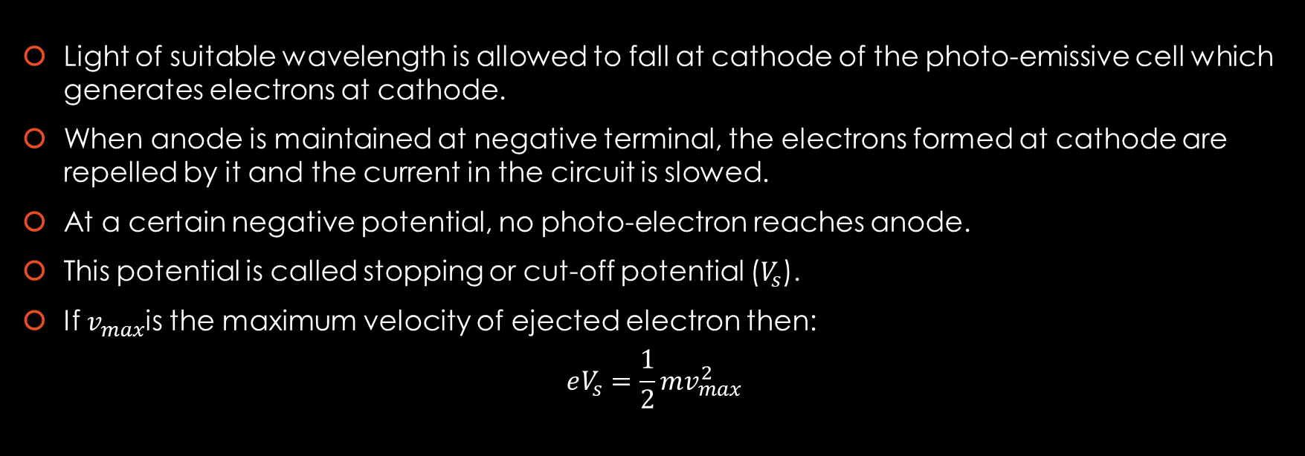
Theory
Light of suitable wavelength is allowed to fall at cathode of the photo-emissive cell which generates electrons at cathode.
When anode is maintained at negative terminal, the electrons formed at cathode are repelled by it and the current in the circuit is slowed.
At a certain negative potential, no photo-electron reaches anode.
This potential is called stopping or cut-off potential ($V_{s}$).
If $v_{max}$is the maximum velocity of ejected electron then:
$$eV_{s}=\frac{1}{2}mv_{max}^{2}$$

Slide 6

The velocity of ejected electrons increases with increase in frequency of incident light. When the frequency is below a certain value called critical or threshold frequency, no electrons are ejected .
If $ν_{o}$ is threshold frequency required to eject an electron from the surface of cathode then work function is :
$W=hν_{o}$
If frequency $ν > ν_{o}$ falls on photo-sensitive material then, a part of the energy is used by the electron to come out of the metal surface and rest is imparted as kinetic energy to the electron.
$hν=$ $\frac{1}{2}mv_{max}^{2}+W=eV_{s}+hν_{o}$
$$V_{s}=\frac{h}{e}ν−\frac{h}{e}v_{o}$$
Now slope of this equation is $\frac{h}{e}$ which is then used to find work function of the photo-sensitive material.
$$W=e(intercept)$$

