Slide 1
Guidelines/Best Practices for
Storyboarding for HTML5 courses

Slide 2

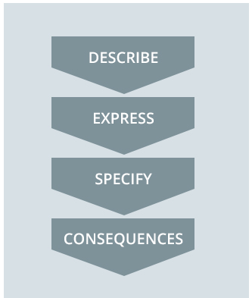
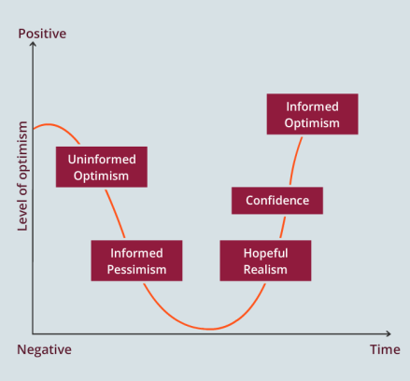
Before creating the storyboard. (For IDs)
If possible use icons instead of images
Actual Chart Images
Box and text Size For PPT chart layout
Maximum Box Size
Copy-paste & create it for Mobile Layout only. (RMD will take care for the desktop & tablet)
Minimum font size
We need to make an Image when we are creating Charts
So when it scale down it should be readable in mobile.

Slide 3
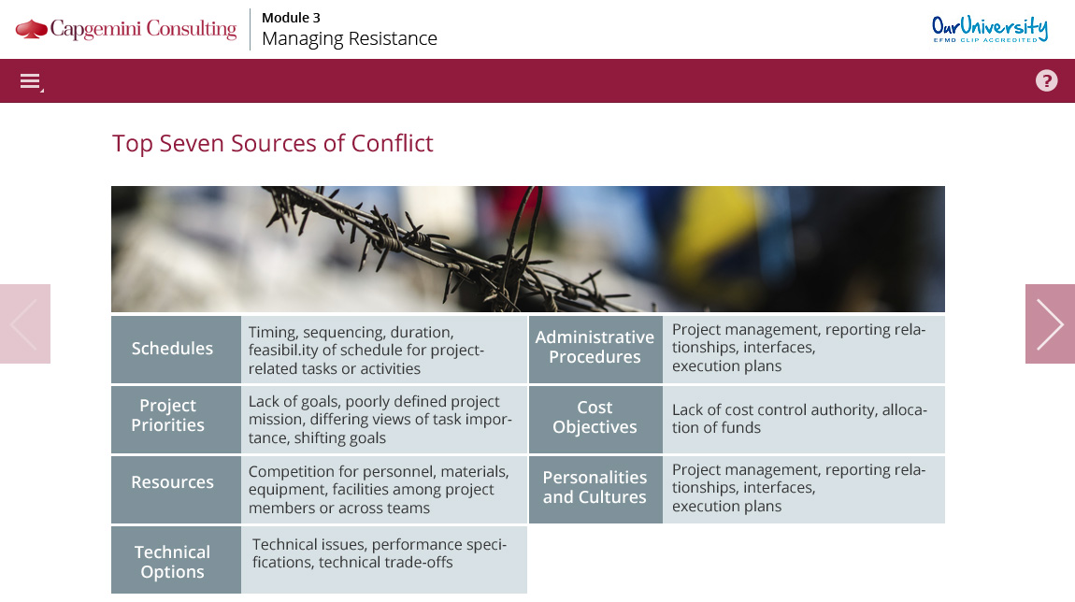
White Spaces & Fonts
Think about the
empty space
Mobile Fonts for OST
Font: Open Sans
H1: 11 px
H2: 10px
Bullet & Paragraph: 9px
Note: You can enlarge font if required, but don’t reduce it below 9 px.
Tablet & Desktop Fonts for OST
Font: Open Sans
H1: 12 px
H2: 11px
Bullet & Paragraph: 10px
Note: You can enlarge font if required, but don’t reduce it below 10 px.

Slide 4
Mobile View
Desktop & Horizontal Tablet View
Don't add any content in red marked area. This area is blocked by the Next and Back button and has some mobile touch jesters controls.
The Content place below this Blue Line will be visible only when the user will scroll the page.

Slide 5
Storyboard Template

Slide 7
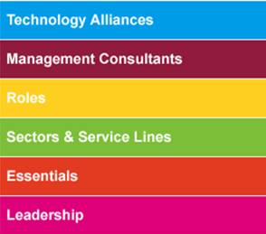

Provide the additional branding
(Its Important to start the production)
Main UI Navigation
(Add / Edit any UI navigation Buttons as required)
#009ce8
#901b3d
#fecf21
#7dbe38
#e33a22
#de0079
Menu | Help | Glossary | Job aids | etc..
Any additional Inputs for RMD or CI.
Example: If there is any specific course which we need to look. Any previous references etc...
Capgemini Branding guidelines
Sogeti Branding guidelines
Provide the colour code if its different from the List above.
# | Name if any

Slide 8
Menu
Page 1 | >
Page 2 | >
Page 3 | >
Page 4 | 3
Page 5 | >
Page 6 | >
Page 7 | >
Page 8 | 6
Page 9 | >
Page 10 | 2
Page 11 | 1
Page 12 | >
Page 13 | >
Page 14 | >
Page 15 | 10
1. Page 1
2. Page 2
3. Page 3
1. Page 1
2. Page 2
3. Page 3
4. Page 4
5. Page 5
6. Page 6
1. Page 1
1. Page 1
2. Page 2
3. Page 3
4. Page 4
5. Page 5
6. Page 6
7. Page 7
8. Page 8
9. Page 9
10. Page 10

