Slide 1
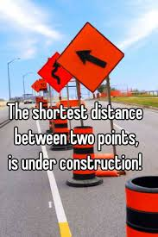
Presented by Robert Fowler
How does your crow fly?
10 May
2018
Notes:
Hi all,
Cool , so I am Rob. Outside of the confines of CSG I am basically a noob at presenting at gatherings like this. Having said that I really would like your feedback if this is helpful or not – so pay attention.
Tonight I want to challenge your thoughts on how you arrive at solutions and how you add value to your projects. It interests me how people think about things and how my thinking has been influence by certain very specific things on my journey. It also interests me that you can change the way that you think.
I don’t really care if you are an analyst, a developer, a tester, a scrum master, technical writer or a manager – I think that this will benefit you. The only two things I haven’t officially been in that list is a tester and a technical writer. I have worked at a startup and a corporate and what I want to share this evening I believe will benefit all of you.
Maybe you already know what I am going to say, this is not something new – along my journey these are three shifts in thinking that I had. These are stand-out moments to me – maybe they wont be as impactful for you but I have observed how these can be stumbling blocks for individuals and teams so I want to share these with you and hope that that they add value to what you do day-in and day-out.
Thanks for listening.

Slide 2
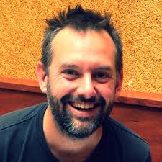

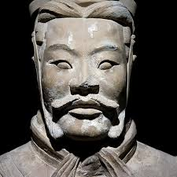

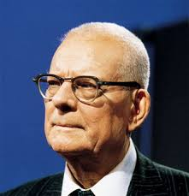

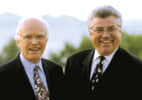
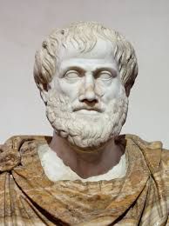
Influences
Notes:
Alistair Cockburn describes software development as a “Collaborative Game”. Some of the thoughts this evening should help you and your team play that game.
Jez Humble, Martin Fowler, Sun Tzu, Neal Ford, Edwards Edming, Robert C. Martin, DeMarco and Lister, Aristotle

Slide 3

I want to challenge your discipline when thinking about the problem space vs. the solution space
The Why
I want to strain your brain
I want you to remember: return 42;
Why am I here
Notes:
Let’s Start with Why? – Why am I here this evening (give away – who said that)
This evening my goal is to do three things:
I want to challenge your discipline when it comes to spending time in the problem space
I want to strain your brain -
Plant a splinter in your mind- so that in your day-to-day you will remember return 42;

Slide 4
3 things…
…in my opinion that can help you
Understand the problem
Re-think the problem
Construct an out of the box solution
Notes:
Our world is mostly about solving problems – right?
We do this all day every day- we build tools to solve business problems and in doing so we solve technical problems.
In our collaborative game, we know most about the problem we are going to solve and the way in which to solve it at the end.
So, the 3 things that I want to spend a few minutes on this evening are: making sure we understand the problem that we are trying to solve, re-thinking the problem making sure we are building on truth and then construct solutions using what we know focusing on thinking outside of the box to reach the goal of adding value quickly.
In 10 minutes I want you to make you think, make a decision …..every time you come up with a solution to a problem you think you understand. This is the splinter.

Slide 5
Problem Space
Problem space vs. solution space
Solution Space
Notes:
The first thing I want to talk to you about is two spaces: The problem space and the solution space. Although not in chronological order this is the first element that I want to talk about that altered my way of thinking.
The natural inclination that I have and that I have observed is that individuals and teams like to spend time in the solution space and fashion solution to problems. This is certainly my go-to place and I like to be the first to the solution – it’s not a race…maybe…
Have you ever experienced this? Maybe in a grooming session or a planning sessions – the team is 10 steps down the solution road but there is that uneasy feeling or there seems not to be consensus about what it is we are actually trying to solve for? C’mon BE REAL – this is a safe space.
How does this turn out for you? We are at standup or almost done with the sprint and folks be like: What problem are we trying to solve again? But I thought?
Anyone else witness this problem? <Show of hands>
Me
Years ago I attended a course on Analytical Thinking and Creative Problem Solving – got the certificate and all.
The key that I took away from that course was to spend the bulk of the time examining and understanding the problem space rather than spending time on the solution space (or at least too early on). This was foreign to me – very foreign to me but the more I understood the value of understanding the problem, what was real, what was not real – assumptions, biases, pre-conceived ideas I recognized the value of truly understanding the problem space before switching over to solution mode. Too often I recognize folks jumping in to solution mode without truly understanding what is really being asked of them.
As it turns out this is a discipline that you can develop and help your teams develop.
The advice
Spend more time (or the appropriate time) in the problem space before moving into the solution space.
I am not saying that we need to build Big Upfront Design – what I am saying is explore the problem space. I am also not saying that we need to know everything before we move on, our world is filled with ambiguity and being comfortable with ambiguity is another skill we need, but what I am saying is understanding the problem that you are trying to solve. This is the beast you need to slay. It takes courage to ask questions in a group setting – but this is necessary. The more we can help our teams understand what the problem is we are trying to solve the better off the team is.
Understanding the problem space, also opens up the opportunity for creativity and set-based design.
We cool with this.

Slide 6
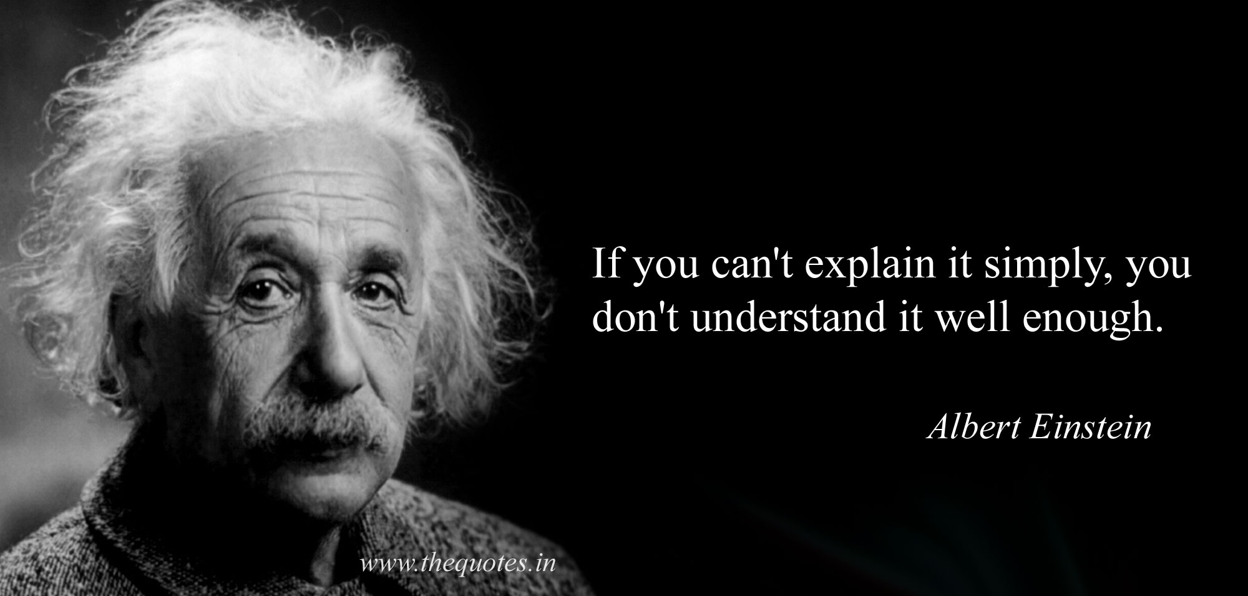

Slide 7
Mission accomplished?
I want to challenge the way you think about the problem space and the solution space
Notes:
Alright, are we happy with this? First mission is to develop a discipline to spend time exploring the problem space before moving into the solution space.

Slide 8
We ALL KNOW…..
…..BUT do we REALLY know?
First principles
“The most valuable thing I learned when studying engineering.” - Rob
Notes:
The second thing I want to talk to you about this evening is that of First Principles – it ties nicely into the problem vs. solution space but looks at different aspect of the problem space.
Again in team setting have you ever heard: “We all know blah blah blah…”, or “We already know …..”.but do we really know?
What are we basing our thinking and our solutions on – are we building on the rock or are we building on the sand? Are we thinking? Are we being creative? Or are we simply going through the motions?

Slide 9
First principles thinking, which is sometimes called reasoning from first principles, is one of the most effective strategies you can employ for breaking down complicated problems and generating original solutions.
It also might be the single best approach to learn how to think for yourself.
First principles
“The most valuable thing I learned when studying engineering.” - Rob
Notes:
The second thing that altered my thinking was the concept of First Principles that I learnt while studying engineering and have valued it ever since.
What is it?
First principles as the definition points to is about tearing things down to key parts and then using these key parts to build a solution. I could never do first principles justice in under 10 minutes but I will encourage you to go and have a look at some of the work on this – Artistotle was one of the first first principle thinkers – so you know its good ;-)
In as small a nutshell I can condense it – first principle thinking is about straining your brain – asking what we know for sure? What are the truths that we have to work with? Look at the fundamental parts then reason a solution using the truth. ….and the truth will set you free!
Me
I recall vividly a structural engineering test I wrote – the material covered some structural equations and how one would use these to make sure your structure didn't fall down and kill anyone. I understood full well how to apply the equations – had them programmed into my HP 48 GX programmable calculator and all and I was ready to go. There was one question on that paper: From first principles derive the structural equations. Needless to say I have carried that big fat 0 mark with me since then – but it serves as a reminder to me to be sure that we understand what it is we are building with and that we are building on a solid foundation.
For you
This takes work, it takes work asking the questions, it takes work boiling things down, and again you may be the one voice in the team that seems to be asking or questioning – what everyone already knows – but there is value here.
Remember – there is a difference here – I am not saying don’t get started before you know everything. We deal in uncertainty to be sure. What I am saying is understand the problem you have and then be sure to boil down what you know into truths.
But don’t just take if from me – it is worth checking out comment from Elon Musk – Space X and Elon’s first principle thinking has been disruptive because of what he has questioned and shown what is false/possible/other

Slide 10
Mission accomplished?
I want you to be aware and empowered to make sure you are dealing in truth and building on rocks
Notes:
Alright, are we happy with this? Second mission is to develop a discipline to spend time making sure that we are dealing in truths and straining our brains to boils things down into component parts before putting them back together.

Slide 11

…but that makes no sense
Do the thing that adds the value
Do the simple, sometimes what seems to be the illogical thing.
…but hey, it works!
Notes:
The third thing that I am going to talk to you about this evening is doing the thing that adds value - Basically, how can we find the shortest distance between two points: the way the crow flies.
Having broken things down into truths and fundamental parts relook at your goal or objective, and the value that you are trying to achieve. It may turn out that doing the simplest thing may be the illogical thing but is the thing that gets you closer to your goal.
Once you have done it and it works, you may even look back later on and say to yourself: ‘man that was obvious – I can’t believe I didn’t see it before”.
Or the most illogical thing, is the simplest thing.
Who would have thought that writing the test code before the implementation code could be a thing – at some point it made no sense – today this is a mainstream way of constructing code and there are books written about the value this brings to the table.
And this ties into Lean Thinking…
The House of Lean: Value in the sustainably shortest lead time.

Slide 12
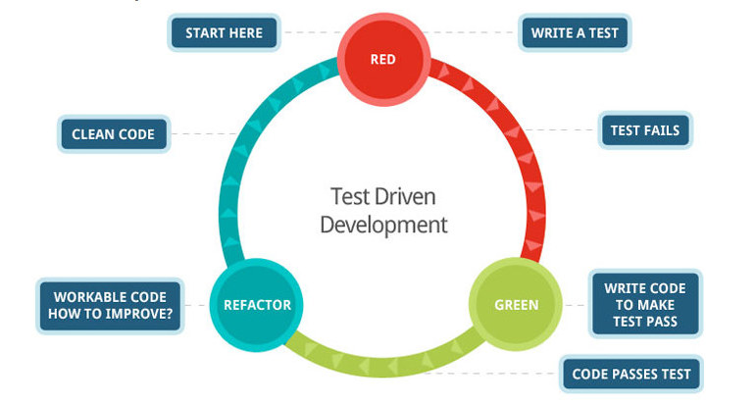
Notes:
I just mentioned TDD and how it may at some time have seemed illogical but now is an accepted and mainstream practice – I am going to build on this since this is the context in which I had my third thought shift.
I am going to look at a TDD example where this first smacked me squarely in the forehead and left a mark. I want to smack each of you in the forehead – so form a single file line over here….just kidding… that would be too large a batch size and we would get value faster if we have had multiple lines….;-)
Unfortunately, you can only see this for the first time once.
The diagram shows the basic TDD loop – brief explanation
Let’s try and think about this problem – where would we start?
How would some of the groups that you are part of work this problem?
What are some of the things that we need to think about? If we were to develop this, where would we start?
I am sure we would need to build a calculator class
I am sure we would need to build methods and algorithms that could add, multiple, divide and subtract
For those that don’t know the TDD approach it uses some of what we have already talked about in a way – we think about what it is we are trying to do, design a test that we reached out goal and then focus on just that bit and just do enough to meet the goal and pass the test –
That all you need to know for now….

Slide 13
//Some Unit Testing code…
//Test Code
public void testMultiplication{
assertEquals(caluclator.multiply(6, 7), 42);
}
----------------------------------------------------
//Some Calculator class…
//Implementation Code
public Integer multiply(Integer x, Integer y){
return 42;
}
How can this help you?
Example Time.
Money Shot
Notes:
In the string calculator kata Uncle Bob is building a calculator – he is using TDD and this also helps him understand his problem space and break the problem into smaller problem (a whole other topic on its own).
In one of the first steps he write a test to return the product of 6 and 7. – ALL GOOD RIGHT – yay our developer are testing their code, maybe we helped them shape their test even, maybe we wrote the test – whatever blows your hair back.
The first bit of value we are going to add is write the code that return the product of 6 and 7 – so we need to do some maths …right…..aaarrgg! WRONG! I can hear Simon Cowell. The first thing that Uncle Bob does is to simply return 42; WTF? He did what – I don’t understand.!!!!!
That is a cheat ..isn’t it? He didn’t do anything! Ok –after some though about what he had just done I arrived at the conclusion that he understood the problem, he boiled it down to the truth that 6X7 is 42 and added value right away! ...Why? Isn't that what is being asked for initially? Simplicity – the art of maximizing the work not done (who knows where this comes from? Another lesson here is that we don’t abstract before we have a second case generally – right?
The problem space is about getting to the result of the product of 6 and 7.
The truth is that the product of 6 and 7 is 42 and cannot be broken down any further.
The simplest thing to do (and it seems like the illogical thing to do the first time you see the kata) is just to return 42.
3 plays 50.!!! #just saying
How can this help you and me? Well it’s a collaborative game.

Slide 14
Mission accomplished?
I want you hear return 42; in the back of your mind….always

Slide 15
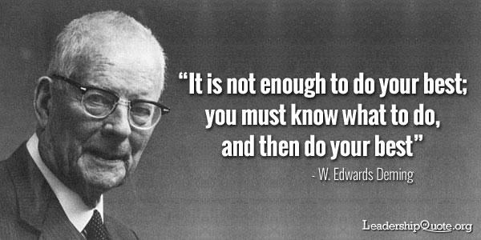
Notes:
How do you know what you must do?
Do you just follow instructions? Or do you understand the problem – really understand the problem and strain your brain and then do your best?

Slide 16
Spend time in the problem space
Key
Takeaways
First Principles can help identify core elements and truths
The shortest distance between two points is uncomfortable at first
60% of the time, it works every time – Scott Fowler
The correct answer is always – well it depends

Slide 17
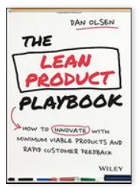
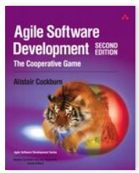
Kata’s
What’s all this nonsense about Katas
TDD Kata’s
First Principles
What we can learn from empty toothpaste boxes
Problem Space vs. Solution Space
TDD Dojo
https://jamesclear.com/first-principles
Things to google
References

Slide 18
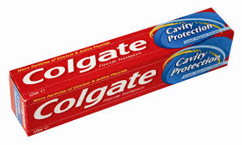
empty toothpaste boxes

Slide 19
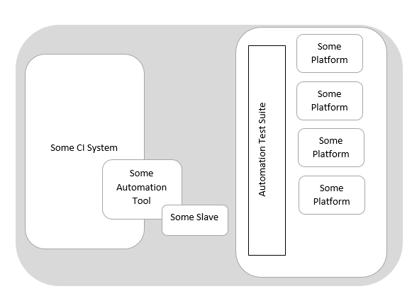
How this helped me
An example from last week.

Slide 20


How this helped me
An example from last week.

Slide 21
Risks or Uncertainty
Automation Tool in the Cloud?
Do we need a new instance?
Are there licensing issues having the Automation Tool software in the cloud?
Slave in the Cloud?
What is the latency going to be like to the UK Data Centre?
Do the configurations need to be different for this platform?
How this helped me
An example from last week.

Slide 22
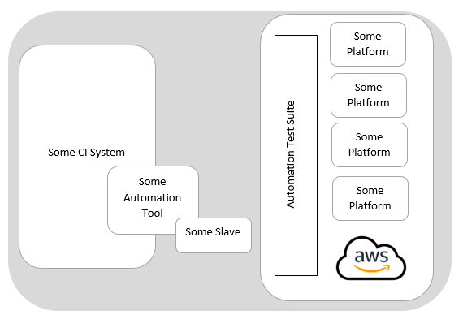
How this helped me
An example from last week.

Slide 23
How this helped me
10 Minutes Worth of Work
An example from last week.

Slide 24
What do you get if you cross Robert Martin and Martin Fowler?
A Joke that only I can tell…;-)
Always wanted to TRY this on an audience that don’t know me.

Slide 25

What do you get if you cross Robert Martin and Martin Fowler?
…
Robert Martin
Martin Fowler
…
Robert Fowler
A Joke that only I can tell…;-)
Use the DRY principle of course.
Notes:
Thumbs up or Thumbs down – my team have written on my door “I do cheese”

Slide 26
Lean
…is about
Delivering (Value + Quality) Fast
+
Reducing Waste
Do the thing that adds the value
Do the simple, sometimes what seems to be the illogical thing.
Notes:
And this ties into Lean Thinking…
The House of Lean: Value in the sustainably shortest lead time.
What we should do an a daily basis is be creative and make sure that we are moving towards our goals. Looking at what is not adding value and chop it out.

Slide 27
I want to challenge the way you think
The why
I want to offer up a distilled summary of experiences and observations that have shaped my way of thinking (and I think is beneficial to you)
I want to plant a splinter in your mind
Why am I here
Notes:
Let’s Start with Why? – Why am I here this evening (give away – who said that)
This evening my goal is to do three things:
I want to challenge the way that you think
I want to give a very cursory look at some disciplines that I have found beneficial for myself and for teams that I have worked with
Plant a splinter in your mind- so that in your day-to-day you will remember return 42;

