Slide 1

GETTING STARTED

Slide 2

GETTING STARTED
Connect to open WiFi SSID “Gaming”.
Open your browser.
Navigate to URL http://10.10.10.5
Register or Login

Slide 3
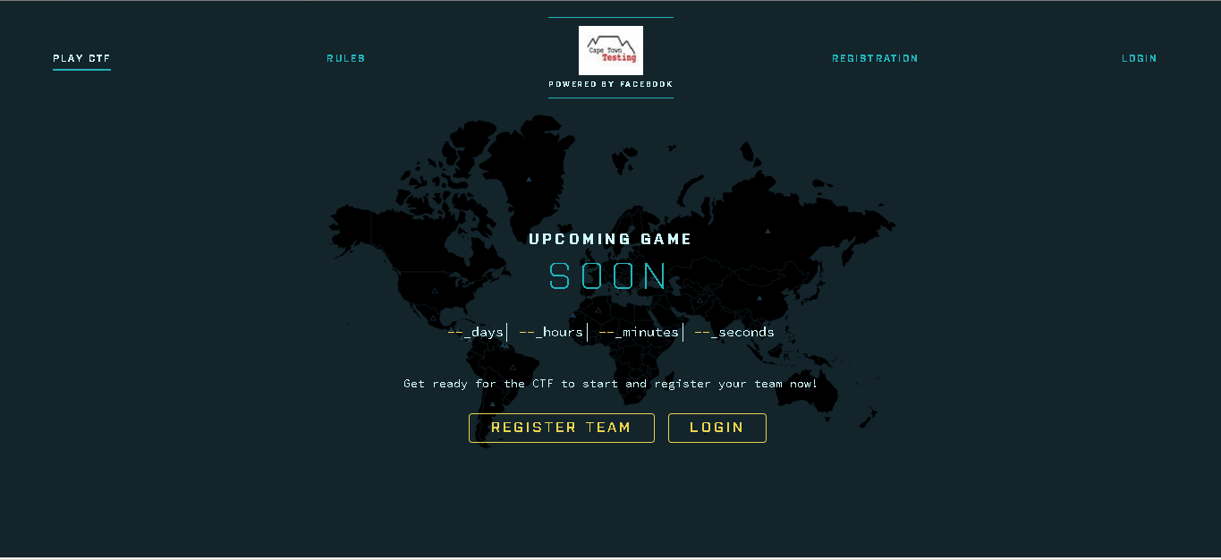
REGISTRATION

Slide 4
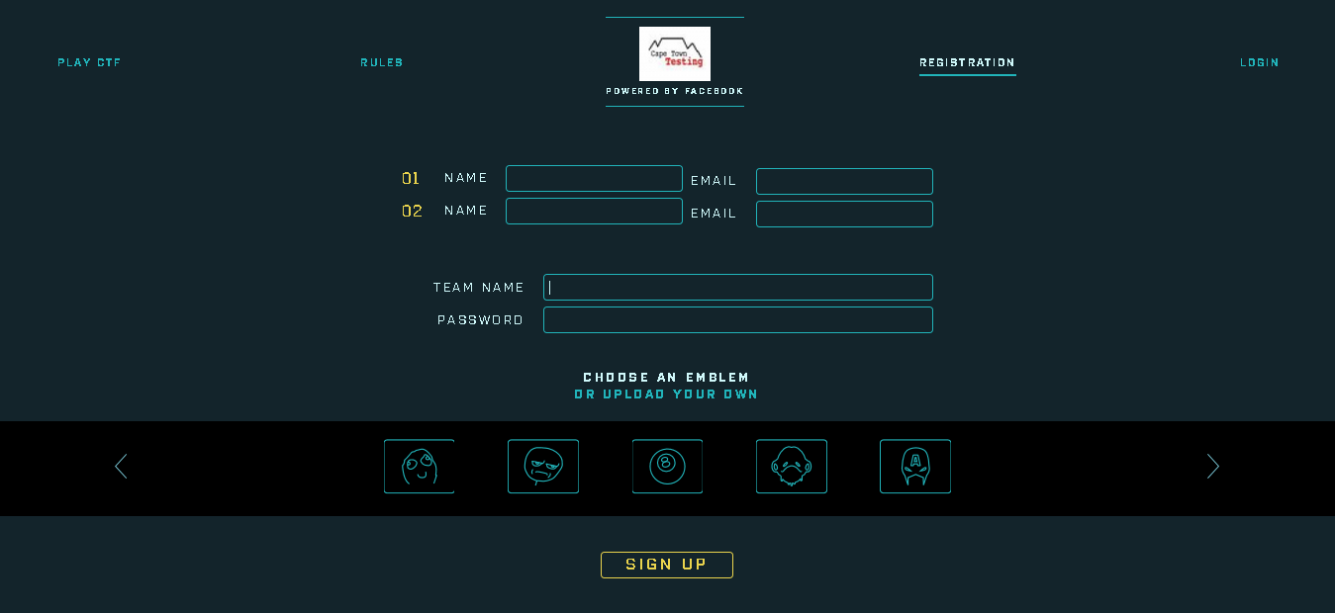
REGISTRATION

Slide 5
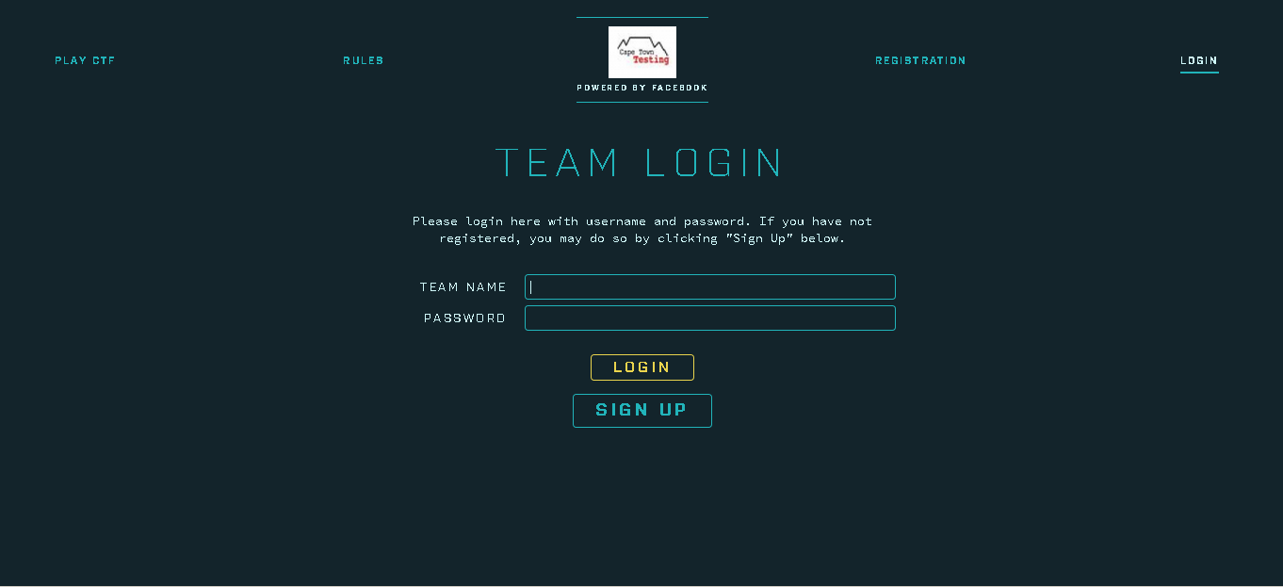

Slide 6
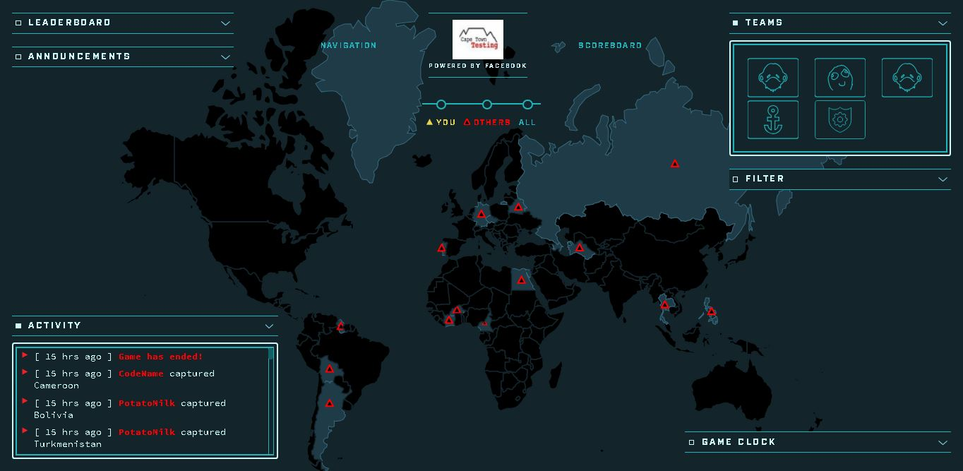

Slide 7
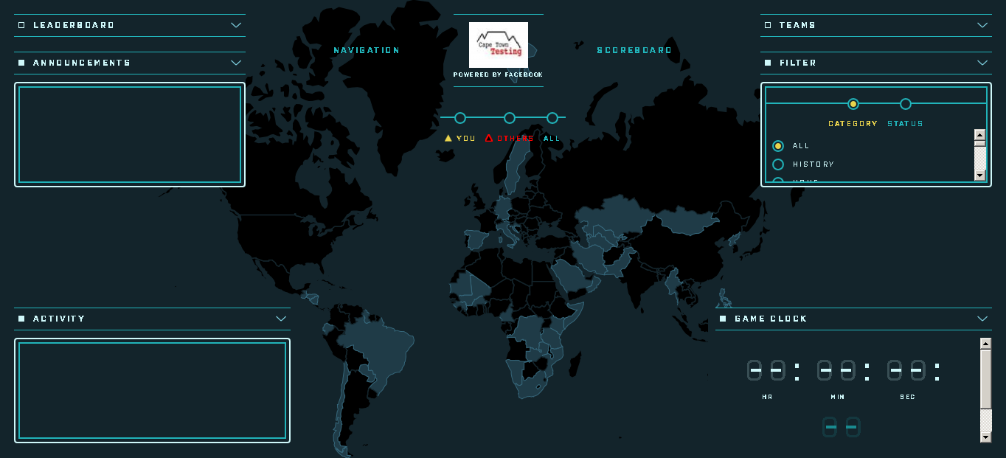

Slide 8
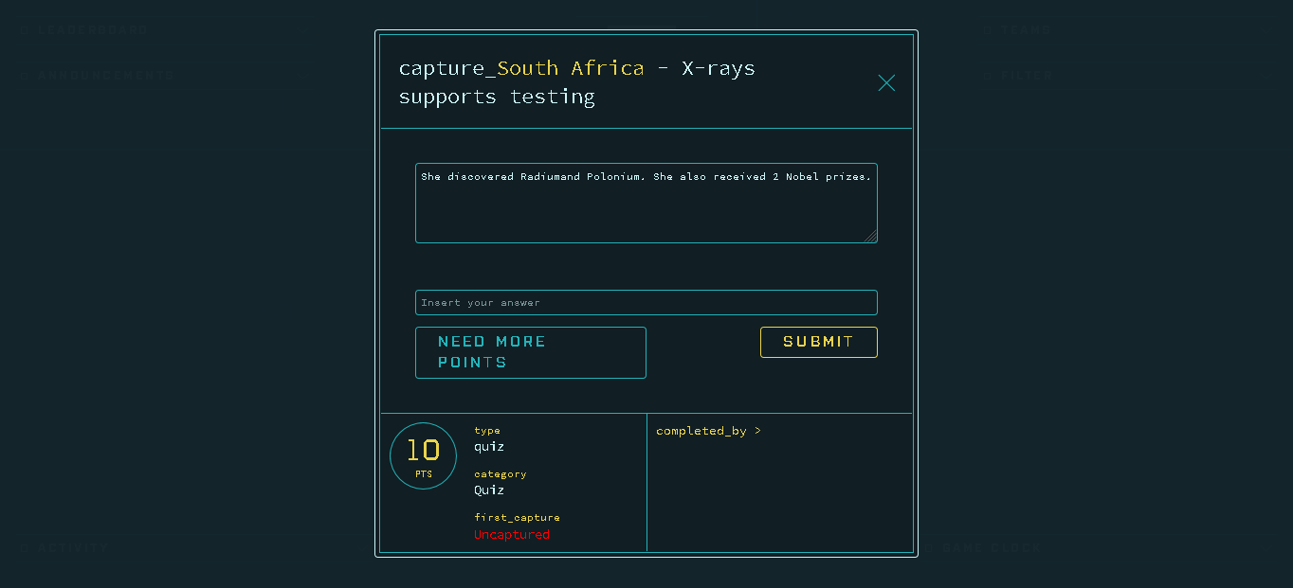
AnSwErS aRe
NoT CaSe SeNsItIvE
Points
Type: Quiz

Slide 9
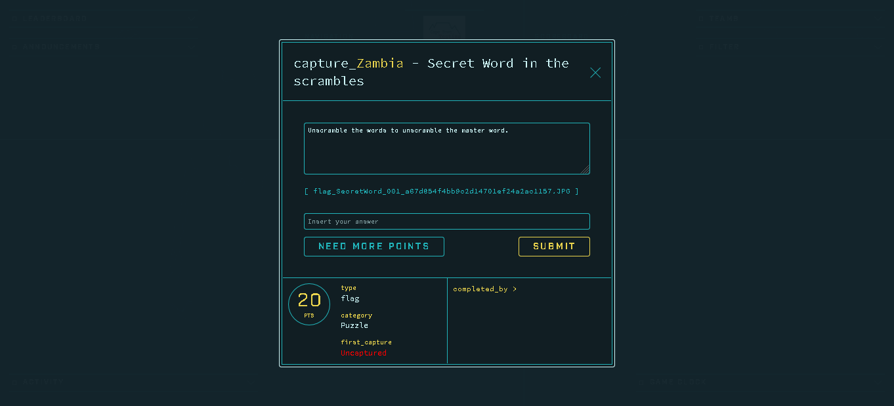
Attachments
Answers ARE Case sensitive
More Points
Type: Flag

Slide 10
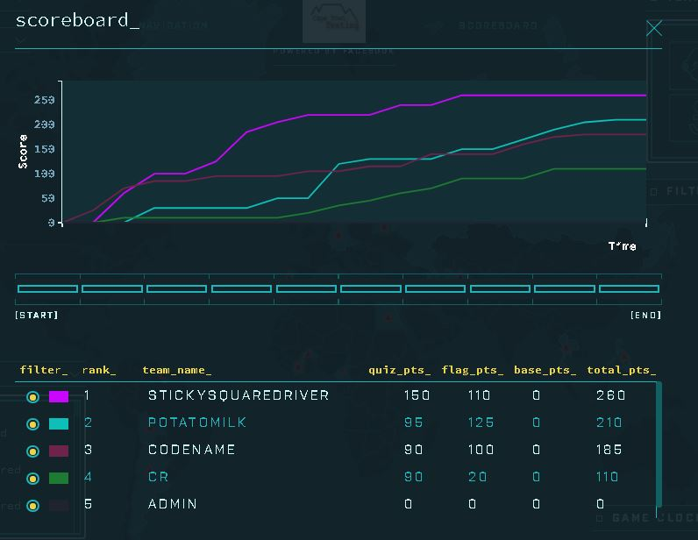

Slide 11

TROUBLESHOOTING
REFRESH THE PAGE

Slide 12
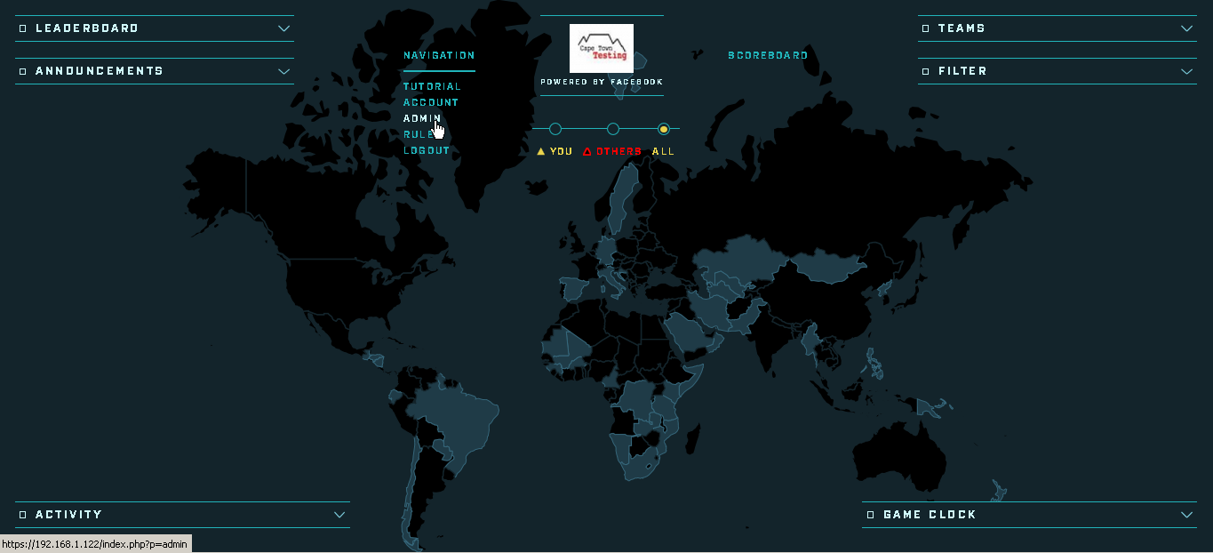
GENERAL RULES

Slide 13
THE EVENT RULES
Play fair and don’t be a douche.
Using Google Search Engine or any other tools available is permitted to find answers.
First capture will always get DOUBLE the points.
Prizes are for the team. The splitting up of prizes is the team’s responsibility.
Feedback can be provided to the event organizers after the event.
REMEMBER TO HAVE FUN!!!

