Slide 1

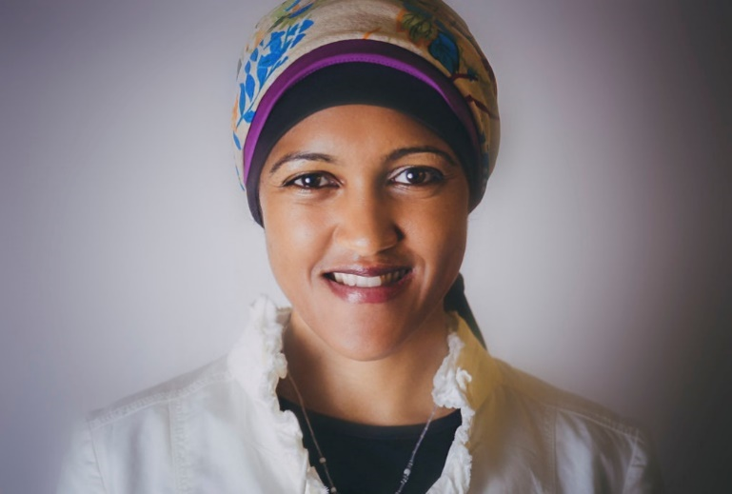
7 August 2018
Rogeema Kenny
@Rogeema
Transformation &
Inclusion in Tech

Slide 2

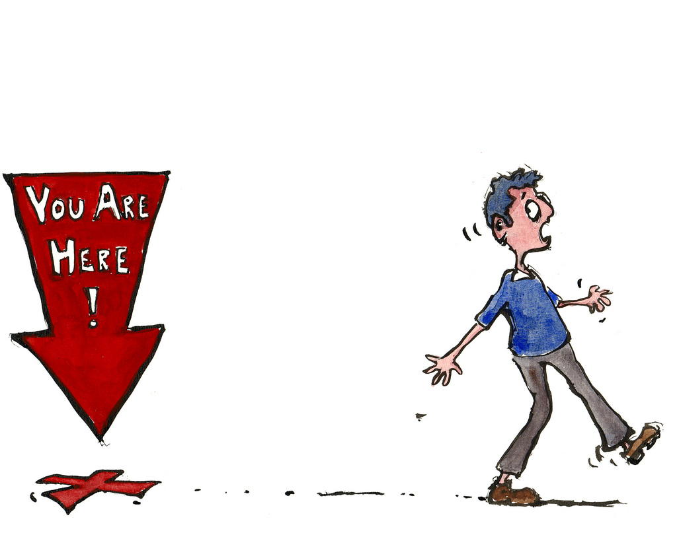


Building a transformed & inclusive culture will demand deliberate interventions
Rogeemakenny.com

Slide 3
Building a transformed & inclusive culture will demand deliberate interventions
teaching
mentoring
Rogeemakenny.com

Slide 4
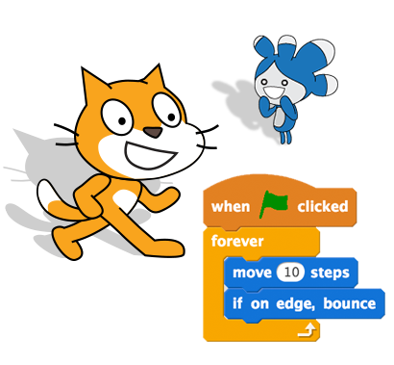
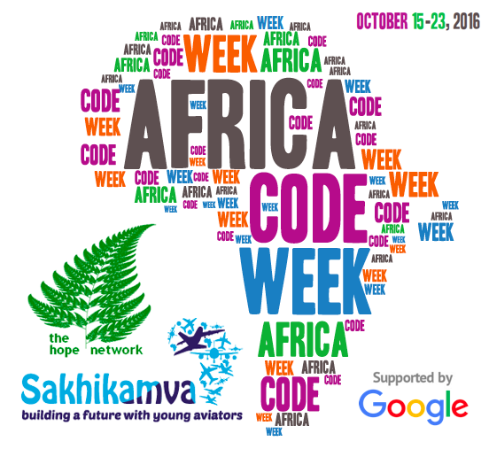
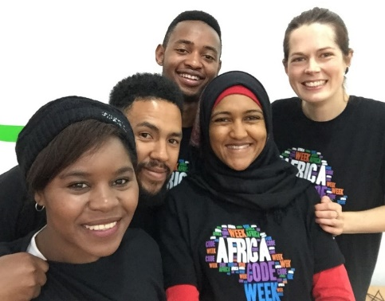
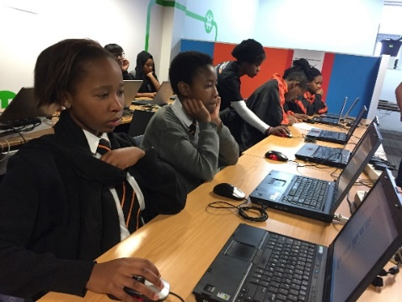
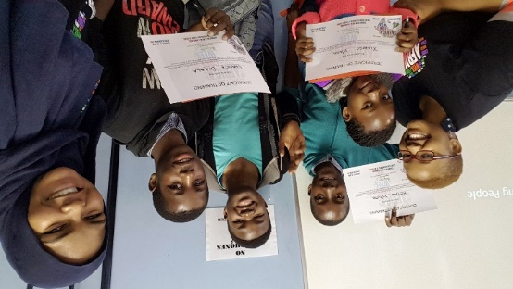
Africa Code Week: A paint-by-numbers tech education blueprint
2016: 1,273 (426,858)
2017: 2,047 (1,291,345)
Rogeemakenny.com

Slide 5

Mentorship: Lift as you climb!
Rogeemakenny.com

Slide 6
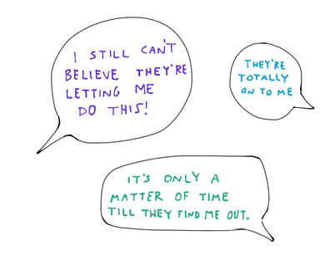
Imposter Syndrome: the incurable disease of the high achiever
Definition:
A psychological phenomenon indicating feelings of inadequacy that persists despite overwhelming evidence that the opposite is true.
Rogeemakenny.com
Rogeemakenny.com

Slide 7

Imposter Syndrome: a personal account
Rogeemakenny.com
Rogeemakenny.com

Slide 8

Imposter Syndrome: a personal account
Rogeemakenny.com
Rogeemakenny.com

Slide 9

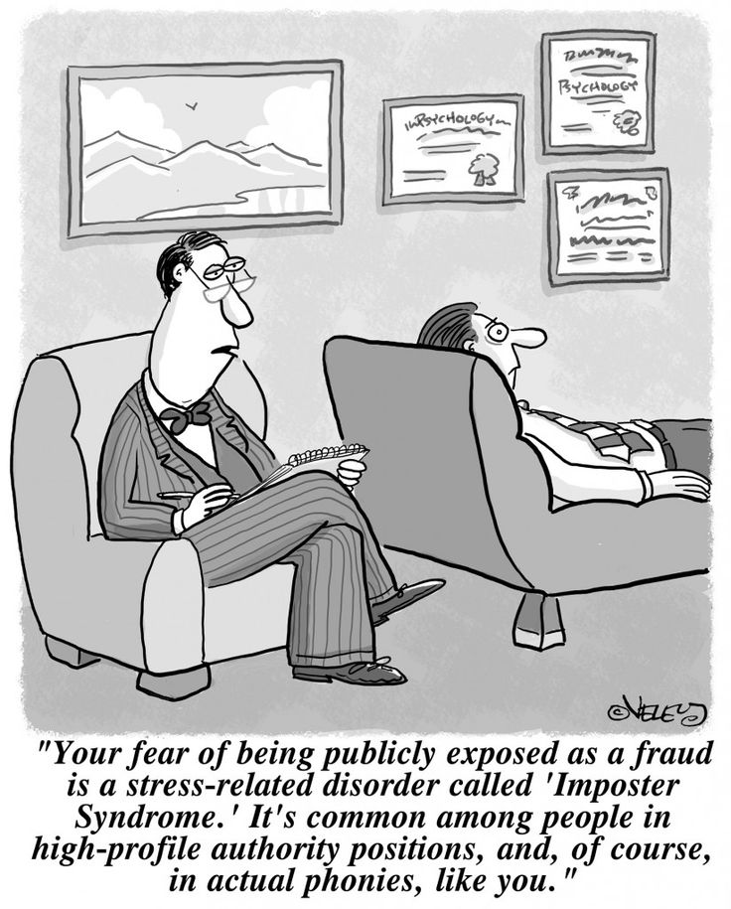
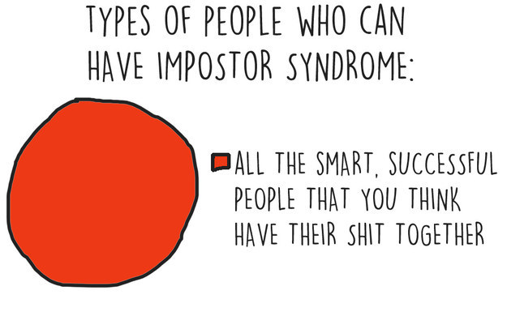
Rogeemakenny.com
Rogeemakenny.com

Slide 10

Did You Know…
41% of women leave tech companies within 10 yrs of graduation, compared to 17% of men
Women write better code!
Code submitted on Github by women are approved at a higher rate than code submitted by men…
IFF the gender of the coder is not disclosed
Rogeemakenny.com

Slide 11
Thank You!

