Slide 1
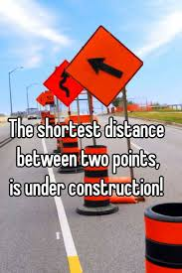
Presented by Robert Fowler
How does your crow fly?
25 April
2018
Notes:
Hi all,
Cool , so I am Rob. I am a noob at presenting at gatherings like this.. Having said that I really would like your feedback if this is helpful or not – so pay attention.
Tonight I want to challenge your thoughts on how you arrive at solutions and how you add value to your projects.
I don’t really care if you are an analyst, a developer, a tester, a scrum master, technical writer or a manager – I think that this will benefit you. The only two things I haven’t officially been in that list is a tester and a technical writer. I have worked at a startup and a corporate and what I want to share this evening I believe will benefit all of you.
Maybe you already know what I am going to say, this is not something new – this is merely some observations that I have made and I want to share these with you and hope that that they add value to what you do day-in and day-out.
You are the steps you take -
On that journey I have seen a common pattern that I love to beat out of folks – (no folks where harmed during the making of these slides)
Thanks for listening.
Shall we start with a joke? I have always wanted to try this on an audience that basically don’t know me. DRY humour.

Slide 2


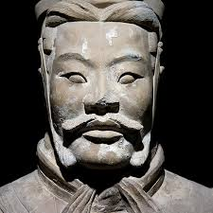

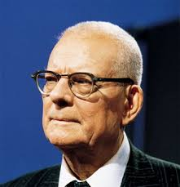

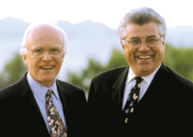
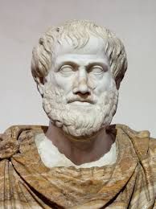
Influences
Notes:
Besides the journey I have been on these are probably the biggest minds that have helped shaped my thoughts about software, people, development, process, strategy, value and quality. Of course, I ran out of space
Alistair Cockburn describes software development as a “Collaborative Game” (he is not up here since I would have run out of space if I have put down all of my influences) ands since these folk influenced me I hope that I can regurgitate what I took away from them and influence you….in a good way.
Anyone pick up a reference I have already made?
Tick tock ….let’s get a move on.

Slide 3

I want to challenge the way you think
The why
I want to offer up a distilled summary of experiences and observations that have shaped my way of thinking (and I think is beneficial to you)
I want to plant a splinter in your mind
Why am I here
Notes:
Let’s Start with Why? (give away – who said that)
This evening my goal is to do three things:
I want to challenge the way that you think
I want to give a very cursory look at some disciplines that I have found beneficial for myself and for teams that I have worked with
Plant a splinter in your mind- so that in your day-to-day you will remember return 42;
I like to think that I see patterns in related and unrelated things and so often things are not new they are just applied in a different way or to a different problem space. So these are a few things that I have joined together to get

Slide 4
I want to challenge the way you think about the problem space and the solution space
More specifically
I want to strain your brain
I want to plant a splinter in your mind: return 42;
Why am I here
Notes:
Let’s Start with Why? (give away – who said that)
This evening my goal is to do three things:
I want to challenge the way that you think
I want to give a very cursory look at some disciplines that I have found beneficial for myself and for teams that I have worked with
Plant a splinter in your mind- so that in your day-to-day you will remember return 42;
I like to think that I see patterns in related and unrelated things and so often things are not new they are just applied in a different way or to a different problem space. So these are a few things that I have joined together to get

Slide 5
3 things…
…in my opinion that can help you
Understand the problem
Re-think the problem
Construct an out of the box solution
Notes:
Our world is mostly about solving problems – right? We do this all day every day- we build tools to solve business problems and in doing so we solve technical problems. In our collaborative game, we know most about the problem we are going to solve and the way in which to solve it at the end.
In 10 minutes I want you to make you think, make a decision …..every time you come up with a solution to a problem you think you understand. This is the splinter.

Slide 6
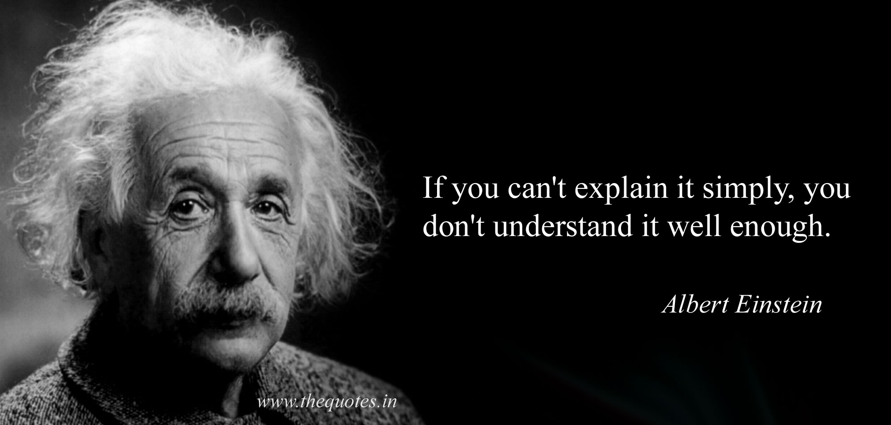

Slide 7
Problem Space
Problem space vs. solution space
Solution Space
Notes:
The first thing I want to talk to you about is two spaces: The problem space and the solution space.
The natural inclination that I have and that I have observed is that individuals and teams like to spend time in the solution space and fashion solution to problems. Have you ever experienced this? Maybe in a grooming session or a planning sessions – the team is 10 steps down the solution road but there is that uneasy feeling or there seems not to be consensus about what it is we are actually trying to solve for? C’mon BE REAL – this is a safe space. How does this turn out for you? We are at standup or almost done with the sprint and folks be like: What problem are we trying to solve again>?
Me
Years ago I attended a course on Analytical Thinking and Creative Problem Solving – got the certificate and all.
The key that I took away from that course was to spend the bulk of the time examining and understanding the problem space rather than spending time on the solution space (or at least too early on). This was foreign to me – very foreign to me but the more I understood the value of understanding the problem, what was real, what was not real – assumptions, biases, pre-conceived ideas I recognized the value of truly understanding the problem space before switching over to solution mode. Too often I recognize folks jumping in to solution mode without truly understanding what is really being asked of them.
The advice
Spend more time (or the appropriate time) in the problem space before moving into the solution space.
The How
Patrick Lencioni talk about leaving titles at the door and dysfunctions to look out when working in a team – it takes courage to slow the group down and ask the questions to understand the problem. Folk have different perspectives – use this to explore the problem space.
This is a discipline that you can develop and need to
Einstein – if you can’t explain it simply, you don’t understand it.
We cool with this.

Slide 8
Mission accomplished?
I want to challenge the way you think about the problem space and the solution space

Slide 9
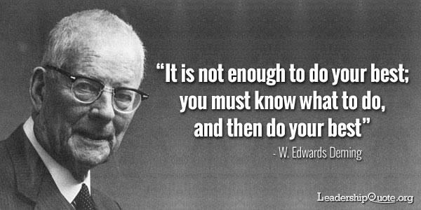

Slide 10
We ALL KNOW…..
…..BUT do we REALLY know?
First principles
“The most valuable thing I learned when studying engineering.” - Rob
Notes:
The second thing I want to talk to you about this evening is that of First Principles – it ties nicely into the problem vs. solution space but looks at different aspect of the problem space.
What are we basing our thinking and our solutions on – are we building on the rock or are we building on the sand? Are we thinking? Are we being creative? Or are we simply going through the motions?
A concept that I learnt while studying engineering and have valued ever since is that of “first principles”.
First principles as the definition points to is about tearing things down to key parts and then using these key parts to build a solution. I could never do first principles justice in under 10 minutes but I will encourage you to go and have a look at some of the work on this – Artistotle was one of the first first principle thinkers – so you know its good ;-)
In as small a nutshell I can condense it – first principle thinking is about straining your brain – asking what we know for sure? What are the truths that we have to work with? WE all know that …..but do we really know that? Look at the fundamental parts then reason a solution using the truth. ….and the truth will set you free!
I recall vividly a structural engineering test I wrote – the material covered some structural equations and how one would use these to make sure your structure didn't fall down and kill anyone. I understood full well how to apply the equations – had them programmed into my HP 48 GX programmable calculator and all and I was ready to go. There was one question on that paper: From first principles derive the structural equations. Needless to say I have carried that big fat 0 mark with me since then – but it serves as a reminder to be sure that we understand what it is we are building with and implementing with.
For you
This takes work, it takes work asking the questions, it takes work boiling things down, and again you may be the one voice in the team that seems to be asking or questioning – what everyone already knows – but there is value here.
Remember – there is a difference here – I am not saying don’t get started before you know everything. We deal in uncertainty to be sure. What I am saying is understand the problem you have and then be sure to boil down what you know into truths.
Also worth checking out Elon Musk – Space X and Elon’s first principle thinking has been disruptive because of what he has questioned and shown to be false/possible/other

Slide 11
noun
the fundamental concepts or assumptions on which a theory, system, or method is based.
"I think we have to start again and go right back to first principles"
First principles
“The most valuable thing I learned when studying engineering.” - Rob
Notes:
The second thing I want to talk to you about this evening is that of First Principles – it ties nicely into the problem vs. solution space but looks at different aspect of the problem space.
What are we basing our thinking and our solutions on – are we building on the rock or are we building on the sand? Are we thinking? Are we being creative? Or are we simply going through the motions?
A concept that I learnt while studying engineering and have valued ever since is that of “first principles”.
First principles as the definition points to is about tearing things down to key parts and then using these key parts to build a solution. I could never do first principles justice in under 10 minutes but I will encourage you to go and have a look at some of the work on this – Artistotle was one of the first first principle thinkers – so you know its good ;-)
In as small a nutshell I can condense it – first principle thinking is about straining your brain – asking what we know for sure? What are the truths that we have to work with? WE all know that …..but do we really know that? Look at the fundamental parts then reason a solution using the truth. ….and the truth will set you free!
I recall vividly a structural engineering test I wrote – the material covered some structural equations and how one would use these to make sure your structure didn't fall down and kill anyone. I understood full well how to apply the equations – had them programmed into my HP 48 GX programmable calculator and all and I was ready to go. There was one question on that paper: From first principles derive the structural equations. Needless to say I have carried that big fat 0 mark with me since then – but it serves as a reminder to be sure that we understand what it is we are building with and implementing with.
For you
This takes work, it takes work asking the questions, it takes work boiling things down, and again you may be the one voice in the team that seems to be asking or questioning – what everyone already knows – but there is value here.
Remember – there is a difference here – I am not saying don’t get started before you know everything. We deal in uncertainty to be sure. What I am saying is understand the problem you have and then be sure to boil down what you know into truths.
Also worth checking out Elon Musk – Space X and Elon’s first principle thinking has been disruptive because of what he has questioned and shown to be false/possible/other

Slide 12
Mission accomplished?
I want you to be aware and empowered to make sure you are dealing in truth and building on rocks

Slide 13

…but that makes no sense
Do the thing that adds the value
Do the simple, sometimes what seems to be the illogical thing.
…but hey, it works!
Notes:
I am going to use an example to illustrate this -
Having broken things down into truths and fundamental parts relook at your goal, and the value that you are trying to achieve. It may turn out that doing the simplest thing may be the illogical thing but is the thing that gets you closer to your goal. Once you have done it and it work, you may even look back later on and say to yourself: ‘man that was obvious – I can’t believe I didn’t see it before”. Or the most illogical thing, is the simplest thing.
The House of Lean: Value in the sustainably shortest lead time.

Slide 14
Lean
…is about
Delivering (Value + Quality) Fast
Reducing Waste
Do the thing that adds the value
Do the simple, sometimes what seems to be the illogical thing.
Notes:
And this ties into Lean Thinking
The House of Lean: Value in the sustainably shortest lead time.
What we should do an a daily basis is be creative and make sure that we are moving towards our goals. Looking at what is not adding value and chop it out.

Slide 15
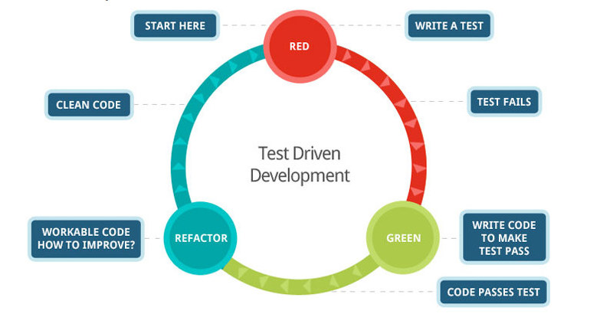
Notes:
How can we do this in our every day?
Basically, how can we find the shortest distance between two points, the way the crow flies.
I am going to look at a TDD example where this first smacked me squarely in the forehead and left a mark. I want to smack each of you in the forehead – so form a single file line over here….just kidding… that would be too large a batch size and we would get value faster if we have had multiple lines….;-)
The example I am going to use is that of a String Calculator – I first saw this several years ago in one of Uncle Bob’s coding Kata’s. the goal is to build a calculator that can perform arithmetic on any two numbers. If we were going to do this how would we go about it? Aside – Kata’s are a great way to practice disciplines that are foreign to us.
Let’s try and think about this problem – where would we start?
How would some of the groups that you are part of work this problem?
What are some of the things that we need to think about? If we were to develop this, where would we start?
I am sure we would need to build a calculator class
I am sure we would need to build methods and algorithms that could add, multiple, divide and subtract
For those that don’t know the TDD approach it uses some of what we have already talked about in a way – we think about what it is we are trying to do, design a test that we reached out goal and then focus on just that bit and just do enough to meet the goal and pass the test –
That all you need to know for now….

Slide 16
How can this help you?
return 42;
Example Time.
Notes:
Maybe you are familiar with Robert C. Martin aka Uncle Bob and more specifically with his Kata’s – these are programming exercises that shape your thinking by following a pattern that you can extend into your code. If you don’t know about these, there are plenty of things that you can learn from these.
I am going to use one of these to illustrate the ideas I have just walked you through:
In the string calculator kata Uncle Bob is building a calculator – he is using TDD and this also helps him understand his problem space and break the problem into smaller problem (a whole other topic on its own).
In one of the first steps he write a test to return the product of 6 and 7. – ALL GOOD RIGHT – yay our developer are testing their code, maybe we helped them shape their test even, maybe we wrote the test – whatever blows your hair back.
The first bit of value we are going to add is write the code that return the product of 6 and 7 – so we need to do some maths …right…..aaarrgg! WRONG! I can hear Simon Cowell. The first thing that Uncle Bob does is to simply return 42; WTF? He did what – I don’t understand.!!!!!
That is a cheat ..isn’t it? He didn’t do anything! Ok –after some though about what he had just done I arrived at the conclusion that he understood the problem, he boiled it down to the truth that 6X7 is 42 and added value right away! ...Why? Isn't that what is being asked for initially?
The problem space is about getting to the result of the product of 6 and 7.
The truth is that the product of 6 and 7 is 42 and cannot be broken down any further.
The simplest thing to do (and it seems like the illogical thing to do the first time you see the kata) is just to return 42.
How can this help you and me?

Slide 17
Mission accomplished?
I want you hear return 42; in the back of your mind….always

Slide 18
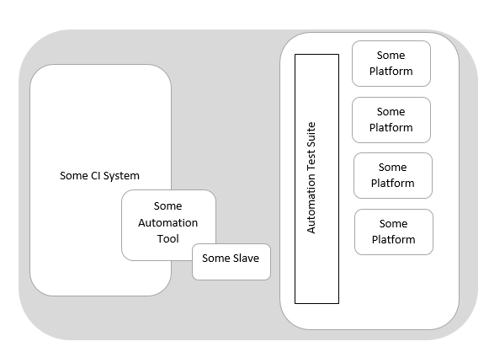
How this helped me
An example from last week.
Notes:
Maybe you are familiar with Robert C. Martin aka Uncle Bob and more specifically with his Kata’s – these are programming exercises that shape your thinking by following a pattern that you can extend into your code. If you don’t know about these, there are plenty of things that you can learn from these.
I am going to use one of these to illustrate the ideas I have just walked you through:
In the string calculator kata Uncle Bob is building a calculator – he is using TDD and this also helps him understand his problem space and break the problem into smaller problem (a whole other topic on its own). In one of the first steps he write a test to return the product of 6 and 7.
..so the first thing that the calculator does is to return 42:
That is a cheat ..isn’t it?...Why? Isn't that what is being asked for initially?
The problem space is about getting to the result of the product of 6 and 7.
The truth is that the product of 6 and 7 is 42 and cannot be broken down any further.
The simplest thing to do (and it seems like the illogical thing to do the first time you see the kata) is just to return 42.
How can this help you and me?
Make a decision
Anyways,

Slide 19


How this helped me
An example from last week.
Notes:
Maybe you are familiar with Robert C. Martin aka Uncle Bob and more specifically with his Kata’s – these are programming exercises that shape your thinking by following a pattern that you can extend into your code. If you don’t know about these, there are plenty of things that you can learn from these.
I am going to use one of these to illustrate the ideas I have just walked you through:
In the string calculator kata Uncle Bob is building a calculator – he is using TDD and this also helps him understand his problem space and break the problem into smaller problem (a whole other topic on its own). In one of the first steps he write a test to return the product of 6 and 7.
..so the first thing that the calculator does is to return 42:
That is a cheat ..isn’t it?...Why? Isn't that what is being asked for initially?
The problem space is about getting to the result of the product of 6 and 7.
The truth is that the product of 6 and 7 is 42 and cannot be broken down any further.
The simplest thing to do (and it seems like the illogical thing to do the first time you see the kata) is just to return 42.
How can this help you and me?
Make a decision
Anyways,

Slide 20
Risks or Uncertainty
Automation Tool in the Cloud?
Do we need a new instance?
Are there licensing issues having the Automation Tool software in the cloud?
Slave in the Cloud?
What is the latency going to be like to the UK Data Centre?
Do the configurations need to be different for this platform?
How this helped me
An example from last week.
Notes:
Maybe you are familiar with Robert C. Martin aka Uncle Bob and more specifically with his Kata’s – these are programming exercises that shape your thinking by following a pattern that you can extend into your code. If you don’t know about these, there are plenty of things that you can learn from these.
I am going to use one of these to illustrate the ideas I have just walked you through:
In the string calculator kata Uncle Bob is building a calculator – he is using TDD and this also helps him understand his problem space and break the problem into smaller problem (a whole other topic on its own). In one of the first steps he write a test to return the product of 6 and 7.
..so the first thing that the calculator does is to return 42:
That is a cheat ..isn’t it?...Why? Isn't that what is being asked for initially?
The problem space is about getting to the result of the product of 6 and 7.
The truth is that the product of 6 and 7 is 42 and cannot be broken down any further.
The simplest thing to do (and it seems like the illogical thing to do the first time you see the kata) is just to return 42.
How can this help you and me?
Make a decision
Anyways,

Slide 21
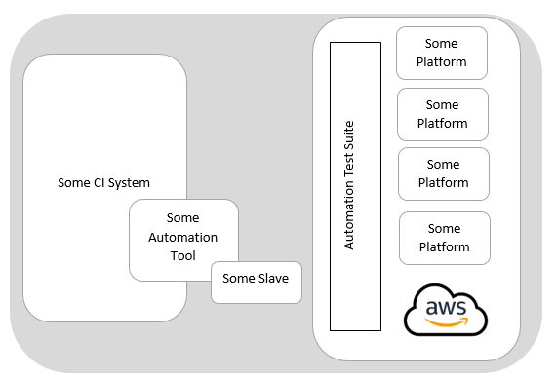
How this helped me
An example from last week.
Notes:
Maybe you are familiar with Robert C. Martin aka Uncle Bob and more specifically with his Kata’s – these are programming exercises that shape your thinking by following a pattern that you can extend into your code. If you don’t know about these, there are plenty of things that you can learn from these.
I am going to use one of these to illustrate the ideas I have just walked you through:
In the string calculator kata Uncle Bob is building a calculator – he is using TDD and this also helps him understand his problem space and break the problem into smaller problem (a whole other topic on its own). In one of the first steps he write a test to return the product of 6 and 7.
..so the first thing that the calculator does is to return 42:
That is a cheat ..isn’t it?...Why? Isn't that what is being asked for initially?
The problem space is about getting to the result of the product of 6 and 7.
The truth is that the product of 6 and 7 is 42 and cannot be broken down any further.
The simplest thing to do (and it seems like the illogical thing to do the first time you see the kata) is just to return 42.
How can this help you and me?
Make a decision
Anyways,

Slide 22
How this helped me
10 Minutes Worth of Work
An example from last week.
Notes:
Maybe you are familiar with Robert C. Martin aka Uncle Bob and more specifically with his Kata’s – these are programming exercises that shape your thinking by following a pattern that you can extend into your code. If you don’t know about these, there are plenty of things that you can learn from these.
I am going to use one of these to illustrate the ideas I have just walked you through:
In the string calculator kata Uncle Bob is building a calculator – he is using TDD and this also helps him understand his problem space and break the problem into smaller problem (a whole other topic on its own). In one of the first steps he write a test to return the product of 6 and 7.
..so the first thing that the calculator does is to return 42:
That is a cheat ..isn’t it?...Why? Isn't that what is being asked for initially?
The problem space is about getting to the result of the product of 6 and 7.
The truth is that the product of 6 and 7 is 42 and cannot be broken down any further.
The simplest thing to do (and it seems like the illogical thing to do the first time you see the kata) is just to return 42.
How can this help you and me?
Make a decision
Anyways,

Slide 23
Spend time in the problem space
Key
Takeaways
First Principles can help identify core elements and truths
The shortest distance between two points is uncomfortable at first
60% of the time, it works every time – Scott Fowler
The correct answer is always – well it depends

Slide 24
Kata’s
TDD Kata’s
First Principles
Problem Space vs. Solution Space
TDD Dojo
https://jamesclear.com/first-principles
Things to google
References

