Slide 1
Content Based News Recommendation System
Team Gryffindor
Group Members: Jeet Shah AU1841006
Manav Vagrecha AU1841022
Parth Patel AU1841028
Shreyansh Shah AU1841046

Slide 2

Problem Statement
Finding relevant and interesting news from a large corpus of news can be a difficult, time-consuming and irritating process.
Given a user with his/her previously read articles, we would like to recommend new articles from the dataset which will be relevant to the user.

Slide 3

Introduction
Our recommender systems can help users find news by providing them with personalized suggestions.
Types of recommendation systems:
Content-Based
Collaborative
Hybrid
Demographic
Utility-based
Knowledge based

Slide 4
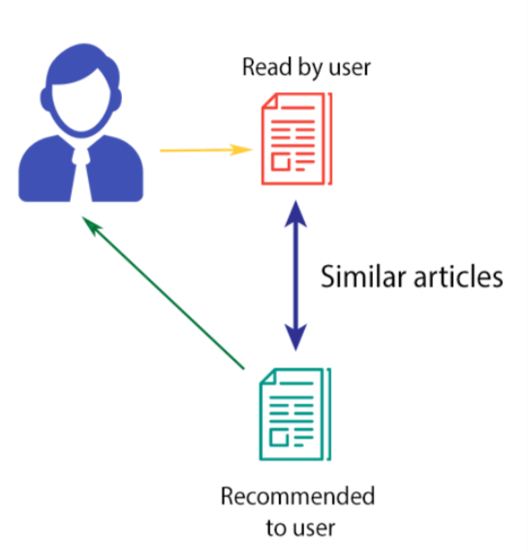
Existing Body of Work
Content-based filtering basically works on user feedback of different articles.
There are 2 ways to get user preferences
Implicit - Track Click based Activity of user (history)
Explicit - Requires the user to evaluate viewed articles on a scale
Based on the user’s preferences, classify all the articles available into 2 categories:
Relevant to the user
Irrelevant to the user
Update user history after fixed number of clicks and retrain the model accordingly.

Slide 5

Approach
Dataset :
Microsoft News Dataset
User Behaviour (History)
News
Actual Size: 1 Million Users
Reduced Dataset includes: 156965 users
Key Reason for selection: Provides us with a pre recorded user history
Data Preprocessing :
Removed Redundant Columns
Removed NaN valued Rows
Removed punctuations, stop words and html words

Slide 6
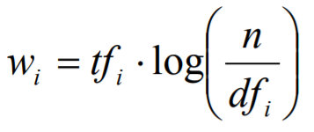
Approach
Feature extraction on the cleaned data.
Feature Extraction ngram range - (1,3)
Assigning weight to a given feature for a given article that signifies its importance in the given article using TF-IDF.
wi : Weight Assigned to the term
tfi = number of occurrences of term ti in article D
n = number of articles in the dataset
dfi = number of articles in which term ti appears atleast once
Perform similar steps to find out user specific preference vector or user profile vector.

Slide 7
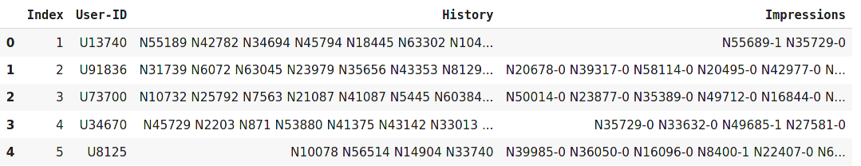
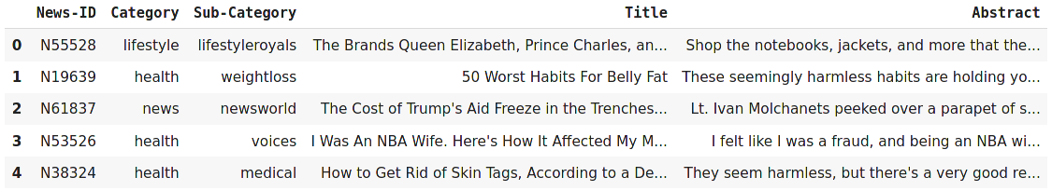
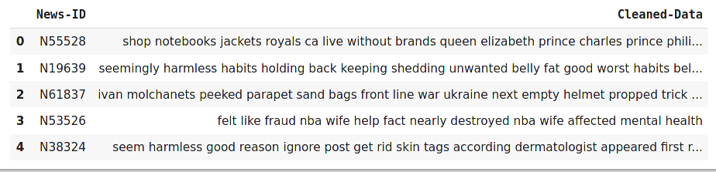
Initial Results
Data after removing redundant columns
Data Preprocessing

Slide 8
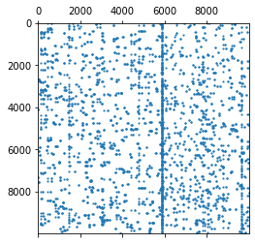
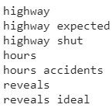
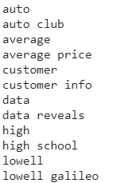
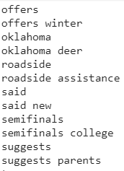
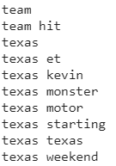
Initial Results
Some of the extracted grams
Visualizing Part (Size : 10000x10000) of Feature Vector Matrix (Size : 48616x1869854)

Slide 9

Future Work
Recommend relevant articles to the users by determining similarity between user profile vector and article feature vector.
Quantifying the recommendations using different metrics.
Including other features like categories, sub-categories for recommendation along with abstract and title content.

Slide 10

Contribution
Name \ Factors | Literature Review | Code | Reports | Planning
Jeet Shah | ✓ | ✓ | ✓ | ✓
Manav | ✓ | ✓ | ✓ | ✓
Parth Patel N | ✓ | ✓ | ✓ | ✓
Shreyansh | ✓ | ✓ | ✓ | ✓

Slide 11
References
http://users.ics.forth.gr/~potamias/mlnia/paper_6.pdf
https://analyticsindiamag.com/hands-on-implementation-of-tf-idf-from-scratch-in-python/
https://towardsdatascience.com/how-to-build-from-scratch-a-content-based-movie-recommender-with-natural-language-processing-25ad400eb243
https://arxiv.org/ftp/arxiv/papers/2010/2010.12798.pdf
https://medium.com/@bindhubalu/content-based-recommender-system-4db1b3de03e7
https://unbscholar.lib.unb.ca/islandora/object/unbscholar%3A7041/datastream/PDF/view

