Slide 1
Content Based News Recommendation System
Team Gryffindor
Group Members: Jeet Shah AU1841006
Manav Vagrecha AU1841022
Parth Patel AU1841028
Shreyansh Shah AU1841046

Slide 2

Problem Statement
Finding relevant and interesting news from a large corpus of news can be a difficult, time-consuming and irritating process.
Given a user with his/her previously read articles, we would like to recommend new articles from the dataset which will be relevant to the user.

Slide 3

Introduction
Our recommender systems can help users find news by providing them with personalized suggestions.
Types of recommendation systems:
Content-Based
Collaborative
Hybrid
Demographic
Utility-based
Knowledge based

Slide 4
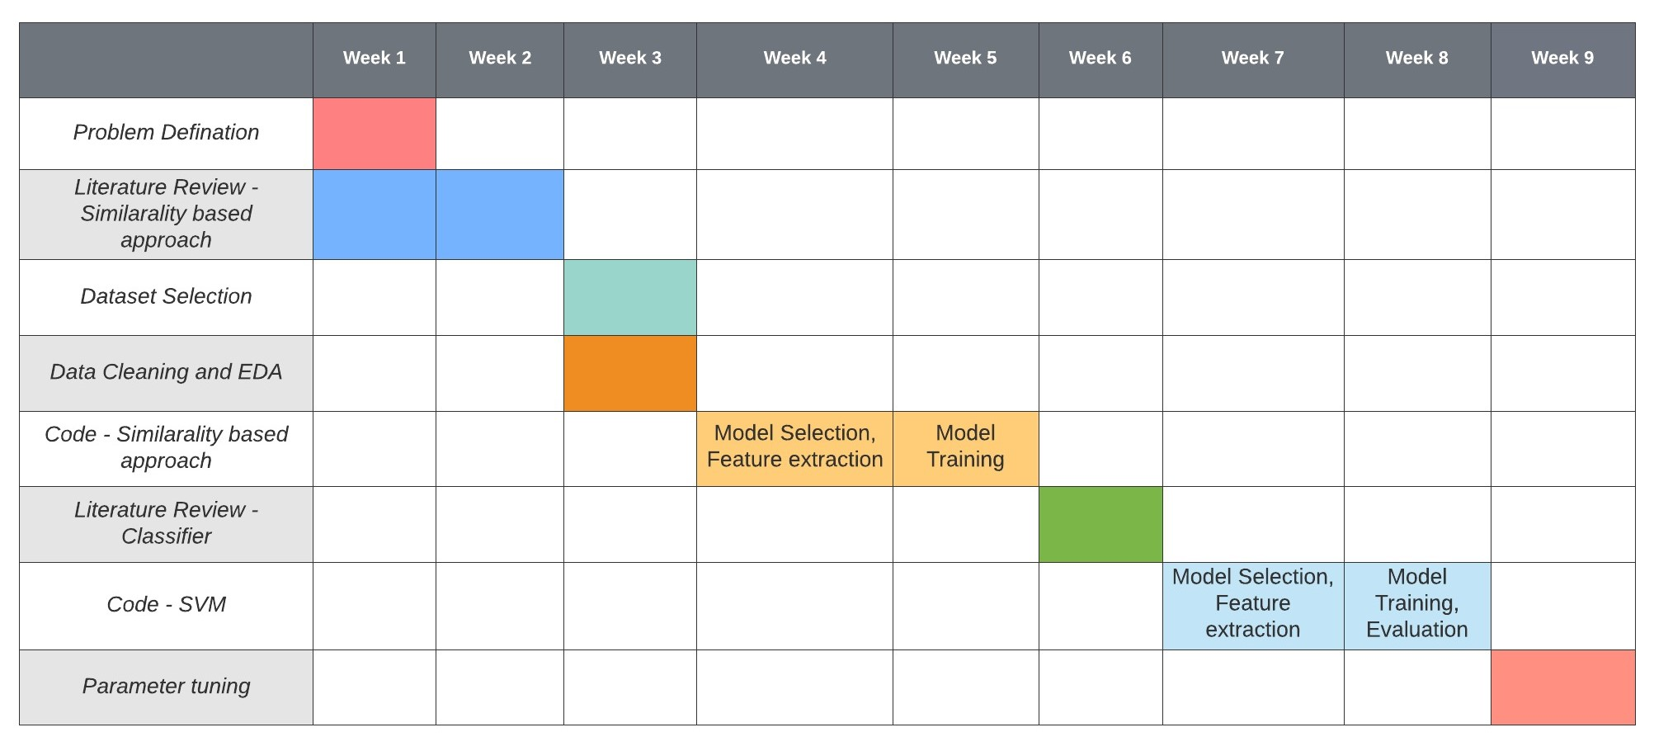
GANTT Chart

Slide 5
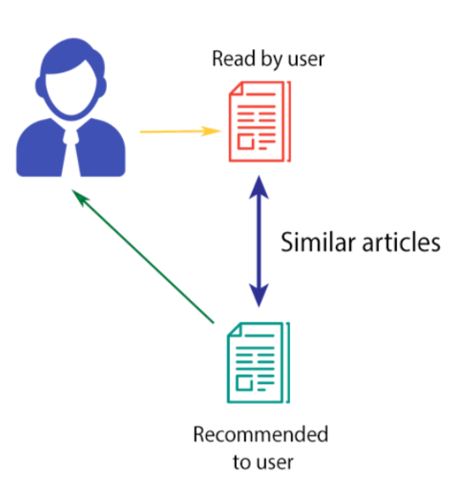
Existing Body of Work
Content-based filtering basically works on user feedback of different articles.
There are 2 ways to get user preferences
Implicit - Track Click based Activity of user (history)
Explicit - Requires the user to evaluate viewed articles on a scale
Based on the user’s preferences, classify all the articles available into 2 categories:
Relevant to the user
Irrelevant to the user
Update user history after fixed number of clicks and retrain the model accordingly.

Slide 6
Existing Body of Work
Existing work uses two different approaches for recommendation.
Similarity Based
Classification
Similarity based approach compares the user history and other documents of the dataset in vector space model by finding cosine similarity between user vector and document vector.
Classification is done using modern classifiers like SVM, KNN where labels from click behaviour of the users is used.

Slide 7

Approach
Dataset:
Microsoft News Dataset
User Behaviour (History)
News - Category, Sub-Category for classification
Actual Size: 1 Million Users
Reduced Dataset includes: 156965 users
Key Reason for selection: Provides us with a pre recorded user history
Feature Engineering:
TF-IDF (For similarity based approach)
Performed on title and abstract
One Hot Encoding (For Classification using SVM)
Performed on Category and Sub-Category fields

Slide 8
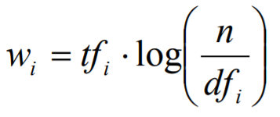
Approach
Similarity based approach:
Assigning weight to a given feature for a given article that signifies its importance in the given article using TF-IDF.
Perform similar steps to find out user specific preference vector or user profile vector.
Find cosine similarity between document and user profile and recommend.
Drawbacks:
Primitive
Complexity increases with the increase in size of database.
No. of features tending to large numbers like 1869854 for a dataset like ours.
A typical rule of thumb is that there should be at least 5 training examples for each dimension in the representation.
Impractical for our application
wi : Weight Assigned to the term
tfi = number of occurrences of term ti in article D
n = number of articles in the dataset
dfi = number of articles in which term ti appears atleast once

Slide 9
Approach
Classification based approach:
Classification based on categorical data - categories and subcategories of the news articles. (Nominal class of Categorical data)
Feature extraction -
Transforming nominal attributes
Encoding categorical attributes
One Hot Encoding Scheme
Each article can now be represented in the form of vector.
0 - Non-Click, 1 - Click (User history)
X = News Features, Y = 0/1 labels from user history
Split into test and train data in 20% and 80% ratio.
Train the model using svm classifier for three different kernels: Linear, Polynomial and RBF.
Use grid search CV to train models with different values of hyper-parameters to find the best fit.
Predict the labels of test data and find accuracy.
Use model with maximum accuracy for recommendation to the user.

Slide 10
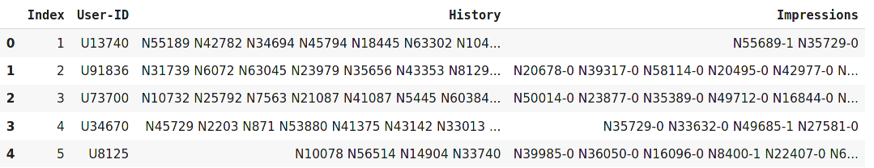
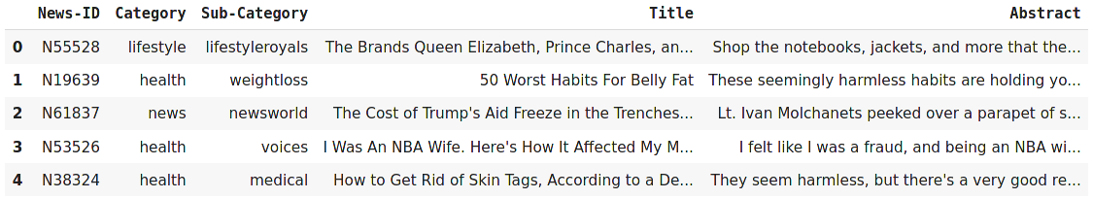
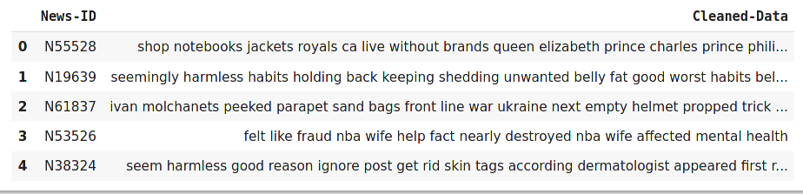
Results - Similarity Based
Data after removing redundant columns
Data Preprocessing

Slide 11
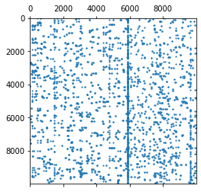
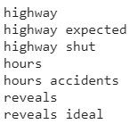
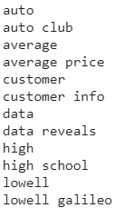
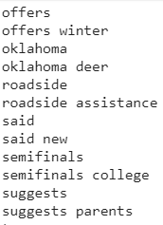
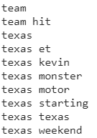
Results - Similarity Based
Some of the extracted grams
Visualizing Part (Size : 10000x10000) of Feature Vector Matrix (Size : 48616x1869854)

Slide 12
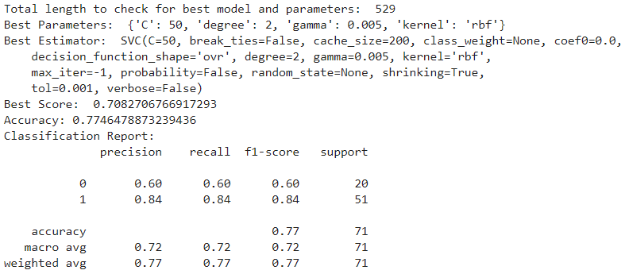
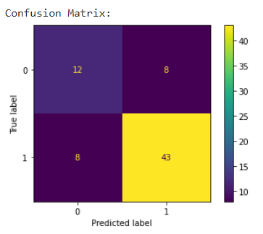
Results - Classification Based
Random User - 1

Slide 13
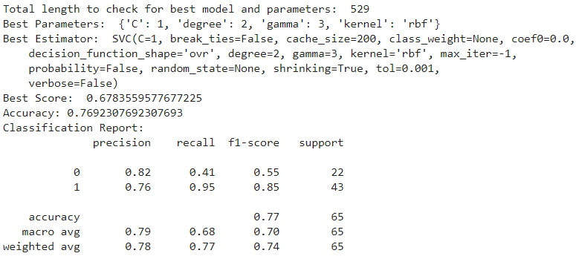
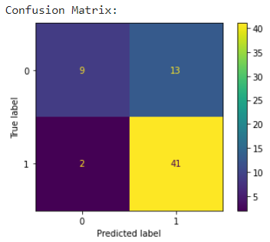
Results - Classification Based
Random User - 2

Slide 14
Conclusion
Average accuracy of the model: 76.25%
We noticed that the accuracy ranged from 65% to 95%.
Performance of the model depends on various factors like:
Number of training points available
Frequency of positive and negative data points in the training data
Distribution of the data

Slide 15

Contribution
Name \ Factors | Literature Review | Code | Reports | Planning
Jeet Shah | ✓ | ✓ | ✓ | ✓
Manav | ✓ | ✓ | ✓ | ✓
Parth Patel N | ✓ | ✓ | ✓ | ✓
Shreyansh | ✓ | ✓ | ✓ | ✓

Slide 16
References
http://users.ics.forth.gr/~potamias/mlnia/paper_6.pdf
https://analyticsindiamag.com/hands-on-implementation-of-tf-idf-from-scratch-in-python/
https://towardsdatascience.com/how-to-build-from-scratch-a-content-based-movie-recommender-with-natural-language-processing-25ad400eb243
https://arxiv.org/ftp/arxiv/papers/2010/2010.12798.pdf
https://medium.com/@bindhubalu/content-based-recommender-system-4db1b3de03e7
https://unbscholar.lib.unb.ca/islandora/object/unbscholar%3A7041/datastream/PDF/view
https://stats.libretexts.org/Bookshelves/Computing_and_Modeling/RTG%3A_Classification_Methods/4%3A_Numerical_Experiments_and_Real_Data_Analysis/Preprocessing_of_categorical_predictors_in_SVM%2C_KNN_and_KDC_(contributed_by_Xi_Cheng)#:~:text=The%20classification%20success%20rate%20is,%2C%20and%2082.32%25%20for%20kNN
https://towardsdatascience.com/understanding-feature-engineering-part-2-categorical-data-f54324193e63
https://en.wikipedia.org/wiki/Curse_of_dimensionality
https://medium.com/machine-learning-101/chapter-2-svm-support-vector-machine-theory-f0812effc72#:~:text=Gamma%20and%20Margin.-,Kernel,where%20the%20kernel%20plays%20role.&text=This%20is%20an%20equation%20that,support%20vectors%20in%20training%20data
https://towardsdatascience.com/a-guide-to-svm-parameter-tuning-8bfe6b8a452c

