Slide 1
Movement Detection and Camera Monitoring base on Raspberry Pi and Azure Services with Face Recognition
Fedex Day Jun.2021

Slide 2
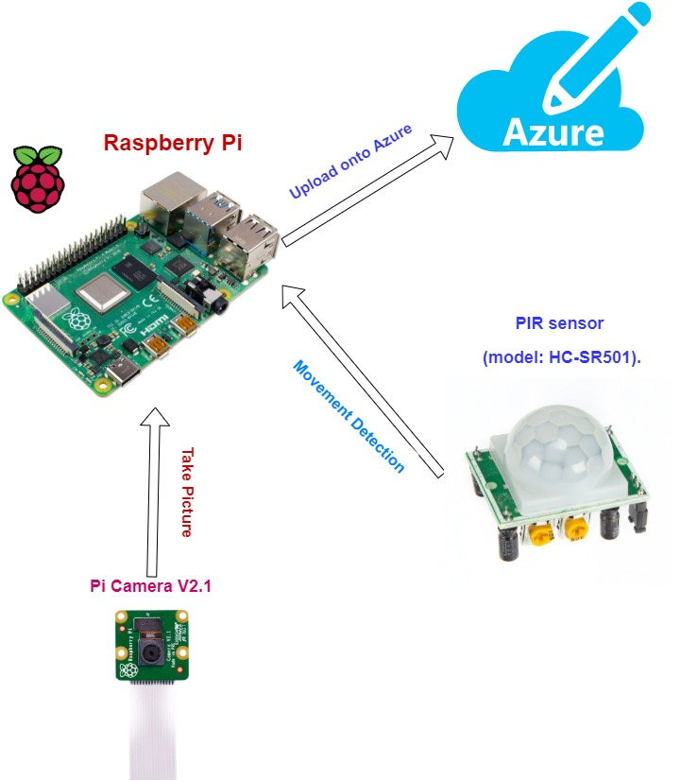
Raspberry Pi Setup

Slide 3
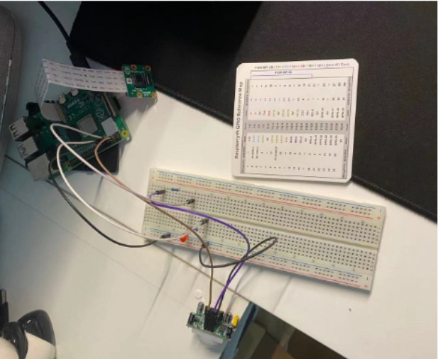
Raspberry Pi Setup

Slide 4
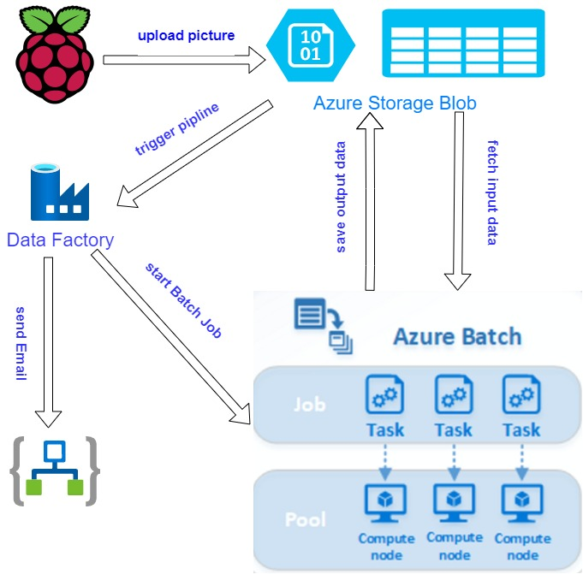
Azure Setup

Slide 5
References
Python face recognition: https://github.com/ageitgey/face_recognition
Automating Python Based Data Transformations With Azure: https://medium.com/analytics-vidhya/automating-python-based-data-transformations-with-azure-297218478fb7
Gmail Connector for Azure Logic apps: https://docs.microsoft.com/en-us/connectors/gmail/

