Slide 1
Time Series Analysis Final Project
Forecasting Arctic Sea Ice
Charles Galea

Slide 2
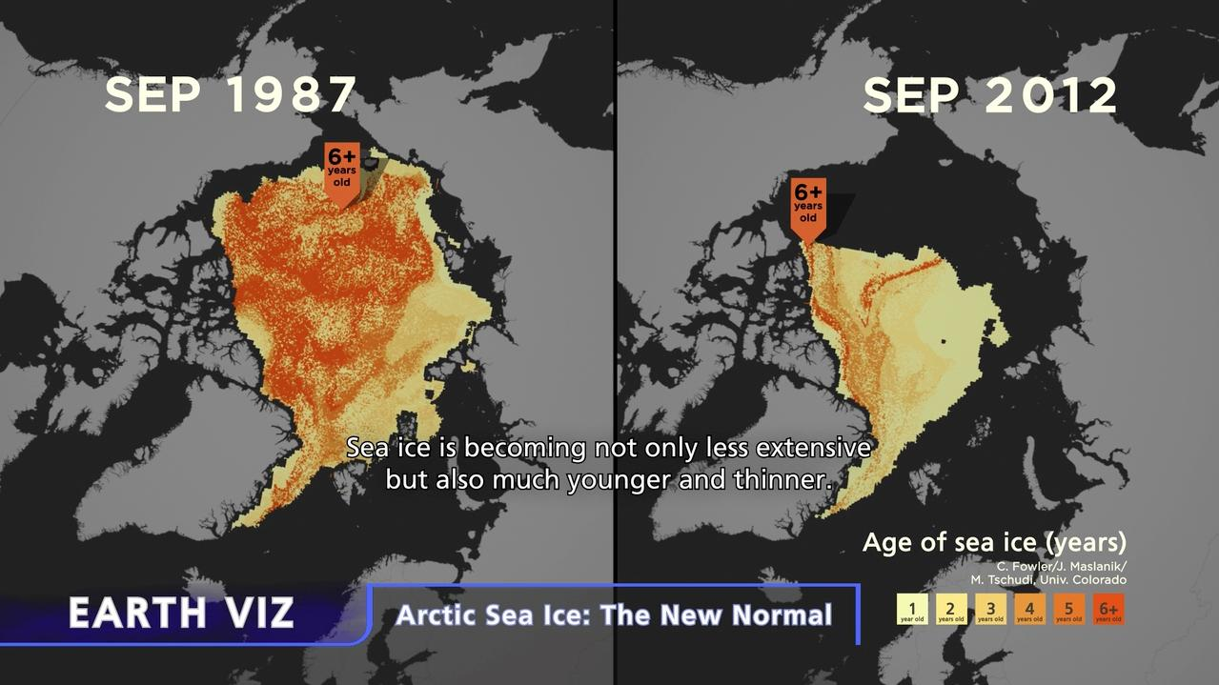
Effects of Climate Change on Arctic Sea Ice
The seasonal ice covering the Arctic is becoming less extensive, younger and thinner.
Observations were obtained from satellite data and drifting buoys which measure the formation, movement, persistence and disappearance of sea ice.
Source: https://sos.noaa.gov/datasets/arctic-sea-ice-the-new-normal/
Notes:
Climate change has had a major effect upon the seasonal ice covering the Arctic Ocean. As this figure illustrates, it has become not only less extensive but is also much younger and thinner. These recent changes indicate that the Arctic has entered a new state which may have dramatic environmental impacts both locally and globally. In this report, we have investigated whether it was possible to forecasting to predict the effect of inaction on climate change upon this fragile system.

Slide 3
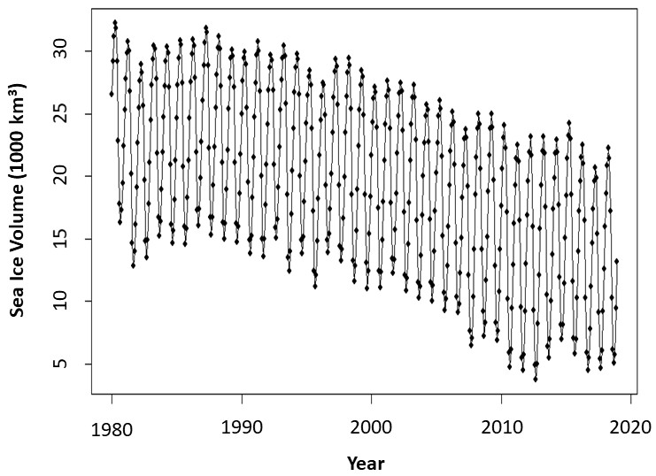
Changes in Arctic Sea Ice
(1980 to 2018)
Plot characteristics
Seasonality with a 12 month period
Downward trend indicating non-stationarity
No obvious change in variance
Not possibility to determine behavior due to the seasonality
No obvious intervention point
Working dataset
Initially not possible to define a model based on original dataset
Due to changing trend in initial and latter portions of dataset
Truncated dataset (1986 – 2012) for developing a model (red box)
Notes:
The plot of Arctic sea ice from 1980 to 2018 displayed seasonality with a downward trend indicating non-stationarity. There was some hint of changing variance but it was not obvious. The was no observed intervention point and the overall behaviour of the data could not be determined due to presence of seasonality. Initial attempts to model the data were not successful due to the change in slope in the initial and latter regions of the dataset. So we decided to truncate the data and used only the portion outlined by the red box in the figure for generating a model.

Slide 4
DETERMINISTIC MODELLING

Slide 5
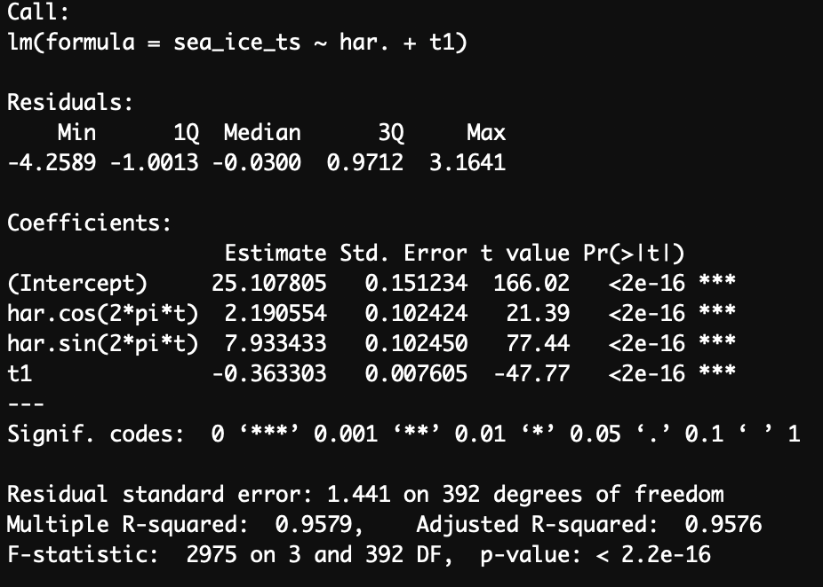
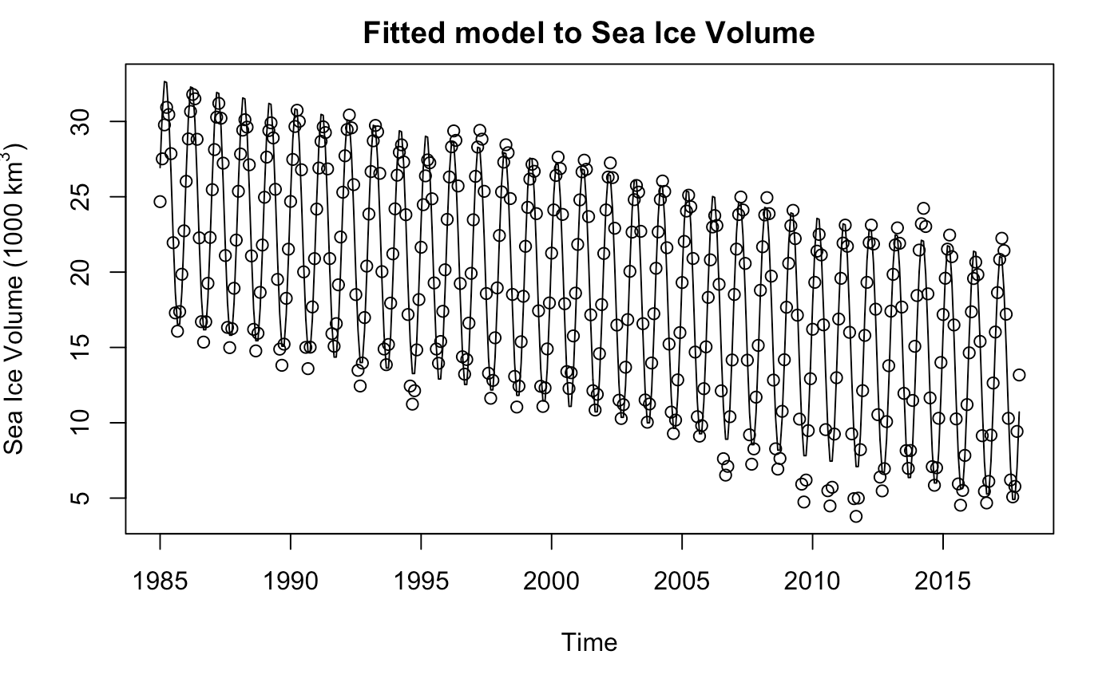
Harmonic-Trend Model
The thinking behind a harmonic model was due to the seemingly constant cyclical nature of this data. We also wanted something that could capture the trend of the data as well. Therefore a Harmonic Trend Model was proposed.
All Coefficients for the model were significant.
Harmonic Trend model fits the early data well, however as time goes on we see that a lot of points are lower than we expect
The adjusted R squared is very high, with the p value of this model being much less than 0.05, therefore this model seems adequate so far for this data
Notes:
So for one of the deterministic models we used a harmonic Trend The strategy behind this model was due to the non-stationarity of the data set as we can see it is definitely trending negatively..kinda scary..for this model we took the cyclical nature of the data in combined it with the trend to see if that would fit the data. According to the summary of the model we can see that all predictors are significant with quite a r2 it is well. Most of the points on the data at first seem to fit the model but as we go further down the trend and further in time we can see that a lot of the points are actually falling below where we expect them to go so this is alright but not great.

Slide 6
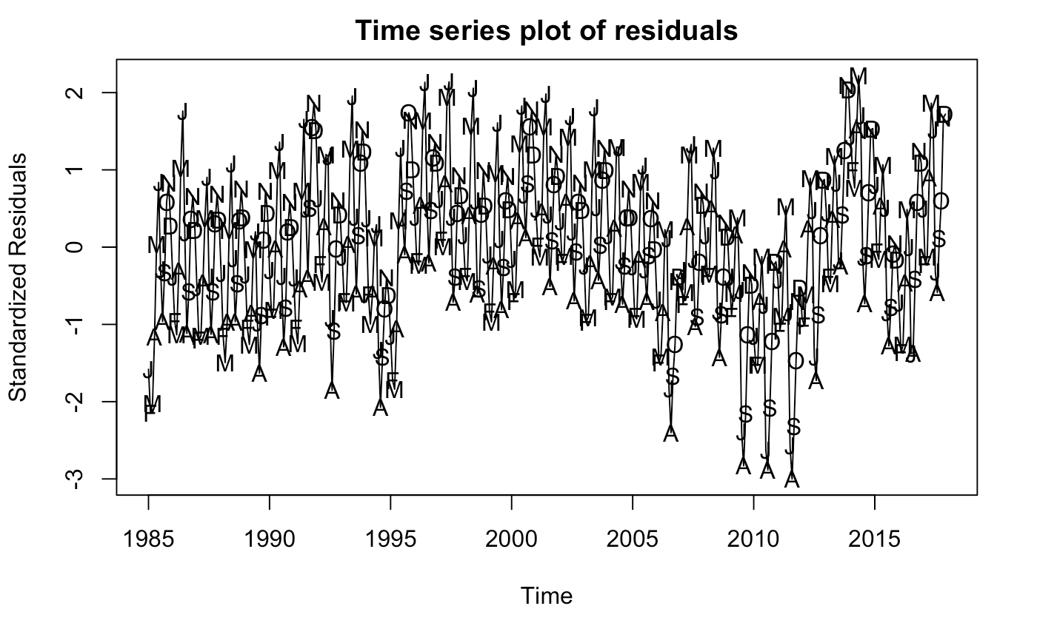
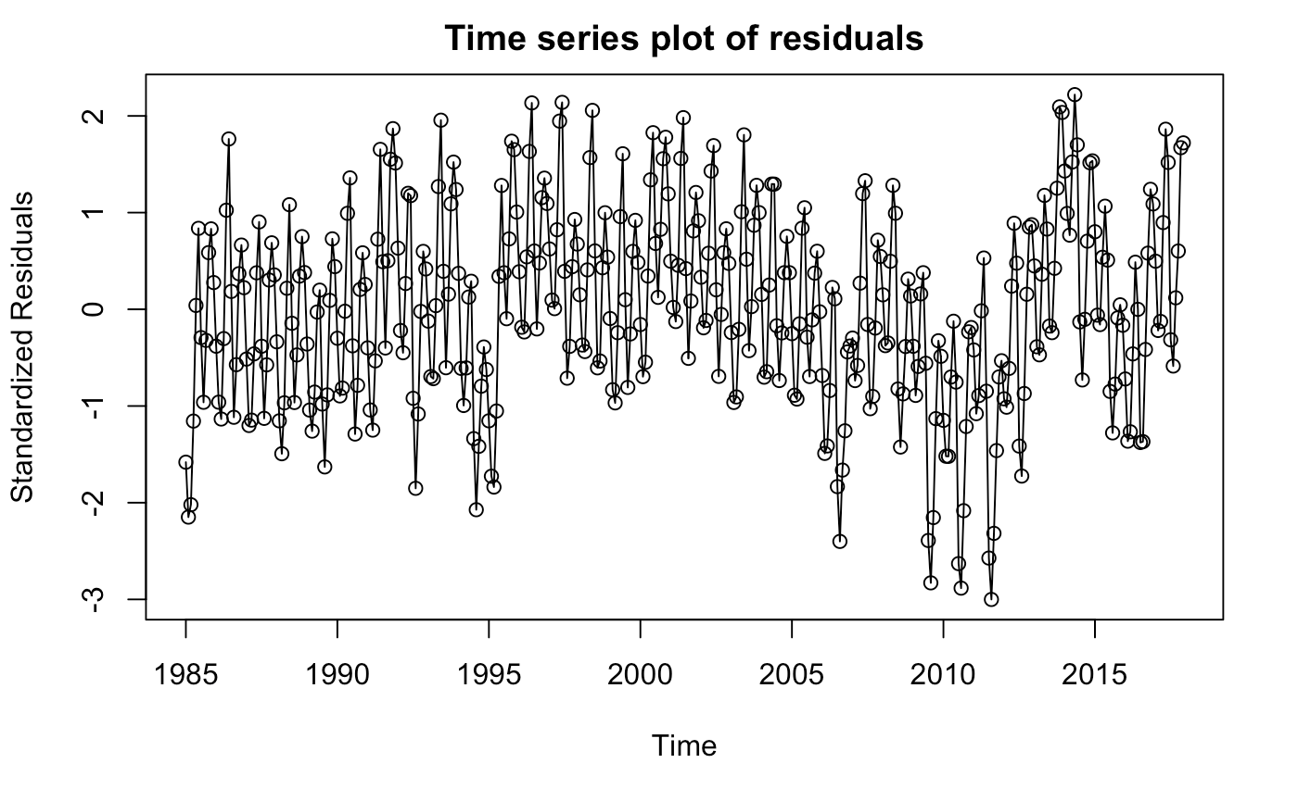
Harmonic-Trend Model
Residual Analysis
Shapiro-Wilk Test shows that the residuals are significantly normal as p > 0.05
Non-Constant Variance test shows that the model violates our assumptions of homoscedasticity as p < 0.05
This is evident in the top right plot where the month of the peaks start to change
Also evident in the bottom right plot as the variance changes as we go forward in time
Test | Shapiro-Wilk | Non-Constant Variance
P Value | 0.06984 | 0.04141394
Notes:
From the analysis of the residuals we could see that although the normality of the residuals was above .05 indicating that the residuals or normal underarm the constant variance test shows that our data is actually not being constantly so therefore we can kind of saying that this model isn't the best in terms of residual analysis. do non constant variance test shows it's just below .05 so we'll to forecast this final just to see what it looks like. you can see from the standardized residuals that at first it looks quite strange and homoskedastic however as we go further and time we can see that the residuals very quite a lot especially with the top right you can see that the month start off as the peak start off as general and then as it goes further in time we can see the peaks start to change

Slide 7
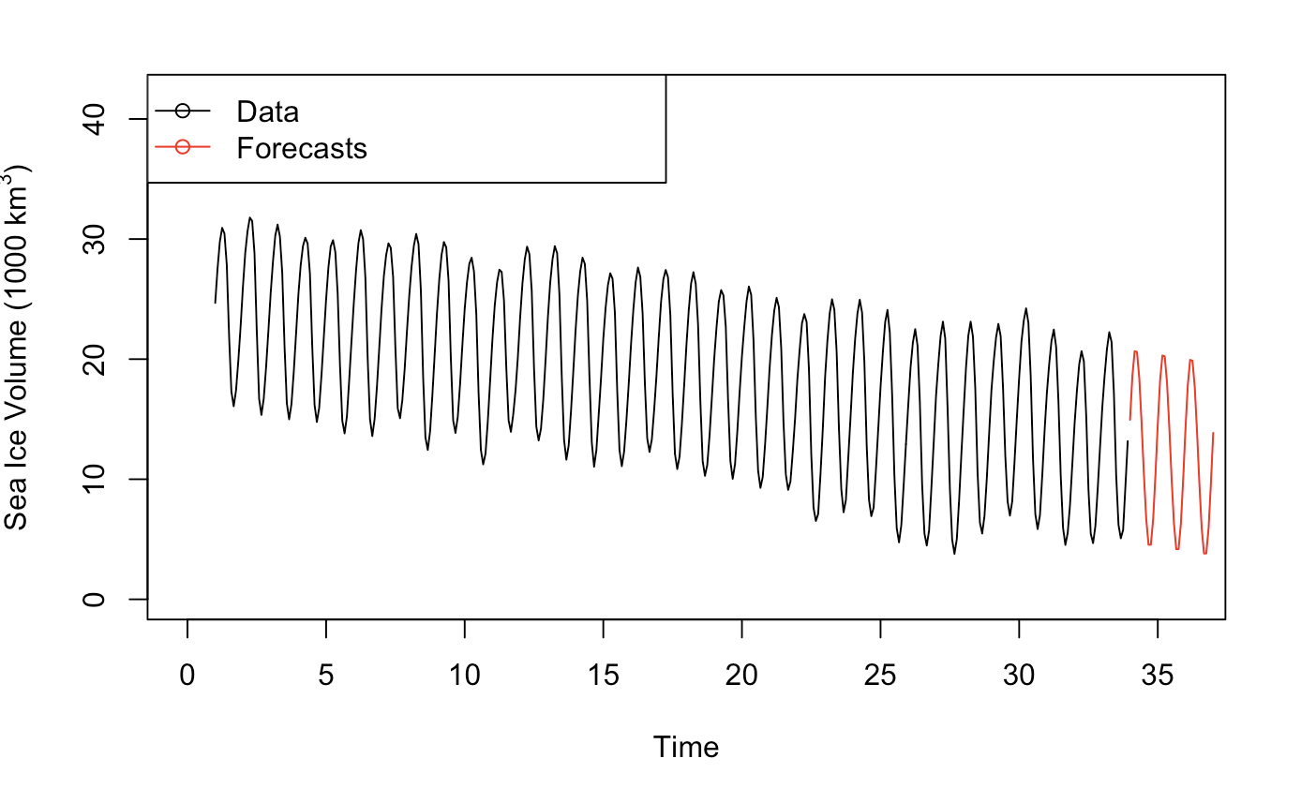
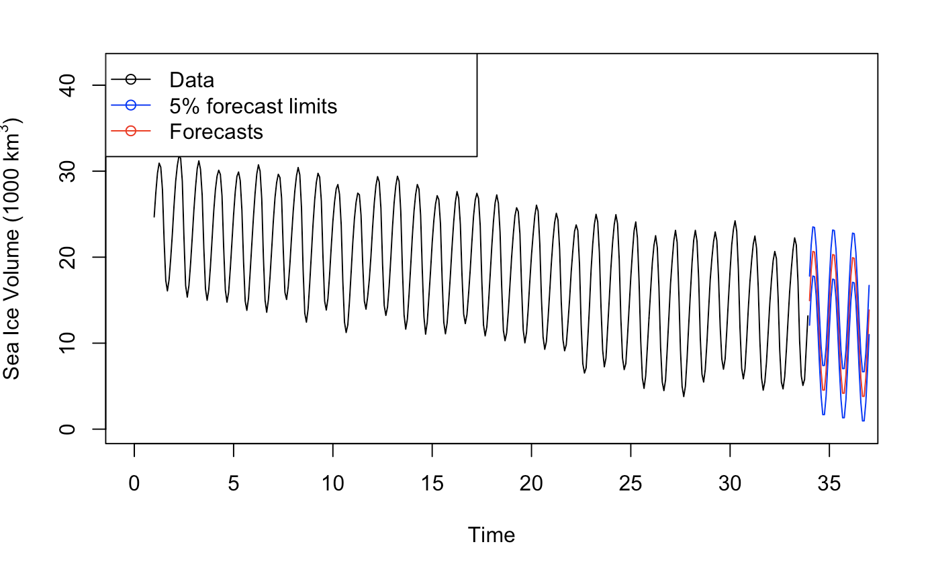
Harmonic-Trend Model
Forecasts
The forecasts seem to capture the overall trend and cyclical nature of the data
However the forecasts don’t seem to capture the variance we see in the data, especially as we go forward in time.
Due to these forecasts not capturing the variance and one of our assumptions for our model being violated, we will now look at a SARIMA model to see if that can better capture the data and forecast the Sea Ice Volume into the future.
Notes:
Forecast seem to capture all the overall data however it doesn't seem to capture the variance that we see going further and time Therefore we should go and explore other options when it comes to forecasting the data Set one such model includes and sarima model. which we will go into further detail in the following slides

Slide 8
SARIMA MODELLING

Slide 9
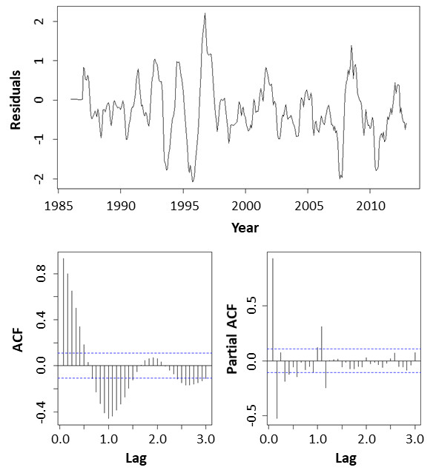
Residuals Approach
Transform and Model Seasonality
SARIMA(0,0,0)x(0,1,0)₁₂
Figure shows residuals remaining after:
Box-Cox transformation (λ = 0.85)
Setting D = 1, period = 12
SARIMA(0,0,0)x(0,1,0)₁₂
Absence of a pattern in the residuals confirms the presence of a seasonal trend.
Slowly decaying pattern prior to 1st period (1s) in ACF plot implies existence of an ordinary trend in the residuals.
Notes:
In this section, we generated a nonstationary seasonal ARIMA or SARIMA model using the residuals approach. We initially applied a Box-Cox transformation using a lambda value of 0.85. We then fit a SARIMA model with a seasonal order D value of 1 and plotted the time series ACF and PACF plots of the residuals. The absence of a pattern in the residuals confirmed the presence of a seasonal trend while the slow decaying pattern prior to the first period in the ACF plot indicated the existence of an ordinary trend in the residuals .

Slide 10
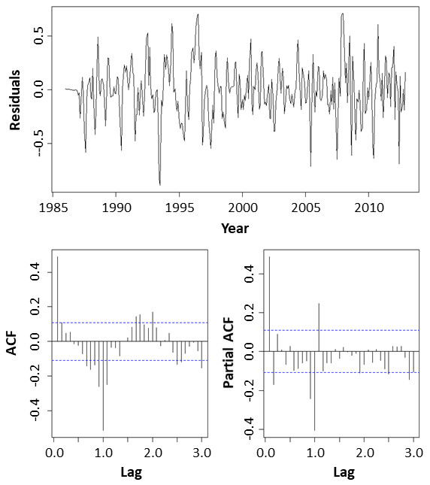
Model Trend
SARIMA(0,1,0)x(0,1,0)₁₂
Figure shows residuals remaining after:
Setting d = 1
SARIMA(0,1,0)x(0,1,0)₁₂
No evidence of ordinary trend remaining in residuals
Decreasing pattern in lags 1,2,3,.... in SARMA component of PACF plot. Correlation at lag 1 in ACF plot is significant. Implies existence of SMA(1) component.
ACF plot - 1 significant lag at 1s and 1 in 1st portion prior to 1s (q=1, Q=1).
PACF plot - 2 significant lags in region prior to 1s and 1 significant lags before 1s. (p=1,2, P=1)
Notes:
To remove the ordinary trend we set the non-seasonal order d value to 1 and re-fitted the model. No evidence of an ordinary trend was observed in the residuals. However, there was a significant autocorrelation at 1 in the ACF plot implying the existence of a SMA(1) component. There was also a significant lag in the initial part of the ACF plot before the first period inferring seasonal and non-seasonal order q values of 1. While the PACF plot displayed 2 significant lags prior to the first period giving seasonal and non-seasonal order p values of 1.

Slide 11
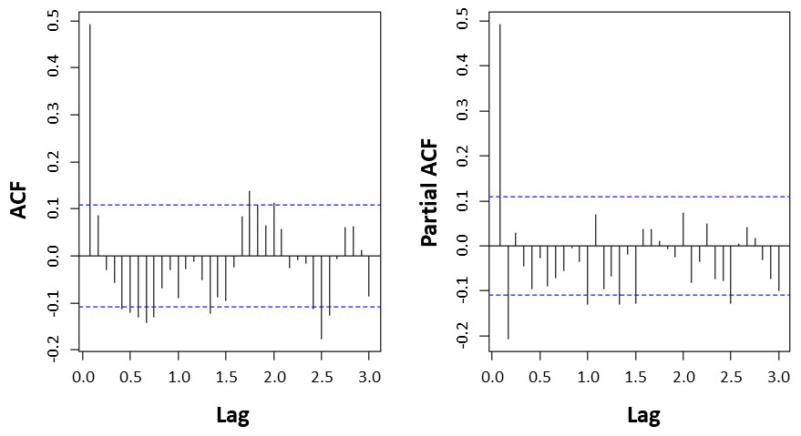
SARIMA(0,1,0)x(0,1,1)₁₂
Figure shows residuals remaining after:
Setting Q = 1
SARIMA(0,1,0)x(0,1,1)₁₂
Autocorrelation (especially 1st seasonal lag) in ACF plot become insignificant or slightly significant.
ACF plot - 1 significant and several less significant autocorrelations (q=1,2) prior to the 1st period.
PACF plot - 2 significant lags (p=1,2) prior to the 1st period.
Suggests ARMA(1,1), ARMA(1,2), ARMA(2,1) and ARMA(2,2).
Notes:
When the seasonal order q value was set to 1 the seasonal autocorrelations in the ACF plot became insignificant. The ACF plot contained 1 significant and several slightly significant autocorrelations prior to the first period while the PACF plot contained 2 significant autocorrelations. This implied non-seasonal order q and p values of 1 and 2. Overall the results suggested models of ARIMA(1,1), ARIMA(1,2), ARIMA(2,1) and ARIMA(2,2).

Slide 12
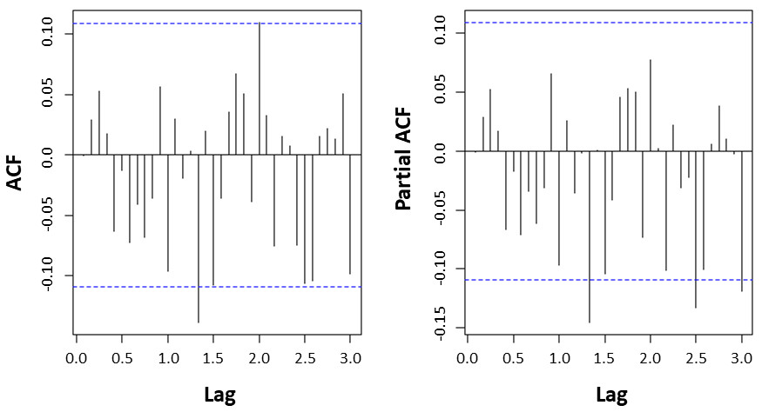
One potential Model - SARIMA(1,1,3)x(0,1,1)₁₂
Residuals of the SARIMA(1,1,3)x(0,1,1)₁₂ model are close to white noise.
Therefore, the orders are p=1, d=1, q=3, P=0, D=1, Q=1 and s=12 for the SARIMA(p,d,q)x(P,D,Q)_{s} model
Notes:
We varied the parameter values to determine a number of potential models. These included this SARIMA model which had seasonal order values of p = 1, d =1 and q = 3 and non-seasonal order values of P = 0, D =1 and Q = 1 with a seasonal period of 12.

Slide 13
Model Fitting
Model |  | Estimate | Std Error | Z value | Pr(>|z|)
SARIMA(1,1,3)x(0,1,1)₁₂ | ar1 | 0.8432 | 0.0394 | 21.3954 | <2.2e-16 | ***
 | ma1 | -0.2979 | 0.0655 | -4.5453 | 5.485e-6 | ***
 | ma2 | -0.4707 | 0.0506 | -9.3018 | <2.2e-16 | ***
 | ma3 | -0.2065 | 0.0564 | -3.66546 | 0.00025 | ***
 | sma1 | -0.6172 | 0.0461 | -13.3797 | <2.2e-16 | ***
Maximum likelihood (ML) estimates (table) and conditional least squares (CSS) indicated that all parameters were statistically significant at 5% level of significance.
Notes:
The maximum likelihood estimates and conditional least squares indicated these parameters were highly significant at a 5% level of significance.

Slide 14
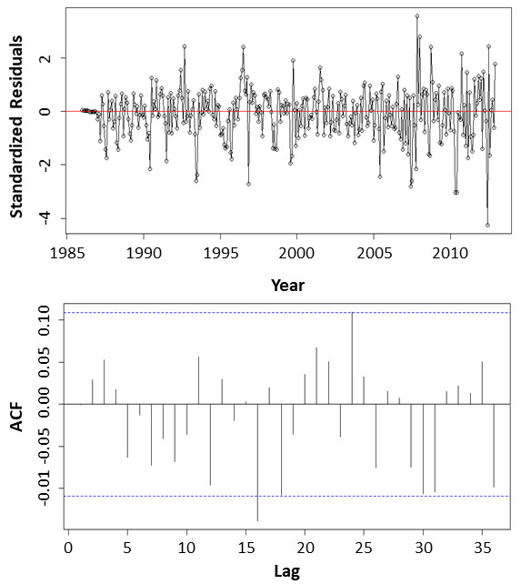
Diagnostic Checking
Plot of standardized residuals
Does not suggest any major irregularities with the model.
Several points that look like outliers that may need to investigated in more detail.
ACF plot of standardized residuals
Slightly significant autocorrelation at lag 16.
No other violations of the independence of residuals.
Box-Ljung Test
p-value of 0.3184
Overall, no problem in terms of independence of errors.
Notes:
The plot of the standardized residuals did not suggest any major irregularities. Although there were several apparent outliers which may warrant further investigation. The ACF plot of the standardized residuals exhibited a slightly autocorrelation at lag 16. However, there were no other violations of the independence of residuals. The Box-Ljung test gave a p-value of 0.318 indicating these was no problem in terms of the independence of errors.

Slide 15
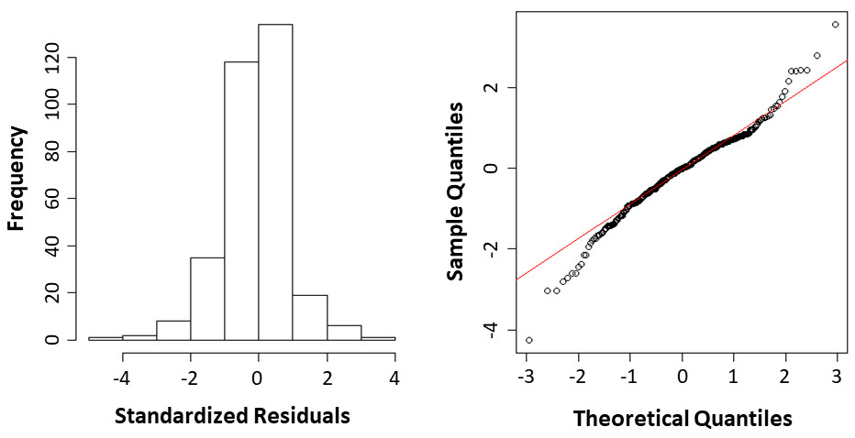
Normality of Residuals
Histogram and Q-Q plot for the distribution of standardized residuals.
Indicate residuals are normally distributed.
Notes:
The histogram and QQ-plots showed that the residuals were fairly reasonably normally distributed.

Slide 16
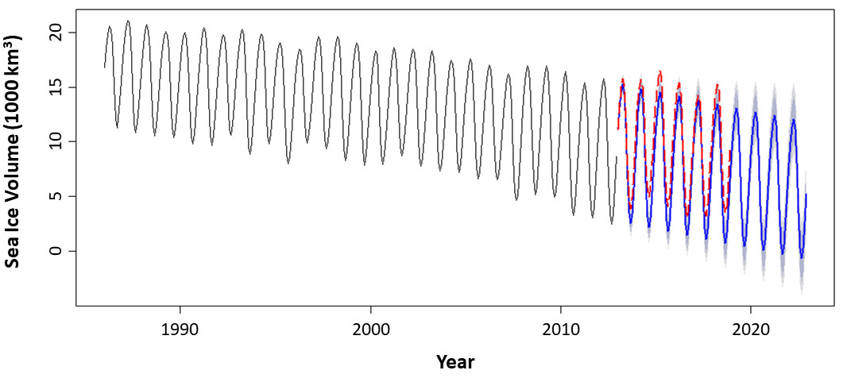
Forecast Using SARIMA Model
10-year forecast
Forecast limits
Actual data points
10-year forecast (2013 - 2023) was generated using the SARIMA(1,1,3)x(0,1,1)₁₂ model.
Truncated datapoints from 2013 to 2018 (dashed red line) that were not used to develop the model fitted well within the limits of the forecast.
Notes:
Having determined an appropriate SARIMA model we generated a 10-year long term forecast for Arctic sea ice volumes - shown as a blue line in this figure. The truncated data that was not used to develop the model, indicated here by the dashed red line, fitted reasonably well within the forecast limits of this model even though the actual data indicate that recent sea ice volumes were tending to level off.

Slide 17


Conclusions
Developed a model to forecast seasonal Arctic sea ice volumes.
Deterministic Harmonic-Trend model
Initial summary of model looked promising
Residuals showed that it was normal however it wasn’t a constant variance
Forecasts didn’t capture the variability in the data
Non-stationary seasonal ARIMA (SARIMA) model
SARIMA(1,1,3)x(0,1,1)₁₂ model
Generated 10-year forecast
Truncated data, not used to develop model, fit well within forecast limits.
Results indicate model can be used to forecast Arctic sea ice volumes assuming future inaction to mitigate effects of climate change.
Developing accurate forecast models essential to understand how climate change will affect the future environment.

