Slide 1
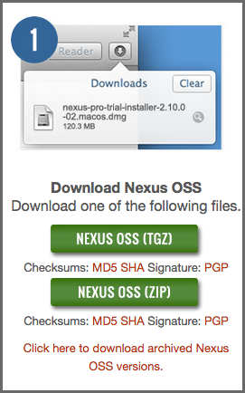
Nexus
Downloading Nexus Repository Manager OSS
To download the latest Nexus Repository Manager OSS distribution, go to http://www.sonatype.org/nexus/go and choose Nexus (TGZ) or Nexus (ZIP) shown in Figure. This will download a Gzip TAR (TGZ) or a ZIP with identical contents. Your download will be file named nexus-2.13.0-01-bundle.zip or nexus-2.13.0-01-bundle.tar.gz.

Slide 2
The following instructions are for installing Nexus Repository Manager OSS
Nexus Repository Manager Pro and Nexus Repository Manager OSS are bundled with a Jetty instance that listens to all configured IP addresses on a host (0.0.0.0) and runs on port 8081 by default.
Nexus Repository Manager OSS do not have any hard coded directories. It will run from any directory. If you downloaded the ZIP
$ unzip nexus-2.13.0-01-bundle.zip
And, if you download the GZip’d TAR archive, run:
$ tar xvzf nexus-2.13.0-01-bundle.tar.gz
The installation directory nexus-2.13.0-01 or nexus-professional-2.13.0-01 has a sibling directory namedsonatype-work. This directory contains all of the repository and configuration data and is stored outside of the installation directory to make it easier to upgrade to a newer version.
By default, this directory is always a sibling to the installation directory. If you installed the repository manager in the/usr/local directory it would also contain a sonatype-work subdirectory with a nested nexus directory containing all of the content and configuration. The location of the sonatype-work directory can be customized by altering the nexus-work property in $NEXUS_HOME/conf/nexus.properties.

Slide 3
Running as a Service on Linux
You can configure the repository manager to start automatically by copying the nexus script to the /etc/init.ddirectory. On a Linux system perform the following operations as the root user:
Create a nexus user with sufficient access rights to run the service
Copy $NEXUS_HOME/bin/nexus to /etc/init.d/nexus
Make the /etc/init.d/nexus script executable and owned by the root user -
chmod 755 /etc/init.d/nexus chown root /etc/init.d/nexus
Edit this script changing the following variables:
Change NEXUS_HOME to the absolute folder location (e.g., NEXUS_HOME="/usr/local/nexus")
Set the RUN_AS_USER to nexus or any other user with restricted rights that you want to use to run the service. You should not be running the repository manager as root.
Change PIDDIR to a directory where this user has read/write permissions. In most Linux distributions,/var/run is only writable by root. The property you need to add to customize the PID file location iswrapper.pidfile. For more information about this property and how it would be configured in wrapper.conf, see: http://wrapper.tanukisoftware.com/doc/english/properties.html.
Change the owner and group of the directories used by the repository manager, including nexus-workconfigured in nexus.properties defaulting to sonatype-work/nexus, to the nexus user that will run the application.
If Java is not on the default path for the user running the repository manager, add a JAVA_HOME variable which points to your local Java installation and add a $JAVA_HOME/bin to the PATH.

Slide 4
Nexus Integration using maven
Nexus Repository Manager OSS with Apache Maven, we configure Maven to check the repository manager instead of the default, built-in connection to the Central Repository.
To do this, you add a mirror configuration and override the default configuration for the central repository in your~/.m2/settings.xml as shown
Configuring Maven to Use a Single Repository Group.
<settings>
<mirrors>
<mirror>
<!--This sends everything else to /public -->
<id>nexus</id>
<mirrorOf>*</mirrorOf>
<url>http://localhost:8081/nexus/content/groups/public</url>
</mirror>
</mirrors>
<profiles>
<profile>
<id>nexus</id>
<!--Enable snapshots for the built in central repo to direct -->
<!--all requests to nexus via the mirror -->
<repositories>

Slide 5
<repository>
<id>central</id>
<url>http://central</url>
<releases><enabled>true</enabled></releases>
<snapshots><enabled>true</enabled></snapshots>
</repository>
</repositories>
<pluginRepositories>
<pluginRepository>
<id>central</id>
<url>http://central</url>
<releases><enabled>true</enabled></releases>
<snapshots><enabled>true</enabled></snapshots>
</pluginRepository>
</pluginRepositories>
</profile>
</profiles>
<activeProfiles>
<!--make the profile active all the time -->
<activeProfile>nexus</activeProfile>
</settings>
</activeProfiles>

Slide 6
In Configuring Maven to Use a Single Repository Group, we have defined a single profile called nexus. It configures a repository and a pluginRepository with the id central that overrides the same repositories in the super pom. The super pom is internal to every Apache Maven install and establishes default values. These overrides are important since they change the repositories by enabling snapshots and replacing the URL with a bogus URL. This URL is overridden by the mirror setting in the same settings.xml file to point to the URL of your single repository group. This group can, therefore, contain release as well as snapshot components and Maven will pick them up.
The mirrorOf pattern of * causes any repository request to be redirected to this mirror and to your single repository group, which in the example is the public group.
It is possible to use other patterns in the mirrorOf field. A possible valuable setting is to use external:*. This matches all repositories except those using localhost or file based repositories. This is used in conjunction with a repository manager when you want to exclude redirecting repositories that are defined for integration testing. The integration test runs for Apache Maven itself require this setting.
More documentation about mirror settings can be found in the mini guide on the Maven web site.
As a last configuration the nexus profile is listed as an active profile in the activeProfiles element.

Slide 7
Adding Repositories for Missing Dependencies
If you’ve configured your Maven settings.xml or other build tool configuration to use the public repository group as a mirror for all repositories, you might encounter projects that are unable to retrieve components from your local repository manager installation.
This usually happens because you are trying to build a project that has defined a custom set of repositories and snapshot repositories or relies on the content of other publically available repositories in its configuration. When you encounter such a project all you have to do is
add this repository to your repository manager as a new proxy repository
and then add the new proxy repository to the public group.
The advantage of this approach is that no configuration change on the build tool side is necessary at all.
Adding a New Repository
To add a repository, log in as an administrator, and click on the Repositories link in the left-hand navigation menu in the Views/Repositories section as displayed in Figure 4.1, “Creating a New Proxy Repository”.
Clicking on this link should bring up a window that lists all the configured repositories. You’ll then want to create a new proxy repository. To do this, click on the Add link that is directly above the list of repositories. When you click the Add button, click the down arrow directly to the right of the word Add, this will show a drop-down which has the options: Hosted Repository, Proxy Repository, Virtual Repository, and Repository Group. Since you are creating a proxy repository, click on Proxy Repository.

Slide 8
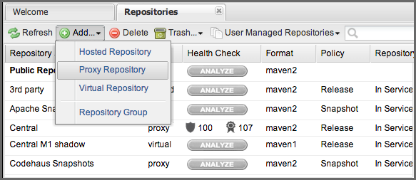
Figure 4.1. Creating a New Proxy Repository
Once you do this, you will see a screen resembling Figure 4.2, “Configuring a Proxy Repository”. Populate the required fields Repository ID and the Repository Name. The Repository ID will be part of the URL used to access the repository, so it is recommended to avoid characters that could cause problems there or on the filesystem storage. It is best to stick with lowercase alphanumerics. Set the Repository Policy to Release, and the Remote Storage Location to the public URL of the repository you want to proxy.

Slide 9
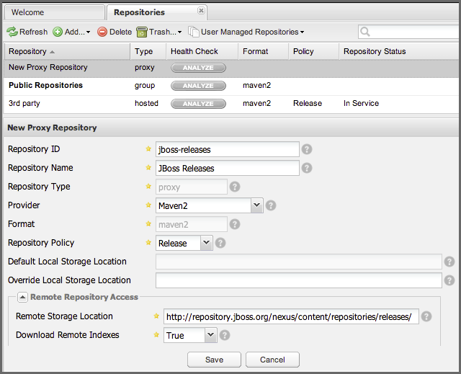
Figure 4.2. Configuring a Proxy Repository
Once you’ve filled out this screen, click on the Save button. The repository manager is now configured to proxy the repository. If the remote repository contains snapshots as well as release components, you will need to repeat the process creating a second proxy repository and setting the policy to Snapshots.

Slide 10
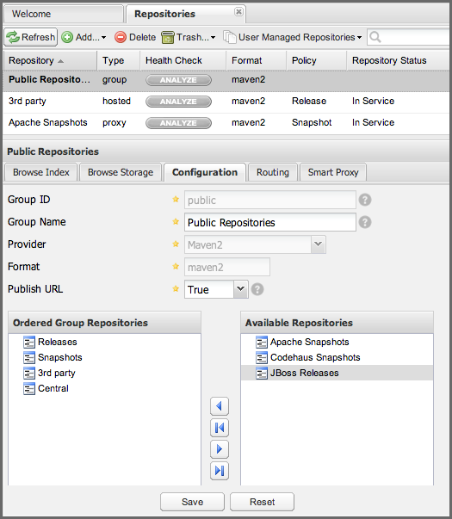
Adding a Repository to a Group
Next you will need to add the new repositories to the Public Repositories repository group. To do this, click on theRepositories link in the left-hand main menu in the Views/Repositories section. The repository manager lists Groups and Repositories in the same list so click on the public group. After clicking on the Public Repositories group, you should see the Browse and Configuration tabs in the lower half of the user interface.
Clicking on the Configuration tab will bring up a screen which looks like Figure 4.3, “Adding New Repositories to a Repository Group”.

Slide 11
To add the new repository to the public group, find the repository in the Available Repositories list on the right, click on the repository you want to add and drag it to the left to the Ordered Group Repositories list. Once the repository is in the Ordered Group Repositories list you can click and drag the repository within that list to alter the order in which a repository will be searched for a matching component.
In the last few sections, you learned how to add a new custom repositories to a build in order to download components that are not available in the Central Repository.
If you were not using a repository manager, you would have added these repositories to the repository element of your project’s POM, or you would have asked all of your developers to modify ~/.m2/settings.xml to reference two new repositories. Instead, you used the repository manager to add the two repositories to the public group. If all of the developers are configured to point to the public repository group, you can freely swap in new repositories without asking your developers to change local configuration, and you’ve gained a certain amount of control over which repositories are made available to your development team. In addition the performance of the component resolving across multiple repositories will be handled by repository manager and therefore be much faster than client side resolution done by Maven each time.

Slide 12
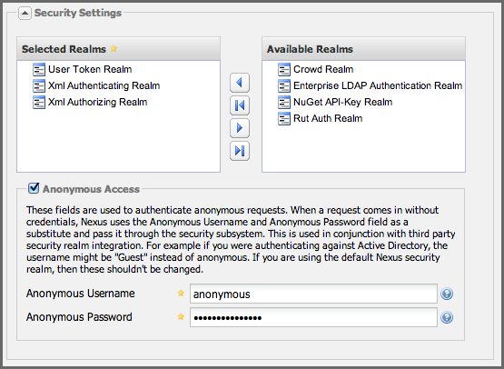
Configuring Nexus Repository Manager
Security Settings
The security settings displayed in Figure 6.3, “Administration Security Settings” allow you to activate and prioritize security realms by adding them to the Selected Realms list on the left and placing them higher or lower on the list.

Slide 13
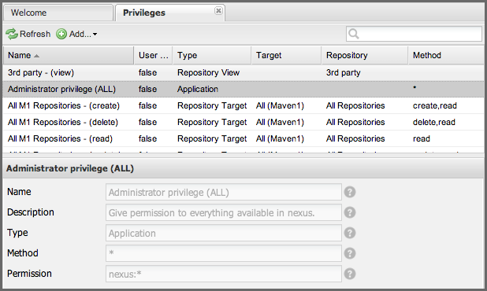
Managing Privileges
Available in Nexus Repository OSS and Nexus Repository Pro
You can access the configuration of privileges via the Privileges menu item in the Security submenu in the left-hand main menu.
The repository manager has three types of privileges:
application privileges - covers actions a user can execute in the user interface,
repository target privileges - governs the level of access a user has to a particular repository or repository target, and
repository view privileges - controls whether a user can view a repository
Behind the scenes, a privilege is related to a single REST operation and method like create, update, delete, read.

Slide 14
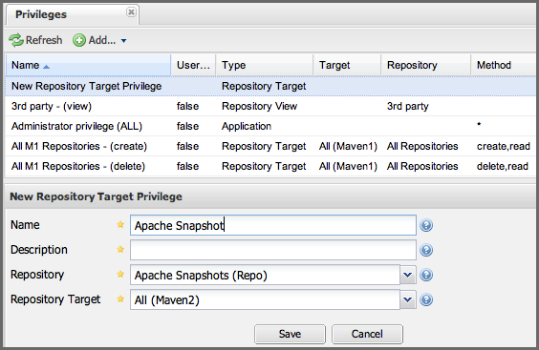
To create a new privilege, click on the Add… button in the Privileges panel and choose Repository Target Privilege. Creating a privilege will load the New Repository Target Privilege form shown in Figure 6.27, “Creating a New Repository Target Privilege”. This form takes a privilege name, a privilege description, the repository to target, and a repository target
Figure 6.27. Creating a New Repository Target Privilege

Slide 15
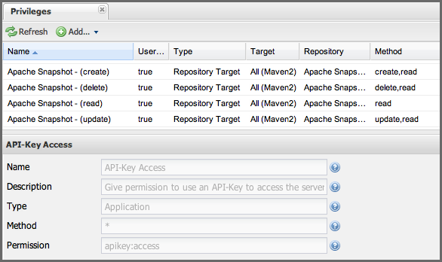
Once you create a new privilege, it will create four underlying privileges: create, delete, read, and update. The four privileges created by the form in Figure 6.27, “Creating a New Repository Target Privilege” are shown inFigure 6.28, “Create, Delete, Read, and Update Privileges Created”.
Figure 6.28. Create, Delete, Read, and Update Privileges Created

Slide 16
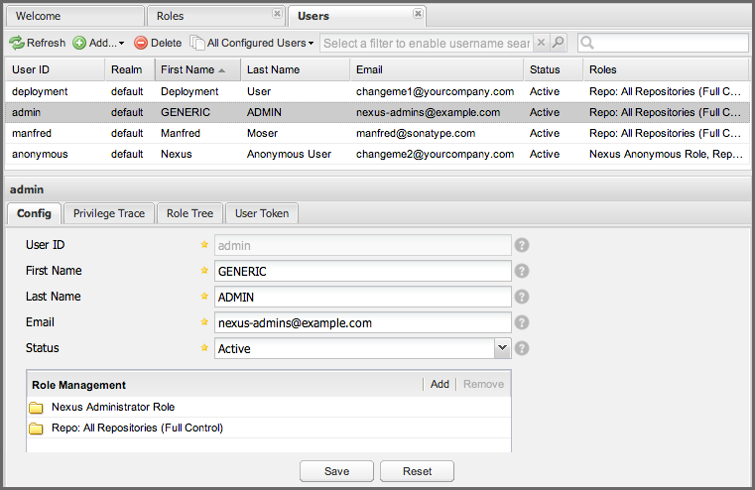
Managing Users
Available in Nexus Repository OSS and Nexus Repository Pro
Nexus Repository Manager Pro and Nexus Repository Manager OSS ships with three users: admin, anonymous, anddeployment. The admin user has all privileges, the anonymous user has read-only privileges, and the deployment user can both read and deploy to repositories. If you need to create users with a more focused set of permissions, you can click on Users under Security in the left-hand main menu. Once you see the list of users, you can click on a user to edit that specific user’s First Name, Last Name and Email. Editing a users Status allows you to activate or disable a user altogether. You can also assign or revoke specific roles for a particular user.
Figure 6.35. Managing Users

Slide 17
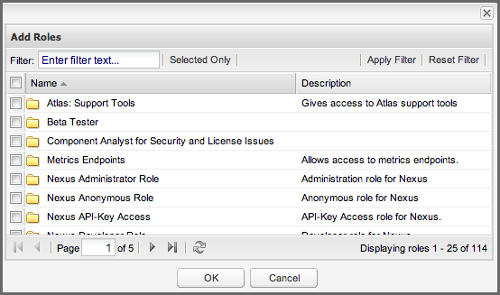
Clicking the Add button in the Role Management section will bring up the list of available roles in a pop-up window visible in Figure 6.36, “Adding Roles to a User”. It allows you filter and search for roles and add one or multiple roles to the user.
Figure 6.36. Adding Roles to a User
A user can be assigned one or more roles that in turn can include references to other roles or to individual privileges. To view a tree of assigned roles and privileges, select the Role Tree for a particular user as shown inFigure 6.37, “User Role Tree”

Slide 18
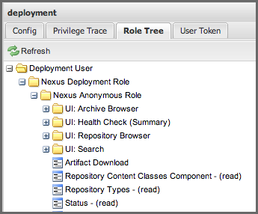
Figure 6.37. User Role Tree
If you need to find out exactly how a particular user has been granted a particular privilege, you can use thePrivilege Trace panel as shown in Figure 6.38, “User Privilege Trace”. The Privilege Trace panel lists all of the privileges that have been granted to a particular user in the Privileges section. Clicking on a privilege loads a tree of roles that grant that particular privilege to a user. If a user has been assigned a specific privilege by more than one Role or Privilege assignment, you will be able to see this reflected in the Role Containment list.

Slide 19
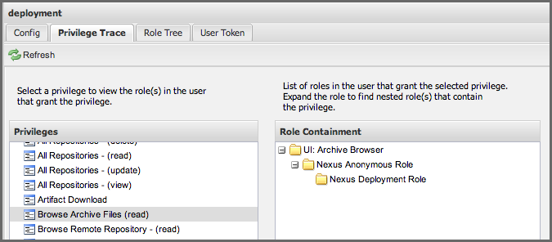
Figure 6.38. User Privilege Trace
Additional plugins can contribute further panels for the security configuration of a user. An example of an additional panel is the User Token panel, added by the User Token feature of Nexus Repository Manager Pro as documented in Section 6.17, “Security Setup with User Tokens”.

