Slide 1
argenx (ARGX)
CURRENT CALL
Long the commercial franchise after the pipeline reset
LONG
Public-data investment research pitch
at $825.03 | PT $1,006
Why: the October selloff reset expectations while VYVGART is still scaling rapidly, margins are expanding, and the remaining pipeline provides multiple independent upside paths.
Key checkpoint
Q3 2026 results | 22 Oct 2026
Catherina Haast | Sector Data Analyst interview project
Sources: argenx releases; Yahoo Finance reference close. Educational use only.

Slide 2
Investment snapshot
The selloff removed Sjogren's value, but the commercial franchise and remaining pipeline support a long setup.
Q2 2026 SALES
H1 OPERATING PROFIT
JUNE LIQUIDITY
OCT 9 CLOSE
$1.516bn
$887m
$5.2bn
$825.03
+60% YoY | +17% QoQ
Q2 operating profit: $494m
cash + current financial assets
~$51.9bn market cap (secondary)
What is attractive
Why the selloff creates an entry point
VYVGART has scaled rapidly and is now highly profitable.
The current price is ~20.5x the revised base FY2027 EPS, below the multiple used for the target.
Positive myositis Phase 3 data supports additional efgartigimod expansion.
Base case assumes 25% FY2027 growth, still a major deceleration from Q2's +60% YoY pace.
FB102 celiac Phase 2 success preserves non-FcRn pipeline optionality.
FB102 celiac success and upcoming MMN data provide upside without relying on Sjogren's.
Decision: LONG | $1,006 base target
Sources: argenx H1/Q2 2026 release (23 Jul 2026); Yahoo Finance ARGX quote (9 Oct 2026).

Slide 3
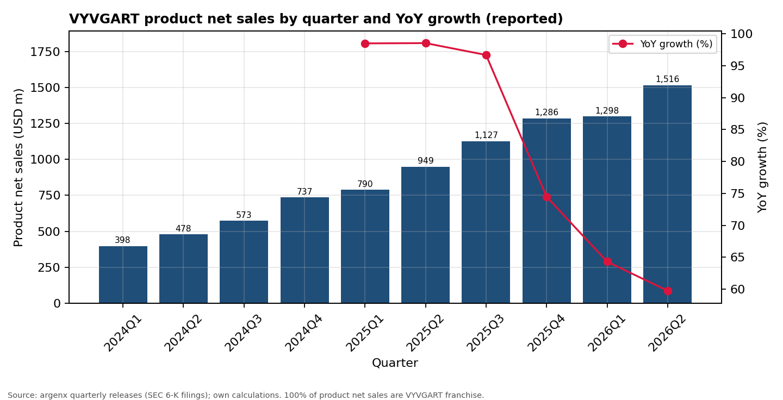
Commercial execution is still the core thesis
Sales have compounded rapidly; the investment question is how much deceleration is already priced in.
Read-through
Q2 reacceleration
+17% QoQ after a nearly flat Q1. The absolute dollar step-up was $218m.
Operating leverage
Q2 operating profit reached $494m, implying ~32.6% of product sales.
What I need next
Q3 must show that expansion is durable enough to offset slowing percentage growth.
Source: argenx quarterly releases / SEC filings; calculations in outputs/tables/growth_table.csv.

Slide 4
8 October was a pipeline reset, not a single-signal day
Two clinical releases arrived at the same time, so the price reaction cannot be attributed cleanly to one headline.
NEGATIVE
POSITIVE
UNITY / Sjogren's
FB102 / celiac
Phase 3 discontinued for futility after the independent monitoring committee concluded the primary endpoint could not be met.
Phase 2 met the primary endpoint (p=0.0176). argenx plans to advance FB102 into Phase 3 development.
Model treatment: zero explicit Sjogren's revenue.
Model treatment: optionality, but no discrete revenue yet.
Investment read-through: lower confidence in broad efgartigimod expansion, but not a break in the approved franchise.
Primary sources: argenx UNITY update and FB102 celiac Phase 2 release, both 8 Oct 2026.

Slide 5
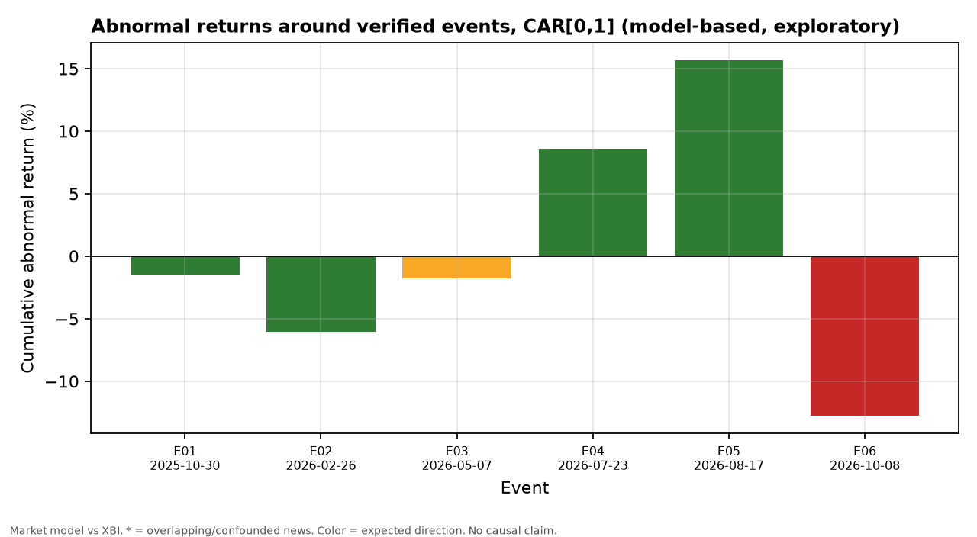
The stock reprices hard around clinical information
A small event study shows large abnormal moves, but the sample is exploratory and several events are confounded.
Two useful anchors
+15.7%
CAR[0,1] around positive ALKIVIA myositis data (17 Aug).
-12.7%
CAR[0,1] around the 8 Oct mixed clinical day. Volume was ~8.3x baseline on day 0.
Use: risk calibration, not causal inference.
Method: market model vs XBI, 100-day estimation windows. See src/event_study.py and docs/limitations.md.

Slide 6
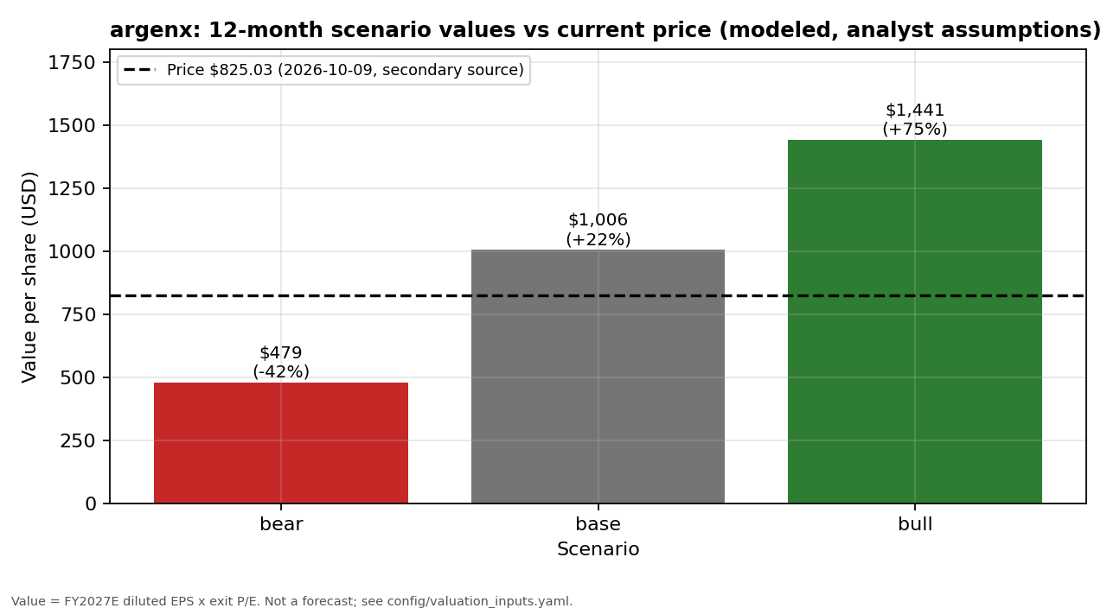
Base case supports a 22% upside target
The long does not require Sjogren's revenue: it rests on commercial execution, operating leverage, and a defensible premium multiple.
Scenario drivers
BEAR
12% FY27 growth | 30% margin | 18x P/E
BASE
25% FY27 growth | 38% margin | 25x P/E
BULL
35% FY27 growth | 40% margin | 30x P/E
Base: $40.23 FY27 EPS x 25x = $1,006/share (+22%).
Model: config/valuation_inputs.yaml; outputs/tables/valuation_scenarios.csv. Price $825.03 from Yahoo Finance.

Slide 7
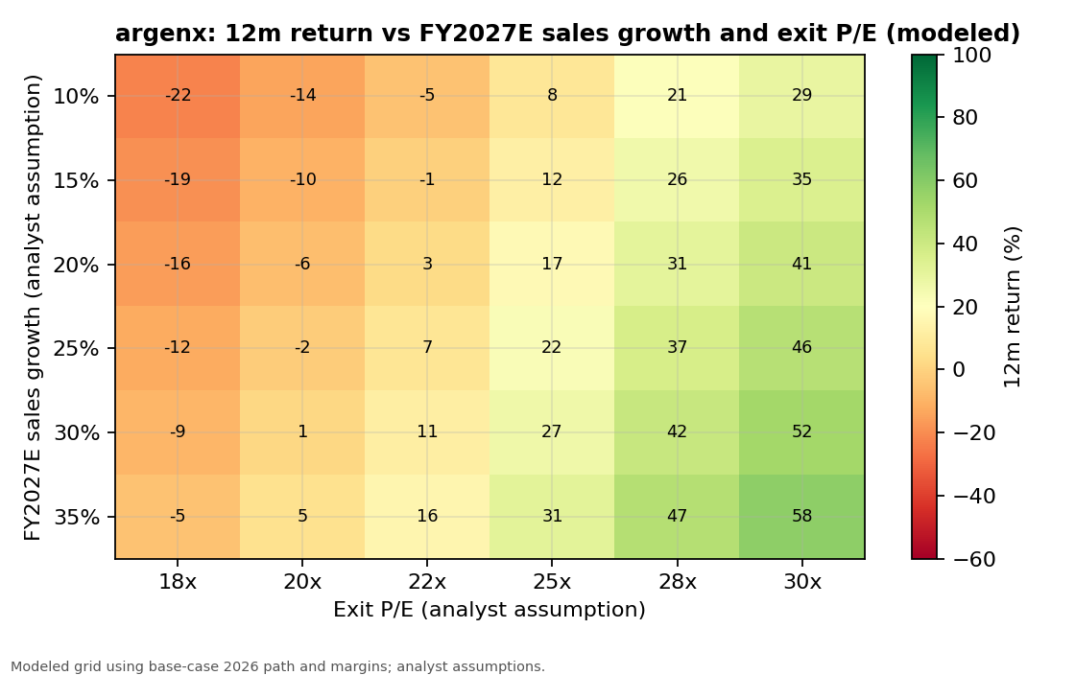
The long is a commercial-growth plus multiple-durability call
At $825, the market pays ~20.5x base FY2027 EPS. The thesis works if growth remains strong enough to sustain a ~25x multiple.
Reverse valuation
10% annual return
25x exit P/E
$8.9bn
2030 product sales required
~9.4%
revenue CAGR from FY2026E base
Reverse valuation assumes 40% 2030 operating margin and base tax/financial-income assumptions.

Slide 8
Long thesis: catalysts, checkpoint, and invalidation
The recommendation is explicit, but it is tied to observable commercial and clinical evidence.
WHY LONG NOW
NEXT CHECKPOINT
THESIS BREAKERS
VYVGART remains the dominant earnings engine after the Sjogren's reset
22 OCT
VYVGART growth decelerates faster than the market expects
Q3 2026 RESULTS
25% FY27 growth is a meaningful haircut from current reported growth
Margins weaken despite scale or cash use is materially worse than expected
Watch: sales growth, operating leverage, post-Forte cash, and updated clinical timing.
FB102 and empasiprubart add upside not required in the base case
Additional late-stage failures undermine the premium pipeline multiple
Current call: LONG at $825.03 | 12m PT $1,006 (+22%)
Conclusion based on public information through 9 Oct 2026. Q3 results are the next major thesis check.

