Slide 1
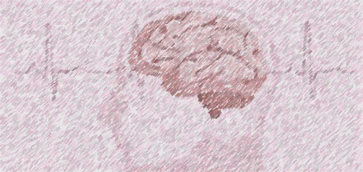
Stroke Prediction An Exercise in Machine Learning and Stroke Probability Predictions
Yakov Krasnikov
Charles Philpott
Troy Youngblood

Slide 2
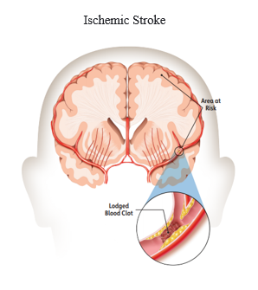
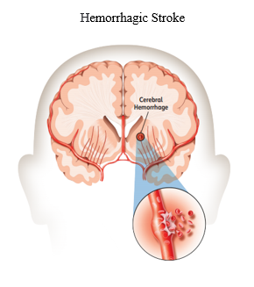
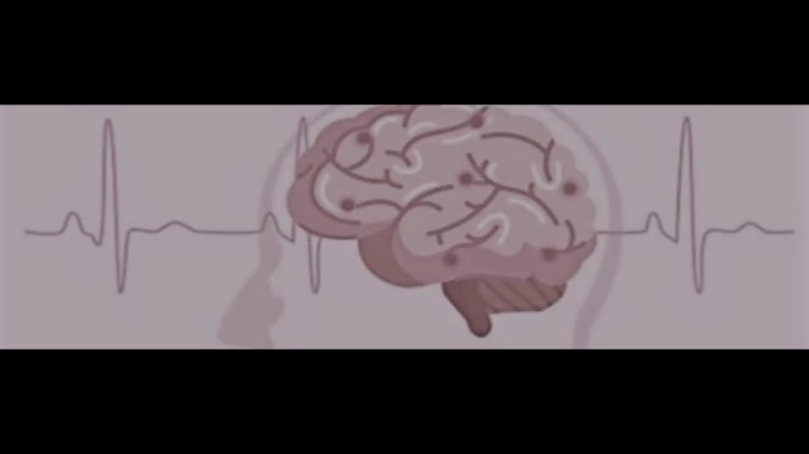
Inspiration: Stroke Screening Tool
Cerebrovascular accidents (strokes) in 2020 were the 5th leading cause of death ^{[1]} in the United States.
A stroke occurs when the blood supply to a region of the brain is suddenly blocked or when a rupture occurs starving the brain cells of oxygen and nutrients. Blockage obstructing the flow of blood to a region of the brain is called an ischemic stroke and accounts for 87% ^{[2]} of all strokes. The rupturing of a blood vessel is called a hemorrhagic stroke and accounts for 13% ^{[3]} of all strokes.
Source of Images ^{[4]}

Slide 3
Data: 11 Clinical features for Predicting Stroke Events
Data ^{[4]} from Kaggle
Dataset used for model contained 5109 unique rows. Each row contains patient information designated by a unique id
2,994 Females
59% of dataset
2,115 Males
41% of dataset
4.9% have had a stroke
92% of strokes occur over age of 50
Data Attributes
id unique identifier for each set of information
gender: “Male, “Female”
age: age of the patient
hypertension: 0 no hypertension, 1 if hypertension
heart_disease: 0 no heart disease, 1 if heart disease
ever_married: “No” or “Yes”
work_type: “children”, “Govt_job”, “Never_worked”, “Private”, or “Self-employed”
Residence_type: “Rural” or “Urban”
avg_glucose_level: average glucose level in blood
bmi: body mass index
smoking_status: “formerly smoked”, “never smoked”, “smokes”, or “Unknown”
stroke: 0 no stroke, 1 if stroke

Slide 4
Hypothesis
A reliable predictive model can be developed if the data and stroke key attributes are correctly identified and prepared for the machine learning process.
The importance of features generated by the model selected will be compared against the stroke risk factors identified by the American Stroke Association.
If the attributes are correctly identified by the model, the hypothesis will be considered validated.
Basis Risk Factors from American Stroke Association common to the dataset.
High Blood Pressure
Smoking
Diabetes
Obesity
Heart Disease
Age (cannot be controlled)
Gender (cannot be controlled)

Slide 5
Web Application

Slide 6
Conclusion
Revisit Hypothesis:
A reliable predictive model can be developed if the data and stroke key attributes are correctly identified and prepared for the machine learning process.
High Blood Pressure
Smoking
Diabetes
Obesity
Heart Disease
Age (cannot be controlled)
Gender (cannot be controlled)
Hypothesis Validated:
The top eleven in the Feature Importance chart:
Age
Heart disease
Diabetes (avg_glucose_level)
High Blood Pressure (Hypertension)
Married
Smoking (smoking_status_former & smokes)
work_type_self-employed & Private
Obesity (bmi)
Gender
(Grayed out attributes are dataset dependencies)

Slide 7
Actionable Items
This model is one of many tools which are needed to increase awareness and help reduce stroke incidents.
80% of strokes are preventable.
Actionable item
Support stroke prevention awareness programs
Exercise
Eating correctly
Programs to stop smoking.

Slide 8
Questions?

Slide 9
References
[1] Ahmad FB, Cisewski JA, Miniño A, Anderson RN. Provisional Mortality Data — United States, 2020. MMWR Morb Mortal Wkly Rep 2021;70:519–522. DOI: https://www.cdc.gov/mmwr/volumes/70/wr/mm7014e1.htm?s_cid=mm7014e1_w#F1_down
[2] American Stroke Association, https://www.stroke.org/en/about-stroke/types-of-stroke/ischemic-stroke-clots
[3] American Stroke Association, https://www.stroke.org/en/about-stroke/types-of-stroke/hemorrhagic-strokes-bleeds
[4] American Stroke Association, Explaining Stroke, pages 1-20, https://www.stroke.org/-/media/stroke-files/stroke-resource-center/brochures/explaining_stroke_brochure_6_25_19.pdf?la=en
[5] American Stroke Association, https://www.stroke.org/en/about-stroke
[6] Stroke Prediction Dataset, 11 clinical features por predicting stroke events, https://www.kaggle.com/fedesoriano/stroke-prediction-dataset

