Slide 1
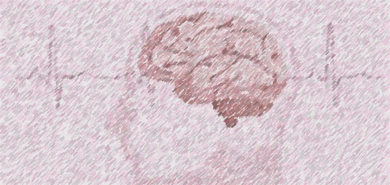
Stroke Prediction An Exercise in Machine Learning and Stroke Probability Predictions
Yakov Krasnikov
Charles Philpott
Troy Youngblood

Slide 2
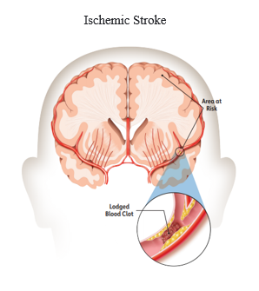
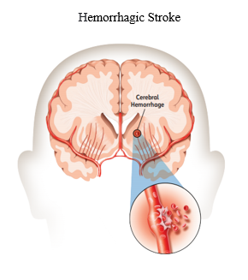
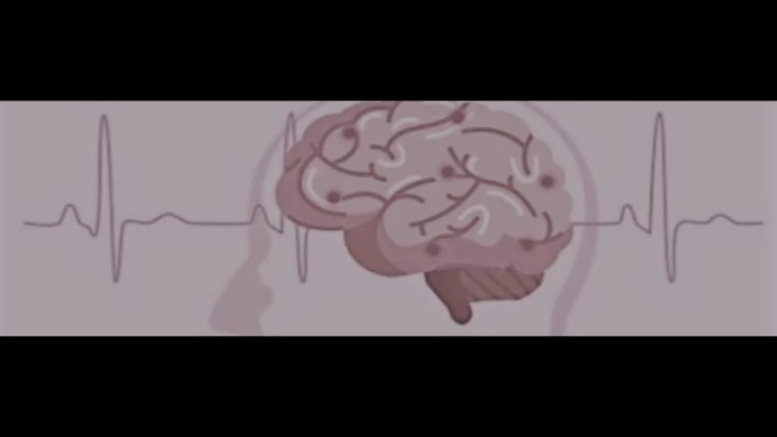
Inspiration: Stroke Screening Tool
Cerebrovascular accidents (strokes) in 2020 were the 5th leading cause of death ^{[1]} in the United States.
A stroke occurs when the blood supply to a region of the brain is suddenly stopped by either a blockage or a rupture.
Blockage is an ischemic stroke and accounts for 87% ^{[2]} of all strokes.
Rupturing of a blood vessel is a hemorrhagic stroke and accounts for 13% ^{[3]} of all strokes.
Source of Images ^{[4]}

Slide 3
Data: 11 Clinical features for Predicting Stroke Events
Data ^{[4]} from Kaggle
Dataset used for model has 5109 unique rows
59% Female, 41% Male
5% have had a stroke
92% of strokes occur over age of 50
38% of strokes between 70 – 79
Obesity and Current/Former Smoker top 2 comorbidities
Occur 86% of stroke victims had comorbidities
Data Attributes
id unique identifier for each set of information
gender: “Male, “Female”
age: age of the patient
hypertension: 0 no hypertension, 1 if hypertension
heart_disease: 0 no heart disease, 1 if heart disease
ever_married: “No” or “Yes”
work_type: “children”, “Govt_job”, “Never_worked”, “Private”, or “Self-employed”
Residence_type: “Rural” or “Urban”
avg_glucose_level: average glucose level in blood
bmi: body mass index
smoking_status: “formerly smoked”, “never smoked”, “smokes”, or “Unknown”
stroke: 0 no stroke, 1 if stroke

Slide 4
Hypothesis
A reliable predictive model can be developed if:
Data and
Key stroke attributes are correctly identified
Importance features of model will be compared against the risk factors from the American Stroke Association.
If the attributes are correctly identified by the model, the hypothesis will be considered validated.
Risk Factors from American Stroke Association
Age (cannot be controlled)
Heart Disease
Diabetes
High Blood Pressure
Smoking
Obesity
Gender (cannot be controlled)

Slide 5
Web Application

Slide 6
Conclusion
Hypothesis Criteria – model importance risk factors match American Stroke Association
Age
Heart Disease
Diabetes
High Blood Pressure
Smoking
Obesity
Gender
Hypothesis Validated:
The top eleven in Feature Importance:
Age
Heart disease
Diabetes (avg_glucose_level)
High Blood Pressure (Hypertension)
Married
Smoking (smoking_status_former & smokes)
work_type_self-employed & Private
Obesity (bmi)
Gender
(Grayed out attributes are dataset dependencies)

Slide 7
Actionable Items
This model is one of many tools which are needed to increase awareness and help reduce stroke incidents.
80% of strokes are preventable.
Actionable item
Support stroke prevention awareness programs
Exercise
Eating correctly
Programs to stop smoking

Slide 8
Questions?

Slide 9
References
[1] Ahmad FB, Cisewski JA, Miniño A, Anderson RN. Provisional Mortality Data — United States, 2020. MMWR Morb Mortal Wkly Rep 2021;70:519–522. DOI: https://www.cdc.gov/mmwr/volumes/70/wr/mm7014e1.htm?s_cid=mm7014e1_w#F1_down
[2] American Stroke Association, https://www.stroke.org/en/about-stroke/types-of-stroke/ischemic-stroke-clots
[3] American Stroke Association, https://www.stroke.org/en/about-stroke/types-of-stroke/hemorrhagic-strokes-bleeds
[4] American Stroke Association, Explaining Stroke, pages 1-20, https://www.stroke.org/-/media/stroke-files/stroke-resource-center/brochures/explaining_stroke_brochure_6_25_19.pdf?la=en
[5] American Stroke Association, https://www.stroke.org/en/about-stroke
[6] Stroke Prediction Dataset, 11 clinical features por predicting stroke events, https://www.kaggle.com/fedesoriano/stroke-prediction-dataset

