Slide 1
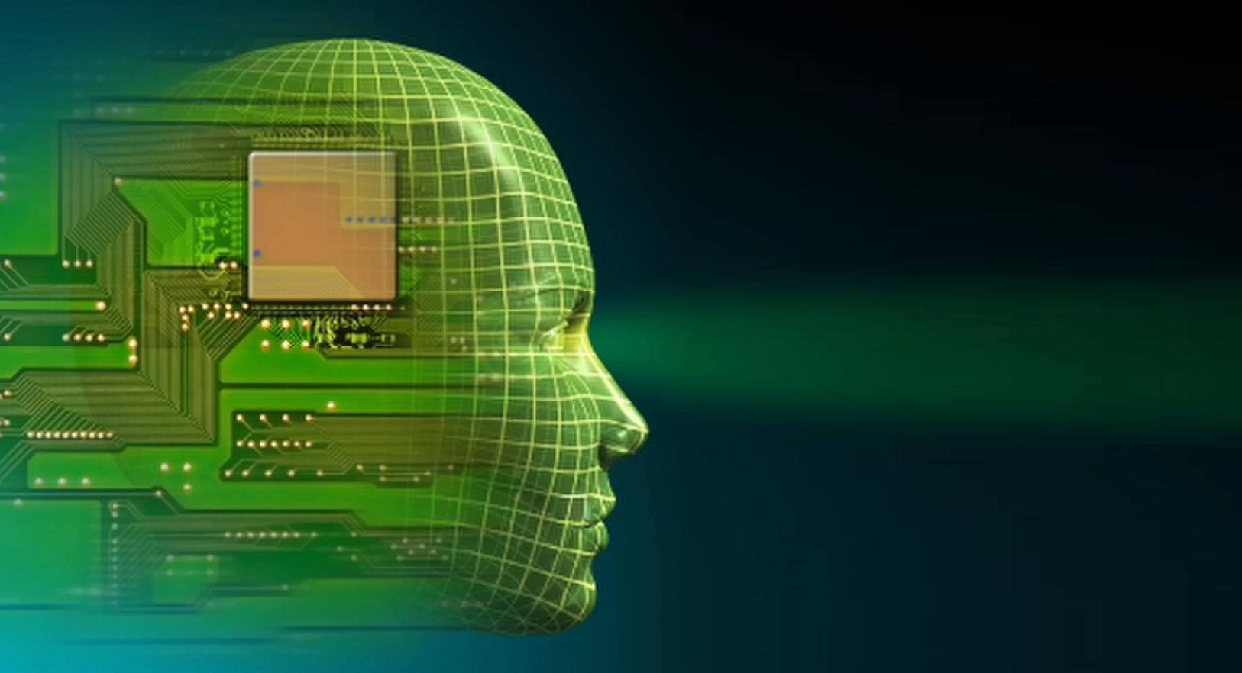
CAPI
cognitive
interface
automatic
psychologist
Your new best friend

Slide 2
Project Team Yuval Khoramian Shoham Zarfati Hod Twito Ron Zeidman Instructor – Prof. Yuval Shahar

Slide 3

The Goal
The main goal of the project is to develop software that will be able to learn how the user express his feelings while using the computer. This will enable the computer to understand the user better.

Slide 4

The Problem
Modern computers don't consider the emotions of users. A form of emotional intelligence can improve the users' experience, by enabling a new aspect of communication between the user and the computer.

Slide 5
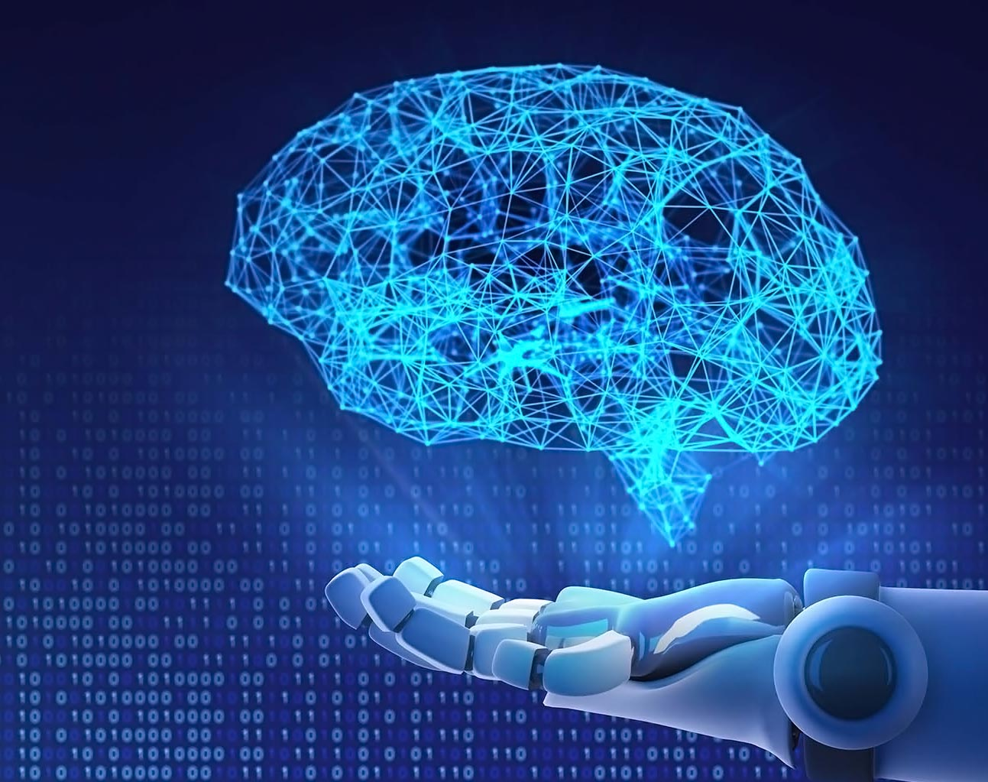
The Solution
We are going to focus on two possible approaches:
Using keyboard and mouse input to predict emotions
Using image/video of the user to predict emotions
Image recognition is a well-studied field, and CNN architectures are very promising. Treating keyboard and mouse as time-series data, using RNN and more modern Transformer architectures, can lead to encouraging results.

Slide 6

Expected Challenges
Creating a high accuracy model for each user.
Obtaining labels in the learning stage.
Extracting useful features from the data.
Creating a model that can be trained quickly.
Planning test to quantify our results.

Slide 7
Project Schedule
start of December
Initial literature review – exploring existing projects and feasibility. (Due start of December)
start of January
Implementing framework and MVP. (Due start of January)
start of April
Second literature review, reviewing more advanced methods and solutions for more specific problems like improving accuracy or performance of the existing models.(Due start of April)
middle of June
Iteratively improving the models. (Due middle of June)
end of June
Improving user experience and the applications itself to better fit newer models. (Due end of June)

