Slide 1
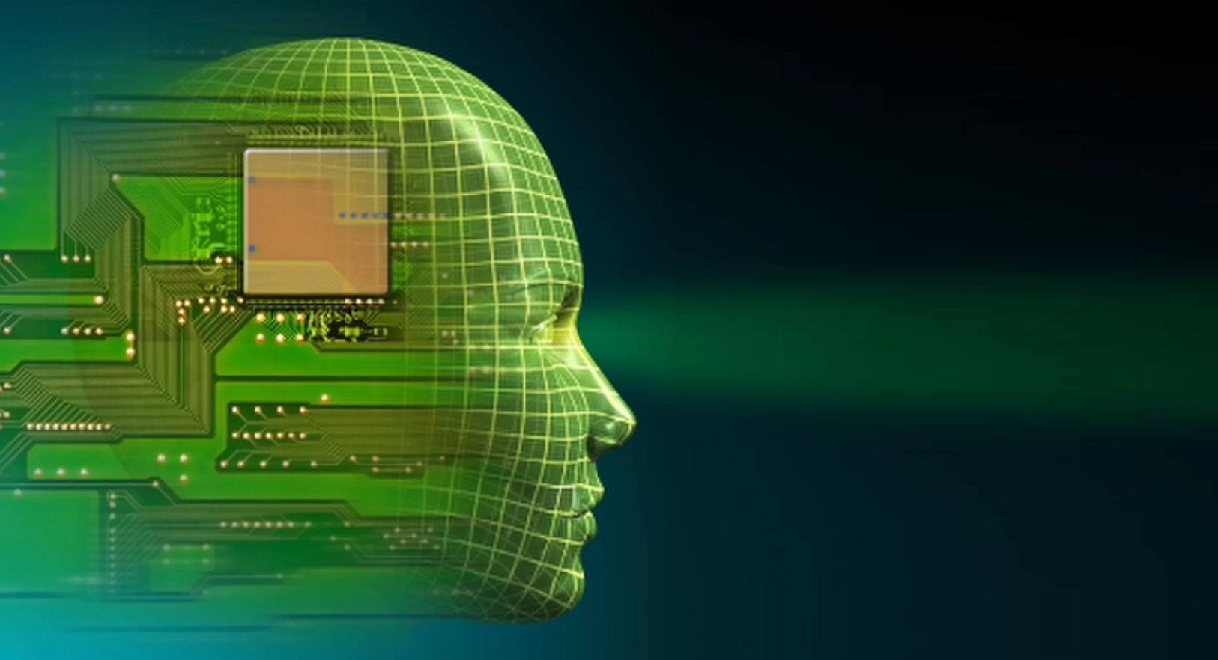
CAPI
cognitive
interface
automatic
psychologist
Your new best friend

Slide 2
Project Team Yuval Khoramian Shoham Zarfati Hod Twito Ron Zeidman Instructor – Prof. Yuval Shahar

Slide 3

The Goal
The main goal of the project is to develop software that will be able to learn how the user express his feelings while using the computer. This will enable the computer to understand the user better.

Slide 4

The Problem
Modern computers don't consider the emotions of users. A form of emotional intelligence can improve the users' experience, by enabling a new aspect of communication between the user and the computer.

Slide 5
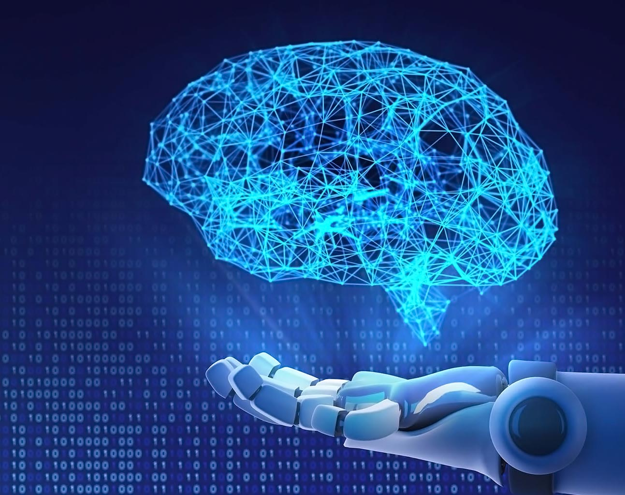
The Solution
We are going to focus on two possible approaches:
Using keyboard and mouse input to predict emotions
Using image/video of the user to predict emotions
Image recognition is a well-studied field, and CNN architectures are very promising. Treating keyboard and mouse as time-series data, using RNN and more modern Transformer architectures, can lead to encouraging results.

Slide 6

Expected Challenges
Creating a high accuracy model for each user.
Obtaining labels in the learning stage.
Extracting useful features from the data.
Creating a model that can be trained quickly.
Planning test to quantify our results.

Slide 7

Literature review insights
After reviewing several papers from related fields - emotional psychology, computer vision, keyboard-mouse dynamics, and emotion detection, we found strong evidence supporting the field's ability to advance in our direction. We found a few papers which we can build upon in order to improve emotion recognition systems. Each paper provided with a few ideas for new approaches to try and combine.

Slide 8

Project requirements
Our project consists of two parts.
The core of the project is the research and development of better solutions for emotion recognition.
The second is the personalized data gathering system.
To begin the research, we first need to gather data from several different experiments. Later, using the data, we will experiment with different models, finally combining them to create an end-to-end personalized emotion recognition.

Slide 9
Project Schedule
12.1.21
Implement data gathering system and begin experiments with models that do not require costume data.
26.2.21
Finish most, if not all data gathering experiments. Start testing models that require costume data.
16.4.21
Finish most experiments with the models, and finish any remaining data gathering.
18.6.21
Finish any remaining experiments and write a paper.

