Slide 1

Dependency Injection (and more)

Slide 2
Going to cover…
Theory - what is Dependency Injection
Code walkthrough of the basic dependency injection pattern
What do Dependency Injection libraries do?
Code walkthrough with Guice
Advanced features of Guice
Handling the most common problem with Dependency Injection
Bonus: other Google classes we’ve found useful

Slide 3
Not going to cover…
Any non-Java stuff
Dagger

Slide 4
What Is Dependency Injection?
It’s a Design Pattern based on:
Separating behaviour from dependency resolution
Removing hard-coded dependencies

Slide 5
Not as complicated as it sounds
You don’t need a library to do it.
You’re probably doing it already.
It can be as simple as passing dependencies into a class via the constructor rather than instantiating them in the class itself

Slide 6
Why Dependency Injection?
Reduces boilerplate code – write classes that do stuff, not plumbing or wiring
Changes the way you think about code
Improves testability
You can easily swap out the implementation of interfaces at runtime or compile time

Slide 7
Why not Dependency Injection?
Adds a bit of cognitive load to understand what’s going on
Moves a lot of errors from compile time to runtime
Older implementations used config files which got out of sync with the code easily
Cannot be used to beat Avinash at table tennis

Slide 8
Super Simple Example
Dependency injection!
No dependency injection ☹
public class MyClass
{
private final HelperClass helper;
public MyClass()
{
this.helper = new HelperClass();
}
}
public class MyClass
{
private final HelperClass helper;
public MyClass(HelperClass helper)
{
this.helper = new HelperClass();
}
}
public class MyClass
{
private final HelperClass helper;
public MyClass(HelperClass helper)
{
this.helper = helper;
}
}
Notes:
After talking through and going to next slide, come back to this one - Why is this better?
Because it’s testable – you can pass in a mock of the helper class and stub it to do whatever you want
The previous way is broken by design because you can’t unit test it
Imagine the Helper class reads a file from the file system or does network access
Any test would therefore fail the strict definition of a unit test

Slide 9
The End.
Thanks for coming.

Slide 10
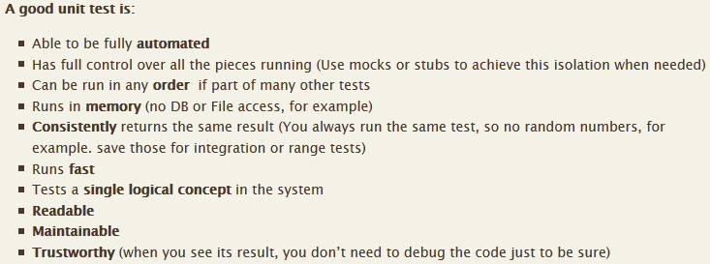
Strict Definition of a Unit Test
http://artofunittesting.com/definition-of-a-unit-test
Notes:
If Helper Class doesn’t touch the file system then it only fails the first one
Otherwise it fails the other three as well
Can’t be consistent because if you delete the file or disk is full then test fails
Can’t be fast if not CPU bound (certainly won’t run every time you change a file)

Slide 11
Ways to get dependencies
Dependency Injection: each class defines the dependencies it needs as part of the class signature (e.g by putting them in the constructor) and an injector inserts them
Service Registry: each class has a dependency on a registry which it can use to look up dependencies, e.g by name or by interface
Notes:
* So we agree that classes instantiating their own dependencies is a bad thing
There are different ways for a class to get dependencies, only going to talk about the first one (second is familiar because of BladeRunner)
Both achieve the goal (decoupling) and there are pros and cons to each, e.g
Dependency injection pro: can just look at constructor to see dependencies, with registry you have to find all the places it calls the registry
Dependency injection con: no dependency between the class and the injector, so once created it might not be able to get anything else
Not going to debate this now

Slide 12
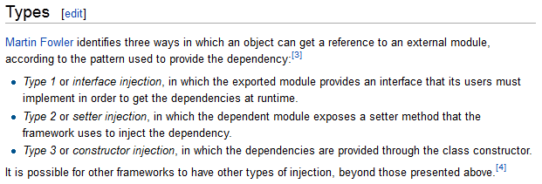
How do you inject a dependency into a class?
https://en.wikipedia.org/wiki/Dependency_injection
Notes:
The two basic ways are to pass dependencies in via the constructor, or via a setter
Setter not as good because the class can be in a partially constructed state
Hidden requirement to call methods in a certain order

Slide 13
ALMOST TIME FOR SOME CODE
Notes:
Going to a show a simple application but first this is what it does

Slide 14
UML (sorry)
<<QuoteListener>>
Application
has-a
FXQuoteProvider
has-a
has-a
<<QuoteService>>
AuditLogger
has-a
OfflineQuoteService
YahooQuoteService
Notes:
This application subscribes to FX quotes and outputs them
The FXQuoteProvider has a subscribe method which takes a currency pair and a listener
It has a service to get a single quote – one which gets the quote from Yahoo, one from a file
It polls the service every second and calls back on the QuoteListener
The Application class implements QuoteListener, it subscribes to quotes and prints them to the console
Separately there is an AuditLogger which I would like to use from a couple of places
--- Now go to the code and refactor to use constructor injection

Slide 15
NOW FOR SOME CODE
Notes:
Right now it has no dependency injection at all, each class creates its own dependencies
Going to show that even if you move everything into the constructors it only solves half of the problem
-- Ex 1: checkout 1.0 and refactor to put things in constructors

Slide 16
Dependency Resolution Everywhere
<<QuoteListener>>
Created the Main instance
Injected the currency pair into the Application instance
Created the FXQuoteProvider
Injected it into the Application instance
Created the ScheduledExecutor
Injected it into the FXQuoteProvider
Created the AuditLogger
Injected it into the Application instance
Injected it into the FXQuoteProvider
Main
has-a
FXQuoteProvider
has-a
has-a
<<QuoteService>>
AuditLogger
has-a
Created the YahooQuoteService
Injected the AuditLogger into the YahooQuoteService
OfflineQuoteService
YahooQuoteService
Notes:
The problem is that even if you move everything to the constructors, something has to choose what to pass into the constructors
So you still have dependency resolution sprinkled everywhere through the code
There is no single Injector that takes responsibility for it
Not so bad for this simple project, most of it is in Main, but…

Slide 17
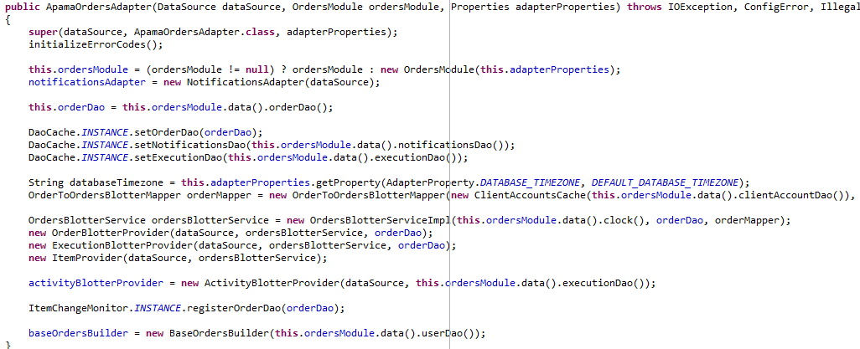
Notes:
Here’s a constructor that needs refactoring from a recent project
Almost all of this code goes away if we used a dependency injection library

Slide 18



Notes:
These libraries provide the Injector
They all allow you to declare your objects and dependencies up front and then the injector constructs everything
Older versions of Spring did this via XML, which was brittle and verbose and frequently got out of sync with the code
Guice was the first to do it via annotations, released in 2008
Dagger is very similar to Guice but newer, and has some fancy features
Go back 4 slides to explain object graph

Slide 19
BACK TO THE CODE
Notes:
-- Ex 2: Check out branch 1.1 and use Guice
- AuditLogger easiest – just give it the @Singleton annotation
- Then the ScheduledExecutor and curr pair (bind in configure method)
- Then a provider method for the QuoteService

Slide 20
Guice Advanced Features
Lots of ways to bind
Bind to an instance, or have a method that provides them, or a separate class
The @Named annotation
For injecting different instances of the same class
Multiple composable modules
To avoid putting logic in your modules
Notes:
Now going to look at some features of Guice beyond simple binding
Not going to code these by hand
-- checkout 1.2a, 1.2b and 1.2c and explain

Slide 21
Creating Instances
Creating the object graph on start up is good, but what about when you need to create instances of things later on?
The solution is Factories … ☹ (blah blah, Java is too verbose, factories everywhere blah, blah blah)
But Guice makes them very easy to create: ☺?
Notes:
Talk through

Slide 22
Creating Instances
The problem is also more difficult if you need a mixture of parameters provided by the injector and parameters only known at creation time.
Three approaches:
Direct instantiation (worst)
Hand-coded factory (medium)
Guice “Assisted Inject” (best)
Notes:
Give example – what if you want to create an object with two parameters: the audit logger and some stuff you know later on
-- Ex 4: checkout 1.3 and build the factory by hand, start from QuoteService (changed method to getMidPrice)
-- need to checkout 1.4 to use assisted inject

Slide 23
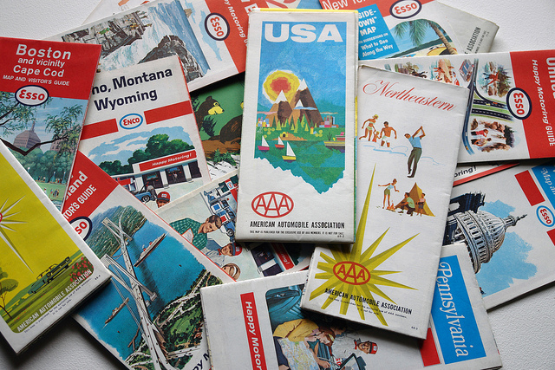
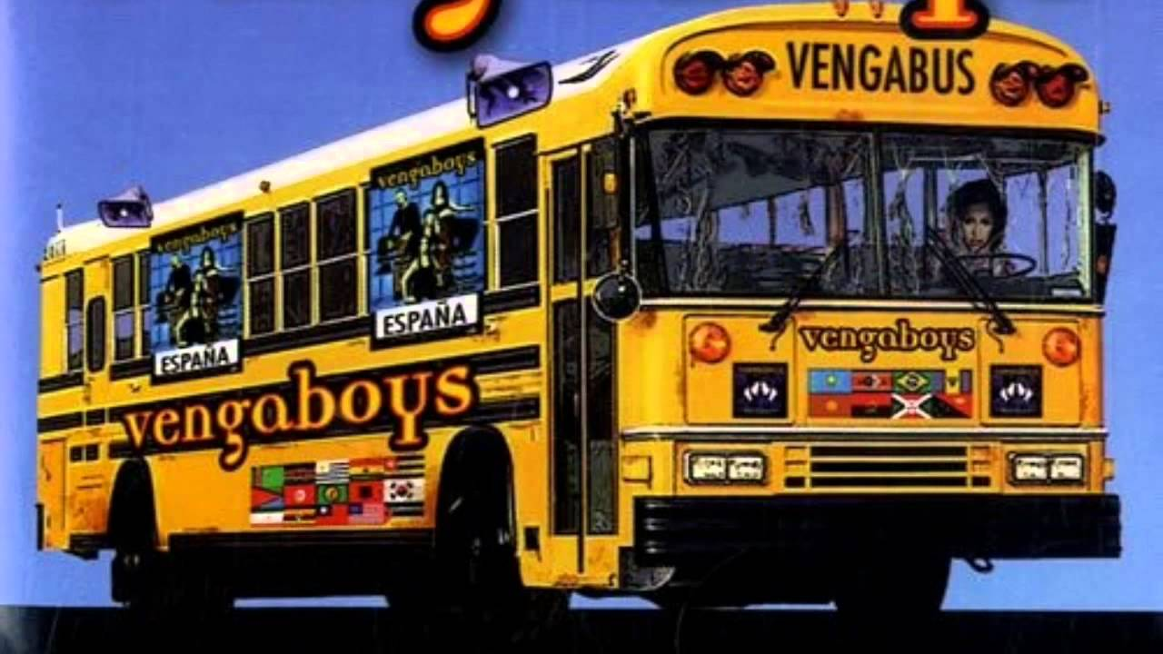
Bonus Feature
Multimaps
EventBus
Notes:
These are some useful classes in Google’s Guava library, which is completely separate from Guice
Multimap is a map where a single key can have multiple values
EventBus is an event bus/event hub which removes the need for listener interfaces
Useful for broadcasting a server event like a trade confirmation to many listeners, e.g a blotter updater and a trade model mover
-- checkout branch 2.0 and talk through datasource (and demo)
-- do the MultiMap upgrade in FXQuoteProvider, then revert
-- demo the EventBus
-- check out 2.2 and show the simplified FXQuoteProvider and slightly more complicated RateProvider

Slide 24

The End (really)

