Slide 1
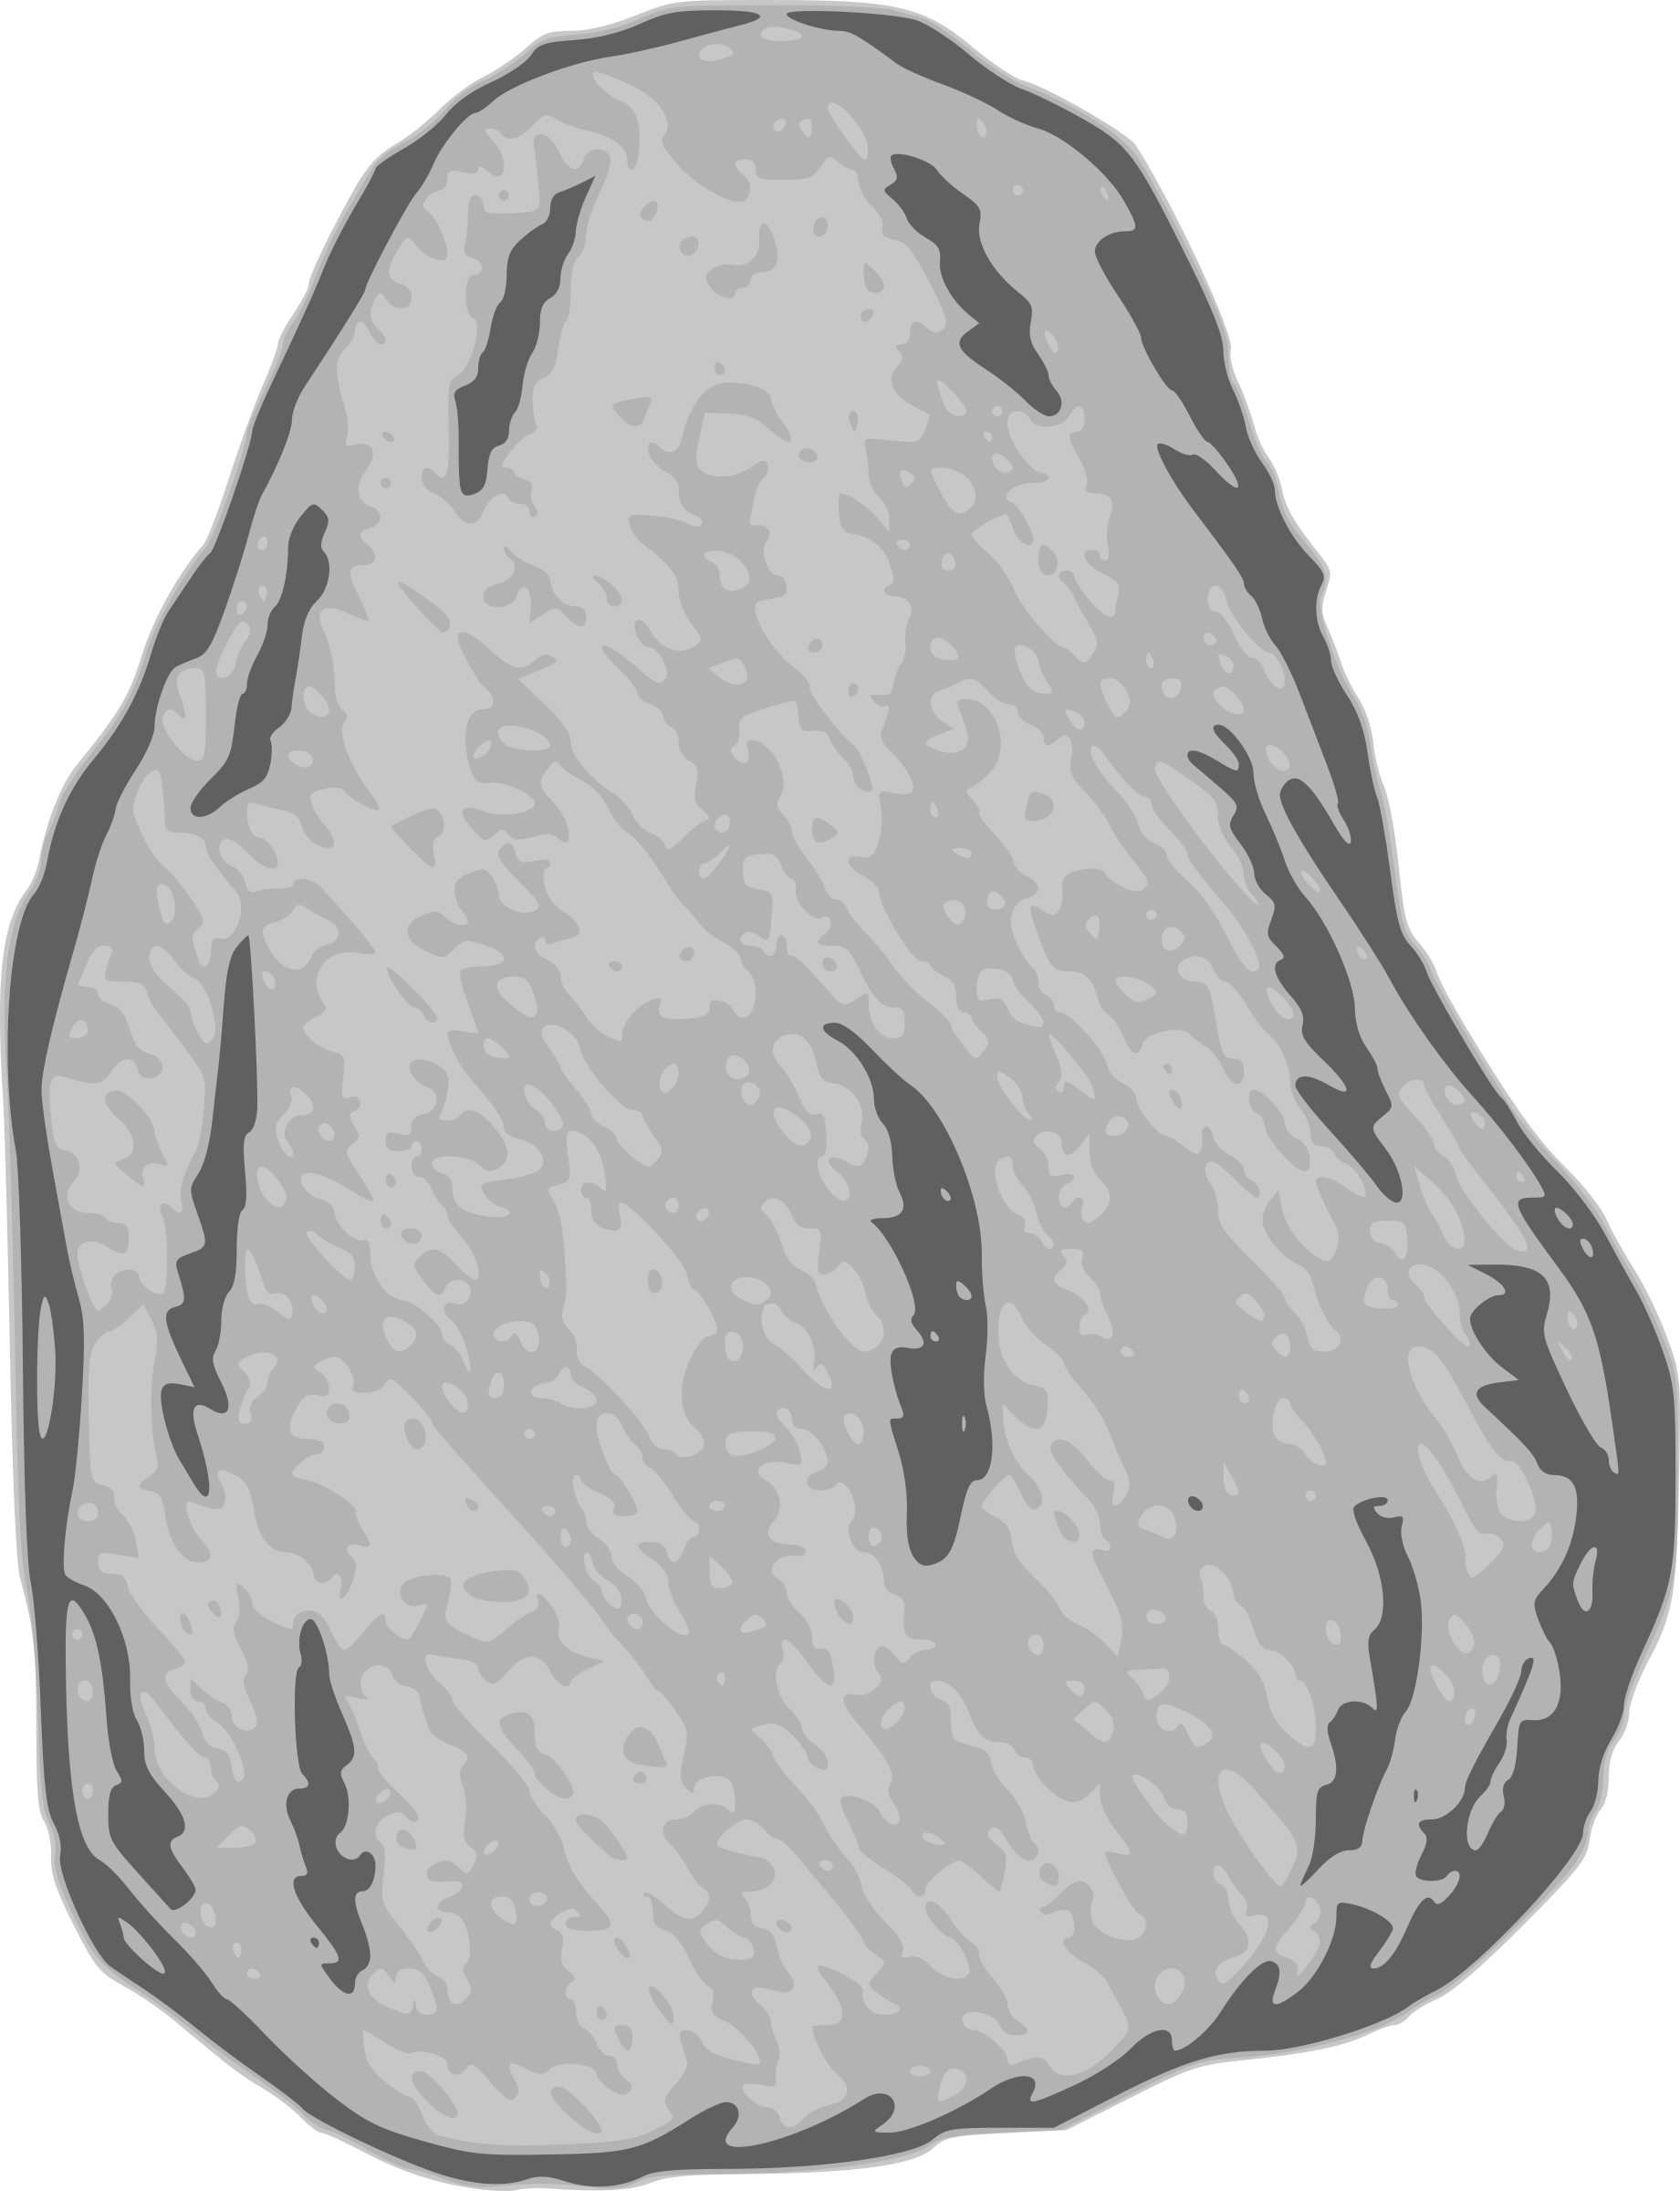

Initial: live Keck AoU REDCap project did not contain all the information from records in HealthPro
Zscaler!
HealthPro RDR
HealthPro data in REDCap
Ops Data API
[pmi_id, date_of_birth, last_name]
Keck All of Us Research Program
Live/prod REDCap project
Manually handle flagged duplicates
matched
unmatched
Add HealthPro data to existing REDCap record but in a new instrument
Assign new study_id (max_study_id + 1) and import
Final: Keck AoU REDCap project merged with data/information from HealthPro records

