Slide 1
Generalized Policy Iterator (GPI)
A new Haskell library module for the resource learning (RL) effort.

Slide 2

Author Info
David Banas (Contractor to Ashwin Rao) Target Sunnyvale (408)829-3037 – cell David.Banas@Target.com

Slide 3
My Timeline at Target
Aug. 23, 2017
100% - Assisting Conal
April 5, 2018
80% - Assisting Conal
20% - Reinforcement Learning (RL)
This presentation only covers my work in Reinforcement Learning (RL).

Slide 4
RL Haskell Coding Tasks
Tic-tac-toe
Jack’s Rental Cars
Gambler
Blackjack
Windy Grid
Inventory (1 store, 1 item)
All described by a Markov Decision Process (MDP).

Slide 5
A common element emerges…
Generalized Policy Iterator (GPI)
Required by all problems tried.
Most problematic part of coding task.
Always had the same interface.
So…
Factor it out!
haskell-rl/RL.GPI – a new Haskell library module for you to try.

Slide 6
Generalized Policy Iterator (GPI)
Performs general policy evaluation/improvement iterations for any MDP.
Offers standard dynamic programming (DP), as well as these temporal difference (TD) modes:
SARSA
Q-learning
Expected SARSA
Reduces new problem solution effort to MDP definition only!

Slide 7
How to define a MDP?
You must define 4 functions:
states, S – Enumerates all possible system states.
actions, A(s) – For a given state, enumerates all possible actions.
nextStates, S’(s, a) – For a given state/action pair, enumerates all possible next states.
rewards, R(s, a, s’) – For a given state/action/nextState triple, enumerates all possible rewards, along with their probabilities of occurrence.
But, watch out…

Slide 8
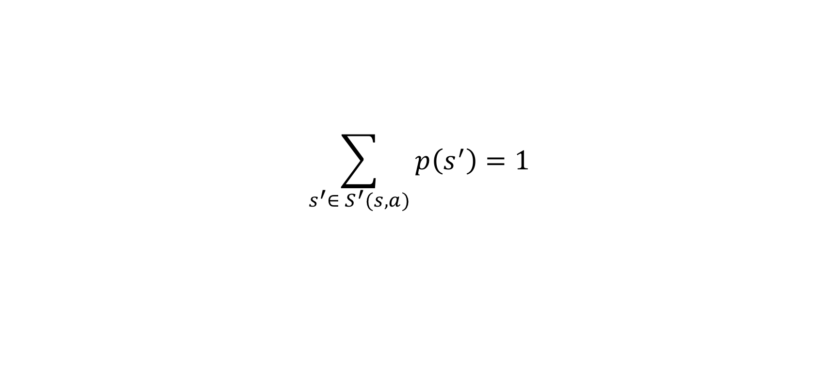
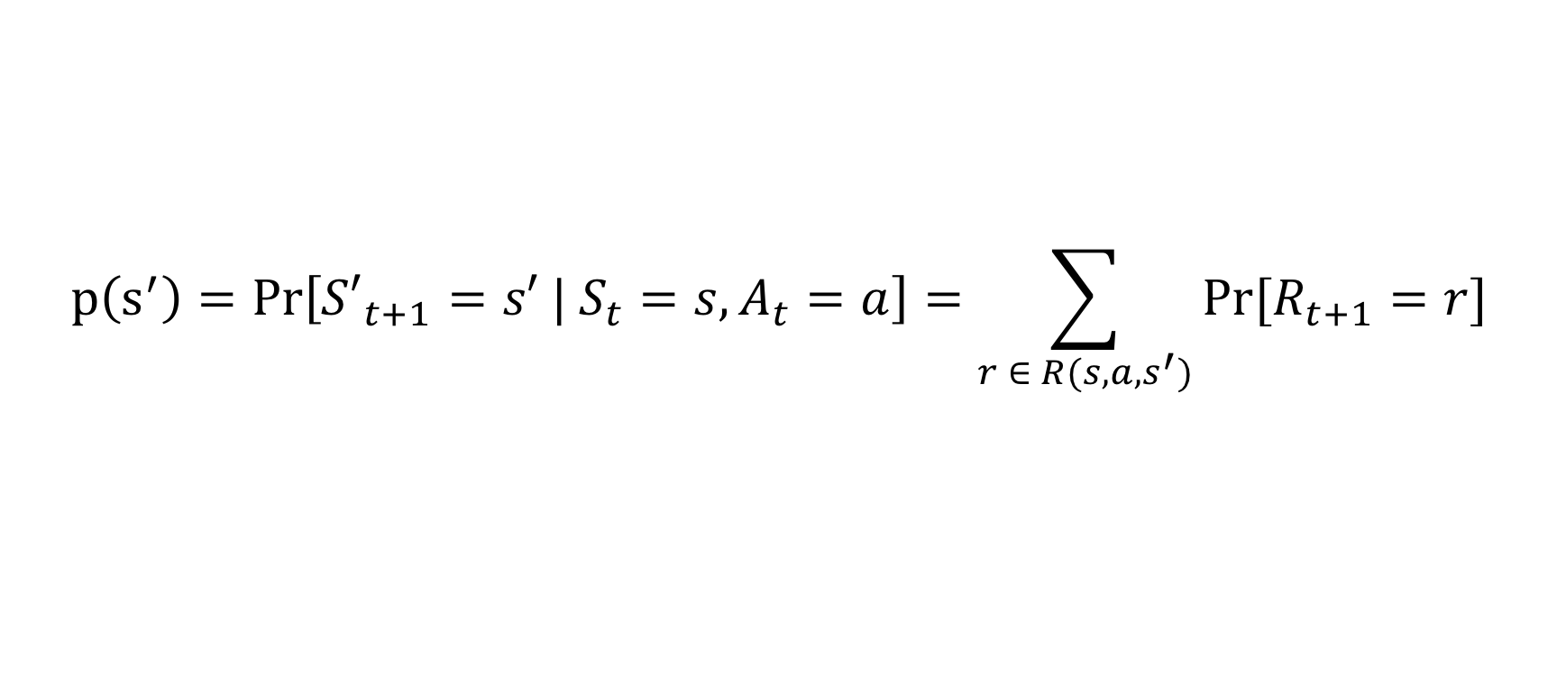
There’s just one caveat…
You must ensure that:
$$p\left(s^{′}\right)=Pr\left[{S′}_{t+1}=s′ | S_{t}=s, A_{t}=a\right]=\sum_{r ∈ R(s, a, s^{′})}{Pr⁡[R_{t+1}=r]}$$
$$\sum_{s^{′}∈ S^{′}(s, a)}{p\left(s^{′}\right)=1}$$

Slide 9
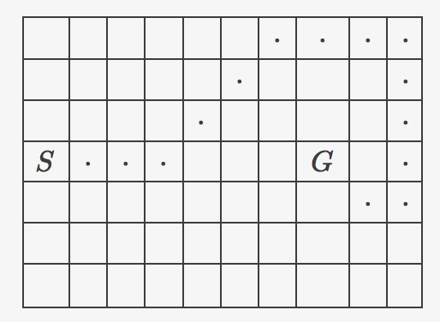
Ex. 1 – Grid World w/ Deterministic Wind
Up
Lt
Rt
Dn
Wind speed:
0 0 0 1 1 1 2 2 1 0
Agent must navigate from “S” to “G” in the presence of wind.

Slide 10
Ex. 1 (cont’d.)
-- | S
allStates :: [MyState]
allStates =
[ (r, c)
| r <- [0..(gNumRows - 1)]
, c <- [0..(gNumCols - 1)]
]
-- | A(s)
myActions :: MyState -> [MyAction]
myActions = const [Up, Dn, Rt, Lt]

Slide 11
An example (cont’d.)
-- | S'(s, a) - list of next possible states.
myNextStates :: MyState -> MyAction -> [MyState]
myNextStates s@(r, c) act =
if s `elem` myTermStates
then [s]
else map bound [ ( r + dr + wind, c + dc ) ]
where
dr = case act of
Up -> 1
Dn -> -1
_ -> 0
dc = case act of
Lt -> -1
Rt -> 1
_ -> 0
wind = gWind `VS.index` finite (fromIntegral c)
Note the deterministic nature of the problem reflected in the single element lists.

Slide 12
An example (cont’d.)
-- | R(s, a, s')
--
-- Returns a list of pairs, each containing:
-- - a reward value, and
-- - the probability of occurrence for that value.
myRewards :: MyState -> MyAction -> MyState -> [(Double, Double)]
myRewards _ _ s' | s' `elem` myTermStates = [( 0, 1)]
| otherwise = [(-1, 1)]
Note the deterministic nature of the problem reflected in the rewards.

Slide 13

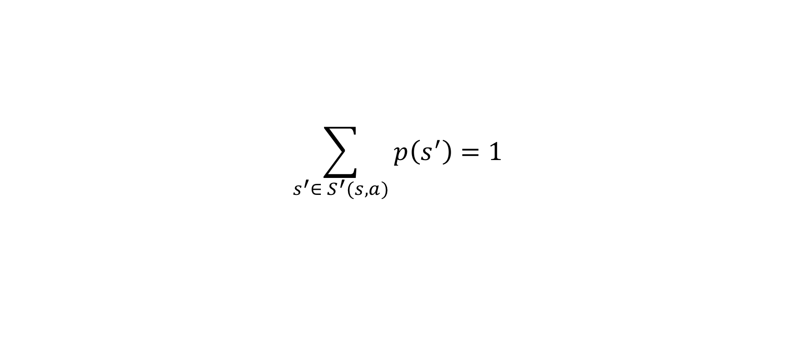
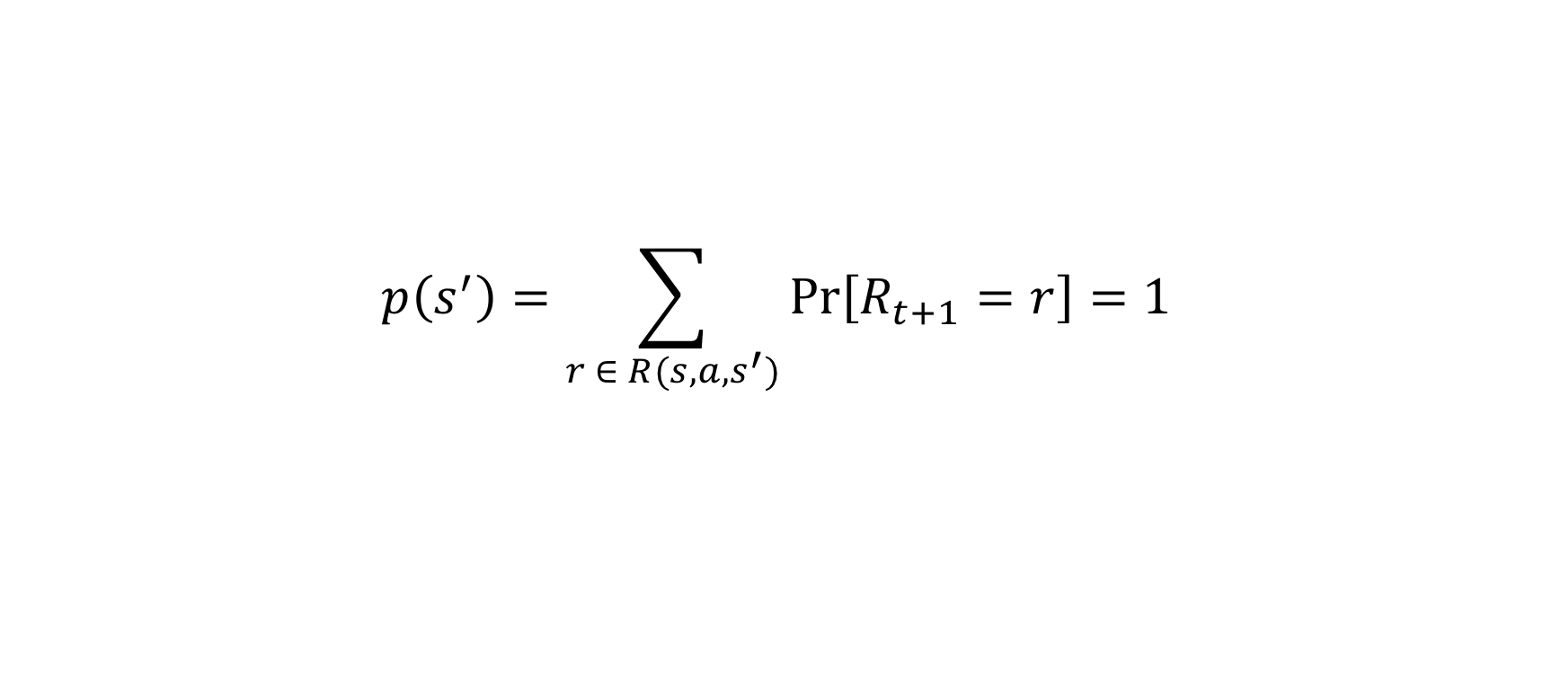
Checking the constraints…
$$p\left(s^{′}\right)=\sum_{r ∈ R(s, a, s^{′})}{\operatorname{Pr}\left[R_{t+1}=r\right]=1}$$
$$\sum_{s^{′}∈ S^{′}(s, a)}{p\left(s^{′}\right)=1}$$
Constraints are trivially satisfied in the deterministic case.

Slide 14
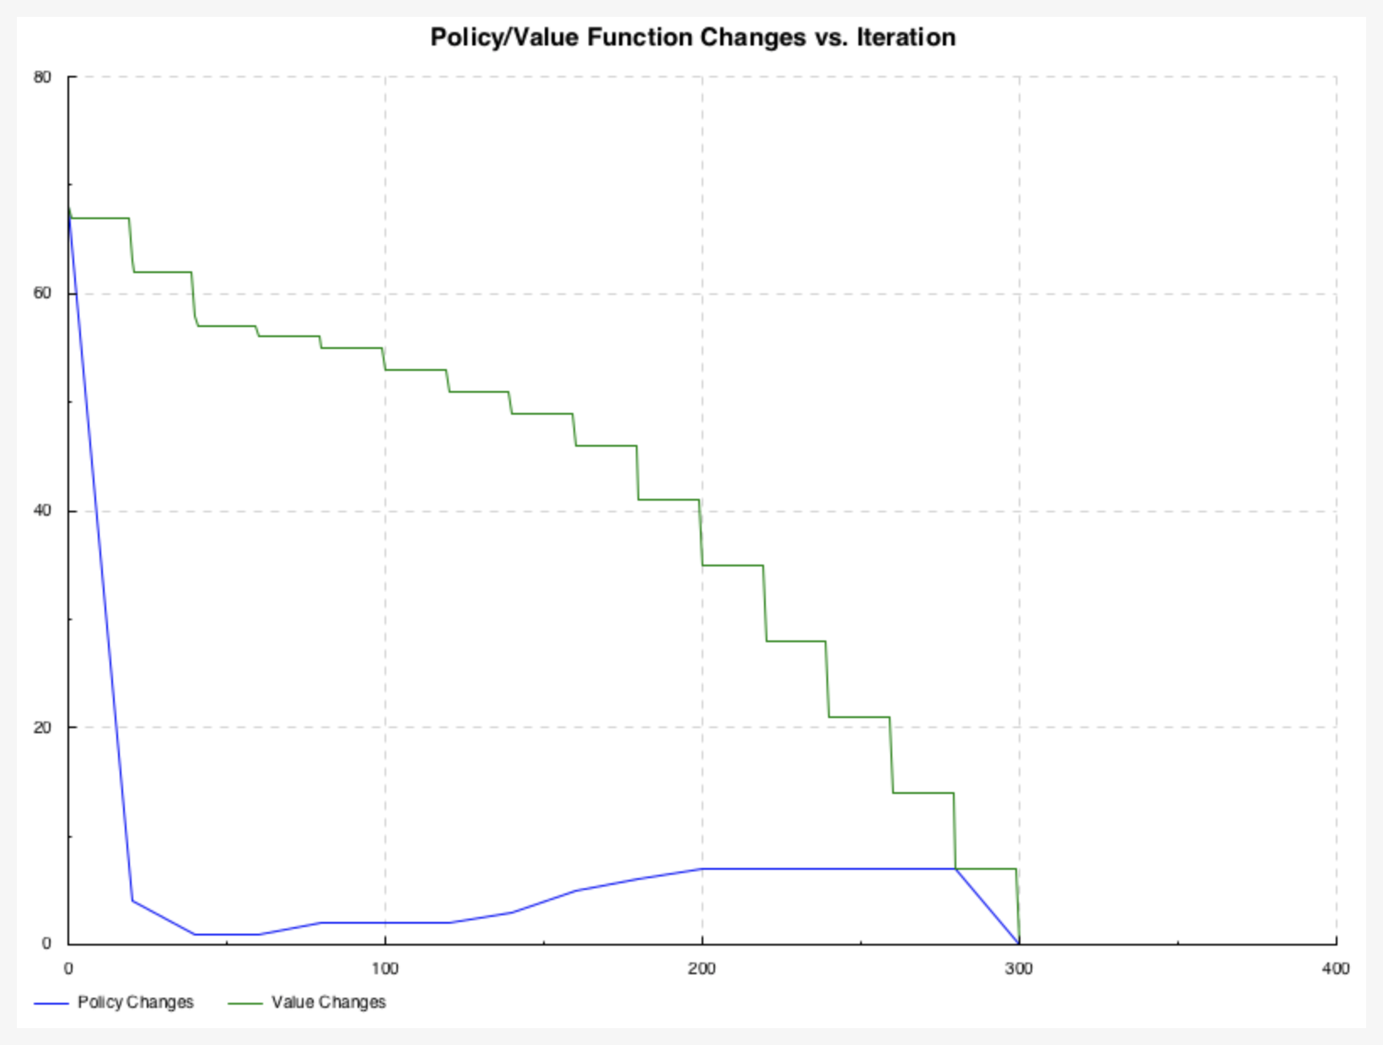
DP Performance w/ Deterministic Wind
Both policy and value function converge.
Trajectory (shown previously) is optimum.

Slide 15
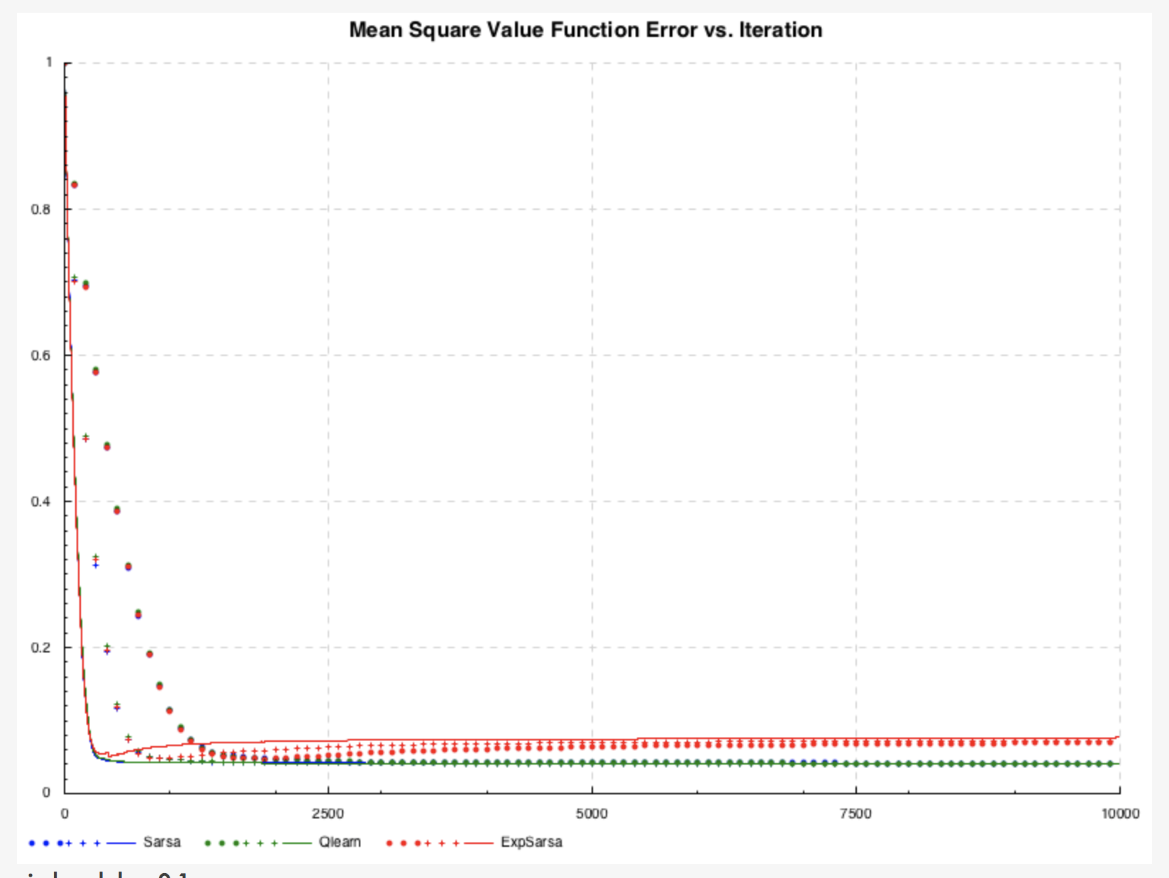
TD Performance w/ Deterministic Wind
Reference is mean square value of DP solution.
Note the increased error for Expected SARSA. The text does not predict this! Bug in code?
Legend:
Circle: α = 0.1
Plus: α = 0.2
Line: α = 0.5

Slide 16
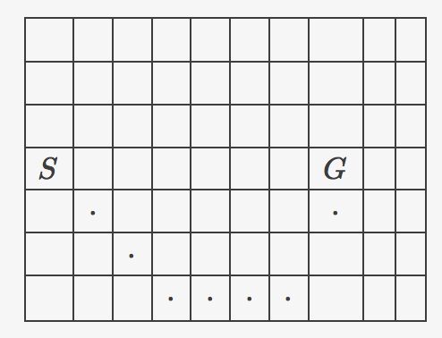
Ex. 2 – Grid World w/ Stochastic Wind & Extra Moves
Up
UL
UR
Lt
NM
Rt
DL
DR
Dn
Wind speed:
0 0 0 1 1 1 2 2 1 0
0 0 0 2 2 2 3 3 2 0
0 0 0 0 0 0 1 1 0 0
Agent must navigate from “S” to “G” in the presence of wind.

Slide 17
An example (cont’d.)
-- | S'(s, a) - list of next possible states.
myNextStates :: MyState -> MyAction -> [MyState]
myNextStates s@(r, c) act =
if s `elem` myTermStates
then [s, s, s]
else [ bound (r + dr + wr, c + dc)
| wr <- if wind /= 0
then [wind - 1, wind, wind + 1]
else [0, 0, 0]
]
Note the stochastic nature of the problem reflected in the multiple element lists.

Slide 18
An example (cont’d.)
-- | R(s, a, s')
--
-- Returns a list of pairs, each containing:
-- - a reward value, and
-- - the probability of occurrence for that value.
myRewards :: MyState -> MyAction -> MyState -> [(Double, Double)]
myRewards _ _ s' | s' `elem` myTermStates = [( 0, 0.33)]
| otherwise = [(-1, 0.33)]
Note the stochastic nature of the problem reflected in the rewards.

Slide 19
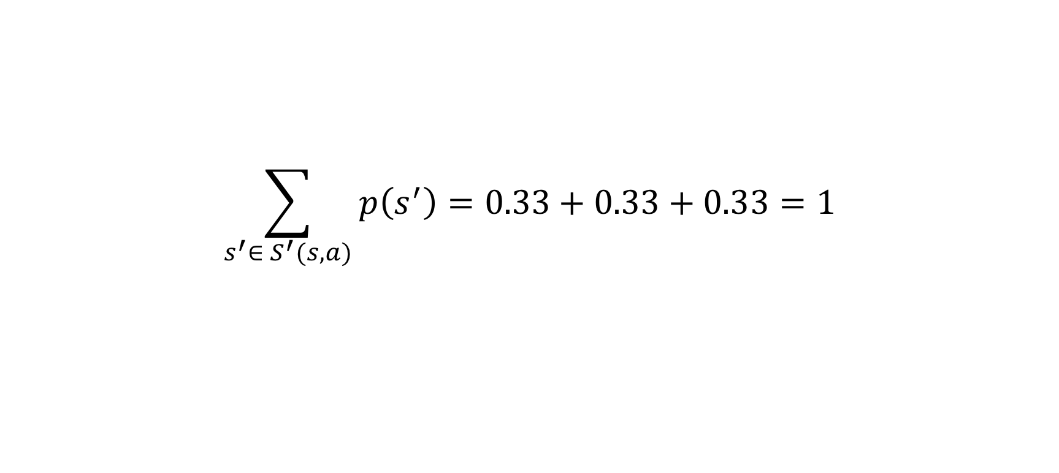
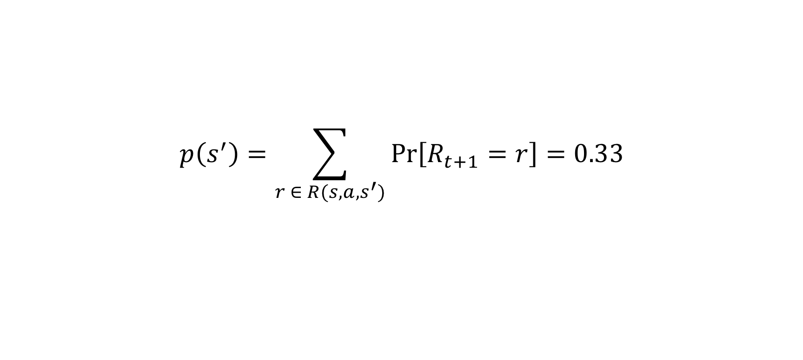
Checking the constraints…
$$p\left(s^{′}\right)=\sum_{r ∈ R(s, a, s^{′})}{\operatorname{Pr}\left[R_{t+1}=r\right]=0.33}$$
$$\sum_{s^{′}∈ S^{′}(s, a)}{p\left(s^{′}\right)=0.33+0.33+0.33=1}$$

Slide 20
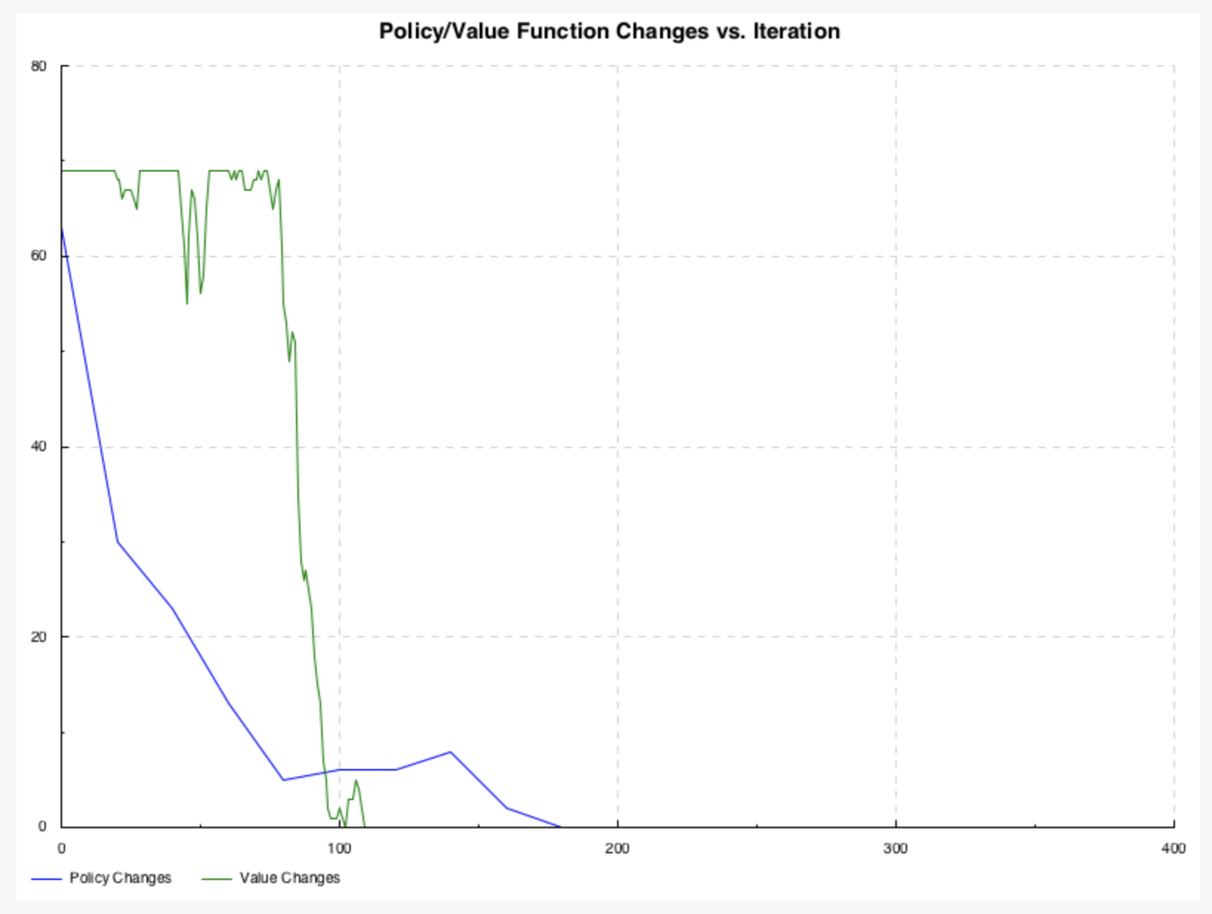
DP Performance w/ Stochastic Wind
Both policy and value function converge.
Trajectory (shown previously) is optimum.

Slide 21
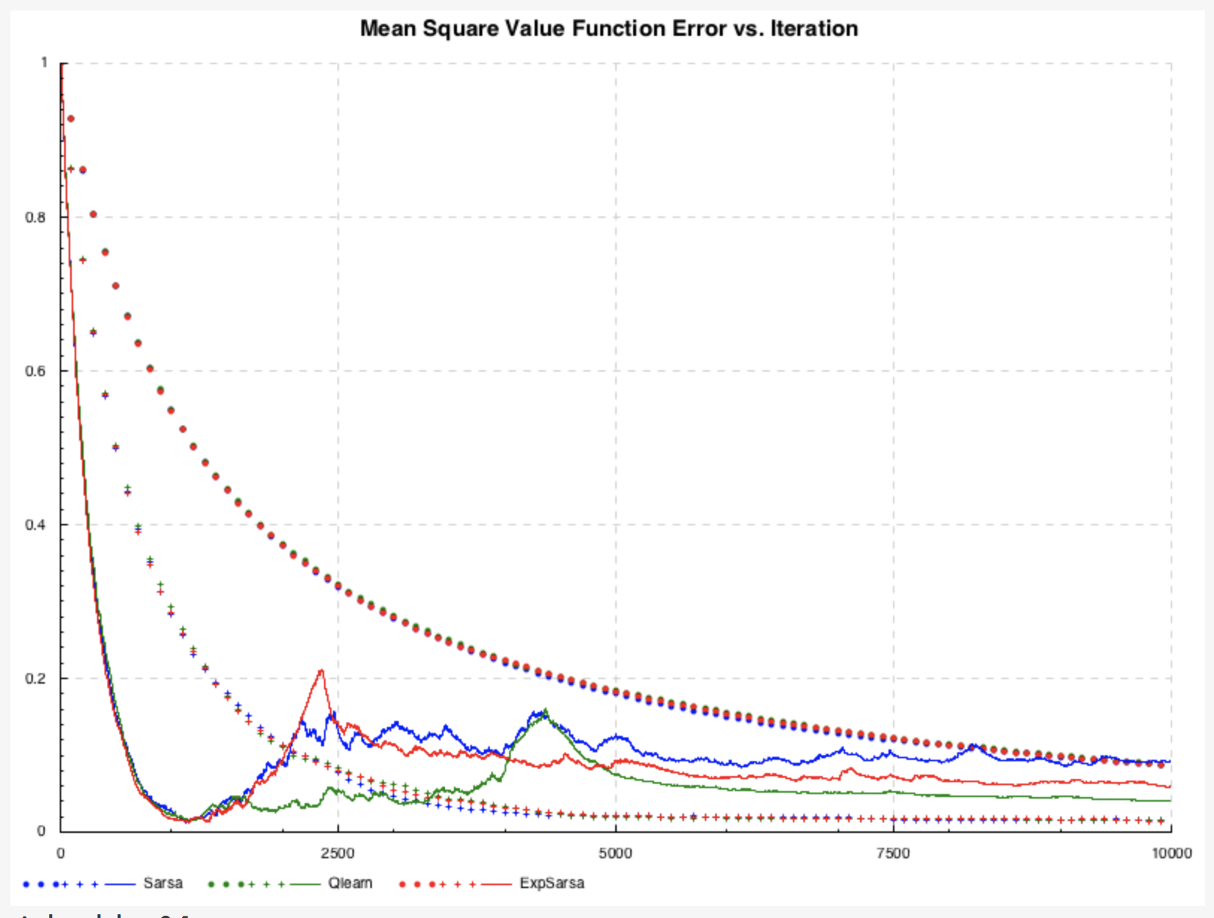
TD Performance w/ Stochastic Wind
Reference is mean square value of DP solution.
Note the volatility of the “α = 0.5” case. Stochastic environments seem to introduce some instability into TD methods. Here we were able to tame this instability by applying an exponential decay to both α and ε.
Legend:
Circle: α = 0.1
Plus: α = 0.2
Line: α = 0.5

Slide 22
Ex. 3 – Mock inventory control & order opt.
A simple 1-store / 1-item model.
Differences from previous examples:
Larger state space; difficult to bound.
Delay between action and reward (lead time).
Environment random variable (demand) has non-uniform (gamma) distribution of broader range (10 vs. 3).

Slide 23
Ex. 3 (cont’d.)
-- | S - all possible states.
--
-- Note: There is no need to track epochs [gLeadTime..].
allStates :: [MyState]
allStates =
[ MyState x (drop n ys ++ take n ys) n
| x <- [-gMaxOnHand..(2 * gMaxOnHand)]
, n <- [0..(gLeadTime - 1)]
, y <- [0..gMaxOrder]
, let ys = y : replicate (gLeadTime - 1) 0
]
We assume lead time equals review period, for simplicity.

Slide 24
Ex. 3 (cont’d.)
-- | A(s) - all possible actions from state `s`.
actions' :: MyState -> [MyAction]
actions' MyState{..} =
if epoch `mod` gLeadTime /= 0
then [0]
else [0..gMaxOrder]
We assume lead time equals review period, for simplicity.

Slide 25
Ex. 3 (cont’d.)
-- | S'(s, a) - list of next possible states.
nextStates' :: MyState -> MyAction -> [MyState]
nextStates' MyState{..} toOrder =
[ MyState onHand'
(P.tail onOrder ++ [toOrder])
(epoch + 1)
| demand <- [0..gMaxDemand]
, let onHand' = onHand + P.head onOrder - demand
]
Note that onHand may grow w/o bound in either direction!

Slide 26
Ex. 3 (cont’d.)
-- | R(s, a, s')
rewards' :: Int -> MyState -> MyAction -> MyState
-> [(Double, Double)]
rewards' p MyState{..} _ (MyState onHand' _ _) =
[ ( fromIntegral p * fromIntegral stockOut - fromIntegral held
, pDemand $ finite $ fromIntegral demand
)
| let held = max 0 onHand'
stockOut = min 0 onHand'
demand = onHand + P.head onOrder - onHand'
]
onHand is allowed to go negative, to represent backlog.

Slide 27
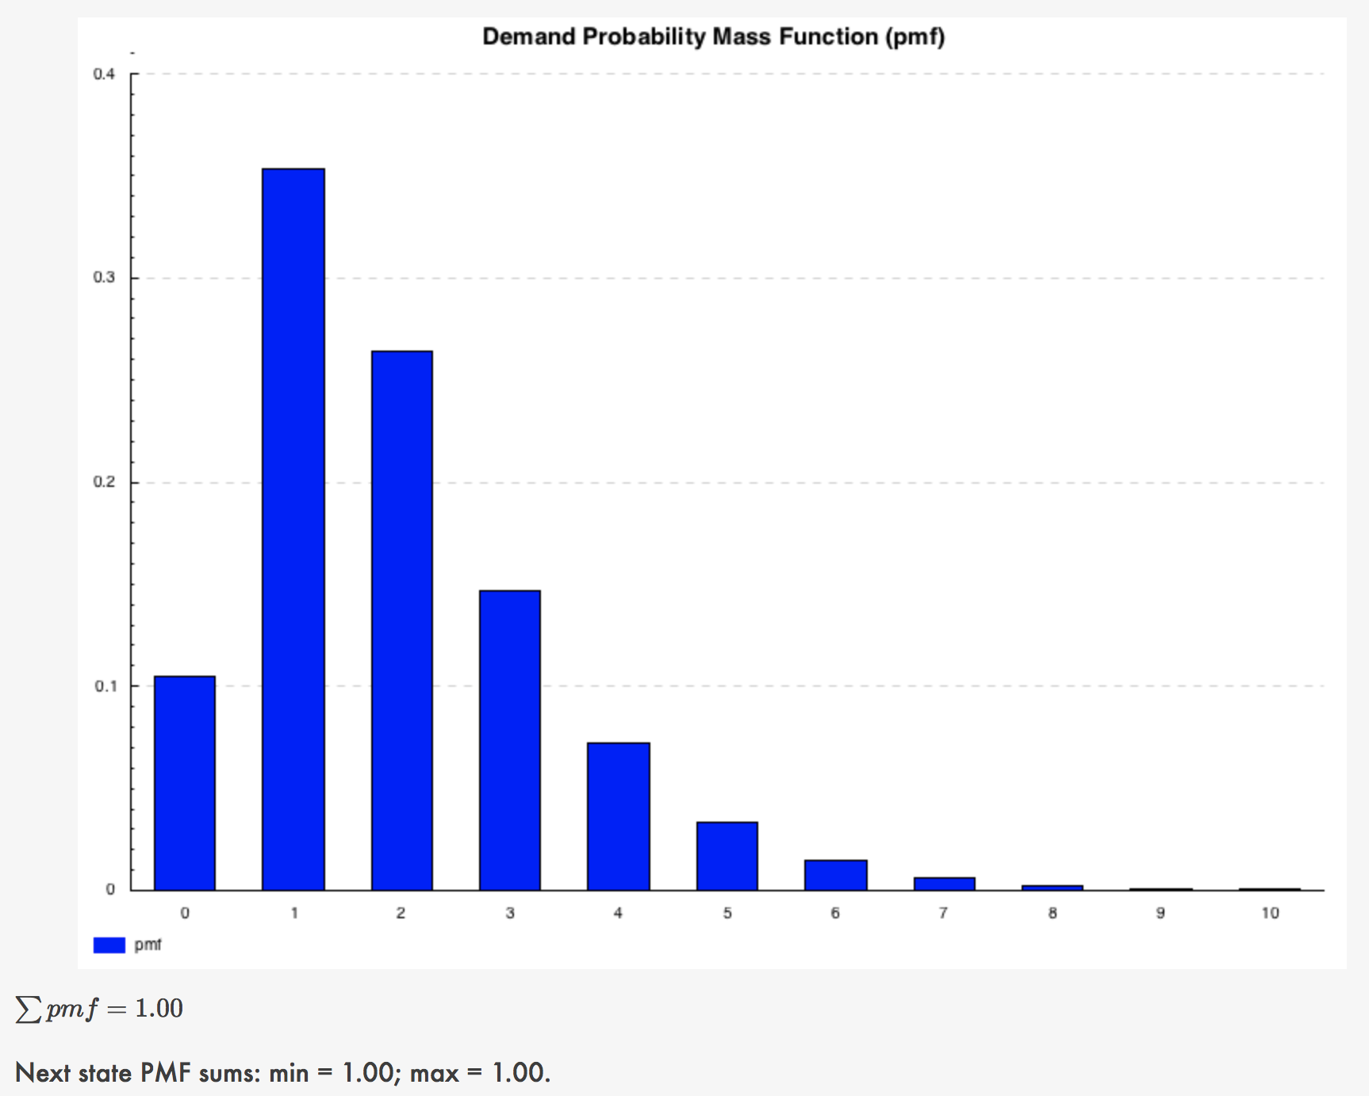
Checking the constraints…
That last line of text, “Next state PMF…,” is the result of programmatic checking of the two equations shown previously, and indicates that both constraints have been met.

Slide 28
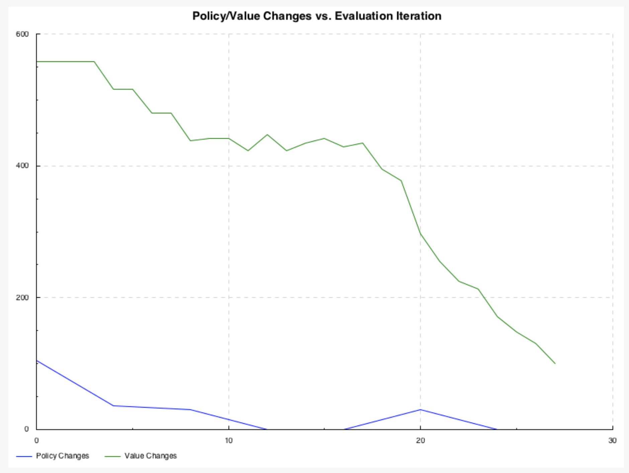
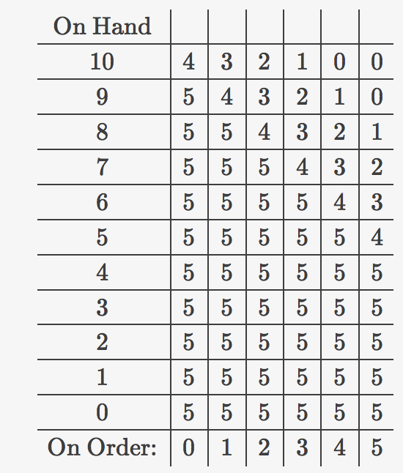
DP Performance
Both policy and value functions converge (almost).
Final policy looks “reasonable”:

Slide 29
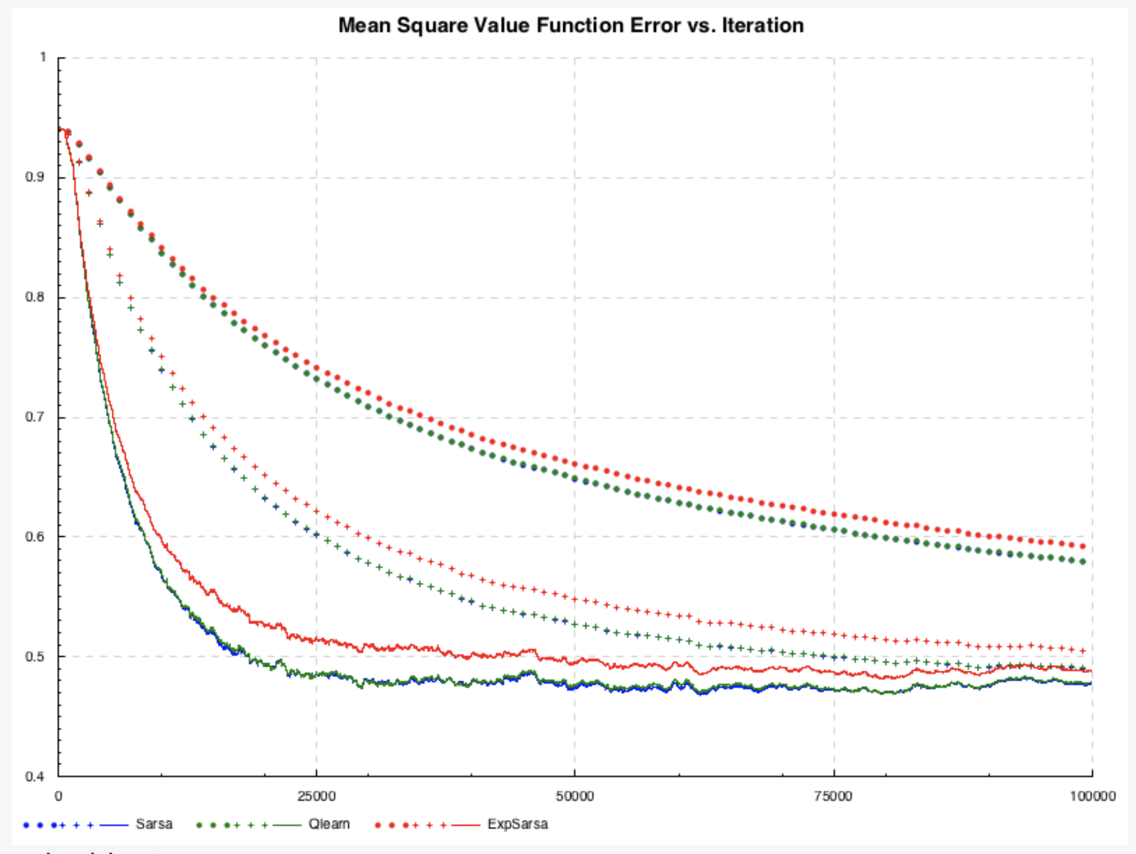
TD Performance
Reference is mean square value of DP solution.
What is causing these terrible results?!
Legend:
Circle: α = 0.1
Plus: α = 0.2
Line: α = 0.5
Runtime improvement over DP is dramatic: approx. 30 : 1 !

Slide 30
Concluding Remarks
The runtime performance advantage of the TD approach over DP is obvious: 30 : 1 in the case of the mock inventory optimization case!
TD appears to produce acceptable results in every case tried, except the one that really matters (mock inventory). Why is this?! Some potential culprits:
The delay between action and reward (due to lead time). (Do I need to allow multiple state transitions per episode in such cases?)
The increased randomness of the environment.
Maybe, the DP results we’re using as a reference are incorrect. (Try newsvendor?)
Maybe, the code still has a bug that doesn’t show up in the other examples.

Slide 31
References
Wiki home page for Haskell RL coding effort at Target
Ramki’s RL Resources Confluence page
Presentations by Joseph, Gregory, Tikhon, Aron, et al., re: hmach architecture, MDPs, Clark-Scarf, Newsvendor, etc.
Related code by Joseph, Gregory, Tikhon, et al., re: MDP optimization in Haskell

Slide 32
Questions?

