Slide 1



CPT Mr. Who
How Bad Add/Sals Can Sink Your Stewardship
Melody Allen McBeth
Founder, Highland Fundraising Solutions
Roxanne Globis
Senior Consultant, Highland Fundraising Solutions

Slide 2


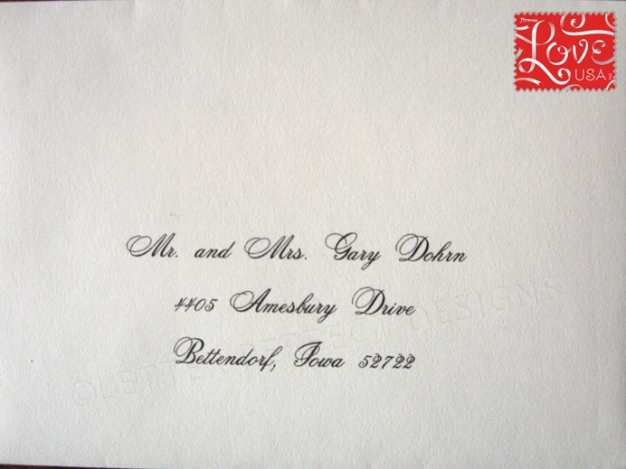

Know Your Terminology
Addressee versus Salutation
Collectively known as Add/Sals.

Slide 3
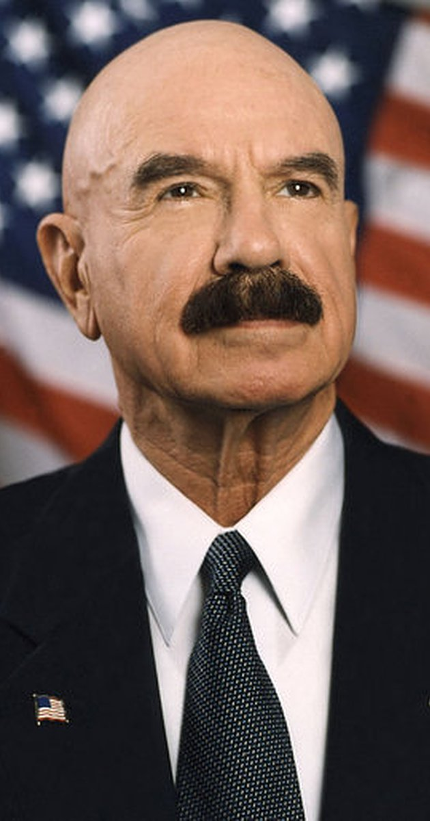
Lack of standards causes many issues.
Title: Mr.
First: George
Middle: Gordon Battle
Last: Liddy

Slide 4
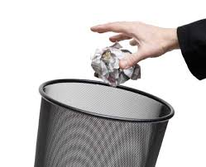
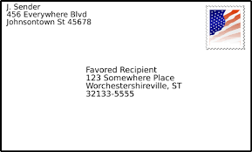
Your constituents feel like
you don’t know them.
Mr. George G. Liddy
123 Any Street
Washington, DC 20001

Slide 5
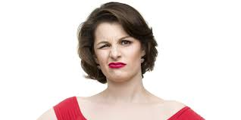
Getting it wrong can even offend some people.
Mr. and Mrs. Gary Smith
90 York Way
London N19GU
ENGLAND

Slide 6
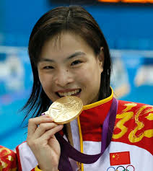


Add/sal conventions depends on culture

Slide 7
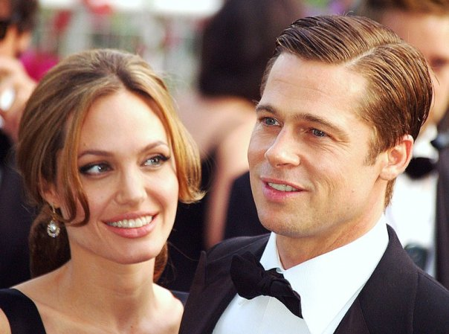
Ignoring a domestic partnership can be costly.
Brad Pitt, Angelina Jolie Donate $2 MILLION To Namibian Wildlife Preserve - Nastasya Tay, 01/03/11, HuffPost Entertainment

Slide 8
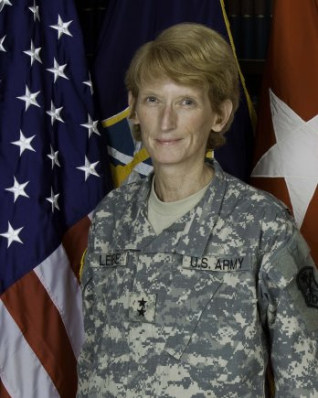
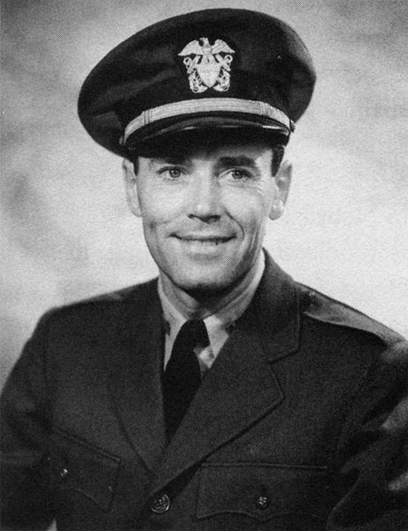
Professional/Military titles can be difficult.
CPT
Capt
CAPT
USA(R)
USAR
LTG Legere
“LTJG Roberts”

Slide 9

Consistency is the key to happiness.
Etiquette
+
Policy
=
Procedure

Slide 10
Nine add/sal types meet most needs.
Primary Addressee
Donor Listing
Legal Listing
Family/
Household
Volunteer Listing
Inside Salutation
Name Tag
Primary Salutation
Outside Addressee

Slide 11

Add/Sal Matrix
Mr. H.F. Gerry Lenfest ’49
Gerry

Slide 12
Add/Sal Matrix
Mr. and Mrs. H.F. Gerry Lenfest ‘49
Marguerite and Gerry
Gerry Lenfest ’49
Marguerite Lenfest & Gerry Lenfest ‘49
Marguerite B. Lenfest and Harold F. Lenfest
The Lenfest Household
Gerry Lenfest

Slide 13


There will be anomalies, so plan for them!

Slide 14

Deployment is always a slippery slope.

Slide 15
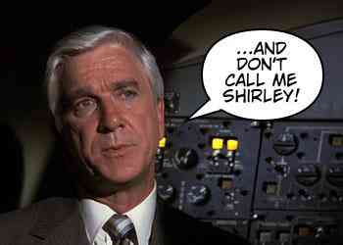
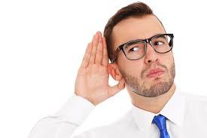
Are you listening to your constituents?

Slide 16
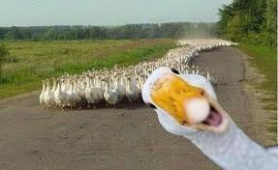
Happiness is when what you think, what you say, and what you do is in harmony – Gandhi (1869-1948)

Slide 17
Thank you!
Melody.McBeth@HighlandFrS.com
Roxanne.Globis@HighlandFrS.com
(717) 516-1266
@HighlandFrS

