Slide 1

The Economics of
Data Integrity
Lynn Andrews, Vice President for Advancement, George Fox University
Melody Allen McBeth, Principal/Sr. Consultant, Highland FRS

Slide 2


Slide 3
DATA INTEGRITY
Accurate
Standardized
Consistent
Subject to data governance
Procedures and policies
Validated
Maintained
Mitigation & training
Notes:
All shops have challenges – some just won’t admit it or are not aware
This is about the most common one

Slide 4
OUR CONTEXT:
The datum is:
Informative
Where its needed (no STDs!)*
Acting appropriately
Reliably reportable
Consistently entered by trained staff
Validated periodically
Standardized when necessary
*shadow type databases
Notes:
Text in number fields, misspellings, inconsistencies

Slide 5
SHOP CHALLENGES
Documentation incomplete or nonexistent
Data not standardized
Reports not optimized
Data in wrong locations
Validations not done

Slide 6
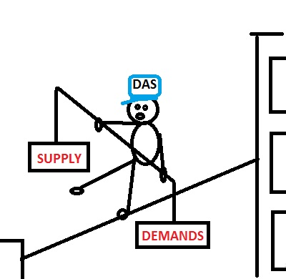
CAUSES
Too many chefs
Bad/no planning
No standardization
Friction with Finance
Policies don’t exist
People not trained
Not enough people

Slide 7
SIGN OF THE TIMES
CRISIS AHEAD

Slide 8
BUT IS IT IMPORTANT?

Slide 9

THE COSTS OF
POOR DATA INTEGRITY

Slide 10



Notes:
Mailing lists reformatted several times
Event invitations cherry-picked
Numbers manipulated to reconcile

Slide 11

HOW BAD CAN IT BE?
One Presidential level mailing list of 20,000 records required 3 weeks to complete
Holiday card stewardship mailing required 6 weeks
End-of-calendar year gifts still being entered in March
Notes:
Some actual examples

Slide 12

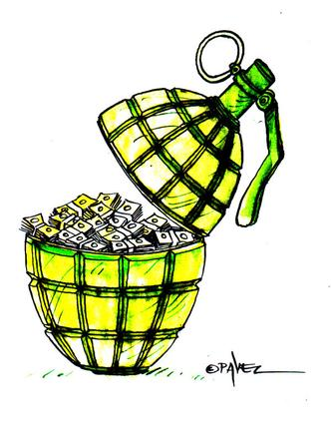
CAUSES
An institution unable to reconcile with Finance for over 2 years
2200 magazines mailed to improperly formatted international addresses at $10 each

Slide 13
Yes, it’s THAT important!

Slide 14

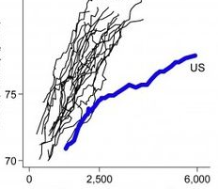
RESULTS
Bad Reporting

Slide 15

Loss of confidence from leadership
Notes:
BODs
Fixing lists
Reporting slowness via excel
Verifying reports for lack of confidence
Hand manipulating bad data
Shadow databases

Slide 16

Loss of donations
Disappearing
business
partnerships

Slide 17


STAFF TURNOVER
I
Notes:
Not enough help
Making mud-pies instead of adobe
Frustration factor
Reoccurring staff in institutions

Slide 18
NUMBERS OF NOTE
2015 – AASP (Association of Advancement Services Professionals and APRA (Association of Professional Researchers for Advancement) conduct Salary Survey
216 unique institutions participated

Slide 19

72% expect Non-AS FTE to grow

Slide 20
48% expect to lose AS FTE headcount
Notes:
70 % of shops are 20 members or less
75 % do not use caging services

Slide 21
Notes:
Who can blame them? How many times have you or your staff worked after hours to finish a routine data project?

Slide 22
Average Bio/Gift manager makes $45,000/yr
Group A – 7 hours
Group B – 1 hours
Average mailing list costs $150 more PER LIST
Notes:
365 – 104 – 7 – 14 * 8 = 1920
23.44 per hour

Slide 23
How big are your mailing lists and how many do you do:
a day
a Week
a YEAR
Notes:
39000 @ 1 a day

Slide 24
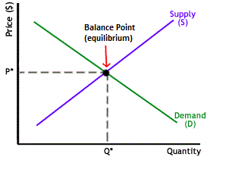
ECONOMICS 101
Equilibrium exists when quantity meets demand
Product =
data projects
Price =
man-hours
Notes:
Equilibrium exists when the number of man-hours available (quantity) matches the number of unfulfilled projects requested (demand)

Slide 25
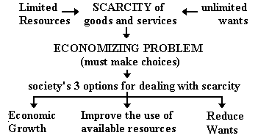
Notes:
Start with the last one – REDUCE WANTS

Slide 26
REDUCE WANTS

Slide 27


IMPROVE THE USE OF AVAILABLE RESOURCES
KNOWLEDGE
“MAN”-HOURS
Notes:
Train the staff
Fix the data
A penny saved is a penny earned

Slide 28
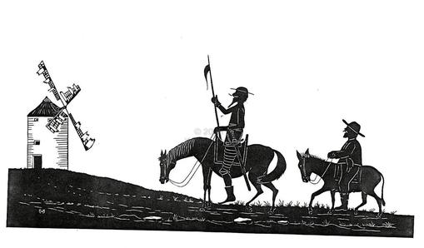
FIND MORE TIME BY REDUCING ANOMALIES
OPTION A:
Mount an internal assault
Notes:
Continuing the improvement of available resource usage
Don Quixote and Sancho Panza take on the dreaded windmill

Slide 29
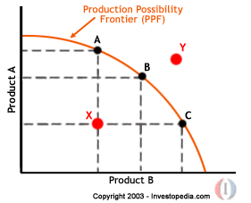
What is our maximum production capacity given the most efficient use of our resources?
Notes:
Available resource usage –
Production Possibility Frontier (PPF)
Maximum output possibilities for 2 or more goods if all inputs are used efficiently
Product A = database work
Product B = data integrity mitigation
Shifting priorities……
More Demand!! Production Possibility Frontier (PPF) Definition | Investopedia http://www.investopedia.com/terms/p/productionpossibilityfrontier.asp#ixzz3lZ3Dp6U2

Slide 30
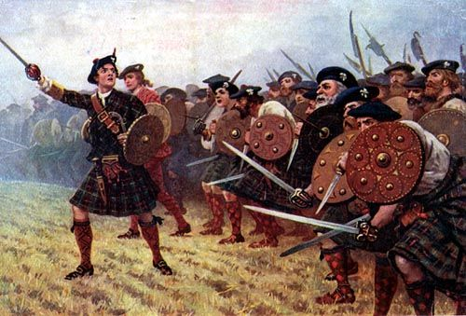
GROWTH –
FIND MORE TIME BY INCREASING MAN-HOURS
OPTION B:
Call in the mercenaries
Notes:
The last way society deals with
scarcity = economic growth
Economic growth = producing more

Slide 31
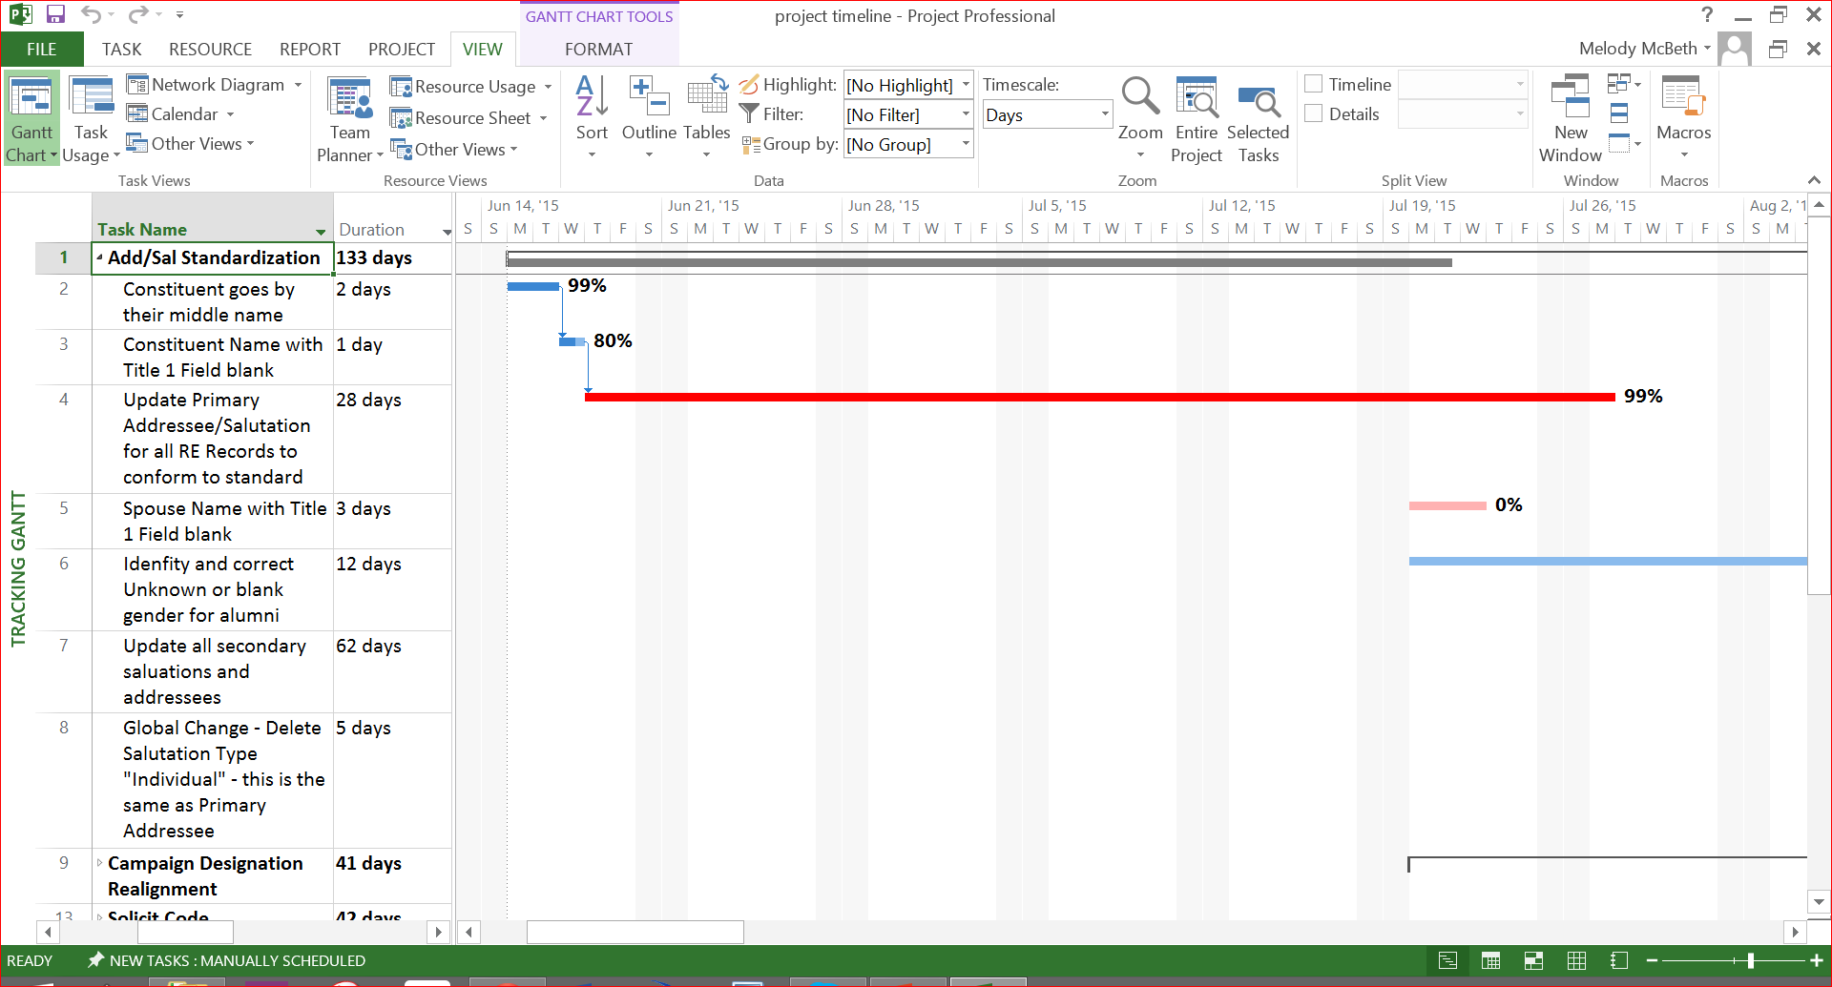
FIXING THE DATA REQUIRES A PLAN
Notes:
This slide contains a hyperlink to the existing MS project file.

Slide 32

IS YOUR SHOP CHALLENGED?
Can you afford to fix it?
Can you afford NOT to?

Slide 33
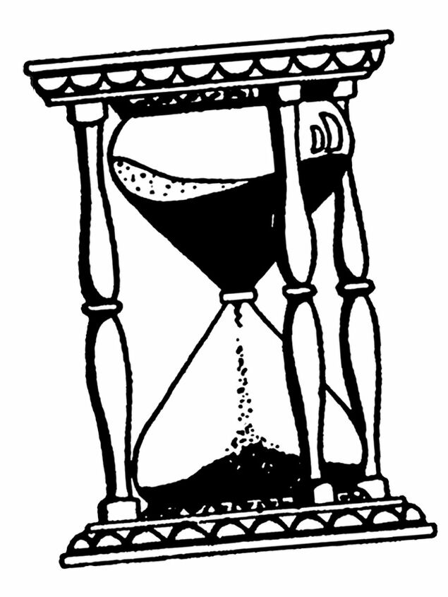
OPTION A CONSIDERATIONS
Shifting priorities
Time constraints
Limited Knowledgebase
Notes:
Option A was the quixotic internal assault

Slide 34

OPTION B CONSIDERATIONS
Focused Effort
Timeliness
Best Practice Experts
Notes:
Option B is calling in the mercernaries

Slide 36
Equilibrium exists when quantity meets demand
Product =
data projects
Price =
man-hours

Slide 37


Lynn Andrews
LAndrews@GeorgeFox.edu
Melody Allen McBeth
Melody.McBeth@HighlandFrS.com
@HighlandFrS
AASP Salary Survey results available at advserv.org
The Constitution only gives people the right to pursue happiness. You have to catch it yourself – Benjamin Franklin

Slide 38
We Listen to Your Feedback
Thank you for attending!
Please evaluate this session:
CASE Mobile App in your app store, or
Go to www.case.org/app

