Slide 1
Similarity Searching with PQ

Slide 2
Outline
Problem
Similarity Searching
SS Applications
Product Quantization with FAISS
PQ & IVF-ADC
FAISS: HelloWorld
In Conclusion

Slide 3
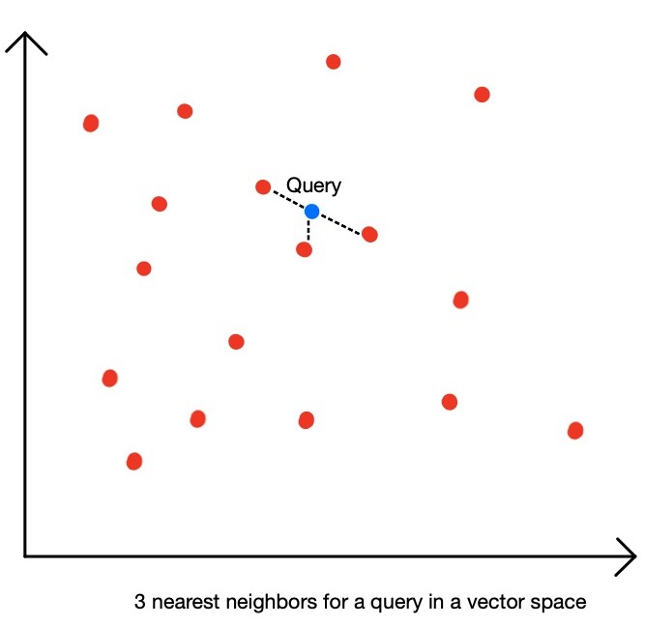
Problem
Similarity Searching
Sometimes formulated as k Nearest-Neighbor
Usually formulated as k Approximated Nearest-Neighbors
Accompanied with a Similarity Metric, or a Distance Metric used to calculate the similarity of entities pairs
-> Curse of dimensionality

Slide 4
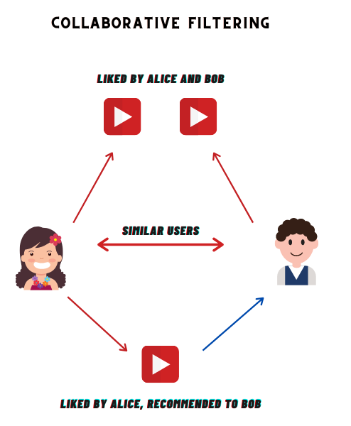
Problem
Similarity Searching Applications
Recommendation Systems
Fast text search
...

Slide 5

Problem
Formulation
Given a vector set S, each e vector is D-dimensioned
Given a Distance Metrics
Given a Query Vector q from the same data source
--> Find the vectors subset of k closest neighbor to q from S.

Slide 6
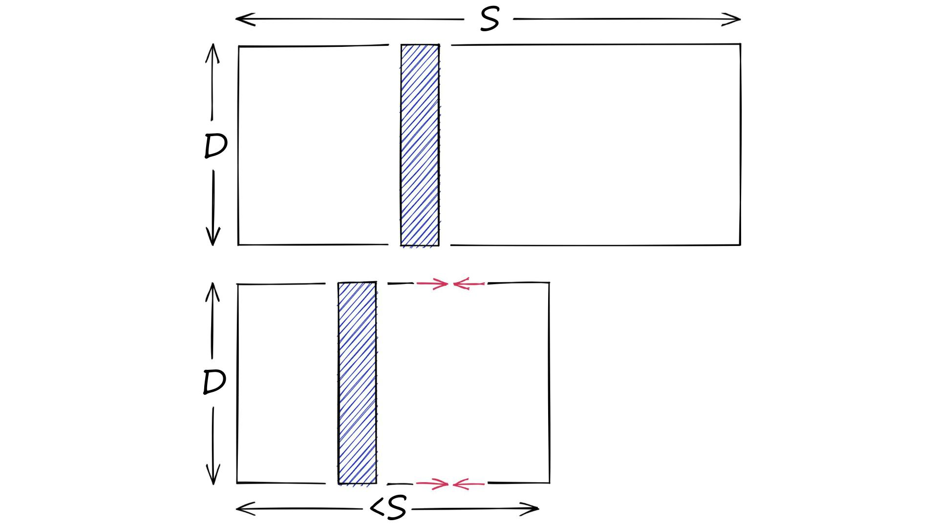
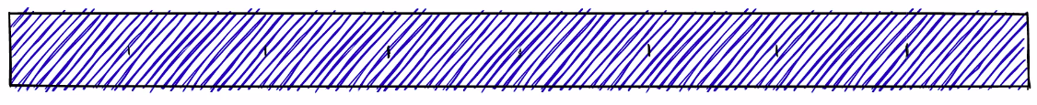
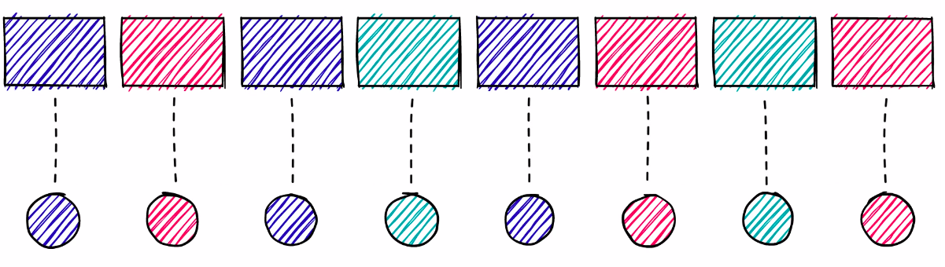
Product Quantization
Idea: "compress" the original vectors in to a lower-resolution "quant" vector.
Execution:
Split the original set of D-length vector, column wise to m sets of D/m-length sets of sub-vectors
Cluster each sets of sub-vectors, substitute each sub-vectors (of each original vectors) with the cluster index with the new element in the low-res vector

Slide 7
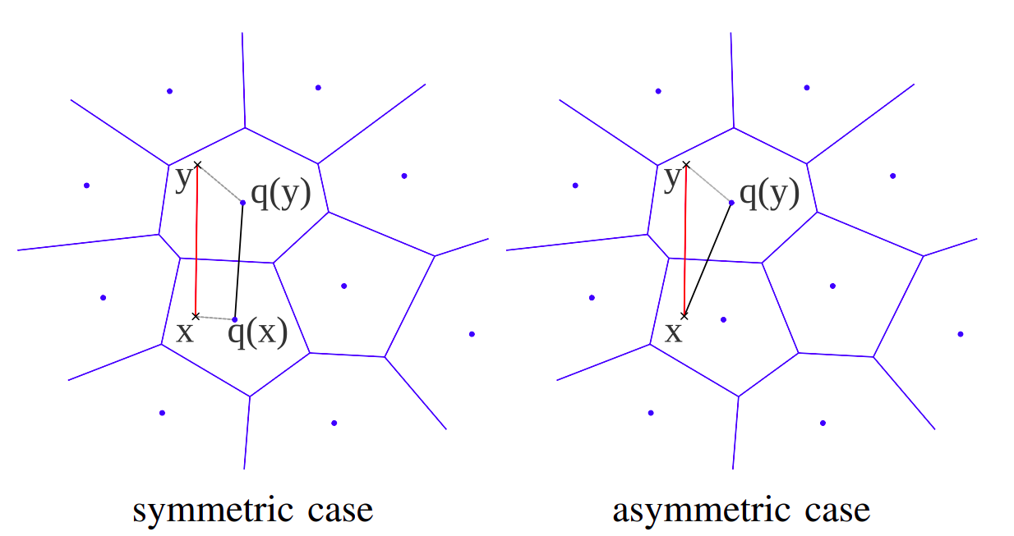
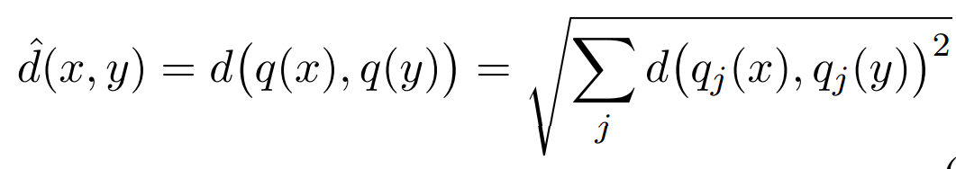
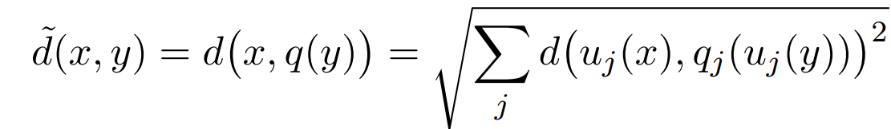
Product Quantization: Asymmetric Distance for Searching
Given a query vector y. How to select the k-nearest vector subset in S?
Naive Searching: L2 distance calculation of y with every x in S, sped-up by using the "quant vectors" q(x)
Two modes of distance calculation:
calculate q(y), then compare q(y) and q(x)
Direct comparison of y and q(x)

Slide 8
Product Quantization: Asymmetric Distance for Searching
Given a query vector y. How to select the k-nearest vector subset in S?
Naive Searching: L2 distance calculation of y with every x in S, sped-up by using the "quant vectors" q(x)
Two modes of distance calculation:
calculate q(y), then compare q(y) and q(x)
Direct comparison of y and q(x)

Slide 9
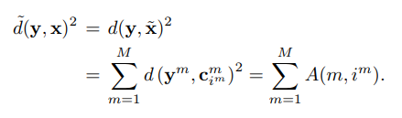
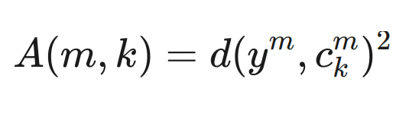
Product Quantization: Faster Seaching with Look-up tables
Given a query vector y. How to select the k-nearest vector subset in S?
Look-up table: L2 distance calculation of y with every centroids in the PQ phase
Aggregation of the Cells for ADC

Slide 10
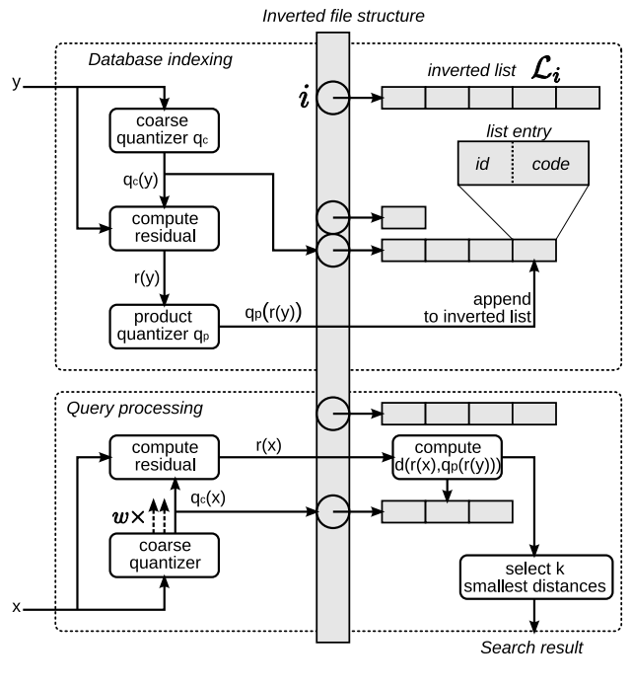
Product Quantization: Non-exhaustive Searching with IVF
Given a query vector y. How to select the k-nearest vector subset in S without exhaustively search through all vectors in S?
--> Only search through "potential matches":
Coarsely cluster S into subsets of similar vectors.
Save all of them into an Inverted File Structure
Only search through the set of "possible matches"

