Slide 1
LINK-STATE ROUTING
Chethan Kumar Appaji A20355296

Slide 2
Link State Routing Protocol:
Link State is a routing protocol which is used in packet switching networks for computer communication. In the network that uses link state, every node will perform link - state; they construct a map of the connection between nodes in network by showing which nodes connected with which other nodes. After that each nodes can independently calculate the best path from it to other nodes in network.

Slide 3
Dijkstra’s Shortest Path Algorithm
Dijkstra's algorithm, is a graph search algorithm that solves the single-source shortest path problem for a graph with non-negative edge path costs, producing a shortest path tree. This algorithm is often used in routing and as a subroutine in other graph algorithms.
It can also be used for finding costs of shortest paths from a single vertex to a single destination vertex by stopping the algorithm once the shortest path to the destination vertex has been determined. For example, if the vertices of the graph represent cities and edge path costs represent driving distances between pairs of cities connected by a direct road, Dijkstra's algorithm can be used to find the shortest route between one city and all other cities.

Slide 4

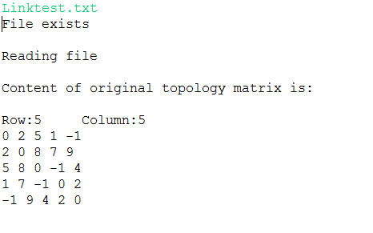
Step 1: On selecting Option 1, to load the distance matrix from a text file

Slide 5
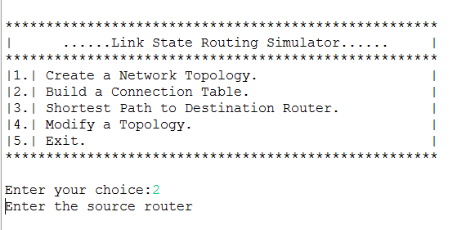
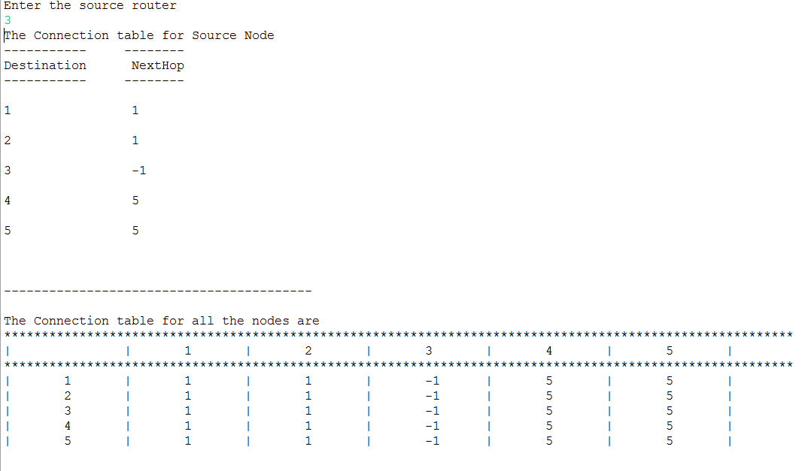
Step 2: On selecting Option 2, to enter the source node and Display Connection table

Slide 6
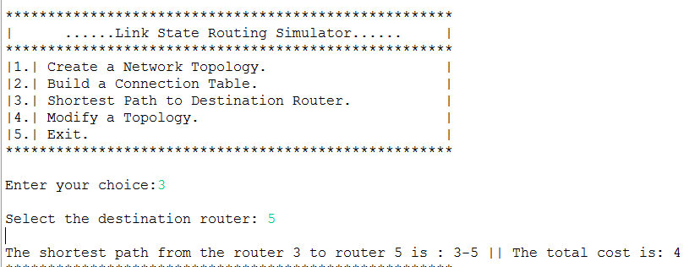
Step 3: On selecting Option 3, to enter the destination node and Display shortest Path and Cost

Slide 7
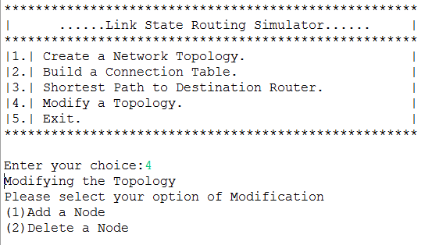
Step 4: On selecting Option 4, Modify a topology. Display options to Add and delete a node

Slide 8
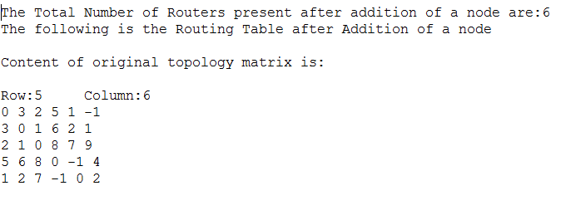
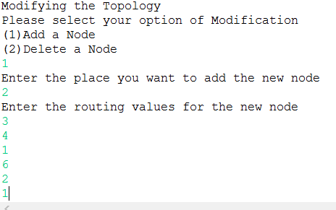
Step 5: On selecting sub-option 1, Add a node. Enter the node to be added and its values and display new matrix.

Slide 9
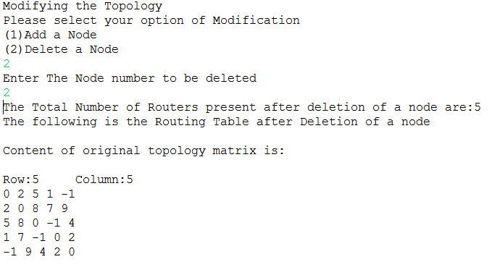
Step 6: On selecting sub-option 2, Delete a node. Enter the node to be deleted and display new matrix.

Slide 10
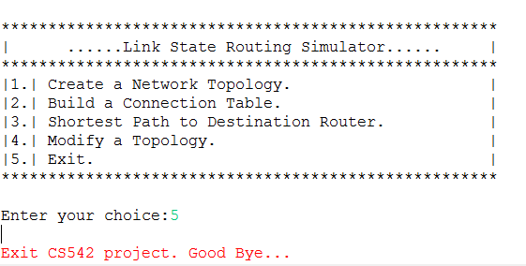
Step 7: On selecting Option 5, Exit from Main Menu

