Slide 1
Basic Statistics II

Slide 2
Correlation tests are a special case of Hypothesis Tests
Need not involve a model; may be “non-parametric”
Return the probability of the null hypothesis:
for correlation tests, the null hypothesis is that the two data sets have no association

Slide 3
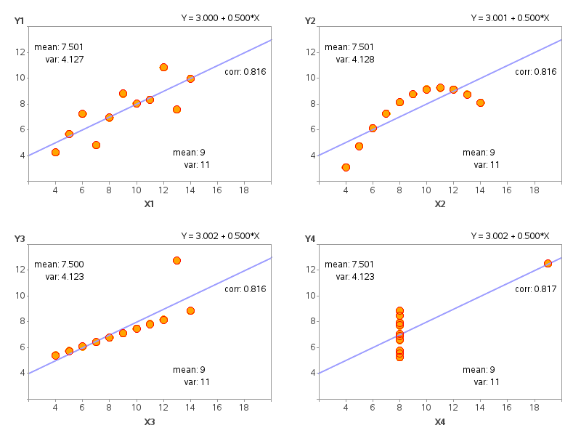
DOES IT MATTER WHICH TEST I CHOOSE?
Anscombe’s Quartet:
illustrates importance of graphical analysis
illustrates importance of choosing the right test based on its assumptions
Pearson
Most common correlation/association tests:
Pearson (parametric): assumes linear relation + Gaussian scatter
Spearman rank (non-parametric): assumes monotonic relation
Kendall’s tau (non-parametric): based on pairwise point analysis

Slide 4
DOES IT MATTER WHICH TEST I CHOOSE?
Spearman-Pearson comparison
What about Spearman vs. Kendall?
Spearman = most popular/widespread
Kendall’s tau = better statistical properties per Ivezic et al. textbook
Spearman same
Spearman weaker (bad)
Spearman stronger (good)
Spearman null (good)
Add Kendall’s tau to the plots and decide for yourself!

Slide 5
Issues for Correlations:
selection bias (luminosity vs. distance)
covariance (color vs. mass)
causality* (correlation ≠ causation)
third parameters/partial correlations
* multi-parameter data sets are often analyzed using “principal component analysis” (PCA) to find the most fundamental driving parameters – however PCA is most effective for linear correlations, and “hidden” fundamental parameters may not be included in the data set

