Slide 1

Chi-squared and Maximum likelihood basics reference slides for CAP Boot Camp tutorials on Interpreting $χ^{2}$ and Parameter Estimation by Maximum Likelihood Model Fitting

Slide 2

Chi-squared value vs. distribution
One value of “Chi squared” compares observed minus expected values (residuals from a model) for one set of N data points with uncertainties $σ$ (expected residuals)
$$χ^{2}=\sum_{i=0,N}{\frac{{\left(O_{i}−E_{i}\right)}^{2}}{σ_{i}^{2}}}$$
Different values of $χ^{2}$for different sets of N data points $\{O_{i}$} are drawn from the Chi squared probability distribution, assuming that for a single data point i, the probability of measuring a value $O_{i}$ is drawn from a normal distribution $\frac{1}{\sqrt{2π}σ_{i}}e^{−{(O_{i}−Ei)}^{2}/2σ_{i}^{2}}$.

Slide 3
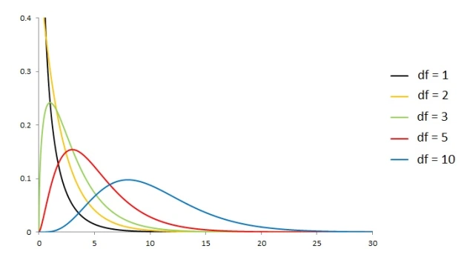



Chi-squared AND reduced chi-squared
The equation for the $χ^{2}$distribution is ugly and depends on the # of degrees of freedom:
$df=N−k$ for $N$ data points and $k$ model parameters.
$χ^{2}$ distribution for various df
For random $χ^{2}$, $\left\langle χ^{2}\right\rangle \sim df$, so people often define a “reduced” $\hat{χ^{2}}=χ^{2}/df$ and expect it to be ~1 for a “good model” (but this is a somewhat risky oversimplification, as you will see in the Interpreting $χ^{2}$ tutorial). Notice that for large df, the $χ^{2}$ distribution starts to look Gaussian (the central limit theorem!).

Slide 4

Chi-squared and likelihood
Assume that for a given data point i, the probability of measuring a value $O_{i}$is $\frac{1}{\sqrt{2π}σ_{i}}e^{−{(O_{i}−Ei)}^{2}/2σ_{i}^{2}},$and verify for yourself that multiplying the individual data point probability distributions gives an overall probability distribution for the data set $\{O_{i}$} that is proportional to $e^{−χ^{2}/2}$where $χ^{2}=\sum_{i}{\frac{{\left(O_{i}−E_{i}\right)}^{2}}{σ_{i}^{2}}}$.
Based on this, we say that the “likelihood” of a model being correct for a given data set is proportional to $e^{−χ^{2}/2}$ if the residuals are normally distributed around the data points.

Slide 5

Traditional maximum likelihood
seek “best fit” models/parameters
typically assume likelihood L proportional to $e^{−χ^{2}/2}$
min $χ^{2}$ ➔ max likelihood
“maximum likelihood estimators” (MLEs) of parameters α_{i} of a model are usually found by $\frac{∂L}{∂α_{i}}=0$ or equivalently $\frac{∂ln⁡(L)}{∂α_{i}}=0$
assuming all residuals follow same normal distribution (i.e. have same σ), called “ordinary least-squares” (OLS) fitting or “minimizing the rms” (root mean square deviations)

Slide 6

Traditional Maximum Likelihood
Example: model $y=αX+β$with equal Gaussian errors σ
$χ^{2}=\sum_{i}{\frac{{(Y_{i}−\left(αX_{i}+β\right))}^{2}}{σ^{2}}}$ ➔ max likelihood
$\frac{∂ln⁡(L)}{∂α}=0$ ➔ $\frac{∂\ln\left(e^{−\frac{χ^{2}}{2}}\right)}{∂α}=0$ ➔ $\sum_{i}{\frac{\left(Y_{i}−\left(αX_{i}+β\right)\right)X_{i}}{σ^{2}}=0}$
$\frac{∂ln⁡(L)}{∂β}=0$ ➔ $\frac{∂\ln\left(e^{−\frac{χ^{2}}{2}}\right)}{∂β}=0$ ➔ $\sum_{i}{\frac{\left(Y_{i}−\left(αX_{i}+β\right)\right)}{σ^{2}}=0}$
two eqns, two unknowns – solve to get result in tutorial:
$α=\frac{\overline{X}\overline{Y}−\overline{XY}}{{\left(\overline{X}\right)}^{2}−\overline{X^{2}}}$ and $β=\overline{Y}−\overline{X}α$
(so for this simple case, no numerical $χ^{2}$ minimization is needed; but harder for more parameters or different σ_{i})

Slide 7
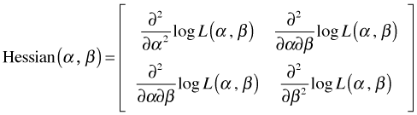

Traditional maximum likelihood
uncertainties on MLE params estimated by 1/E(-H) = inverse of expectation of negative “Hessian matrix”
Hessian matrix example: $y=αX+β$
note covariance terms!
complicated to compute Hessians, often done numerically
fully worked Hessian for least squares case at http://mathworld.wolfram.com/LeastSquaresFitting.html - note errors on parameters generally decrease as $\frac{1}{\sqrt{N}}$

