Slide 1
BASIC STATISTICS III

Slide 2

Chi-squared value vs. distribution
One value of “Chi squared” compares observed minus expected values (residuals from a model) for one set of N data points with uncertainties $σ$ (expected residuals)
$$χ^{2}=\sum_{i=0,N}{\frac{{\left(O_{i}−E_{i}\right)}^{2}}{σ_{i}^{2}}}$$
Different values of $χ^{2}$for different sets of N data points $\{O_{i}$} are drawn from the Chi squared probability distribution, assuming that for a single data point i, the probability of measuring a value $O_{i}$ is drawn from a normal distribution $\frac{1}{\sqrt{2π}σ_{i}}e^{−{(O_{i}−Ei)}^{2}/2σ_{i}^{2}}$.

Slide 3
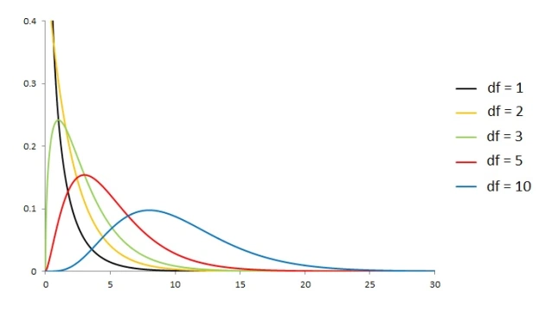



Chi-squared AND reduced chi-squared
The equation for the $χ^{2}$distribution is ugly and depends on the # of degrees of freedom:
$df=N−k$ for $N$ data points and $k$ model parameters.
$χ^{2}$ distribution for various df
For random $χ^{2}$, $\left\langle χ^{2}\right\rangle \sim df$, so people often define a “reduced” $\hat{χ^{2}}=χ^{2}/df$ and expect it to be ~1 for a “good model” (but this is a somewhat risky oversimplification, as you will see in the Interpreting $χ^{2}$ tutorial). Notice that for large df, the $χ^{2}$ distribution starts to look Gaussian (the central limit theorem!).

Slide 4

Chi-squared and likelihood
Assume that for a given data point i, the probability of measuring a value $O_{i}$is $\frac{1}{\sqrt{2π}σ_{i}}e^{−{(O_{i}−Ei)}^{2}/2σ_{i}^{2}},$and verify for yourself that multiplying the individual data point probability distributions gives an overall probability distribution for the data set $\{O_{i}$} that is proportional to $e^{−χ^{2}/2}$where $χ^{2}=\sum_{i}{\frac{{\left(O_{i}−E_{i}\right)}^{2}}{σ_{i}^{2}}}$.
Based on this, we say that the “likelihood” of a model being correct for a given data set is proportional to $e^{−χ^{2}/2}$ if the residuals are normally distributed around the data points.

Slide 5

Traditional maximum likelihood
seek “best fit” models/parameters
typically assume likelihood L proportional to $e^{−χ^{2}/2}$
min $χ^{2}$ ➔ max likelihood
“maximum likelihood estimators” (MLEs) of parameters α_{i} of a model are usually found by $\frac{∂L}{∂α_{i}}=0$ or equivalently $\frac{∂ln⁡(L)}{∂α_{i}}=0$
assuming all residuals follow same normal distribution (i.e. have same σ), called “ordinary least-squares” (OLS) fitting or “minimizing the rms” (root mean square deviations)

Slide 6
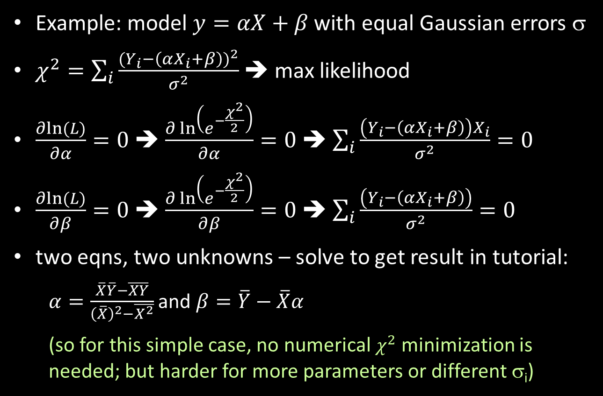
Traditional Maximum Likelihood
Example: model $y=αX+β$with equal Gaussian errors σ
$χ^{2}=\sum_{i}{\frac{{(Y_{i}−\left(αX_{i}+β\right))}^{2}}{σ^{2}}}$ ➔ max likelihood
$\frac{∂ln⁡(L)}{∂α}=0$ ➔ $\frac{∂\ln\left(e^{−\frac{χ^{2}}{2}}\right)}{∂α}=0$ ➔ $\sum_{i}{\frac{\left(Y_{i}−\left(αX_{i}+β\right)\right)X_{i}}{σ^{2}}=0}$
$\frac{∂ln⁡(L)}{∂β}=0$ ➔ $\frac{∂\ln\left(e^{−\frac{χ^{2}}{2}}\right)}{∂β}=0$ ➔ $\sum_{i}{\frac{\left(Y_{i}−\left(αX_{i}+β\right)\right)}{σ^{2}}=0}$
two eqns, two unknowns – solve to get result in tutorial:
$α=\frac{\overline{X}\overline{Y}−\overline{XY}}{{\left(\overline{X}\right)}^{2}−\overline{X^{2}}}$ and $β=\overline{Y}−\overline{X}α$
(so for this simple case, no numerical $χ^{2}$ minimization is needed; but harder for more parameters or different σ_{i})

Slide 7
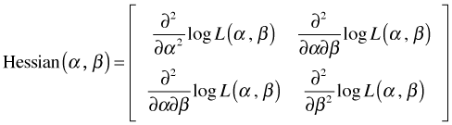

Traditional maximum likelihood
uncertainties on MLE params estimated by 1/E(-H) = inverse of expectation of negative “Hessian matrix”
Hessian matrix example: $y=αX+β$
note covariance terms!
complicated to compute Hessians, often done numerically
fully worked Hessian for least squares case at http://mathworld.wolfram.com/LeastSquaresFitting.html - note errors on parameters generally decrease as $\frac{1}{\sqrt{N}}$

Slide 8
The Bayesian Approach: maximum likelihood distributions
construct space of models with expected ranges of parameters
prob(model|data) $∝$ prob(data|model) × prob(model) or Posterior $∝$ Likelihood × Prior
for flat priors on model params, posterior probability of each model is proportional to its likelihood, $e^{−χ^{2}/2}$ (math matches frequentist, but Bayesian would keep full posterior distribution and not make a “point estimate”)
integrate over “nuisance parameters” (“marginalize” over them) to get probability distribution for one parameter

Slide 9
The Bayesian Approach: maximum likelihood distributionS
More uses of marginalization:
Compare whole classes of models A and B (e.g. straight line or curved?) by integrating over parameters:
“Bayes Factor” = $\frac{\int_{α}{dα p_{A}}ℒ\left(X_{i}|α,A\right)p(α|A)}{\int_{α}{{dα p}_{B}}ℒ\left(X_{i}|α,B\right)p(α|B)}$
Get probability distributions for model quantities other than model parameters, e.g., galaxy stellar masses from SPS fits to galaxy SEDs (stellar mass is not an input to the model, rather it is a scale factor determined in the fit)

Slide 10
The Bayesian Approach: choice of priors
Priors can be “uninformative” in different ways – e.g., uniform in linear parameter, “scale-free” (uniform in log parameter), uniform in a transformed parameter
Given lots of data and/or small error bars, posterior results should be insensitive to the choice of prior within the spread in the posterior
Given crappy data or few data points, need to test sensitivity of posterior to substituting reasonable priors – and full Bayesian posterior is crucially more informative in such a case than a frequentist point estimate

