Slide 1
The Art of Mathematical Modeling

Slide 2
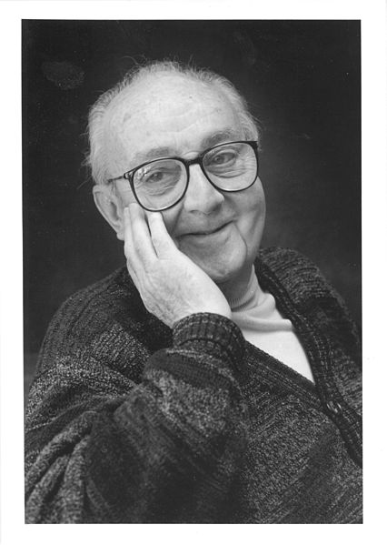
The Art of Mathematical Modeling
“Remember that all models are wrong; the practical question is how wrong do they have to be to not be useful.”
-OR-
“All models are wrong, but some are useful.“
–George E. P. Box

Slide 3
General Process of Mathematical Modeling
Write & Present Results
Investigation & Problem Identification
Compare with Reality
Assumptions, Selection of Inputs & Outputs
Interpret Solution
Solve the Mathematical Model
Mathematical Formulation of Problem

Slide 4
General Process of Mathematical Modeling
Write & Present Results
Investigation & Problem Identification
Compare with Reality
Assumptions, Selection of Inputs & Outputs
Interpret Solution
Solve the Mathematical Model
Mathematical Formulation of Problem

Slide 5
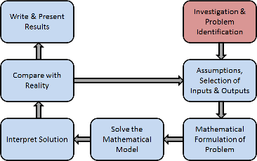
Example: Chickenpox
How do we model a chickenpox epidemic?
An uninfected person is susceptible to chickenpox.
An infected person comes in contact with a susceptible person and infects this person.
After a period of time, the person recovers.

Slide 6
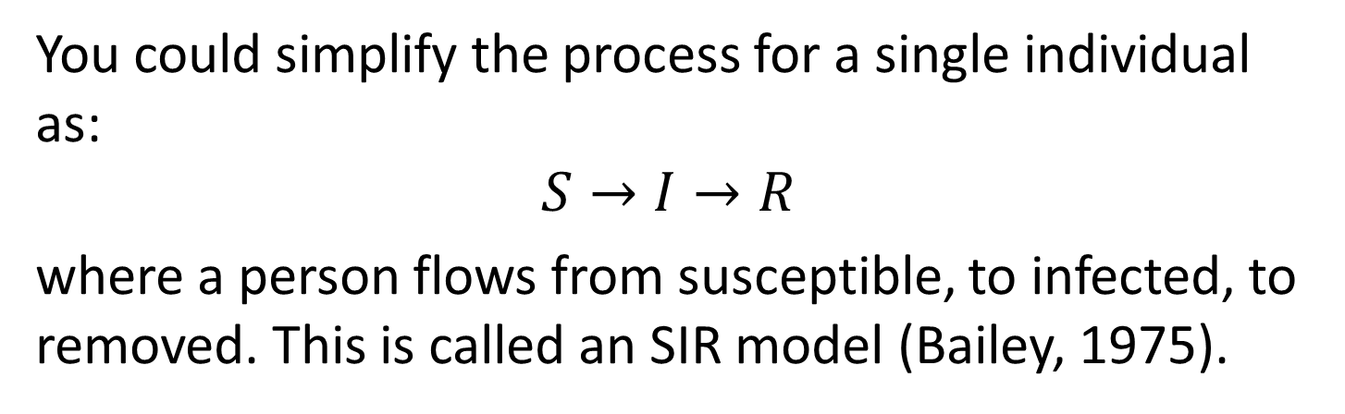
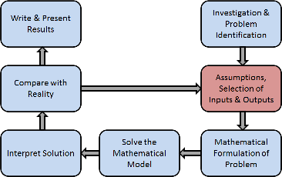
Assumptions

Slide 7
Selection of Inputs
Independent variables: Typically considered variables you have control over or are fixed.
Time* (t)
Space (x)
Parameters: Arbitrary constants whose values characterize members of a system.
Infection rate (λ)
Recovery rate (r)

Slide 8
Selection of Outputs
Dependent variables: The quantity you measure in the experiment and what is affected during the experiment.
Susceptible people (S)
Infected people (I)
Recovered people (R)

Slide 9
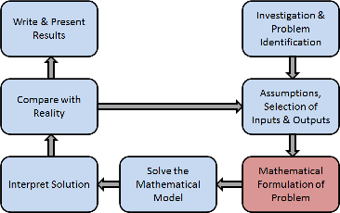
What kind of model?
Discrete or continuous in time?
Difference equations vs. differential equations.
Discrete or continuous in space?
Compartment models vs. partial differential equations
Deterministic or Stochastic?
Stochastic: Gillespie, stochastic differential equations, etc.
Time delays?
Delay differential equations.

Slide 10
Example – SIR differential equations
Continuous in time: neglect discrete events (such as going to work or school each day).
Neglect space: system is well mixed. There are no local outbreaks.
Neglect delays: individuals contagious as soon as infected.
Neglect chance: If system is large enough, on average results are always the same.

Slide 11
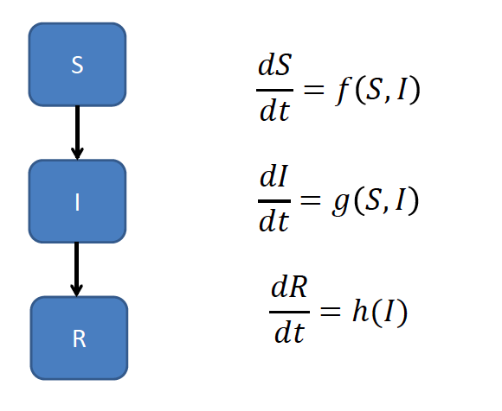
SIR Model

Slide 12


SIR Model
S
$$λIS$$
I
$$rI$$
R

Slide 13
Variables and Parameters
Time (t) – days
Number Susceptible (S) – number of people.
Infected (I) – number of people.
Recovered (R) – number of people.
Infection rate (λ) – (people *day)⁻¹
Recovery rate (r) – days⁻¹

Slide 14
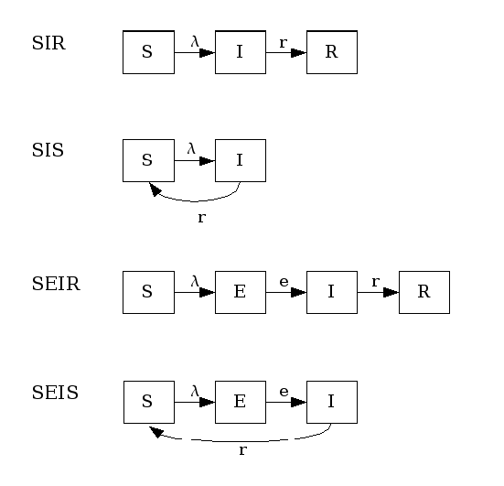
Other choices for epidemic models

Slide 15
Rates
Law of Mass Action for Infection (λSI)
Assumes infections are similar to reactions in molecular dynamics (random bumping).
Recovery rate modeled as rI, where r is 1/(number of days infectious).
All people recover at the same rate.

Slide 16
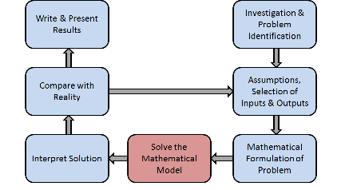
Solve the model
Many commercial solvers are available for systems of differential equations.
Matlab/Python codes available.
Need to find reasonable parameter values.
Literature searches
Experiments
Best guess

Slide 17
Best guess at rates
λ can be considered the average number of people one person would infect per day if everyone was susceptible.
Guess: 0.1 days⁻¹
R is 1 divided by the average number of days you are infectious.
Guess: 0.5 (people*day)⁻¹
Note that it usually takes 10-21 days to show symptoms (not including this yet).

Slide 18
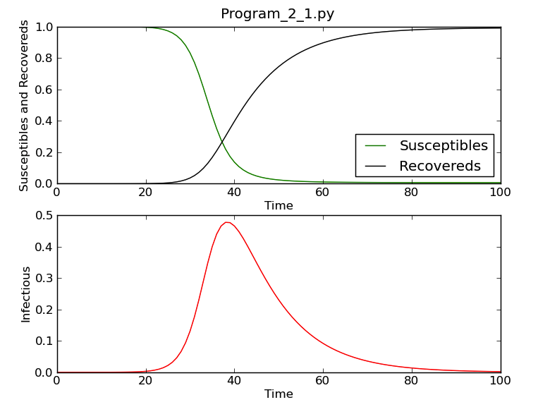
SIR Results

Slide 19
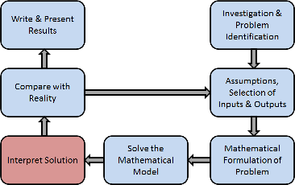
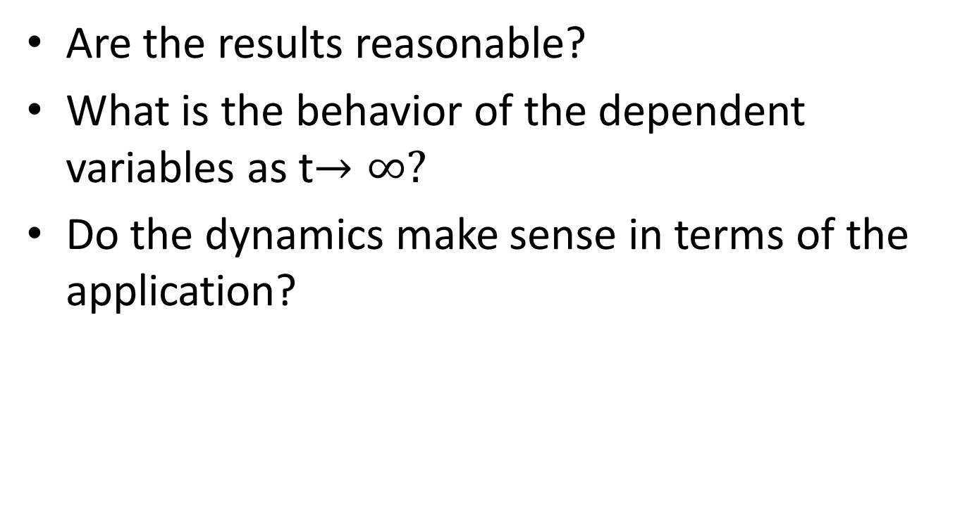
Interpret results
Are the results reasonable?
What is the behavior of the dependent variables as t$→∞?$
Do the dynamics make sense in terms of the application?

Slide 20
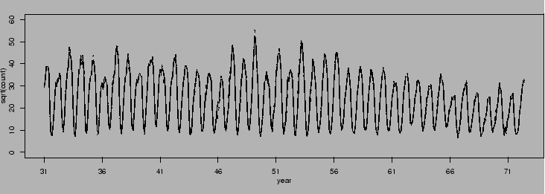
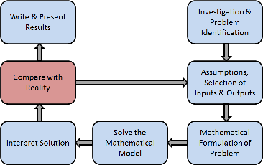
Chicken Pox Data
Monthly reported number of chickenpox, New York City, 1931-1972.
Source: Hipel and Mcleod (1994).

Slide 21
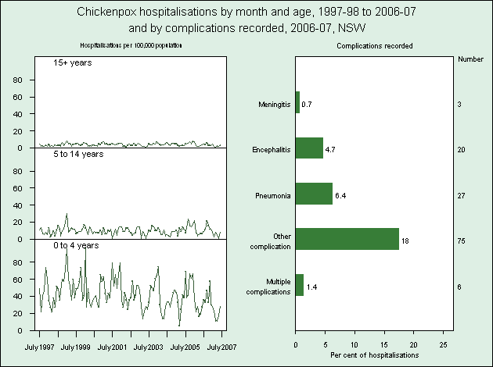
Age Structured Chickenpox Data
http://www.health.nsw.gov.au/publichealth/chorep/com/com_chickenpox_cxhos.asp

Slide 22
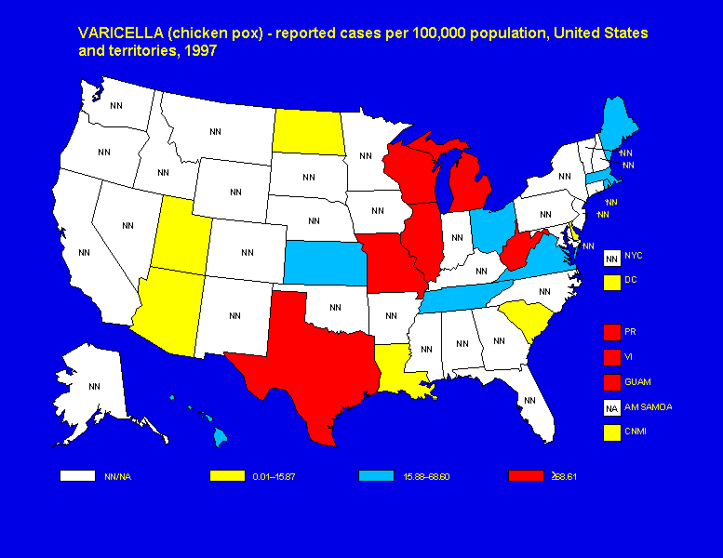
Chickenpox by State

Slide 23
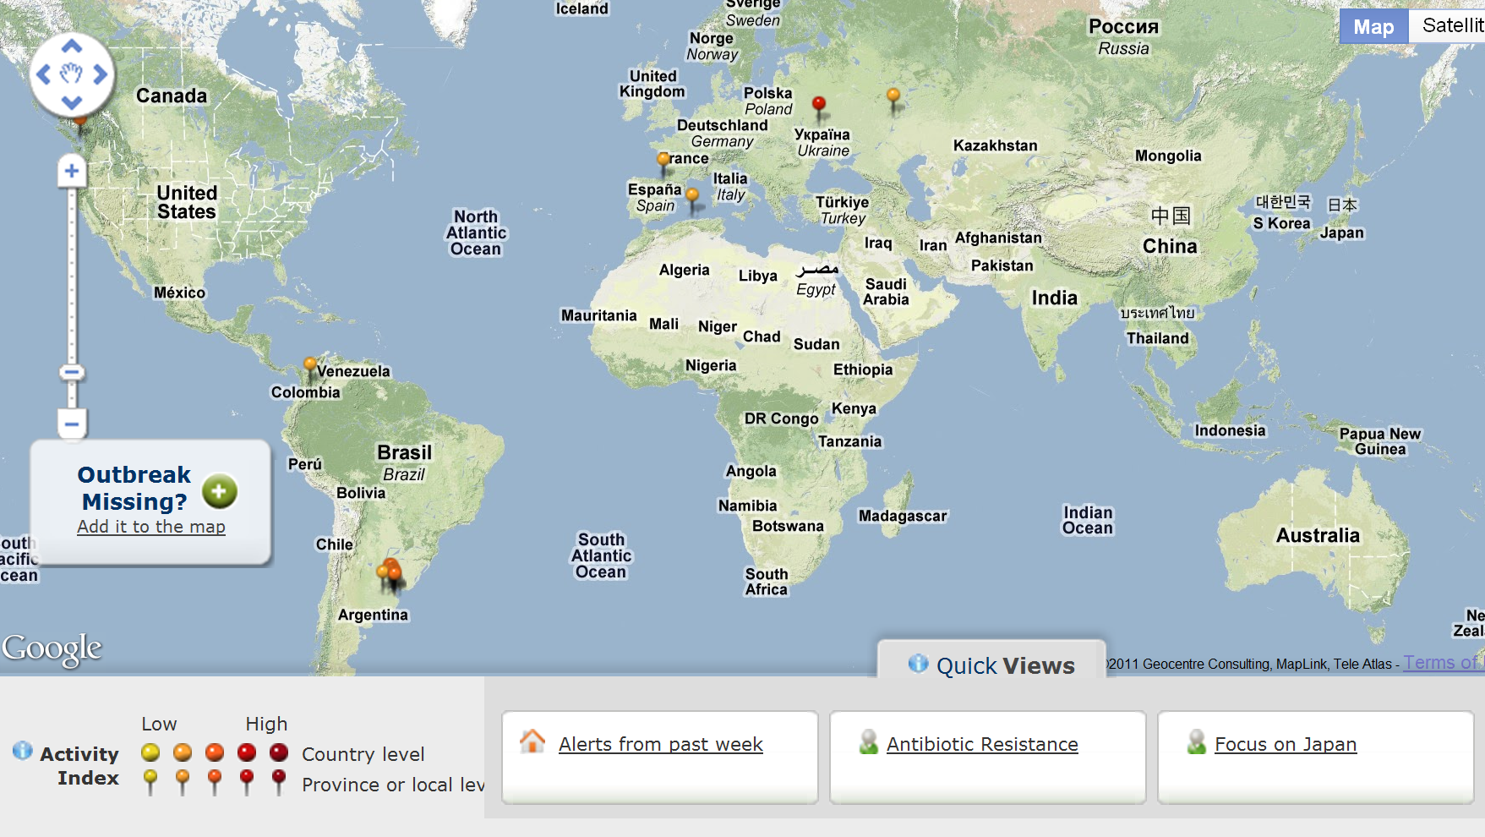
Current Global Outbreaks

Slide 24
Gleamviz global epidemic simulator
http://www.gleamviz.org/simulator/client/

Slide 25
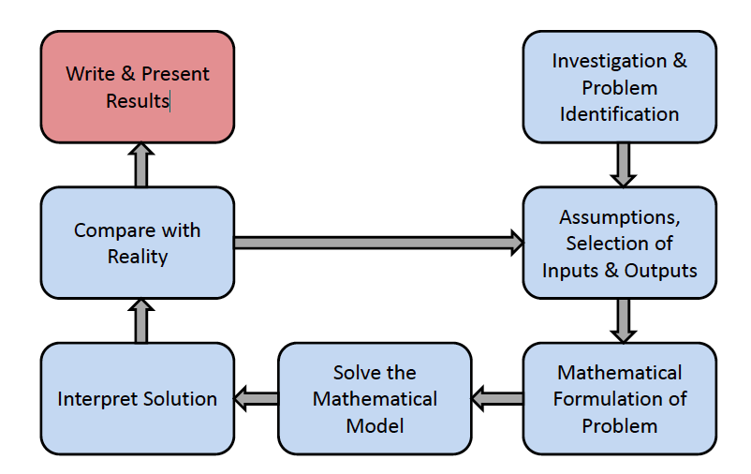
Final step!

Slide 26
The most complex models aren’t necessarily the most significant
“One the greatest scientific achievements of the 1990's was the development of a clear understanding of HIV pathogenesis aided by simple mathematical models. These simple formulations were enough to interpret clinical data, determining quantitative characteristics of the interaction between the HIV virus and the cells targeted by it. “
- From http://www.etsu.edu/cas/math/cbmsDes.aspx

