Slide 1
King County, WA Home Price Predictions
John Capps

Slide 2
Research Question:
Using the data available, can we predict the price of homes in King County, WA?
Using the data available, and after splitting the price of homes into four categories (Low, Medium, High, Very High), can we predict into which price category the homes in King County, WA will fall?

Slide 3
The Datasets
House Sales in King County, USA
Kaggle - https://www.kaggle.com/harlfoxem/housesalesprediction
Race and Hispanic or Latino: 2010 - County – County Subdivision and Place
US Census Bureau - https://factfinder.census.gov/faces/tableservices/jsf/pages/productview.xhtml?src=CF

Slide 4
Explore the Data – House Sales in King County, USA
Number of variables in the dataset:
Total: 21
Continuous: 13
Categorical: 8
Number of datapoints in the dataset:
Total: 21,613

Slide 5
Explore the Data – Continuous Variables
Continuous Variables
Id
Date (Year/Month/Day)
Price
House Size (square feet)
Lot Size (square feet)
House Size – Not Including the Basement (square feet)
Basement Size (square feet)
Year the Home was Built
Year the Home was Renovated
Latitude
Longitude
sqft_living15
sqft_lot15

Slide 6
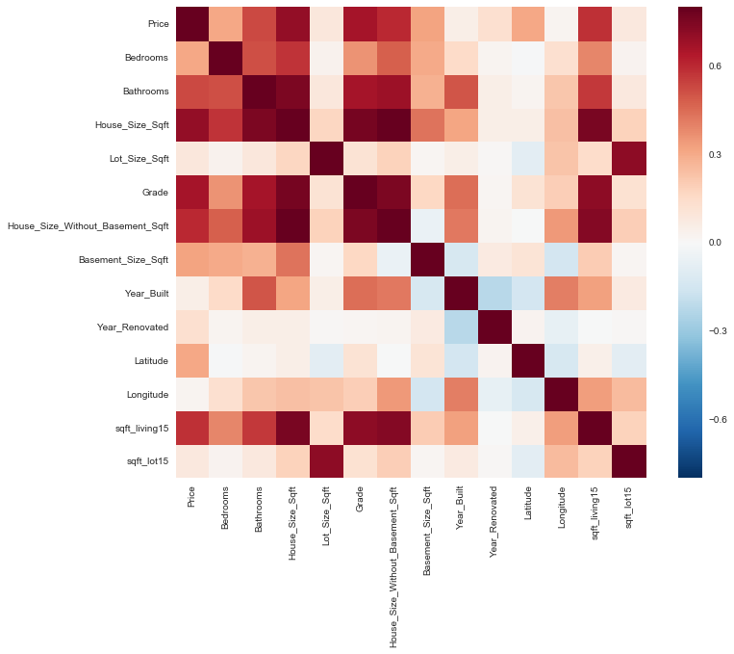
Explore the Data – Continuous Variables
Drop features: house size without basement, sqft_living15, sqft_lot15
Strong correlations with house size and lot size
House size-house size without basement: 0.88
House size-sqft_living15: 0.76
Lot size-sqft_lot15: 0.72
Not sure exactly what those features represent

Slide 7
Explore the Data – Categorical Variables
Categorical Variables
Number of Bedrooms
Number of Bathrooms
Number of Floors/Levels in the Home
Waterfront Property
View
Condition of the Home
Grade of the Home
Zip Code of the Home

Slide 8
Explore the Data – Categorical Variables
Added two new categorical variables:
Has_Basement
Was_Renovated
There were many homes that did not have basements or had not been renovated

Slide 9
Feature Selection
Recursive feature elimination with cross-validation (RFECV)
Selects features by recursively considering smaller and smaller sets of features
First, an estimator trains the data on the initial set of features and ranks the features through a coefficient (coef_) or feature importance (feature_importances_) attribute;
Then, the least important feature is dropped from the current set of features;
This process repeats until the desired number of features is obtained;
The results are then cross-validated to find the optimal number of features.
Estimator for feature selection: Random Forest
Wanted to use a complex and accurate estimator to choose the features
Gradient boosting classifier was too complex and took too long to run

Slide 10
Regression Models
Most successful regression models:
Random forest regression:
KNN Regression:
Gradient boosting regression:
Metrics Used:
R-squared, Pearson R-value

Slide 11
Random Forest Regression
Parameters:
Iterations: 500
Max Depth: None
Cross-Validation: 5
Results:
Mean R-squared: 0.88 (+/-) 0.1
Pearson R-Value: 0.94

Slide 12
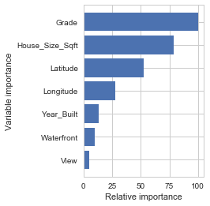
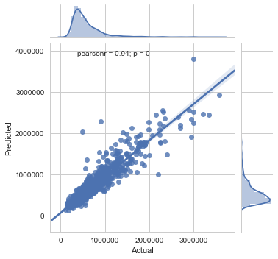
Random Forest Regression
rfr

Slide 13
KNN Regression
Parameters:
Neighbors: 10
Weights: Distance
Cross-Validation: 5
Results
Mean R-squared: 0.83 (+/-) 0.2
Pearson R-value: 0.93

Slide 14
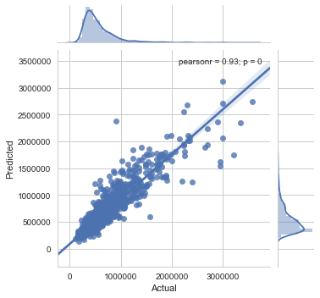
KNN Regression

Slide 15
Gradient Boosting Regression
Parameters:
Loss: Least Squares
Iterations: 500
Max Depth: None
Cross-Validation: 5
Results:
Mean R-Squared: 0.77 (+/-) 0.2
Pearson R-value: 0.89

Slide 16

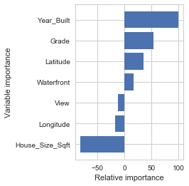
Gradient Boosting Regression
gbr

Slide 17
Motivation for Classification
I wanted to see if I could make a more accurate model by binning the price of the homes into categories and making a classification model.
Binning the Data: Divide the Date Based on Price:
Label | Range (Percentile) | Range ($) | # of Datapoints
Low | 0-25th | 0 - $321,950 | 5460
Medium | 26th-50th | $321,951 - $450,000 | 5404
High | 51st-75th | $450,001 – $645,000 | 5,376
Very High | 76th-100th | $645,001 - $7,700,000 | 5,373

Slide 18
Classification Models
Most successful models:
Random forest classifier:
Gradient boosting classifier:
KNN Classifier
Metrics Used:
Accuracy

Slide 19
Random Forest Classifier
Parameters:
Iterations: 500
Max Depth: None
Cross-Validation: 5
Results:
Mean Accuracy: 0.76 (+/-) 0.2
 | False Positives | False Negatives
Low | 0.32 | 0.28
Medium | 0.27 | 0.24
High | 0.28 | 0.27
Very High | 0.1 | 0.18

Slide 20
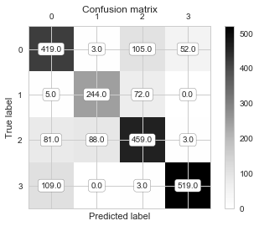
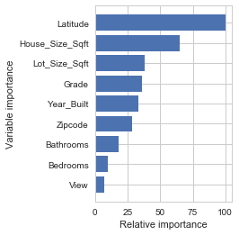
Random Forest Classifier
Rfc

Slide 21
Gradient Boosting Classifier
Parameters:
Loss: Deviance
Iterations: 500
Max Depth: None
Cross-Validation: 5
Results:
Mean Accuracy: 0.74 (+/-) 0.2
 | False Positives | False Negatives
Low | 0.34 | 0.26
Medium | 0.28 | 0.27
High | 0.28 | 0.28
Very High | 0.09 | 0.19

Slide 22

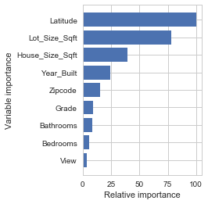
Gradient Boosting Classifier
cm

Slide 23
KNN Classifier
Parameters:
Neighbors: 10
Weights: Distance
Cross-Validation: 5
Results
Mean Accuracy: 0.72 (+/-) 0.1
 | False Positives | False Negatives
Low | 0.37 | 0.33
Medium | 0.29 | 0.3
High | 0.32 | 0.33
Very High | 0.12 | 0.16

Slide 24
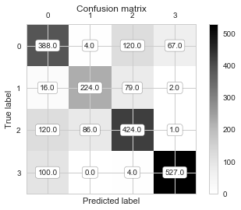
KNN Classifier

Slide 25
Additional Interesting Observations
Potential correlation between race and home prices
Use Gmaps to plot homes by price
Use census data to identify communities with the largest percentage minority and largest percentage white
Observations:
Communities with the largest percentage minority populations tend to be clustered south of Seattle and contain many Low price homes
Communities with the largest percentage white population tend tend to be scattered around the outskirts of of the county

Slide 26
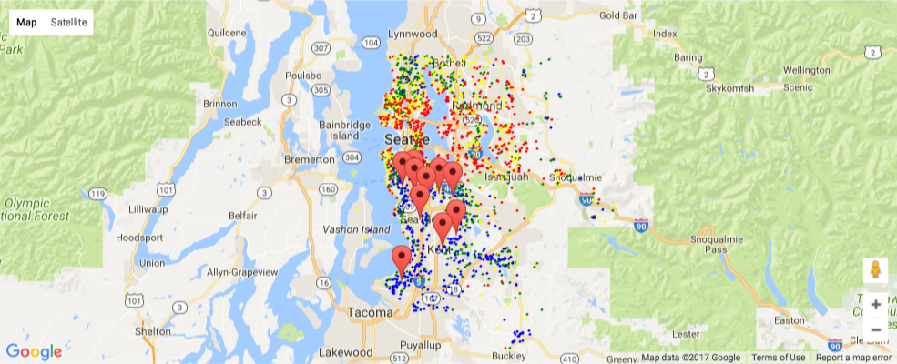
10 Communities in King County, WA with Largest Percentage of Minority Populations

Slide 27
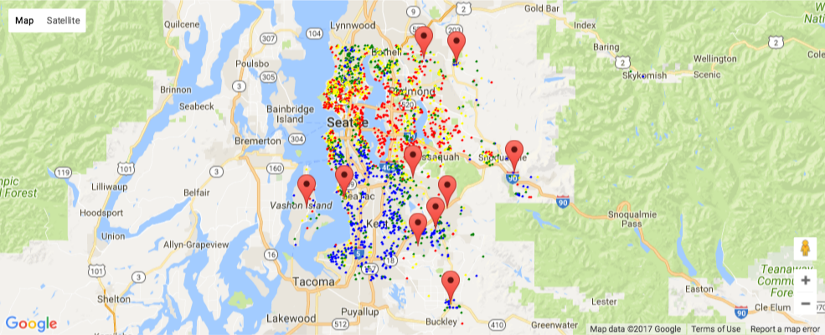
10 Communities in King County, WA with Largest Percentage of White Populations

Slide 28
Summary
Most important features:
House size, latitude, grade, year built, lot size
Best models for both regression and classification:
Random forest, gradient boosting, KNN
Models are good for…
Developer and home renovators who want to know the market value of a home they might build or renovate
Individual households who are considering home renovations or additions to see what the value of the home would be after completion
Potential Future Research:
Racial disparity in housing
If racial disparity is found, what is the cause

