Slide 1

Mats Slik
Lisa Hu
Dennis Haandrikman
Orfeas Gkourlias
Project Chocokoffie

Slide 2
Analyse en plan: Wat MOEST er anders?
Redundante code
Inefficiënt
Missende documentatie & moeilijk te begrijpen
Niet OO
PEP8 Niet aangehouden
Python2

Slide 3
Algemene Doelen
Alle code herschrijven
Multiprocessing
Object-oriented schrijven
Task management (Trello)

Slide 4

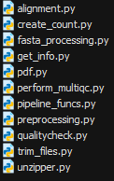

OO & Structuur

Slide 5
Classes & Functies
Create All (Pipeline_mod Function)
Unzipper
QualityCheck
TrimFiles
Determine Genome Info (Pipeline_mod Function)
Fasta Processing (Pipeline_mod Function)
Alignment
Preprocessing
Write FIle (Pipeline_mod Function)
Perform multiqc (Pipeline_mod Function)
pdf

Slide 6
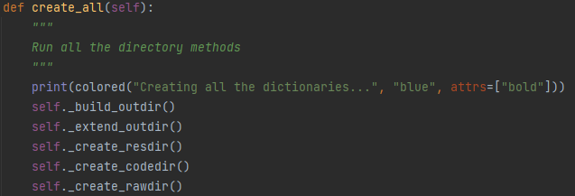
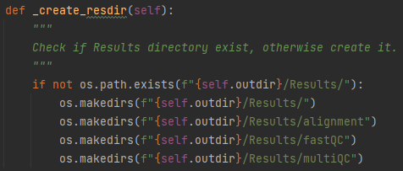
Create All (pipeline_mod function)
Creates all the necessary dicts.

Slide 7
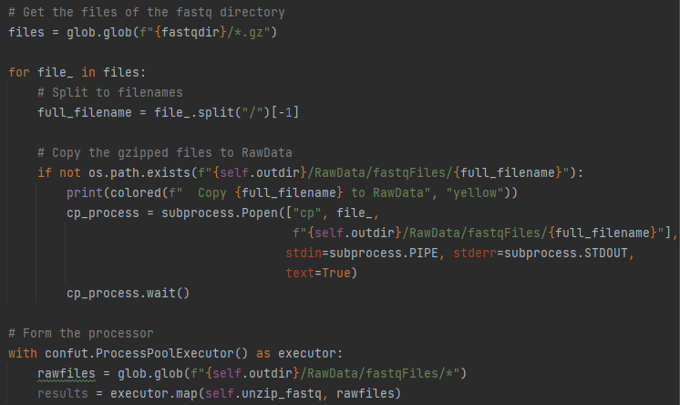
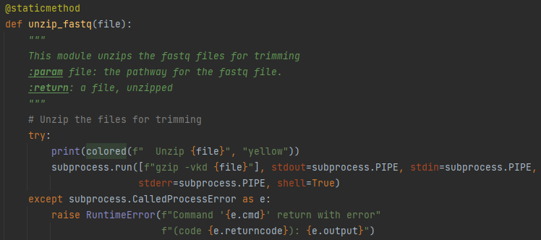
Unzipper
Multiprocessed
OO

Slide 8
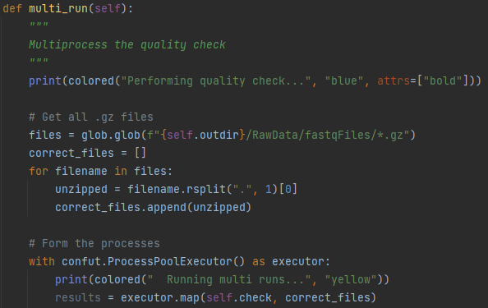
QualityCheck
Multiprocessed
OO

Slide 9
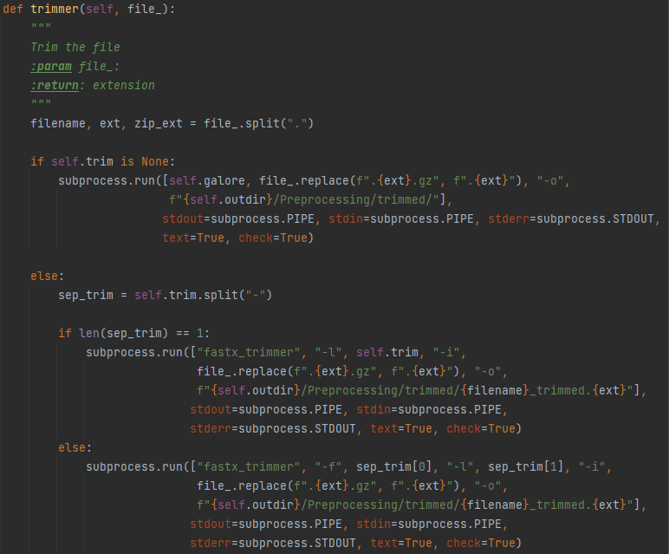
TrimFiles
Multiprocessed
OO

Slide 10
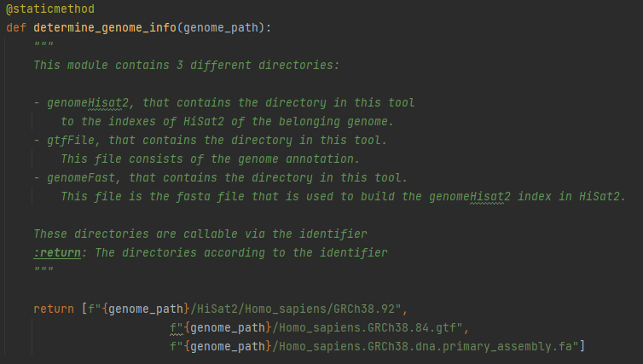
Determine Genome Info (Pipeline_mod Function)
OO

Slide 11
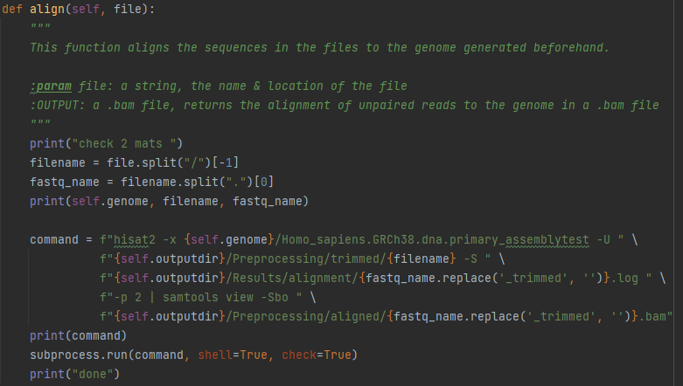
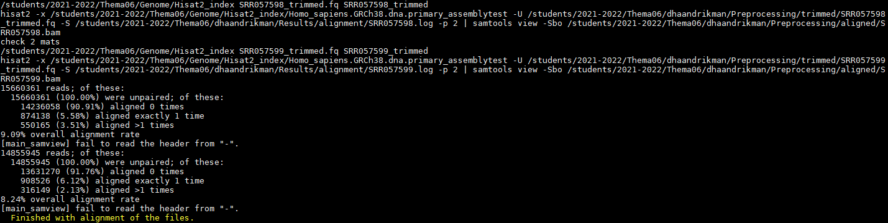
Alignment
Preliminary showcase
OO
Multiprocessed

Slide 12
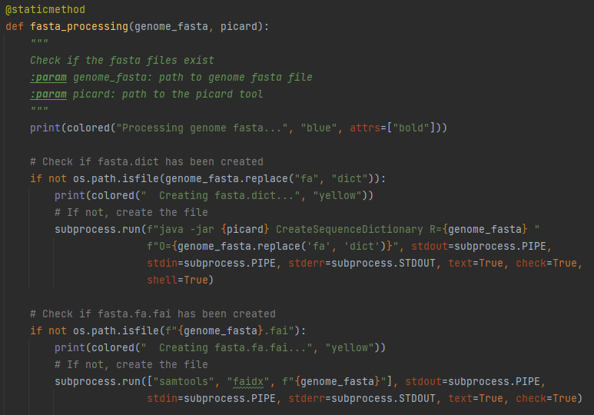
Fasta Processing (Pipeline_mod Function)
Preliminary showcase
OO
Multiprocessed

Slide 13
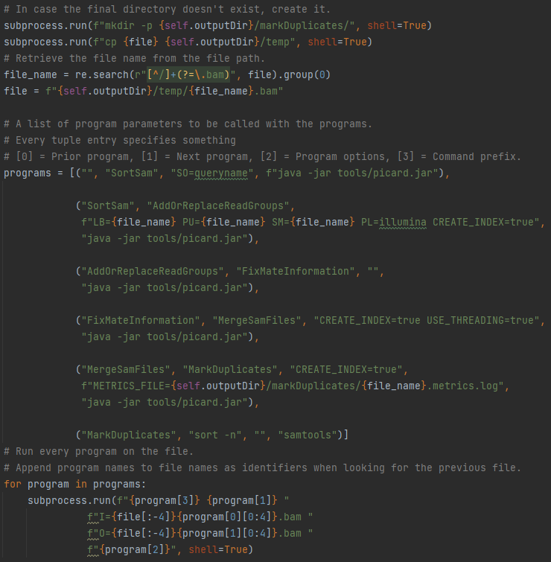
Preprocessing
Preliminary showcase
OO
Multiprocessed

Slide 14
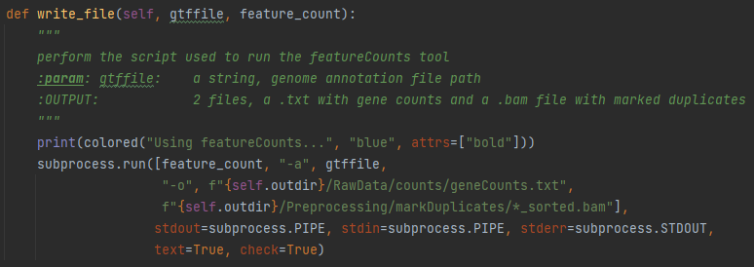
Write File (Pipeline_mod Function)
Preliminary showcase
OO

Slide 15
Write File (Pipeline_mod Function)
Preliminary showcase
OO

Slide 16
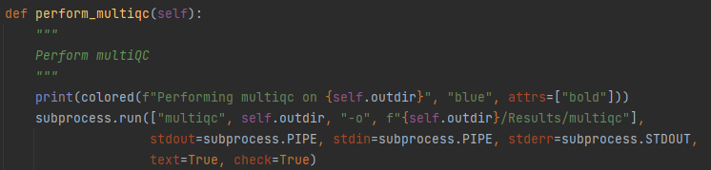
Perform multiqc (Pipeline_mod Function)
Preliminary showcase
OO
Multiprocessed

Slide 17
Eindresultaat
Bugs that have been found
Fastq quality of a number of files was too low to be used in alignment.
Files; SRR018013_1.fastq.gz, SRR01803_2.fastq.gz, SRR1106118.fastq.gz, SRR1106122.fastq.gz, SRR1106138.fastq.gz, SRR1106139.fastq.gz & SRR1106140.fastq.gz their quality has been marked as insufficient by the trimmer function.
As such, these files have sub-par quality scores.

Slide 18
Reflectie
Grotendeels volgens plan.
Veel geleerd over OOP, sequencing tools en de interacties daarbij.
Het belang van documentatie & overzicht ontdekt.
Belang van taak-management ontdekt: The Trello Page

