Slide 1
Pivotal Cloud Foundry
Notes:
© 2006 Capgemini - All rights reserved

Slide 2
Objectives of PCF
Purpose:
  To learn pivotal cloud foundry and deploy some application into PCF with some services.
Product:
  Infrastructure as a Service( Iaas)
  Platform as a Service (PaaS)
  Software as a Service (SaaS)
Process:
© 2014 Capgemini - All rights reserved

Slide 3
Table of Contents
Pivotal Cloud Foundry Basic
  Introduction to Cloud Technologies
  Getting started with Pivotal CF
  Cloud Foundry Concepts
  Using Command Line, Web plug-in, Eclipse plug-in
  Developing with Cloud Foundry
Pivotal Cloud Foundry Basic
  Using Services
  Using BuildPacks
  Managing Applications in Cloud Foundry
  Cloud Foundry Architecture and Concepts
© 2014 Capgemini - All rights reserved

Slide 4
  Introduction to Cloud Technologies
© 2011 Capgemini - All rights reserved

Slide 5
What is Cloud Foundry?
“The Cloud”
Means many things to many people.
  Distributed applications accessible over a network
    Typically but not necessarily, The internet
  An application and/or its platform.
  Resources on demand.
  Inherently Virtualized
  Can run in-house(private cloud) as well.
  Hardware and Software sold as a commodity.
© 2011 Capgemini - All rights reserved

Slide 6
Types of cloud computing
  IaaS → Infrastructure as a Service
  Paas → Platform as a Service
  SaaS → Software as a Service
© 2011 Capgemini - All rights reserved

Slide 7
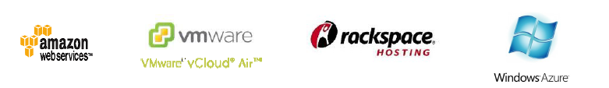
Infrastructure as a Service (Iaas)
  Replacement for physical hardware
  Provides virtual hardware
  Amazon Web Services (AWS) , RackSpace, Microsoft Azure, Vmware vCloud Air
© 2011 Capgemini - All rights reserved

Slide 8
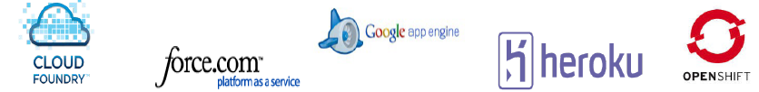

Platform as a Service (Paas)
  More than raw machine with OS.
  Provides ready-made platform for running apps.
  CloudFoundry, Heroku, Google App Engine, Amazon Elastic Beantalk.
© 2011 Capgemini - All rights reserved

Slide 9
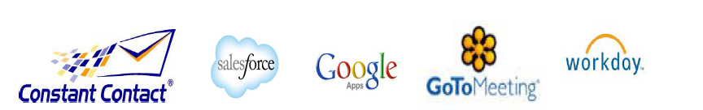
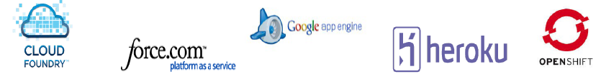
Software as a Service ( SaaS)
  Complete Software Application
  SalesForce.com, Google Apps, hundreds of examples.
© 2011 Capgemini - All rights reserved

Slide 10

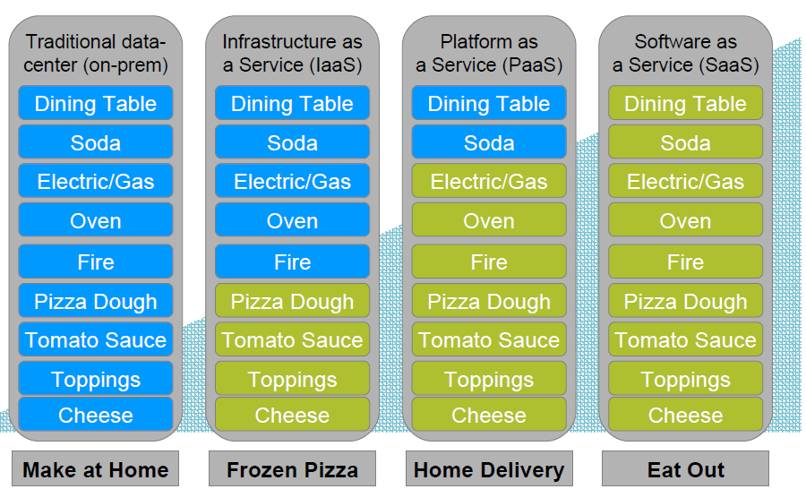
PaaS : Pizza as a Service !
© 2011 Capgemini - All rights reserved

Slide 11
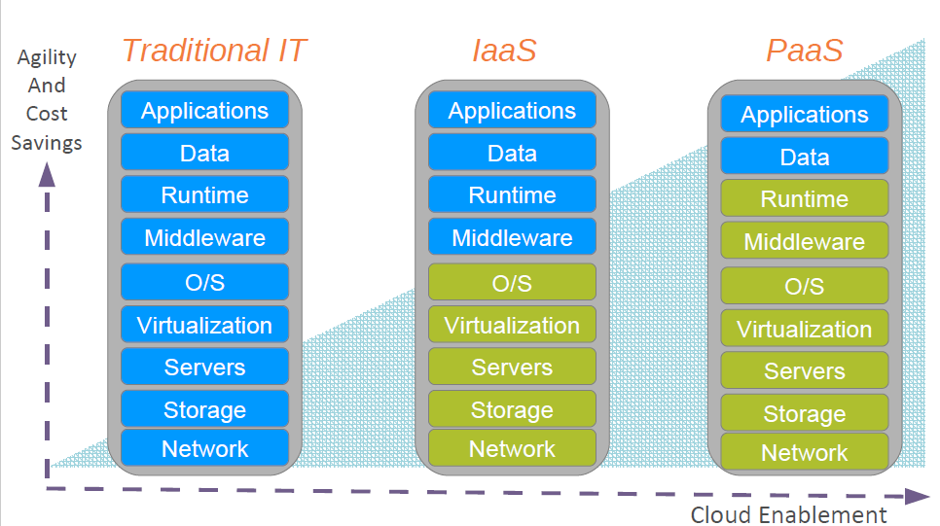
Platform as a Service (Paas)
© 2011 Capgemini - All rights reserved

Slide 12
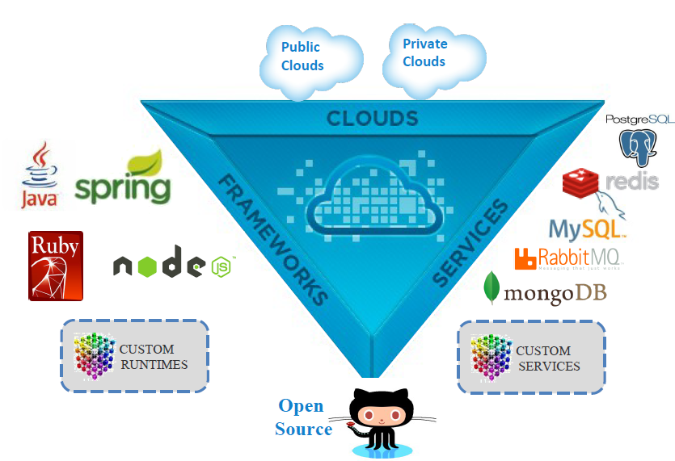
CloudFoundry – The Open PaaS
© 2011 Capgemini - All rights reserved

Slide 13

Why Cloud Foundry
Open Source
  Reduce vendor – lock
Public or private
Language Independence
  Via Buildpacks
Wide growing range of service
© 2011 Capgemini - All rights reserved

Slide 14
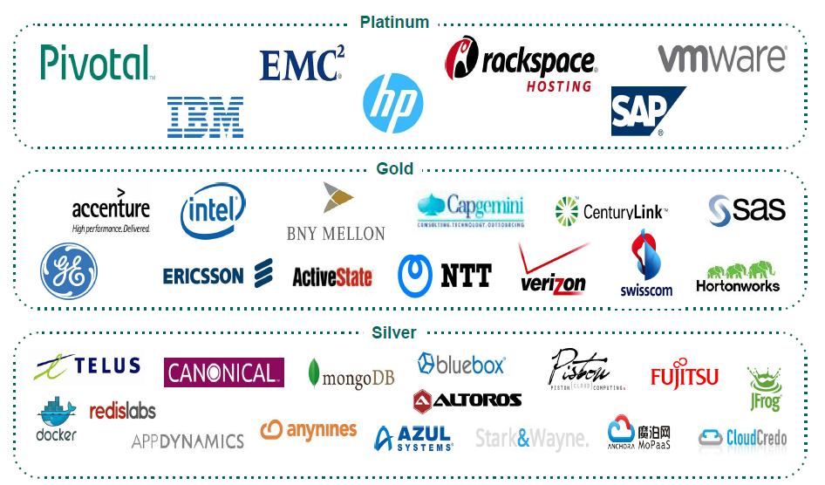
Cloud Foundry : Foundation
Open Governance
© 2011 Capgemini - All rights reserved

Slide 15
An Explanation of the Various Web Sites
A web-search for “Cloud Foundry” can be confusing!
URL | Details
cloudfoundry.org | The open source project’s home page No hosting of any kind here. Documentation.
github.com/couldfoundry | The location of the source. Download, build and run it you like!
cloudfoundry.com | Old commercial web-site. superseded by run.pivotal.io
blog.cloudfoundry.org | Technical blog
run.pivotal.io | Pivotal Web Services (PWS) Pivotal’s hosted environment, runs Pivotal CF
© 2011 Capgemini - All rights reserved

Slide 16
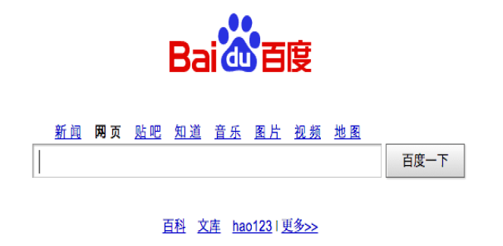
A Major Cloud Foundry Site
Largest Chinese Internet Search Site
  One billion page views per day
  Ad-words facility powered by Cloud Foundry
© 2011 Capgemini - All rights reserved

Slide 17
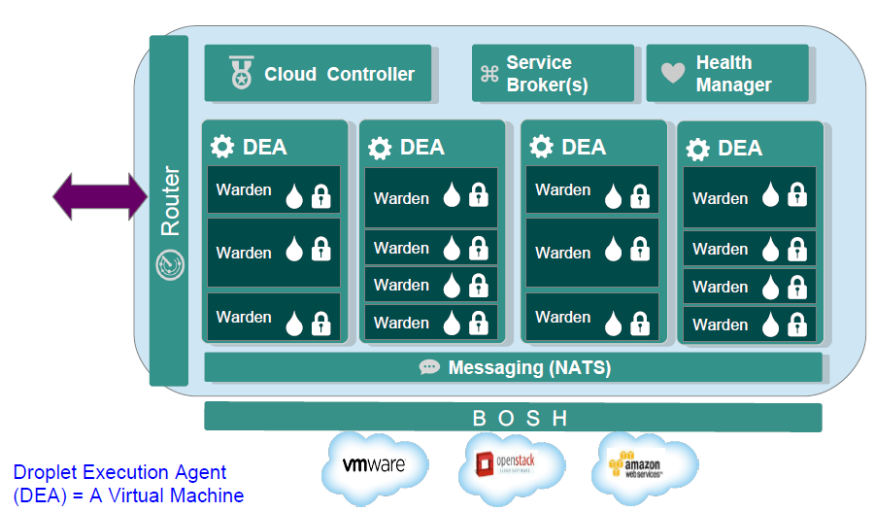
Cloud Foundry Architecture
© 2011 Capgemini - All rights reserved

Slide 18
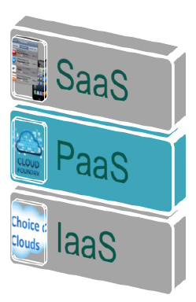
Cloud Foundry Platform as a Service
Application is the new unit of deployment and control
  Abstracting VMs and Middleware.
  Abstracting container and processes.
  Data as a service.
  Eliminate bottleneck of provisioning & deployment.
© 2011 Capgemini - All rights reserved

Slide 19
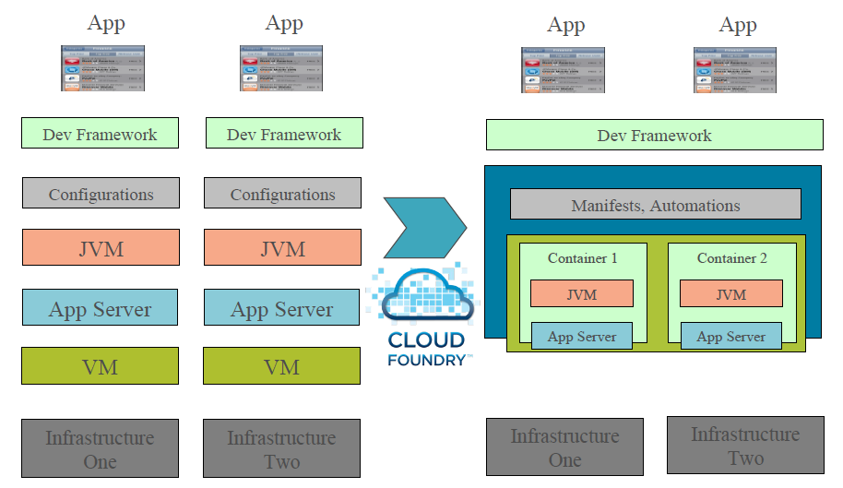
From VM Centric to Application Centric
© 2011 Capgemini - All rights reserved

Slide 20

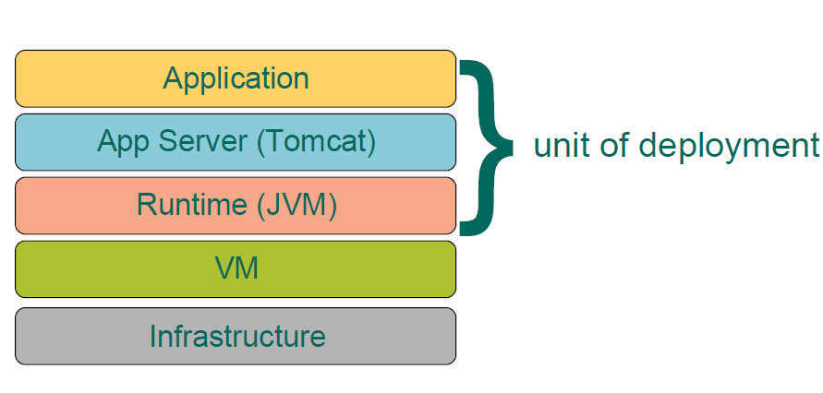
Iaas : VM – centric Deployment
Scaling = creating VM from blueprints/templates
© 2011 Capgemini - All rights reserved

Slide 21

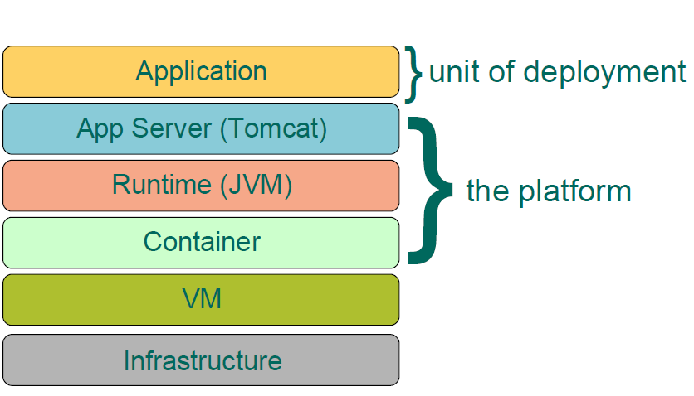
PaaS – App centric Deployment
Scaling = creating container in a VM pool
© 2011 Capgemini - All rights reserved

Slide 22
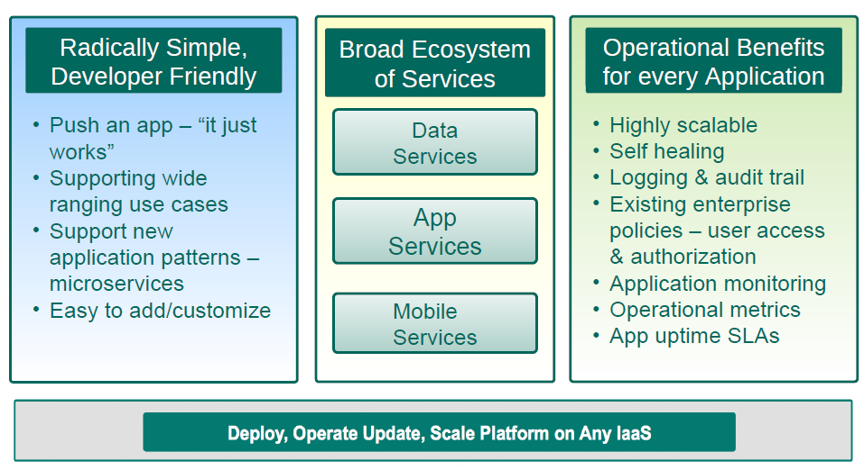
Core Tenets of Pivotal CF
© 2011 Capgemini - All rights reserved

Slide 23

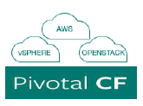
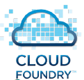
Which Cloud Foundry Product
Pivotal Web Services
Public CF PaaS run/ managed by Pivotal
Hosted on AWS
No guaranteed SLAs, not for production
Support offered
  PWS-E
PWS Enterprise
Same as PWS with guranteed SLAs.
Open source
Setup and run a PaaS for yourself
No paid support
No tools
Commercial Product
Run private PaaS in-house, or
Create public PaaS (ISP managed)
Sophisticated Web Console (App Mgr)
Additional Tools( Ops Mgr)
Less hassle
Support offered
© 2011 Capgemini - All rights reserved

Slide 24
  Getting started with Pivotal CF
© 2011 Capgemini - All rights reserved

Slide 25
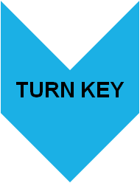

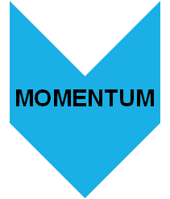
What is Pivotal Cloud Foundry?
An Enterprise PaaS powered by Cloud Foundry
Delivers a turnkey PaaS experience on the private cloud,
complete with application and data services.
Enable enterprises to speed up application and data services
delivery from months to days and innovate with disruptive speed
Entered GA in Nov 2013
www.pivotal.io/pivotal-products/pivotal-cf
© 2011 Capgemini - All rights reserved

Slide 26
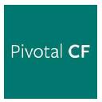
Pivotal CF : Enterprise PaaS Commercially supported
Certified upgrades, curated & tested quarterly releases.
Operations Manager Cloud Administrative Console
Elastic Runtime Application manager *
Built-in Application Performance Monitoring (APM)
Operational Metrics service
Auto-Scaling service
  * Formerly Developer Console
Easy LDAP/ Active Directory Integration
Historical Usage Data per Application Instance
Declarative Availability Zones
Behind the firewall download packages (do not require internet access)
Enterprise documentation (PDF format)
© 2011 Capgemini - All rights reserved

Slide 27

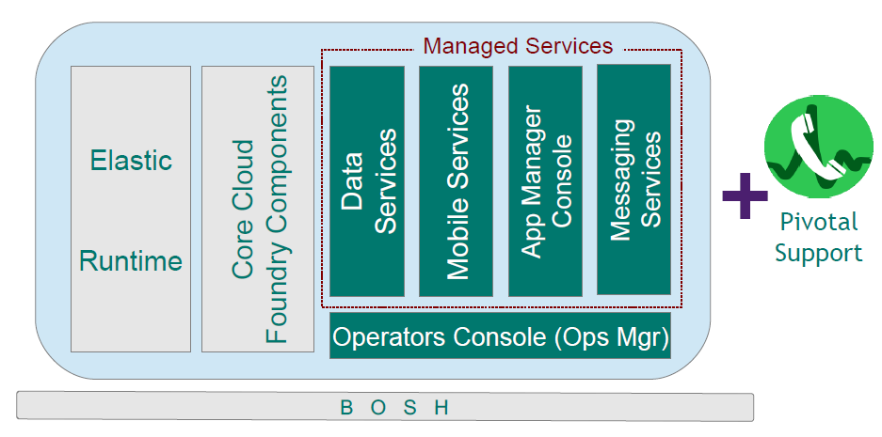
OSS vs Pivotal Cloud Foundry
Data Services: RDB and NOSQL Messaging services : Rabbit/MQ
Mobile Services: Push Notifications, API Gateway , Data Sync, ….
© 2011 Capgemini - All rights reserved

Slide 28
Pivotal CF – Commercial Components
PCF Ops Manager | One Pivotal CF Operation Manager instance hosted across a cluster of VMs. Typical enterprise deployment contains 2-3 Pivotal CF Ops Manager Instances (dev/test + production x2 for HA)
PCF Elastic Runtime Application Instances (AI) | Individual instance of deployed applications on PCF Elastic Runtime or on Pivotal Web Services (PWS) An application may scale up to multiple instances For a Java app : each AI is a Java Virtual Machine (JVM)
Service Instances (SI ) | A single, unique configuration of a service (such as a database or other software or middleware ) within a PCF Foundation (installation) utilizes resources (such as CPU, cores, virtual machines, messaging, development and/or data storage) within the same (or another) licensed Foundation.
© 2011 Capgemini - All rights reserved

Slide 29
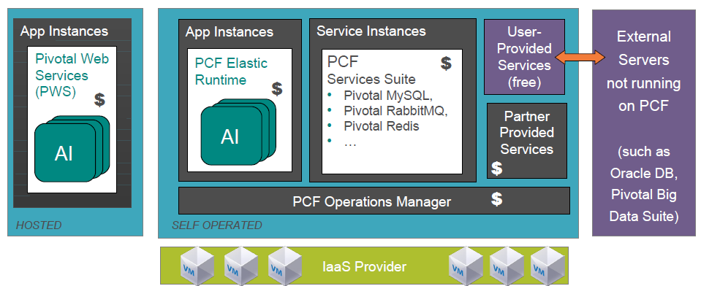
What Pivotal Charge For
Each App Instance, each Op manager, each managed Service
© 2011 Capgemini - All rights reserved

Slide 30
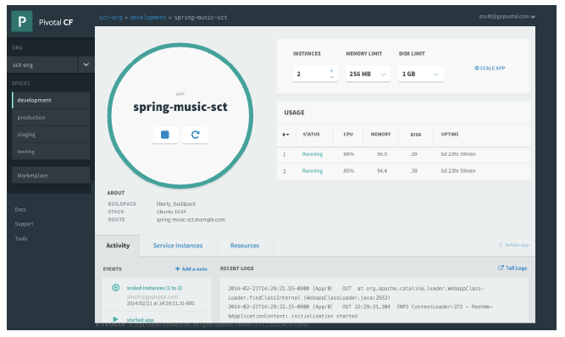
Pivotal CF : Developer Benefits
Application Manager
  Start / Stop
  Scale
  Services
  Logs
  ect.
© 2011 Capgemini - All rights reserved

Slide 31
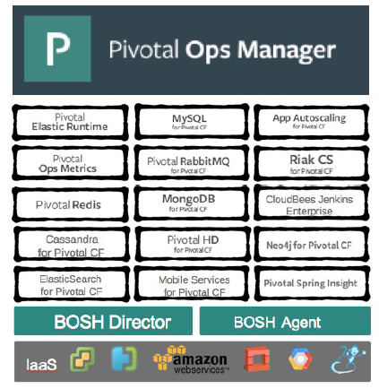
Pivotal CF : Operator Benefits
Click to Install
No downtime updates
Explore install logs
Click to scale platform
Built – in high availability
Built – in platform monitoring
Integrated Services
© 2011 Capgemini - All rights reserved

Slide 32
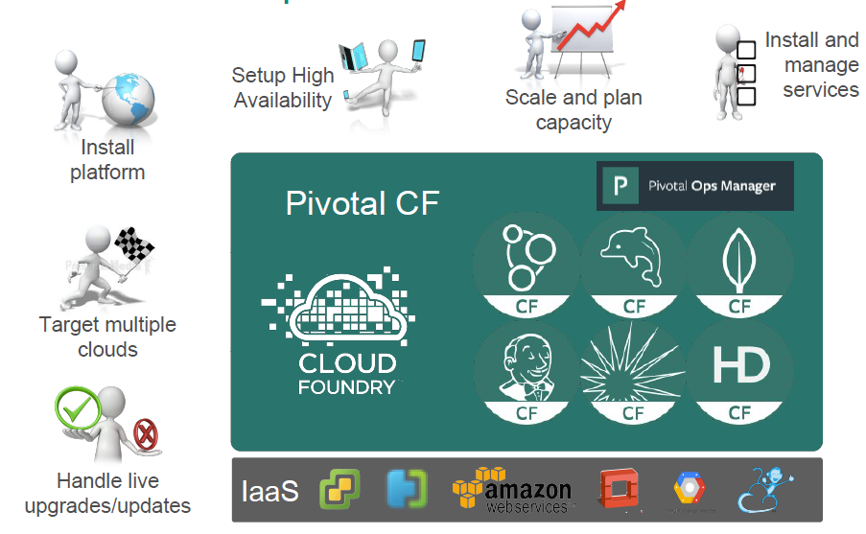
Pivotal CF : Operators View
© 2011 Capgemini - All rights reserved

Slide 33
How can I use Pivotal CF?
Pivotal CF is the commercial PaaS based on CF
Many options:
  Public – Pivotal Web Services : run.pivotal.io
  Basis of other public PaaS offerings
  Run it in-house as the basis of your private cloud
  Run it yourself in third-party cloud provider
    Open Stack, AWS , …
© 2011 Capgemini - All rights reserved

Slide 34
Documentation
CF docs can be found on three different sites, depending on the context:
  http://docs.cloudfoundry.org
    Open-source CF project docs
  http://docs.pivotal.io/pivotalcf
    Setting up and running Pivotal CF
  http://docs.run.pivotal.io
    Information about running on Pivotal Web Services
Generic information about Cloud Foundry can be found on all three sites
  In general pick one and stay with it.
© 2011 Capgemini - All rights reserved

Slide 35


Pivotal Support
Support is available for Pivotal Cloud Foundry
  Options : http://pivotal.io/support/offertings
  Register : http://tinyurl.com/piv-support
  Support Portal : https://support.pivotal.io
    Community forums, knowledge Base, Product documents
  PWS Support:
    https://support.run.pivotal.io or support@run.pivotal.io
Community forums
  https://groups.google.com/a/cloudfoundry.org/forum/#!forumsearch/
© 2011 Capgemini - All rights reserved

Slide 36

Summary
Cloud Foundry is “the Open PaaS”
Key Concepts : Organizations, Spaces, Services
  The Application is the unit of deployment.
  Simpler for Developers
Pivotal CF is Pivotal Cloud Foundry Distribution
  Supported easier to install /manage
Various documentation resources available
© 2011 Capgemini - All rights reserved

Slide 37
  Cloud Foundry Concepts
© 2011 Capgemini - All rights reserved

Slide 38
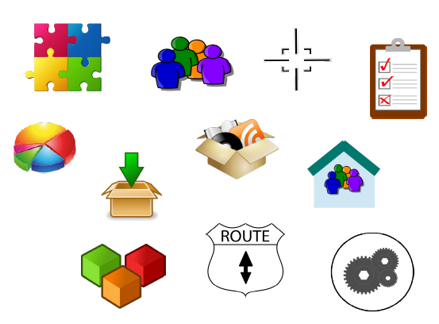
Overview
After completing this lesson, we should understand:
  Applications
  Buildpacks
  Manifests
  Organizations
  Spaces
  Users and Roles
  Quotas
  Domains
  Routes
  Services
© 2011 Capgemini - All rights reserved

Slide 39

Applications
PaaS exits to deploy applications
  In Cloud Foundry, the application is the unit of deployment
  Developers focus on apps, not runtimes or services
Cloud Foundry is development agnostic
  Not limited to specific language
  Doesn’t mandate the runtime environment you get
  Some are “out-of-the-box”
  you can add more
© 2011 Capgemini - All rights reserved

Slide 40

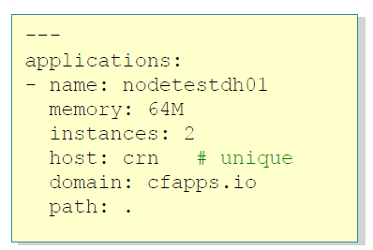
Buildpacks and Manifests
Buildpacks
  Allow CF to support multiple languages and deployment environments
    Buildpacks for Java, Ruby, JavaScript, …
    Buildpacks for Tomcat, Rails, Node.JS ….
Manifests
  A deployment “blueprint” for an application
  Repeatable : redeploy using same manifest
© 2011 Capgemini - All rights reserved

Slide 41
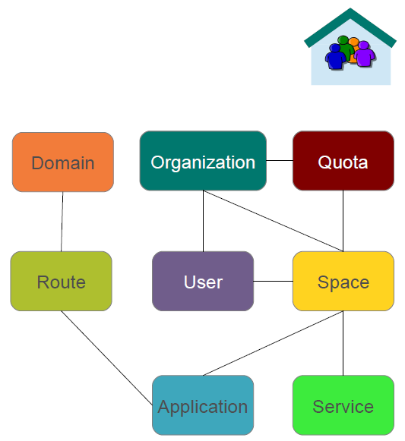
Organizations
Top-most administrative unit
Contains Spaces and users
  Which own routes, applications and services
Quotas restrict resources
  For orgs and spaces
Domain(s)
  Define routes to apps
© 2011 Capgemini - All rights reserved

Slide 42
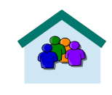
Organizations
CF is designed for use by Organizations
  Typically a company, department, application suite or large project
Designed to support collaboration
  Potentially many users
Defines one or more domains
  Cloud Foundry instance defines default domain for all organizations
    For PWS: cfapps.io
  You may add additional domains
Defines Security, Quotas
© 2011 Capgemini - All rights reserved

Slide 43
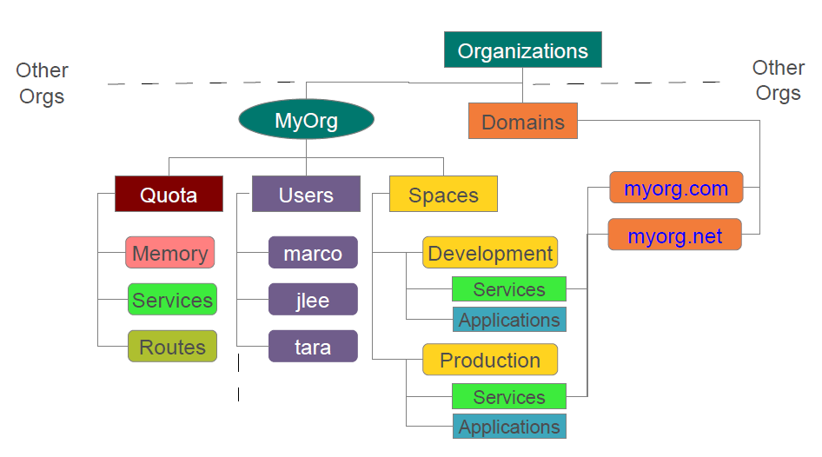
Example Organization
© 2011 Capgemini - All rights reserved

Slide 44

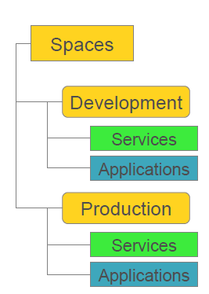
Spaces
Organization contains multiple spaces
  Default PWS space: development
  Users can create additional spaces
Application and services scoped to a space
  Many applications can run/scale within space
Provides set of users access to a shared location
    Application development
    Functionality and/or performance testing
    Quality Assurance
    Deployment to production
    Maintenance
© 2011 Capgemini - All rights reserved

Slide 45

Users and Roles
Members of the organization
  You can invite users to share your cloud
Have specific roles
  Roles control access to domains and spaces
  Roles therefore control who has permission
    To manage routes (see later slides)
    To deploy applications
    To add/bind/remove services
Don’t need to be CF User to access deployed apps
  Each application does its own user-management
© 2011 Capgemini - All rights reserved

Slide 46

Organization Roles
Organization manager
  Can invite/manage users, select/change the plan, establish spending limits
Organization Auditor
  View only access to all org and space info, settings, reports
© 2011 Capgemini - All rights reserved

Slide 47
Application Space Roles
Space Manager
  Can invite/mange users, enable features for a given space
Space Developer
  Can create, delete, manage applications and services, full access to all usage reports and logs
Space Auditor
  View only access to all space information, settings, reports, logs
© 2011 Capgemini - All rights reserved

Slide 48
Administrator User / Roles
Special Administrator user / role defined
  Defined for the Cloud Foundry installation
  Separate from users defined at Organization / Space
Several CF commands restricted to Administrator only
  Setting organization and space qutoas
  Defining security groups
  Administering services
  Adding, modifying and removing user accounts
Use without right role, CLI return:
© 2011 Capgemini - All rights reserved

Slide 49

Quotas
Restrictions on available resources
  Total memory available to all applications
  Total number of routes
  Max application instance size
  Total number of services
Can view
  Using the CLI
  Using App Manager (on org homepage)
© 2011 Capgemini - All rights reserved

Slide 50

Domains
Deployed applications are associated with a URL
  All requests to that URL redirect to the application
Each Cloud Foundry instance has a default app domain
  PWS has cfapps.io
Custom Domains
  Register your own domain
  Give it to Cloud Foundry to use and manage
Subdomains
  Each application has a unique sub-domain
    Its’ URL is therefore sub-domain.domain
    Example: deploy an app to http://myapp.cfapps.io
© 2011 Capgemini - All rights reserved

Slide 51
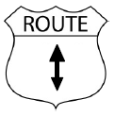
Routes
Define how to get to an application
  A unique route exits to each application in every space
  Behind the scenes CF uses a router
    Maps incoming request to the right application
Domain can be mapped to multiple spaces
  Route can only be mapped to one spaces
  Same application can be deployed in multiple spaces
    Each mush have a different, unique URL
    Development space route: http://myapp-test.cfapps.io
    Production space route : http://myapp.cfapps.io
© 2011 Capgemini - All rights reserved

Slide 52

Services
Any type of add-on that can be provisioned along side your apps
  Database, messaging, mail, third-party SaaS provider
Services are usually “bound” to 1 or more applications
  Connection info and credentials are put in an environment variable: VCAP_SERVICES
  Note:
    All configuration data to CF applications should be passed via environment variables
    Can’t use configuration files: no file system
© 2011 Capgemini - All rights reserved

Slide 53
Recap
SaaS
IaaS
PaaS
Pivotal
Cloud
Cloud Foundry
PCF
© 2014 Capgemini - All rights reserved
Notes:
Recap – tips : To make it further lighter, many facilitator ask participant that they were allow to leave only if they will answer say 12 correct answers out of 15 questions. And then produce all recaps as questions.
© 2006 Capgemini - All rights reserved

Slide 54
Notes:
© 2006 Capgemini - All rights reserved

