Slide 1
Basic data security
- symmetric → shared key / password (e.g. zip -e, openssl )
- asymmetric → everyone shares his/her public key. Private key needed to decypher (gpg)
- signing →asymmetric, making sure that you are the sender. Only private key allows to do it.
- hashing → integrity

Slide 2
Notebooks, why?
Why and when to use? | When not to use?
- PoC (proof of concept) - prototyper modèles - env déjà prêt, rapide set up - pratique (graphiques, code, commentaires, plusieurs langages…) - mémoriser les résultats, les partager - reproduire | - prod - calcul longs, crashs intempestifs - mots de passe - review, versionning, le diff est tout pouri - coder à deux est impossible

Slide 3
Notebook reviews, why?
- Est-ce compréhensible, commentaires, code
- validation, conseils, son expertise
- reviewer → apprendre des choses
- conviavilité, partage

Slide 4
Notebook reviews
1. Shared jupyter server

Slide 5
Notebook reviews
1. Shared jupyter server
2. Notebook export to text file
https://github.com/drivendataorg/nbautoexport

Slide 6
Notebook reviews
1. Shared jupyter server
2. Notebook export to text file
https://github.com/drivendataorg/nbautoexport
3. Integrated environment
https://www.reviewnb.com

Slide 7
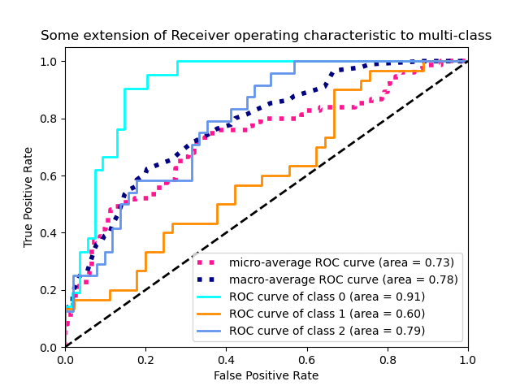
ROC curve

Slide 8
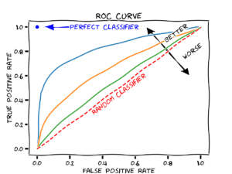
ROC curve
AUC = area under the curve, ne dépend pas du seuil

Slide 9
